Slide 1

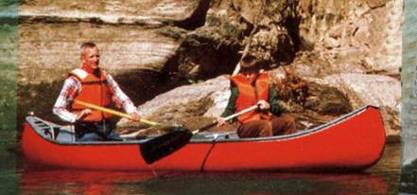
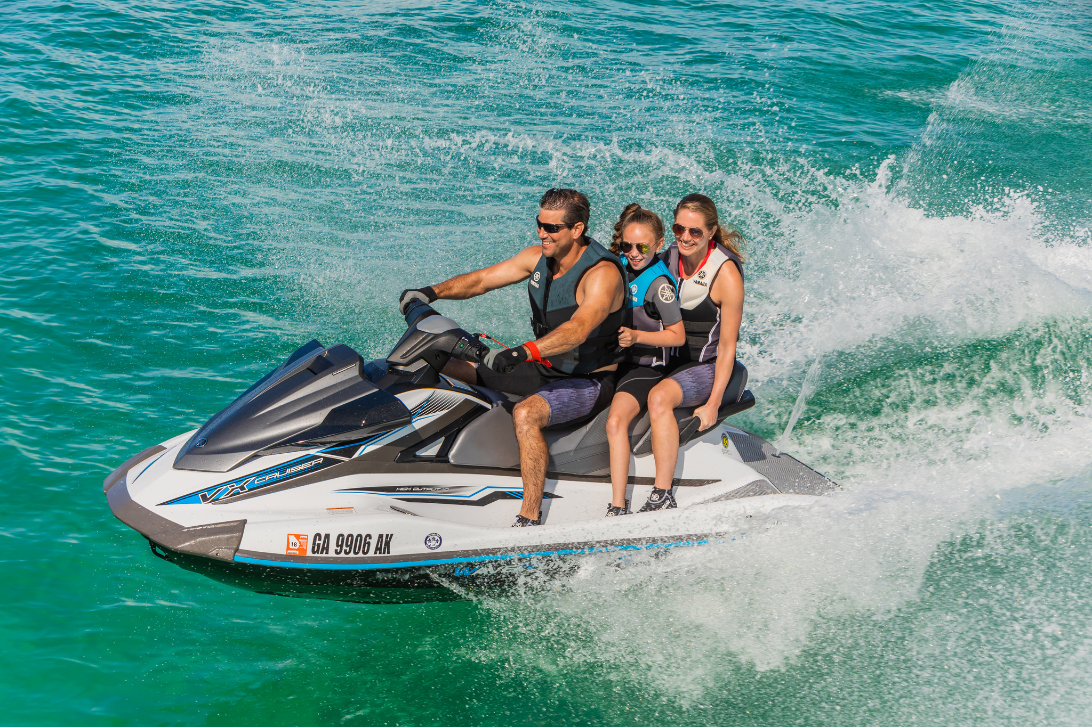
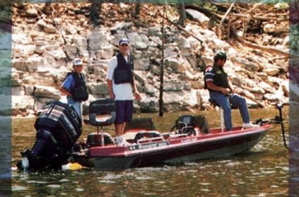
Waypoints
A Guide to Boating Safely
Copyright 2019 - Coast Guard Auxiliary Association, Inc.
Notes:
Instructors need to always remember that when talking to young people, especially preteens to keep the language simple and clear. Kids learn differently than adults, and the more activity you can involve the kids with the better they learn through practice. When working with students and young people, it is always desirable to have at least two instructors in the room. If possible, it is preferable to have one male and one female instructor.

Slide 2
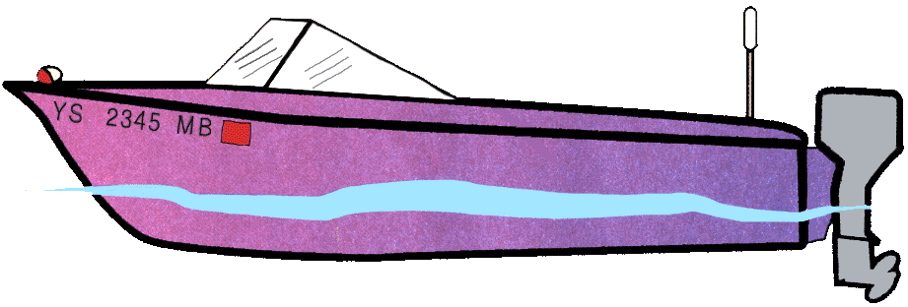
Parts of a Boat
Boater’s Language
1
3
2
4
Notes:
1. Bow
2. Stern
3. Hull
4. Transom

Slide 3

Parts of a Boat
7
6
5
Notes:
5. Starboard Side
6. Port Side
7. Helm

Slide 4
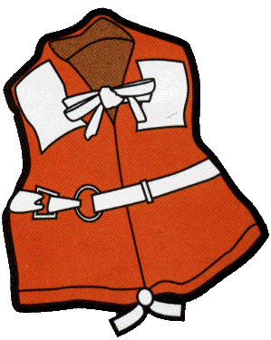
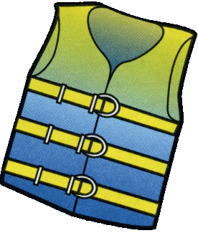
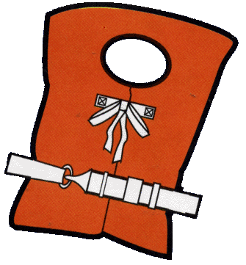
Life Jackets
Type 1
Type 3
Type 2
Notes:
**Instructors Can Adapt These Comments to Fit the Age-Appropriateness of Their Students.**
The lifejackets:
U.S. Coast Guard approved life jackets are required for every person in the boat, and should be worn by everyone. This includes your parents, brothers and sisters, friends. Encourage wear within 10 feet of the water’s edge to help reduce the risk of drowning if a person unexpectedly falls in.
* Lifejackets need to be fitted and adjusted for adults and children. Emphasize the age that children MUST wear a life jacket in your state.
* Children’s life jackets are approved for specific weight categories. Check the “User Weight” on the label and for an approval statement.
* U S Coast Guard-approved inflatable life jackets are authorized for use by persons 16 years of age and older (check the label).
* Inflatable life jackets require regular maintenance and attention to the condition of the inflator.
* Bright colors such as red, yellow, or orange enhance visibility and are preferred over blue, olive, or camouflage on waterways.
Lifejackets not only reduce the risk of drowning, they also can provide protection from rocks and other debris in rivers, provide a place to store critical emergency equipment (e.g., whistle, signal mirror, light), and can help keep paddlers warm. Always remember that a whistle Is not a toy. It is for getting help or attracting attention when you can’t be seen by bigger boats. Although you could have an air horn to meet legal requirements, it might be worth emphasizing that the whistle is on you all the time, ready to be used in the rare cases it’s needed.

Slide 5
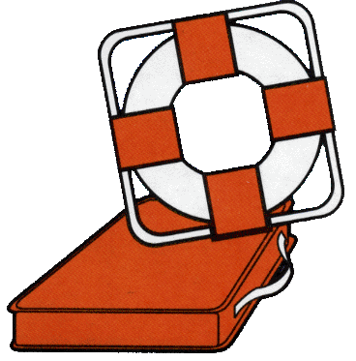
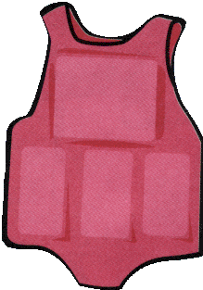
Life Jackets
Type 4 Type 5
Notes:
**Instructors Can Adapt These Comments to Fit the Age-Appropriateness of Their Students.**
The lifejackets:
U.S. Coast Guard approved life jackets are required for every person in the boat, and should be worn by everyone. This includes your parents, brothers and sisters, friends. Encourage wear within 10 feet of the water’s edge to help reduce the risk of drowning if a person unexpectedly falls in.
* Lifejackets need to be fitted and adjusted for adults and children. Emphasize the age that children MUST wear a life jacket in your state.
* Children’s life jackets are approved for specific weight categories. Check the “User Weight” on the label and for an approval statement.
* U S Coast Guard-approved inflatable life jackets are authorized for use by persons 16 years of age and older (check the label).
* Inflatable life jackets require regular maintenance and attention to the condition of the inflator.
* Bright colors such as red, yellow, or orange enhance visibility and are preferred over blue, olive, or camouflage on waterways.
Lifejackets not only reduce the risk of drowning, they also can provide protection from rocks and other debris in rivers, provide a place to store critical emergency equipment (e.g., whistle, signal mirror, light), and can help keep paddlers warm. Always remember that a whistle Is not a toy. It is for getting help or attracting attention when you can’t be seen by bigger boats. Although you could have an air horn to meet legal requirements, it might be worth emphasizing that the whistle is on you all the time, ready to be used in the rare cases it’s needed.

Slide 6
Life Jackets
One for each person
Youth and non-swimmers
One Throwable
Notes:
Explain how throwables can be used to help people who have fallen into the water. Add that tying a line to them can help pull people back to the boat.

Slide 7
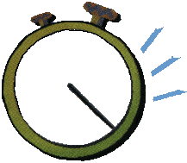
Life Jackets
Water Skiers
Fit Properly
Label (50 mph)
1 Minute Mystery
Notes:
1-Minute Mystery:
Lindsey is tubing behind the family boat. She hits a big wave and bounces off the tube. When she hits the water her life jacket comes up over her mouth. The water is over her mouth and she can only breathe though her nose. Because the boat had a good lookout they were able to rescue Lindsey.
What was wrong?

Slide 8
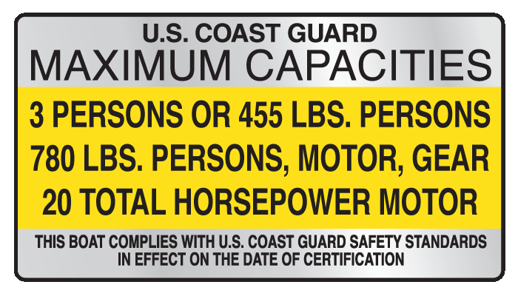
Capacity Plate
Notes:
Talk about why maximum weight is important in balancing a boat and overcrowding endangers people. There are many ways this can be demonstrated by placing several objects on something until it collapses. If a small plastic bowl with water is available, you can place objects of different weight to show flotation and sinking.

Slide 9
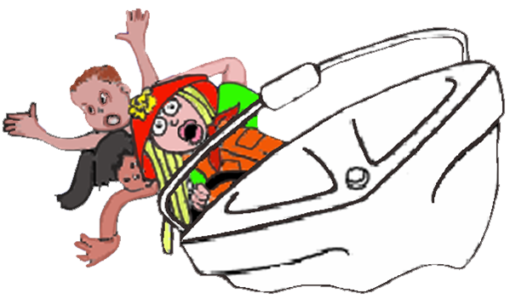
Balance the Boat
The load should be lighter
in rough water
Notes:
What happens if you have too many people on your bike? What if you have too many people on one side of a wagon, bike, scooter, etc?

Slide 10
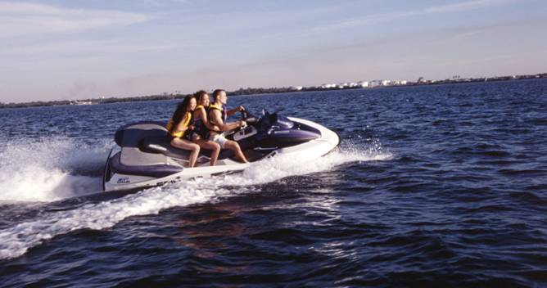
Float Plan
Where you are going
When you will return
1 Minute Mystery
Notes:
Planning your trip
Always tell someone where you are going– don’t go farther than you should. It is important that your family always lets a friend or neighbor know where you are going, and when you expect to be home.
1-Minute Mystery:
It was a nice summer day and Julie and her Mom decided to take the Jet Ski out for a ride. They zoomed straight up the lake and went in a bay with calmer water. They were having lots of fun doing donuts when the jet ski stopped running. They were a long way from shore and no other boats were in sight. Clouds were rolling in and it was getting darker out. The wind was getting stronger.
Two hours later Julie’s dad started to get worried that they hadn’t returned. He called the local Coast Guard Auxiliary for help. They asked him these questions.
How many people aboard?
Where did they leave from?
Where were they going?
When did they expect to return?
What should Julie and her Mom have done before leaving home port?

Slide 11
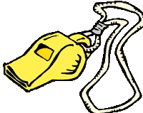
Equipment
Whistle, horn, or air horn
Notes:
Instructors should focus on why a sound producing device is so important in getting attention. Talk about all the other noise in the boat or on the waterway that makes shouting difficult to hear by others. Draw attention that in many schools a whistle, bell or a horn is needed to get student’s attention on the playground because of all the noise outside.

Slide 12
Fire Extinguisher
Required on certain vessels
Pull pin
Aim at base of fire
Squeeze handle
Sweep side to side
Notes:
Just as kids see these in their schools or homes, it’s good to remind them they should be on boats too. Some of the families might also have a camper for vacations with a fire extinguisher. It’s good practice to know how to use one.

Slide 13


Distress Signals
Notes:
Talk about how each of these can be used to get the attention of other boaters for help.

Slide 14
1-Minute Mystery
Kevin was fishing in the middle of the lake in his small boat. The wind was getting stronger and the waves were increasing.
A wave came over the bow of his boat. Kevin started to bail out the water but because the boat was now lower in the water, waves continued to come over the bow. The boat was filling up fast.
Kevin tried to stand up to get help and when he did the boat turned over. Kevin is now in the water and his life jacket is floating away from him.
What should Kevin do?
Should he stay with the boat or swim for his life jacket?

Slide 15
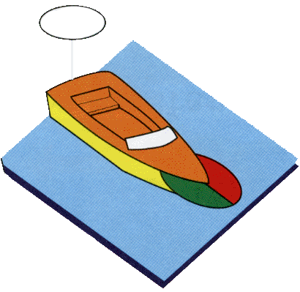
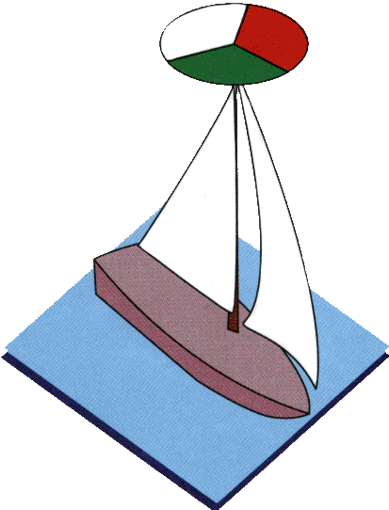
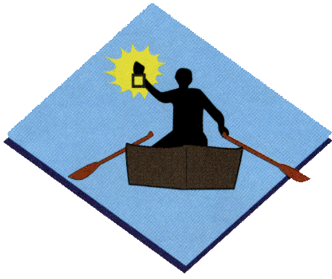
Navigation Lights
Notes:
Without getting too technical about light configurations, talk about the basic lights on a boat and why they are important. The red, green, and white sectors will also play a role later when looking at some “rules of the road” and avoiding collisions.

Slide 16
Navigation Lights
Lights must be shown after sunset
In reduced visibility
PWC have no lights – why?
Notes:
Lights on a boat, just as with a car, allow others to see you at night or in rain and fog and help avoid accidents.

Slide 17
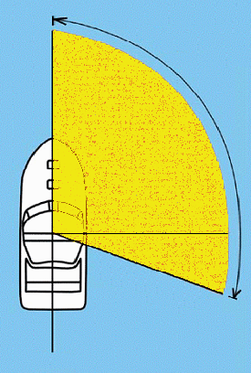
Rules of the Road
                Boating Terms:
                Stand-on Boat: The boat
                that does not change
                direction or speed.
                Give-way Boat: The boat
                that has to change its
                direction or speed to
                stay out of the way.
Dead ahead
.
Danger Zone
Astern
Notes:
It is important to keep this definition very simple by saying any vessel appearing in the general direction of the yellow shaded area is the stand-on vessel and YOU must stay out of their way. If it appears anywhere else, you become the stand on vessel and they must avoid you. Remind them again that most other boaters don’t know as much about this rule as the students now do and be prepared to take action to avoid a collision. Keep the language simple and kid oriented. If possible use boat models to demonstrate the movement. Plastic toy boats can work very well, and are familiar to the age group. Discuss why looking out from the boat in the yellow area is so important to see what color light or side in on the other boat. If you see the RED side, that means stop or danger. You need to move out of the way.

Slide 18


Rules of the Road
Meeting head-on
Notes:
Explain that both boats need to move to stay out of the way. When meeting head-on BOTH boats are “Give-way” boats. Again, using boat models to demonstrate can be visually effective with preteens and teens. Having two instructors walk toward each other and then go around each other to the right will provide an active demonstration. You can have sets of students practice the movement as well. Another technique is to wear a red glove and a green glove to show the direction of movement. You can hold red and green cardboard or construction paper as well.

Slide 19
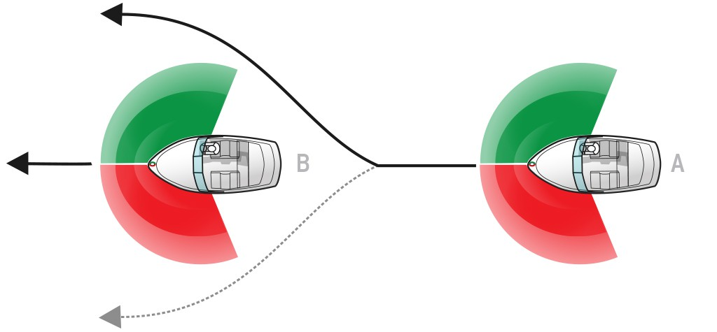
Rules of the Road
Passing
Notes:
Explain that the rear boat wants to pass the front boat. When passing it is the rear boat that is “Give-way” by increasing speed a little and moving to pass. The boat in front is “Stand-on” because it does not go faster or slower or change direction. Again, using boat models to demonstrate can be visually effective with preteens and teens. Having two instructors, one behind the other and walking faster to pass the other will provide an active demonstration. You can have sets of students practice the movement as well. This is also a good place to talk about sound signals to let a vessel know you are passing. Again, you can wear a red glove and a green glove to show the direction of movement. You can hold red and green cardboard or construction paper as well.

Slide 20

Rules of the Road
Crossing
Notes:
Explain that the boat on the top is seeing the danger zone needs to move to avoid danger becoming the “Give-way” boat, and must turn to go around the stern (back) of the bottom boat. The boat on the bottom is the “Stand-on” boat and should continue to move ahead. Again, using boat models to demonstrate can be visually effective with preteens and teens. Having two instructors demonstrate the movement is effective. You should also have sets of students practice the movement as well. This is also a good place to talk about sound signals to let a vessel know you are passing. Again, you can wear a red glove and a green glove to show the direction of movement. You can hold red and green cardboard or construction paper as well.

Slide 21
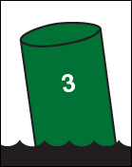
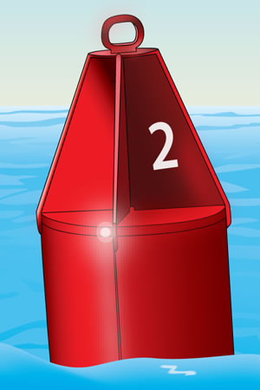

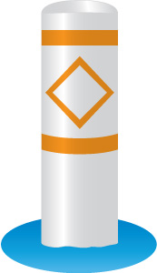

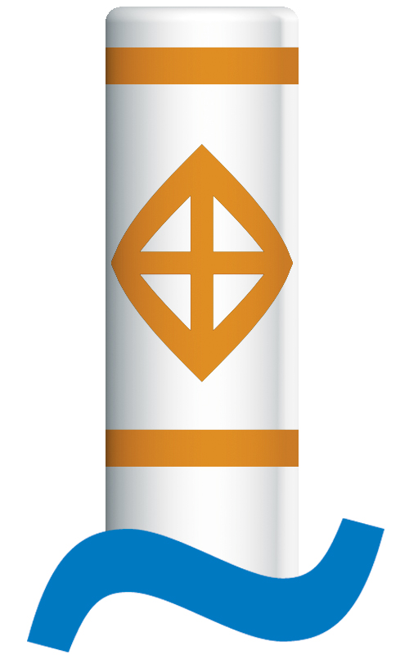
Buoys
Left Side
Right Side
Information
Hazard
Control
Keep Out
Notes:
Again, keep the buoyage system simple: red on the right, green on the left of channels, and land side of ICW. Talk about the four most common orange and white floating buoys. Explain each with some examples. Hold red and green paper and have the students move through a “channel” keeping red on their right and green to their left.

Slide 22
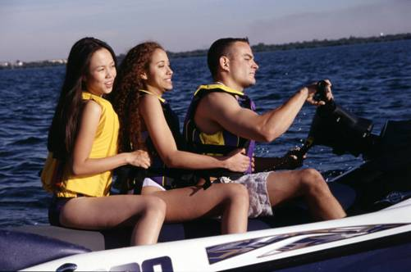
Personal Watercraft (PWC)
Laws are the same as for a boat
Must wear a life jacket
Never overload with too many people
Notes:
A PWC has to follow all the same rules the student just saw in the previous slides. Just as a car and a motorcycle on the road must follow the same rules, so too a boat and a PWC.
Always remember that you must wear a life jacket on a personal watercraft. It’s important NEVER OVERLOAD A PWC. If there is one seat…only one rider. If two seats you may have two riders, etc.
If a PWC is towing someone, like a water skier, then there must be three seats. Do you know why? One for the driver, one for the observer. Remember someone must always be watching the skier for safety. And a seat for the skier so they can get out of the water.

Slide 23
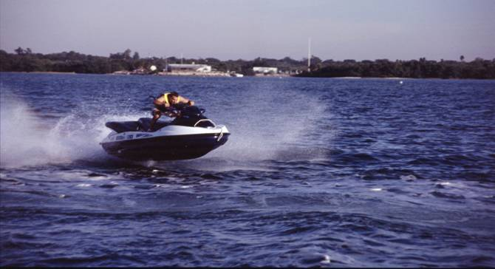
PWC
1 Minute Mystery
Notes:
1-Minute Mystery, PWC:
Dakota and Destiny were having great fun riding their new jet ski. They jumped a big wave and both fell off. Laughing, they swam back to the Jet Ski. Dakota got on but when Destiny tried to get on, it turned over. They tried again and the same thing happened. Next Destiny got on first but when Dakota tried to get on it turned over again.
What went wrong?
What should they do now?
(answer) They should have practiced getting on close to shore. If both could not do that at the same time, then only one should have been on the jet ski.
Blow their whistle to get help.

Slide 24
Swimming
Learn to swim
Swim with a buddy
Adult supervision
1 Minute Mystery
Notes:
1-Minute Mystery:
Michelle and her five-year old brother, Austin, were standing on the dock watching a distant boat when suddenly Michelle heard a splash! She looked around to see Austin splashing about in water over his head. On the dock with her were an oar, a ring buoy and the family canoe.
How could Michelle best help Austin?

Slide 25
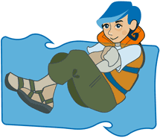
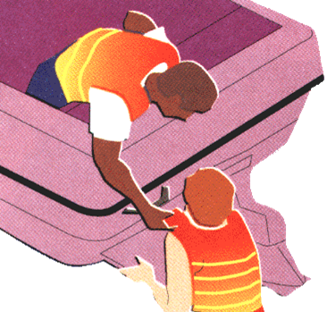
Falling Overboard
Notes:
This is very dangerous and why you must always have your life jacket on when on a boat. Explain to students how easily this can happen if the boat is going too fast, turns too sharp, or just hits something unseen in the water. Talk about not taking your eyes off the person in the water and shouting “Man Overboard” as loud as you can to get everyone’s attention. This can happen when standing in a small boat or moving around too much, or leaning over the side of the boat. Always be careful.

Slide 26
Falling Overboard
1 Minute Mystery
Notes:
1-Minute Mystery:
Man Overboard
10 year old Jacob was riding in the family boat with his Dad and Mom. They were cruising slowly around the lake. Jacob was riding in the back of the boat and leaned over the side to touch the water. When he did the boat hit a big wave and he fell in the water. On hearing the splash, Mom looked around and saw Jacob in the water. She yelled “Jacob fell overboard!” Jacob’s dad slowed the boat and turned it around to pick up Jacob.
What went wrong?
What went right?

Slide 27
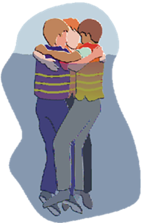
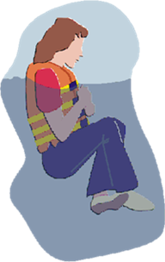
Hypothermia
Body core temperature below normal is called hypothermia
  Get out of cold water if possible.
  Huddle up if you must stay in cold water.
Notes:
If you fall in the water, talk about the HELP position if alone and the HUDDLE position if with a group. Demonstrate with students if possible.

Slide 28
Review
Life Jackets
Float Plan
Rules of the Road
Falling Overboard
Copyright 2019 - Coast Guard Auxiliary Association, Inc.

