Slide 1
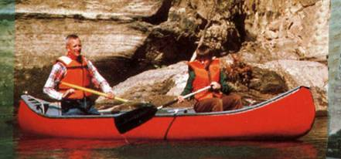
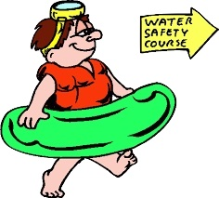
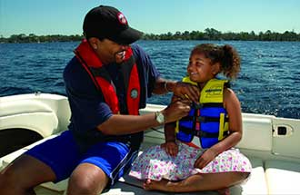
Water N’ Kids
Water Safety Program
Notes:
Instructors always need to remember that when talking to young people, especially preteens, to keep the language simple and clear. Kids learn differently than adults, and the more activity you can involve the kids with, the better they learn through practice. When working with students and young people, it is always desirable to have at least two instructors in the room. If possible, it is preferable to have one male and one female instructor. Photos and images used are from current ANSC brochures, public domain images, or from copyright and royalty sites such as Unsplash.
Instructors greet the children and introduce themselves. They explain the purpose of the class. That the students will learn some basic safety habits around the water and boats. Begin by asking the students some questions to gauge their knowledge. If they have been swimming for several years, they might have a good understanding of safe swimming rules around water. If they live in an area where boating is common, their answers might give you a better understanding of their experience around boats. Begin by asking:
How many students know how to swim?
What are some safety rules when swimming? Answers will vary, but some might include:
Don’t swim alone.
Swim around adult supervision.
Swim in designated areas.
Don’t swim in water too deep for you.
Don’t run around pools.
Has anyone ridden on a boat?
What are some safety rules everyone should follow on a boat? Answers may vary but some might include:
Wear a life jacket.
Stay seated.
Wear sunscreen.
Drink lots of water.

Slide 2
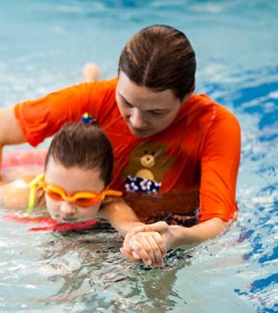
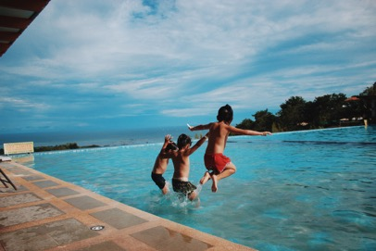
Swimming
Learn to
Swim
Notes:
Who knows how to swim?
Why is it important to learn how to swim? Talk about swimming as relaxing, fun, good exercise, and a sport. Remind students that there is water all around us. Do students live near the beach? A lake or river? Do they have a swimming pool or know friends who do? Discuss how knowing how to swim can save a person if they fall into the water near a pool or lake. Why is knowing how to swim important if on a boat? Can you fall off a boat?

Slide 3
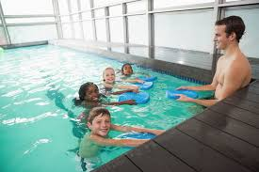
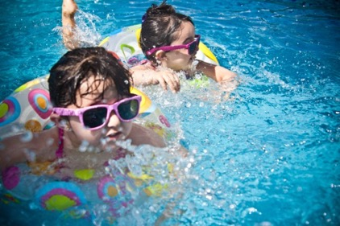
Swimming
Swim with
a buddy
Notes:
Ask the students what are some good rules about swimming?
Don’t run.
Don’t jump if you don’t know how deep the water is.
Don’t push.
And swim with a buddy.
Ask what are some of the dangers if swimming alone? What are some courtesies when swimming? How should you safely play with others when around water? What are good examples, and what are bad examples? Responses could include:
No pushing
No running
Don’t go into water above your chest if you can’t swim well.
In general, always be courteous and polite.

Slide 4
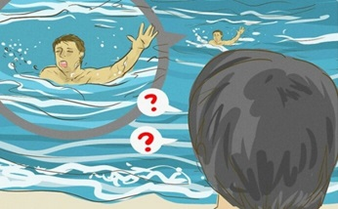
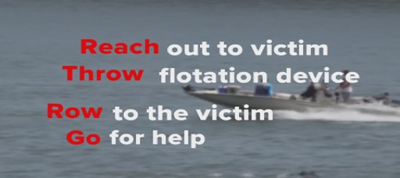
Swimming
If someone needs help:
Reach
Throw
Row
Go for Help
Notes:
Discuss the ideas of Reach, Throw, Row but Don’t GO into the water…Go for help. Looking at the picture, how can you immediately help your friend without also endangering yourself? Can you reach and grab his hand? A long branch or stick nearby? A paddle? You can use anything that will reach. If nothing will reach, what can you throw to your friend that floats? Maybe a ball? A cooler? A life ring? Anything that can help float.
If you know how, can you row a boat to him? Explain how this situation could be avoided.
Ask the students if they notice anything the person in the water does not have. Try to get them to respond that there is no life jacket.

Slide 5
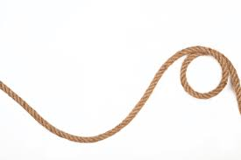
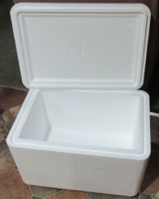
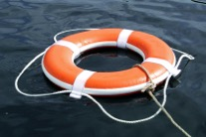
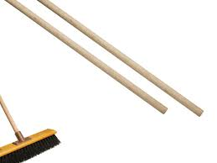
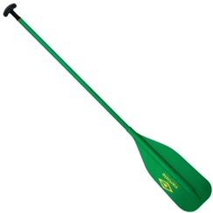
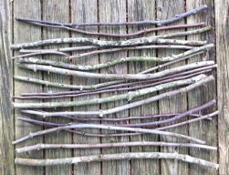
Swimming
If someone needs help:
Reach
Throw
Row
Go for Help
Notes:
Discuss the ideas of Reach, Throw, Row but Don’t GO into the water…Go for help. Looking at the picture, how can you immediately help your friend without also endangering yourself? Can you reach and grab his hand? A long branch or stick nearby? A paddle? You can use anything that will reach. If nothing will reach, what can you throw to your friend that floats? Maybe a ball? A cooler? A life ring? Anything that can help float.
If you know how, can you row a boat to him? Explain how this situation could be avoided.
Ask the students if they notice anything the person in the water does not have. Try to get them to respond that there is no life jacket.

Slide 6
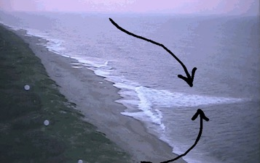
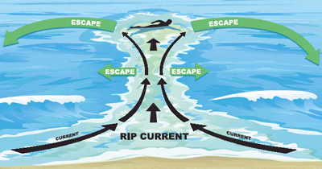
Rip Currents
Notes:
Explain what rip currents are and why they are dangerous. How do they move in the water? How can you recognize them? How do they affect swimmers? And most important, how do you get out of a rip current safely? Explain that you should always first swim with the shore (parallel) until out of the current, then swim to shore.
Rip currents form when the waves break near the shoreline, piling up water between the breaking waves and the beach. One of the ways this water returns to the sea is to form a rip current, a narrow stream of water moving swiftly away from shore, often perpendicular to the shoreline.

Slide 7
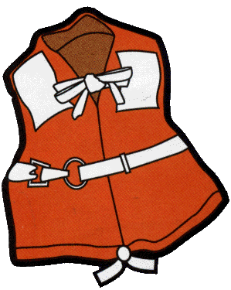
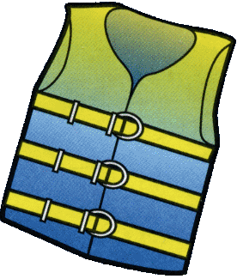
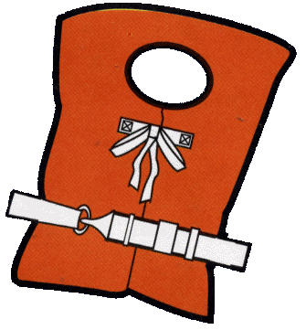
Life Jackets
Type 1
Type 3
Type 2
Notes:
**Instructors Can Adapt These Comments to Fit the Age-Appropriateness of Their Students.** This is also where instructors will want to “show and tell.” Have life jackets of various types and sizes available for the kids to try one and adjust its size. What happens when a life jacket is too large or too small? During this section ask for volunteers, being careful to ask permission to put a life jacket on a student. Always be very careful if touching the students and ask permission. Be sure another adult or teacher is nearby.
U.S. Coast Guard approved life jackets are required for every person in the boat and should be worn by everyone. This includes your parents, brothers and sisters, friends. Encourage wear anytime near the water’s edge to help reduce the risk of drowning if a person unexpectedly falls in.
* Lifejackets need to be fitted and adjusted for adults and children. Emphasize the age that children MUST wear a life jacket in your state.
* Children’s life jackets are approved for specific weight categories. Check the “User Weight” on the label and for an approval statement.
* U S Coast Guard-approved inflatable life jackets are authorized for use by persons 16 years of age and older (check the label).
* Inflatable life jackets require regular maintenance and attention to the condition of the inflator.
Lifejackets not only reduce the risk of drowning, they also can provide protection from rocks and other debris, provide a place to store emergency equipment (e.g., whistle, signal mirror, light), and can help keep paddlers warm. Always remember that a whistle Is not a toy. It is for getting help or attracting attention when you can’t be seen by bigger boats. Although you could have an air horn to meet legal requirements, it might be worth emphasizing that the whistle is on you all the time, ready to be used in the rare cases it’s needed.
* Bright colors such as red, yellow, or orange enhance visibility and are preferred over blue, olive, or camouflage on waterways.

Slide 8
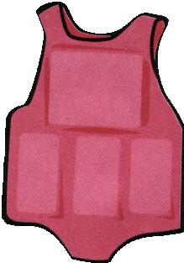
Life Jackets
Type 4 Type 5
Notes:
**Instructors Can Adapt These Comments to Fit the Age-Appropriateness of Their Students.**
The lifejackets:
Explain that the seat cushion and life ring types are for throwing. Add that by tying a line on these they can be used to help pull someone out of the water. This will also help in later slides when you discuss the Reach-Throw-Row-and Go techniques.
The last sample of life jacket is designed for paddling. Describe the wider armholes and freedom of movement it provides.

Slide 9
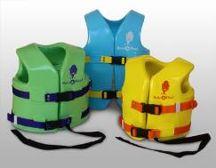
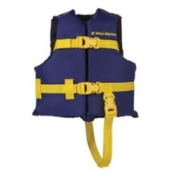
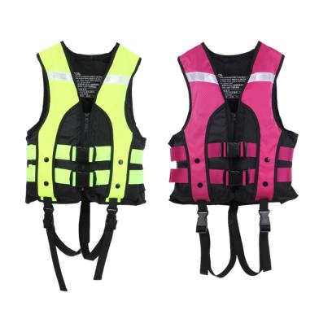
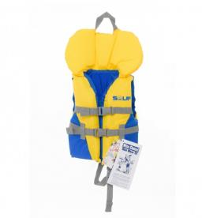
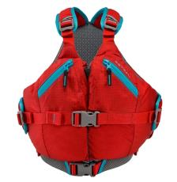
Some Life Jackets for Kids
Notes:
Life Jackets come in different sizes. Always be sure it fits and won’t fall off. If possible, demonstrate different sizes and types. With parent’s permission, have kids try the wrong size on and demonstrate why fit is important. This is a good point to have student participation.
Instructor note: Be very careful when helping kids try on life jackets. This is why it’s required that all instructors have complied with any youth protection classes required by the school or school district have been completed. One recommendation is to take the Youth Protection Course offered by the Boy Scouts of America, that is required when working the Sea Scouts. You can find this course at: https://my.scouting.org/

Slide 10
Life Jackets
Always look for this tag and the printed label to know your life jacket is Coast Guard approved

Slide 11
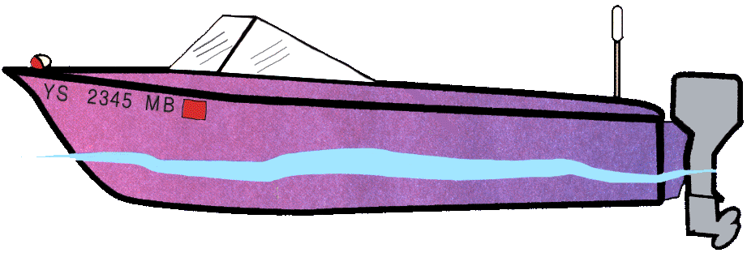
Parts of a Boat
Boater’s Language
1
3
2
Stern
Bow
Hull
Notes:
1. Bow
2. Stern
3. Hull
Explain each of these parts. You can explain that the bow refers to the “pointy part” of the boat. Stern is the back of the boat. Hull is the main body of the boat. It can be made of wood, fiberglass, steel, aluminum, or even concrete.

Slide 12
Parts of a Boat
Port Side
5
Starboard Side
4
Notes:
4. Starboard Side
5. Port Side
Boats do not refer to left or right sides because what is to your left and right change if you turn around. The terms used for the sides of a boat are port (left facing the front) and starboard (right facing the front). The port side and starboard sides do not change no matter which way you face in the boat.

Slide 13
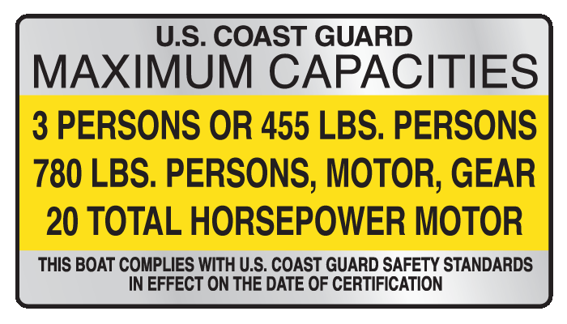
Capacity Plate
Notes:
Talk about why maximum weight is important in balancing a boat, and overcrowding endangers people. There are many ways this can be demonstrated by placing several objects on something until it collapses. If a small plastic bowl with water is available, you can place objects of different weight to show flotation and sinking.

Slide 14
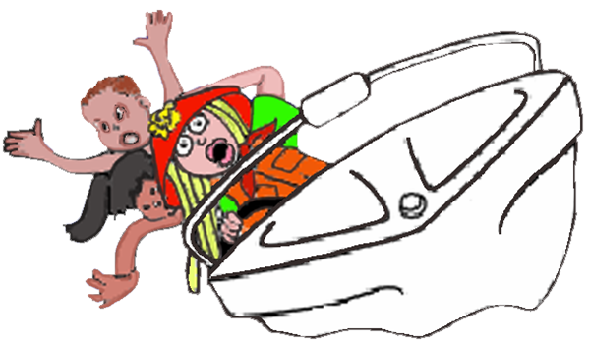
Balance the Boat
The load should be lighter
in rough water
Notes:
What happens if you have too many people on your bike? What if you have too many people on one side of a wagon, bike, scooter, etc.?

Slide 15
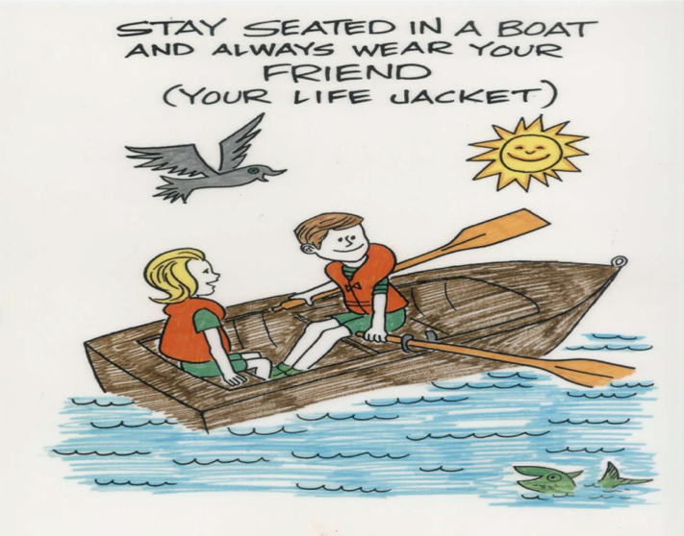
Stay Seated
Notes:
Why should you not walk around on a boat? Why is it important to always have your life jacket on?

Slide 16
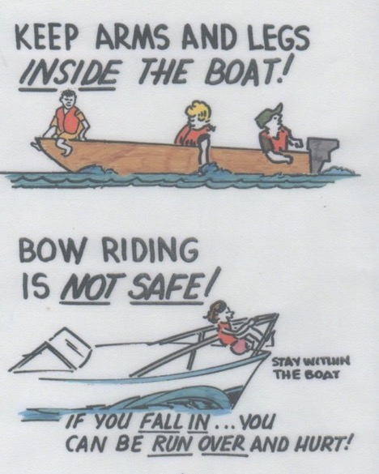
Keep your arms
and legs
inside the boat
Bow riding is
not safe
Notes:
Ask the students why these safety rules are important. Explain how these two things can be dangerous and avoid them. Have the students ever been to an amusement park? Have they been told to keep their arms and legs inside the ride? Explain the safety reasons for that.

Slide 17
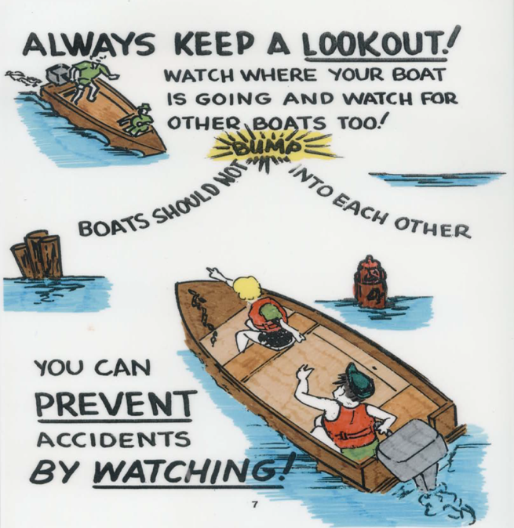
Notes:
Boats are moving. A lot is going on at the same time. One person can’t see everything, so you need to help. It’s actually a good job that kids can help with. Talk about what kinds of things to look for. For example, other boats, jet skis, sailboats, and paddlecraft. Objects in the water that could hit the boat, or the boat might run over, e.g., logs and tree branches, rocks, buoys, markers, especially swimmers in the water.

Slide 18
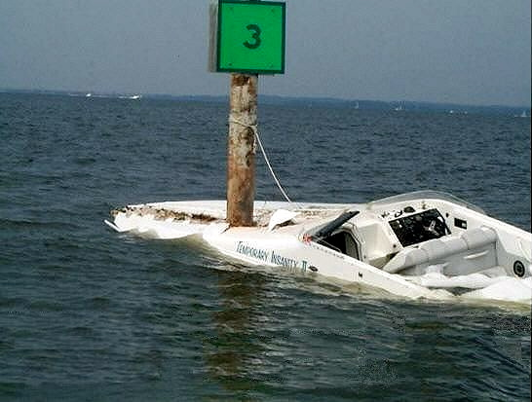
Keep the boat balanced
Stay seated
Always keep a look out
Notes:
What went wrong here????? Was someone helping the driver look out for dangers? What do you think might have prevented this accident? Explain to students why someone should be looking forward, behind, and to the sides.

Slide 19
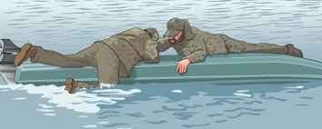
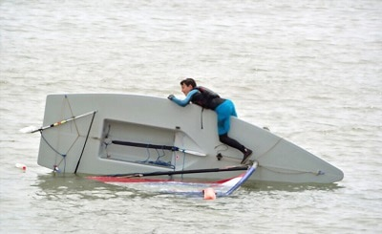
Always Stay With the Boat
Notes:
Ask why if the boat capsizes that you should not swim away. Swimming will make you too tired and cramp your muscles. Get on the boat, if possible, to get dry and stay warmer than being in the water, and it makes you much more visible for rescuers to find you.

Slide 20
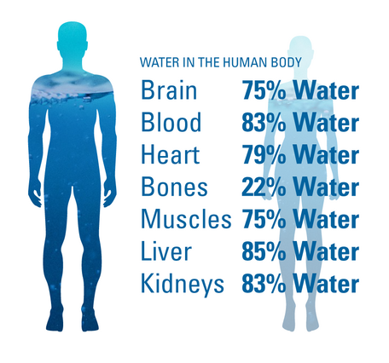
Stay Hydrated!
Drink Water
Drink Water
Drink Water
Drink Water
Notes:
Talk about being thirsty. The body is on average 60% water. Explain the symptoms of dehydration and ask if any of the students have felt that way on a hot day. Talk about what not to drink…and why water is so important.

Slide 21
Float Plan
Tell Someone:
when you are leaving.
when you plan to be home.
where you are going.
what the boat looks like.
who you are going with.
Notes:
Always tell someone where you are going, and when you plan to get back. What is search vs. rescue? How does someone know where to look for you? How do they know what your boat looks like? Who should you leave information with to be sure it’s used?

Slide 22
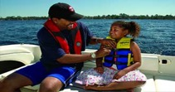
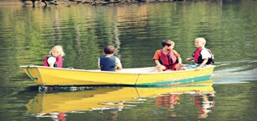
Boating Safety
Wear a Life Jacket
Balance the Boat
Stay with the Boat
Keep a Lookout
Stay Healthy/Drink Water
Notes:
Review with students each of these five major points.

Slide 23
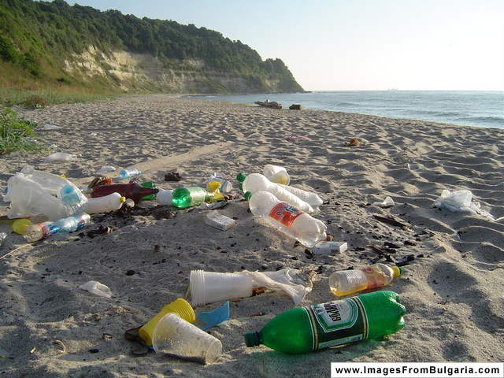
Pollution
Notes:
Ask students what they know about pollution. What causes it? Why is it important that beaches, oceans, lakes, and rivers, remain clean?

Slide 24
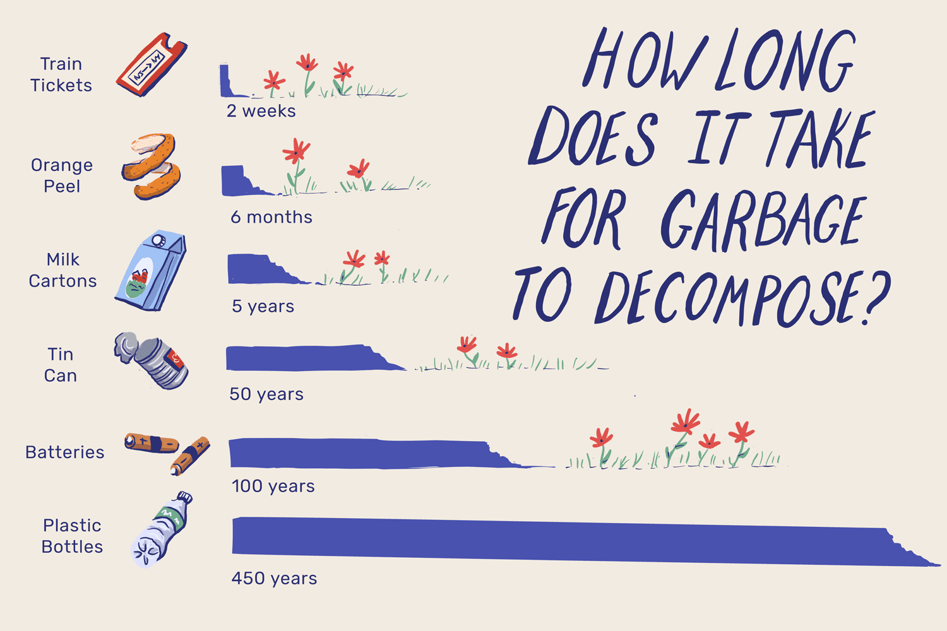
Notes:
How long does it take for trash to decompose? Talk about paper, vs. plastic, vs. fishing line for example.

Slide 25
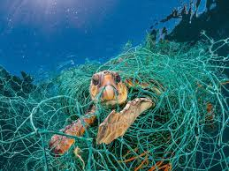
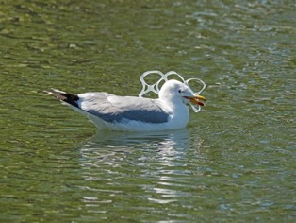
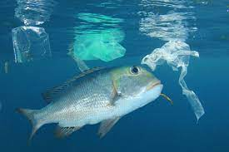
Pollution
Notes:
How does pollution affect wildlife? Destroys their habitat; get caught in nets and lines and other items which will cause them to struggle and perhaps die.

Slide 26
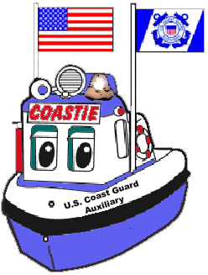
Coastie Says:
“Let’s talk about my rules”
Notes:
Everyone read aloud

Slide 27
Coastie Says:
“Wear your life jacket,
don’t just pack it”
Notes:
Everyone read aloud.

Slide 28
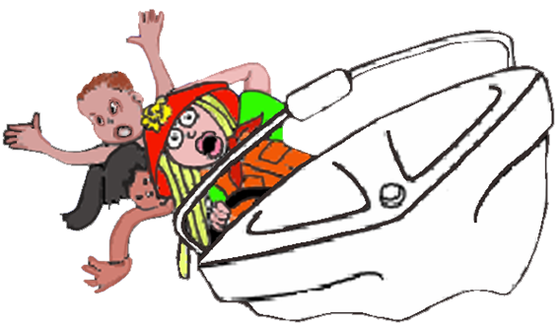
Coastie Says:
“Never ride on the bow (front) of a boat. You might fall in, you may
not float. Also, stay seated and remember
to balance the boat”
Notes:
Everyone read aloud.

Slide 29
Coastie Says:
“Reach or Throw but NEVER Go in”
Notes:
Everyone read aloud

Slide 30
Coastie Says:
“Learn to Swim”
Notes:
Everyone read aloud

Slide 31
Coastie Says:
“Swim with a buddy in a
supervised area”
Notes:
Everyone read aloud.

Slide 32
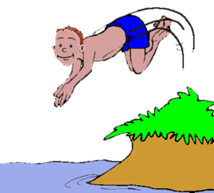
Coastie Says:
“Look before you leap”
Notes:
Everyone read aloud

Slide 33
Coastie Says:
“Always Pick Up Your Trash”
Notes:
Everyone read aloud

Slide 34
Coastie Says:
“If you have a boat, ask your parents
to take a
safe boating course”
Notes:
Everyone read aloud

Slide 35
Coastie Says:
“Safety first is the best rule.
Follow it and you’ll always be cool”
Notes:
Everyone read aloud

Slide 36
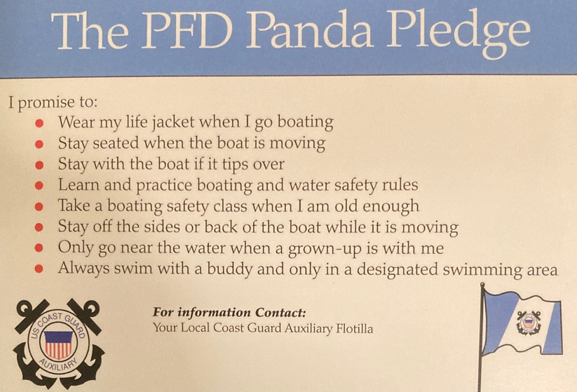
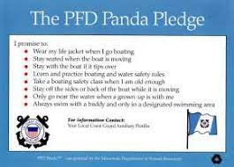
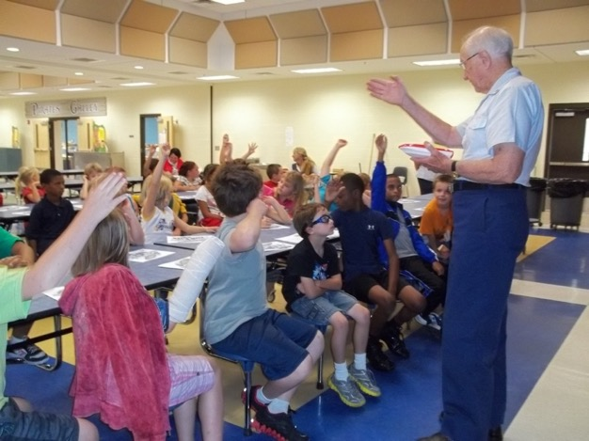
PANDA Pledge
Notes:
At this point, hand out copies of the Panda Pledge to all the students. Talk about the Panda Pledge and have the students read it aloud with you.

Slide 37
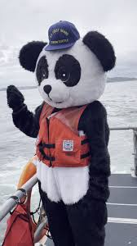
Water Safety:
Questions?

Slide 38
Coastie Says:
Thank you for your attention.
Have a safe and fun time.

