Slide 1
Virtual PE Classes Overview and Strategy
Prepared for E – Directorate Commodore Robert Laurer
District Staff Officers-Public Education
Meetings June 15, and June 23, 2020
Notes:
The world is taking a crash course on digital. Our homes are now offices, schools, and gyms.
And in two months, a new word has been added to our vocabulary – Zooming…over 300 million users daily. A jump from 10 million users three months ago.
At FIU, where I am a faculty member, ironically, teaching disruptive innovation in the Honors College, we went from 350 online courses to over 4,000 courses online from March 11, when we closed physical classroom doors, to March 16, when we re-opened virtually, about 100 hours later. Zoom was the selected video platform and we quickly adopted and adapted to using it, helping our graduating class of 2020 to achieve their dreams of a quality education.
Simultaneously, CGAUX was told to “step down” Face-To-Face, and asked to” step up” virtual classes. We started with Member Training and most recently, PE is being opened state by state.
And here we are…

Slide 2
AGENDA
The Concept
Platforms
Virtual Classes to Date
We Found That…
Experiential Learning
Starting Out
Attracting Students
Most Powerful Features
Appendix
Five Key Takeaways
Marketing & Promotion
Resources
Notes:
I was asked to share our experience with you tonight using Zoom for our first ABS class on June 1, 2020 as well as teaching various member training classes for DIV6 and university classes.

Slide 3
THE CONCEPT…
Virtual Classes
Video Conferencing
Webinars
Notes:
Virtual classes can be held using Webinars or Video. The differences are material…this conversation is about video
Mass video communication is a disruptive technology which in the last three months has increased the market exponentially propelled by the pandemic.
This offers us an unparalleled opportunity to grow our Public Education classes to the boating public and to attract new members wishing to serve.
And we can do so by offering a superior product to that one offered by online vendors because we offer the interactive expertise of our instructors.
Webinar - A one-way seminar conducted over the Internet…view-only platform… one way… … attendees cannot see each other… host cannot see the attendees… … used for large audiences to impart information one-way … … some hybrids allow a few thumbnails of the participants to be seen…Video classes are not webinars
Video - all participants can see, speak, hear, and screen-share with each other simultaneously……meetings … classes … conferences…… designed to be a collaborative event … all participants being able to participate…simultaneously … almost as if all were together in a room…little if any concerns about bandwidth or capacity …Video classes are fully interactive

Slide 4
Most popular current video platforms*
Video Conferencing
Zoom
Google Hangouts/Meet
GoToMeeting
Join.me
Cisco Webex
Slack
*https://zapier.com/blog/best-video-conferencing-apps/
Notes:
Today we are illustrating with Zoom.
The reasons for its selection at the moment are its: ease of use as both host and participant, development as a tool for education, familiarity by most of our user members/boaters from their work, academic and home uses, bandwidth scalability, and modern technology with simultaneous video/screensharing/chat capabilities. Cost is competitive at $12.49 pppm.
CGAUX does not endorse any one product.
Each flotilla may select its platform. Leading ones are posted here.
Furthermore, prudent risk management suggests diversification of platform for many reasons, technical, geopolitical, etc.

Slide 5
Virtual Classes Taught to Date
Video Mentoring for Self-Study ~ Core Courses, BQII, FEMA ICS
Video Conferencing Guided ~ Operations Workshops, VE Workshops, Comms Workshop, Intro to Risk Management, 4-hour TCT Refresher
Video Conferencing Blended ~ Virtual Boat Crew Training Dockside Instruction (16 session), Virtual Vessel Exam Certification (6 session)
Public Education Classes ~ ABS
Notes:
Video Mentoring for Self-Study – a mentor will host a video conference call and invite you to participate in video conferences for self-study classes. The mentor will then run through the class helping you as needed.
~ Core Courses, BQII, FEMA ICS
Video Conferencing Guided - a CGAUX Instructor will host a video conference and carry out assignments and assessments per topic. Sign-off on PQS and Qualification can take place now if face-to-face testing is not required.
~ Operations Workshop, VE Workshops, Comms Workshop, Intro to Risk Management, 4-hour TCT Refresher
Video Conferencing Blended - a CGAUX Instructor will host a video conference and carry out assignments and assessments per topic. Final sign-off on qualifications will take place after face-to-face instruction is resumed.
~ Virtual Boat Crew Training Dockside Instruction, Virtual Vessel Exam Certification

Slide 6
We found that…
Some instructors were very apprehensive but got more comfortable as the class progressed…
Clicking on the buttons became second nature…
We started out stressed, fearful, apprehensive…and ended up where we could not close the meeting because the students and the instructors were enjoying themselves…
We ended up with feelings of friendship and familiarity not unlike a pleasant social event…

Slide 7
We found that…
The more we used the gallery the more participants spoke up…
Those who did not turn on their video lost interest and were not engaged…
When one spoke up the others listened…
One good comment or example generated another…
Participants brought up the one/items that really concerned them…
They helped us instructors to focus on what is relevant to them…

Slide 8
We found that…
The more that instructors listened, the more that the students learned…
We laughed a lot more than in class…and listened more…
When we could see everyone’s body language on the gallery,
we got good feedback
better understanding
better timing
And, there began to be a positive energy…sense of humor…shared experience…

Slide 9
We found that…
We were gradually becoming better educators because…
we limited the use of PPT as a crutch…use it better than before…
we asked students to prepare in advance…
we used class time to discuss the topics, reinforce the learning…
As those of you in education know, learning, not teaching, is our objective…
We are finding that video is helping us to get there…
And the better that the student learns… well, perhaps some of that translates into better boating…

Slide 10
Experiential Learning
So far, there are no scientifically-based rules for setting the number of participants, time for teaching, breaks, etc.
Logistical decisions should be made at the lowest possible level, FSO-PE
FSO-PE should be guided by common sense and experience
Guidance from senior staff is best given as a range not a maximum…
Divisions/districts/directorates could facilitate information by setting up information clearing houses
Focus on the messaging from the word “video”
Notes:
Experiential learning…learn as we go requires maximum flexibility…openness…willing to try different approaches… tasks…etc.
Avoid temptation to set absolute limits.
Encourage scheduling instructors for a dry-run before their first public class…

Slide 11
Starting Out
Set Up
Additional Resources
Download
Help Center
Getting Started
Quick Start
E- Directorate What’s New
D7 DIV6 Training Resources
Six Steps to Set Up
Tips for Holding Business Meetings
Best Learning Practices for Member Training and Public Education Classes
D7 DIV6 Calendar
Notes:
Zoom offers a rich array of tools to set up and run the platform.
There are also auxiliary specific additional resources:
D7 DIV6 is posting its training resources on its website and any D7 auxiliarists may access it simply by going to the website and logging into Training.
DIV6 at the request of the COL opened its classes to D7 SO-MTs. These classes may be seen on the DIV6 Training Calendar.
E-Directorate DSO-PEs are welcome to view these offerings. Please do not distribute further. If there is interest in Group Sessions, kindly find contact at the end.

Slide 12
Effective Market Reach
Face to Face Class
Online self-study (generic)
Video class with
Auxiliary Instructors
Notes:
Face to Face is limited by classroom size, transportation, ability to obtain free or rent space, parking, facilities, projector, electricity, WiFi , comfortable seating, ability to break for lunch…and other physical and logistical factors…
Online self-study is likely those to comply with state boating requirements…and are not limited, but not likely to attract boaters interested in learning,
Video classes are likely to attract, both, boaters interested in learning, safety, etc. and complying with state boating requirements as well as rental companies.. They are limited only by the need to have audio and webcam. That means we can effectively reach boaters virtually within our states; bringing the benefit of auxiliary knowledge and skills to our boaters in unprecedented numbers. And, flotillas can greatly strengthen their financial resources to support its multiple missions.

Slide 13
Virtual Public Education Class
District 7 Flotilla 61
Henry Cespedes, SO-PE, FSO-PE
June 1, 2020
4 consecutive evening sessions of 90 minutes each
30 students
Platform: Zoom
Registration: JotForm
Test: Google Drive
Two instructors; one observer
Gallery ~ Shared screen ~ Chat
Tests went well
Students stayed after class to converse; “very happy”
Four more classes scheduled
Two already “Sold Out” ~(15, 22)
Same format
Contact: Henry Cespedes
305 519 - 4610
Notes:
There are other models which are best developed by each flotilla in response to its boaters’ needs.
Each location will be different and should have flexibility to develop its course offerings accordingly.
For example:
The current ABS class may be given over one day or over the course of up to four days; consecutive or weekly.

Slide 14
OUR STUDENTS ARE COMING FROM…
Flotilla 61 Audience
Referrals from past students, families, relatives, friends…
South Florida Powerboat club
Monthly class - regularity and reliability of offering
Personal Attention – phone and email number to register
Website SEO
Getting inquiries outside of Miami
Notes:
Simply offering a class on a website is not going to get us significant numbers of students…
How do we obtain students…in this case, these are the critical factors…for this market…they can and will change over time…

Slide 15
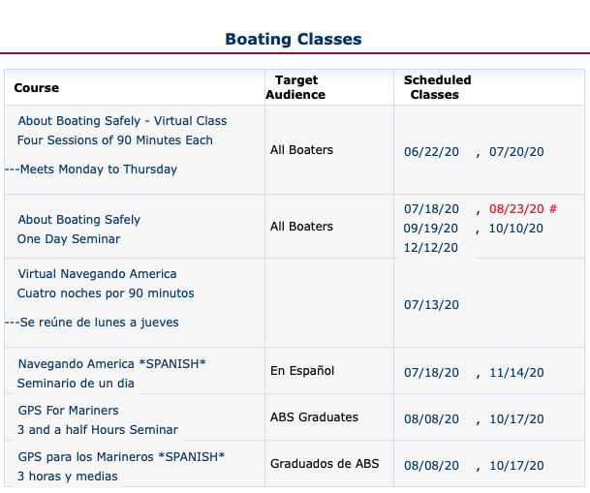
Notes:
Very easy to find website page and easy to use calendar…
Most of the year is laid out for the student to select; no classes are cancelled except for hurricanes and stand downs…not even pandemics, if virtual classes are approved by the authorities.
Students value constancy and makes it easy to make referrals…
Rich selection of classes builds our market presence: ABS in English, Navegando America in Spanish, GPS for Mariners in English and in Spanish

Slide 16
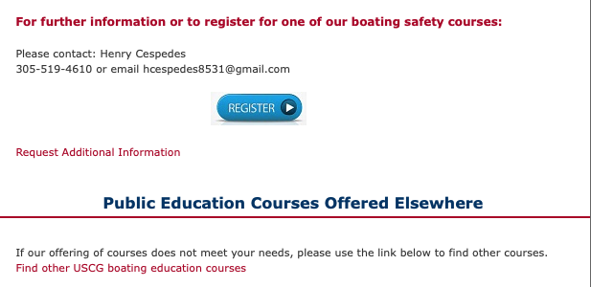
Notes:
Registration is very easy, very convenience and very personal: by phone, by email or by registration form.
Additional Information is offered
and a Forwarding Link to other Aux boating education courses is also offered to make sure the boater gets a class from someone in the auxiliary…
This is specially important as we enter online delivery which brings more capacity than one class can handle…

Slide 17
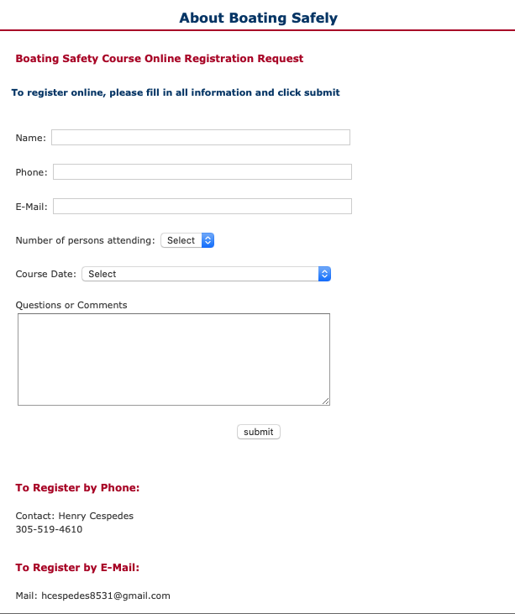
Notes:
Registration: easy JotForm form to fill, or by phone directly to the organizer, or by email directly by the organizer…very convenient for boaters…
Again, no matter where the boater turns, it is very easy to sign up…

Slide 18
THE CLASS
Notes:
E – Directorate What’s New has various resources including: Checklist (Preparing, Presenting and Concluding Class), NASBLA Test, Best Learning Practices for Member Training and Public Education Classes PPT

Slide 19
NSBLA Test
Notes:
NASBLA test can be given as part of the class or separately.
Under chat section, select more (three dots), follow prompts to shared drives, in this case Google Drive, to the test.
Share with the students who can open and take it during the session while you are semi-proctoring them through video.
Or, share with the students to take home and return by your deadline with attestation.

Slide 20
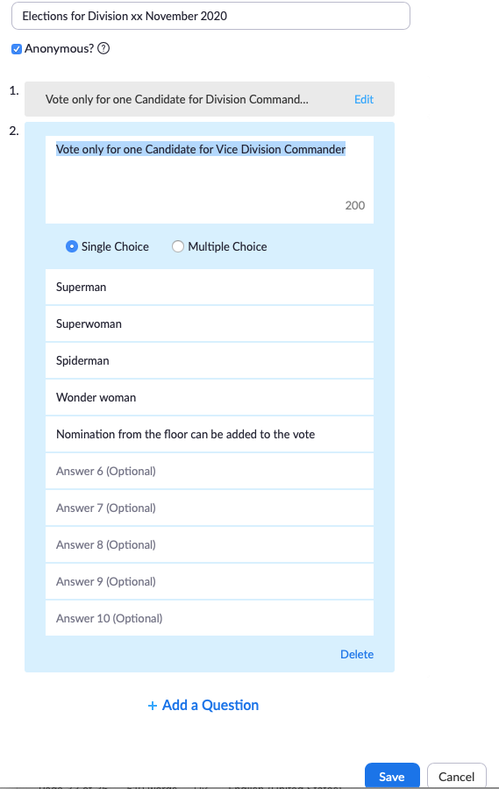
FEEDBACK
Polling
Monkey Survey
Qualtrics
Mail Chimp
Constant Contact
Notes:
Very important to assess all aspects of the class and adjust for the next one…
We like to say that the mission is not done until the 7030 or other form is filed…well, the class is not done until the survey is completed and the next class adjusted for it…

Slide 21
Integrated PE Model
Market/
Sales
Register/
Payment
Class/
Test
Survey/
Cross-sell
Recruit/
Retain
Member/
Officer
Notes:
We are playing with some conceptual models for flotilla growth based on our ability to systematically deliver PE classes …
We start with the classes for expediency and add modules as we can to carry out these functions, eventually creating a self-renewing circle of activities.

Slide 22
Zoom Apps for the PE Model
PlusThis/
Calendar
JotForm/
Square
Zoom/
Google Drive
Survey Monkey/ Commsor
Rooster
Training
Notes:
Over 400 apps connect with Zoom to fill in the functions in the model…these are initial possibilities … it is very early going and we are learning how to use these…
Primary objective is to deliver quality boating classes, but Zoom clearly offers functionality with premier apps in their respective spaces to connect our flotilla activities in ways we could only dream about three months ago…
FTF is understood to be critical to close the loop…

Slide 23
Most Powerful Features
Notes:
Gallery – up to 49
A screen full of friendly participants…students and instructors ready to exchange knowledge, experience, and stories…
Interactive – see, speak, hear, chat SIMULTANEOUSLY
Communicating constantly
Good humor
Body language
Fun with virtual backgrounds
Division 1, 3, 5, 6, 10, 11… We ended up calling each other friends…

Slide 24
This is all it takes to schedule a class…
Notes:
This is all it takes to schedule a class…

Slide 25
This is all it takes to send out invitations…
Notes:
Most powerful scheduling and tracking tool…Google, Outlook, Yahoo calendars…save tons of time…allows for edits, updates, attachments, etc.

Slide 26
Calendar Invitation
Notes:
Informational…who…when…what…how…why…and a simple hyperlink…

Slide 27
Using YouTube - Charting
Notes:
Leverage good YouTube videos…part or full…why reinvent the wheel…

Slide 28
Direct to Charting Program
Notes:
An aircrew from South Carolina shared his charting program for real time navigation

Slide 29
Second Camera – Physical Items
Notes:
Zoom offers various physical appendages to enhance training…we are just scratching the surface with a second camera…

Slide 30
Sharing Controls
Notes:
Range of tools at the host, co-host disposal…

Slide 31
Common sense is not as common…
Notes:
Lower right hand…
While this conversation has been about using video to deliver our PE mission and to build relationships, the importance of returning to Face To Face has to be clearly understood.
Mass video communication, however, more than a temporary tool, it can be a permanent enhancement to our missions.
This is an interesting screen shot sent to us by a student of a car driving front end into the water to launch their boat…common sense can’t be taught…enjoy!

Slide 32
APPENDIX

Slide 33
FIVE KEY TAKEAWAYS

Slide 34
Virtual Classes
Video Conferencing
Webinars
Notes:
Virtual classes can be held using Webinars or Video. The differences are material…this conversation is about video
Mass video communication is a disruptive technology which has increased the market exponentially in the last three months propelled by the pandemic.
This offers us an unparalleled opportunity to grow our services to the boating public and attract new members wishing to serve.
And we can do so by offering a superior product to strictly online vendors with the interactive expertise of our instructors.

Slide 35
Effective Market Reach
Face to Face Class
Online self-study
Video class with
Auxiliary Instructors
Notes:
Face to Face is limited by classroom size, transportation, ability to obtain free or rent space, parking, facilities, projector, electricity, WiFi , comfortable seating, ability to break for lunch…
Online self-study is likely those to comply with state boating requirements…and are not limited, but not likely to attract boaters interested in learning,
Video classes are likely to attract, both, boaters interested in learning, safety, etc. and complying with state boating requirements as well as rental companies.. They are limited only by the need to have audio and webcam.

Slide 36
Integrated PE Model
Market/
Sales
Register/
Payment
Class/
Test
Survey/
Cross-sell
Recruit/
Retain
Member/
Officer
Notes:
We are playing with some conceptual models for flotilla growth based on our ability to systematically deliver PE classes …
We start with the classes for expediency and add modules as we can to carry out these functions, eventually creating a self-renewing circle of activities.

Slide 37
Most Powerful Features
Notes:
Back to the tool at hand
Gallery – up to 49
Interactive
Communicating constantly
Good humor
Body language
Fun with virtual backgrounds
Division 1, 3, 5, 6, 10, 11… We ended up calling each other friends…

Slide 38
Zoom apps for the PE Model
PlusThis/
Calendar
JotForm/
Square
Zoom/
Google Drive
Survey Monkey/ Commsor
Rooster
Training
Notes:
Over 400 apps connect with Zoom to fill in the functions in the model…these are initial possibilities … it is very early going and we are learning how to use these…
Primary objective is to deliver quality boating classes, but Zoom clearly offers functionality with premier apps in their respective spaces to connect our flotilla activities in ways we could only dream about three months ago…
FTF is understood to be critical to close the loop…

Slide 39
Marketing & Promotion

Slide 40
Effective Market Reach
Face to Face Class
Online self-study (generic)
Video class with
Auxiliary Instructors
Notes:
Face to Face is limited by classroom size, transportation, ability to obtain free or rent space, parking, facilities, projector, electricity, WiFi , comfortable seating, ability to break for lunch…
Online self-study is likely those to comply with state boating requirements…and are not limited, but not likely to attract boaters interested in learning,
Video classes are likely to attract, both, boaters interested in learning, safety, etc. and complying with state boating requirements as well as rental companies.. They are limited only by the need to have audio and webcam. That means we can effectively reach boaters virtually within our states; bringing the benefit of auxiliary knowledge and skills to our boaters in unprecedented numbers. And, flotillas can greatly strengthen their financial resources to support its multiple missions.

Slide 41
Marketing & Promotion
…explore the timing and the decision-making flow of their needs…
Timing | Flow
when they buy a boat | explore new/used boat dealers referrals
when they insure a boat | explore boating insurance company referrals
when they register or renew their annual registration | explore State boat registration offices, get mailing list, develop data base
fishing tournaments boat shows | explore with organizers
Notes:
To grow the number of boaters that sign up to take our classes, marketing and sales is necessary.
It is a well-demonstrated tactic to be top of mind with the potential user of services at the time of decision making…
Following is list of promotional activities based on the timing of the need of the boater and their decision-making.
Each flotilla can use as few as one or as many as resources permit.

Slide 42
Promotion …
Timing | Flow
when they rent a boat | explore local rental companies
when they join a boating organization | explore local sailing, yacht, boating clubs, dockmasters
when they go to renew their public marina slips | explore local marinas
when their child turns of boating age | explore local high schools
when local charitable entities seek to support safe boating, clean marinas, etc. | explore boating safety, environmental foundations
Notes:
Each of us at the flotilla level have some entry into these opportunities…

Slide 43
Promotion …
when local businesses are looking to help the local community | explore annual donations from corporate community foundations (CVS, Publix …)
when they read up on local current events | explore special interest articles with local community papers, social media
when they see you on the local TV news | get a local interview for the 5 and 10 pm news
when they hear you on the local radio boating, fishing programs | get local interviews
Notes:
And various flotilla members can help to open our doors, it does not all have to fall on the PE Instructor…

Slide 44
Close the sale with personal service…
Service | Service
set up own PE website | set up own blog
use SEO to keep top of search | PE dedicated email address, phone number
Notes:
Relying on a passive website or “outbound marketing” is the least effective. A combination of inbound and outbound marketing would work best here.
The other critical factor is “closing the sale” or securing the registration; just because a potential student replies to a website does not mean they understand and are committed to the class. Personal conversation with the applicant ensures a good fit, reinforces their decision to take the class and handles any logistical barrier.

Slide 45
Resources
Zoom
CGAUX Resources
Attend Live Training
Video Tutorials
Knowledge Base
App Marketplace
Meetings for Education (Students & Educators)
E- Directorate What’s New
D7 DIV6 Training Resources
Six Steps to Set Up Video Classes
Tips for Holding Business Meetings
Best Learning Practices for Member Training and Public Education Classes
D7 DIV6 Calendar
Notes:
Zoom offers a rich array of tools to set up and run the platform.
There are also auxiliary specific additional resources:
D7 DIV6 is posting its training resources on its website and any D7 auxiliarists may access it simply by going to the website and logging into Training.
DIV6 at the request of the COL opened its classes to D7 SO-MTs. These classes may be seen on the DIV6 Training Calendar.
E-Directorate DSO-PEs are welcome to view these offerings. Please do not distribute further. If there is interest in Group Sessions, kindly find contact at the end.

Slide 46
Schedule Group Training
To schedule group training
Resource for questions, practice, trouble-shooting
Feedback and observations welcome
Hortensia Sampedro, DIV6, SO-MT (305) 742-8221

