Slide 1
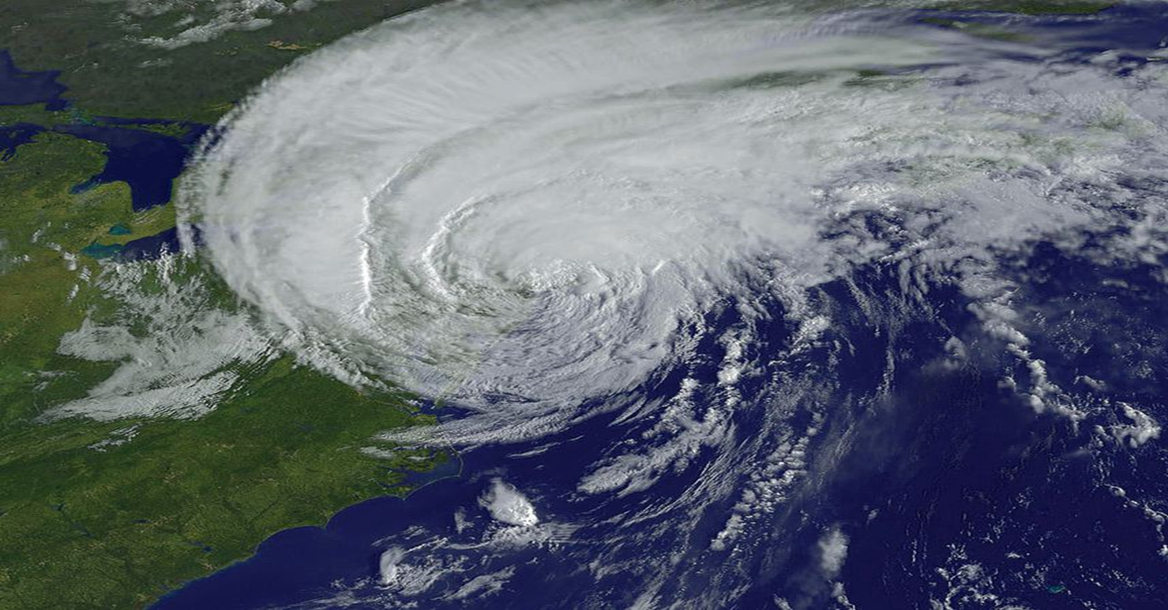
Heavy Weather is Coming
What Do You Do to Prepare Your Boat?
Notes:
When we think of “Heavy Weather,” many boaters think of raging thunderstorms on the lake or hurricanes along the coast. No matter what you consider “heavy weather,” you need a plan to be prepared. Because they are the most recognizable “heavy weather” storm, we will use hurricanes as a teaching example of heavy weather. Yet, what we say applies to a storm that can strike anywhere in the US.

Slide 2
What Do I Do and When?
Three stages of doing something about heavy weather:
  Pre-storm preparation
  When the storm hits
  Recovering from a storm

Slide 3
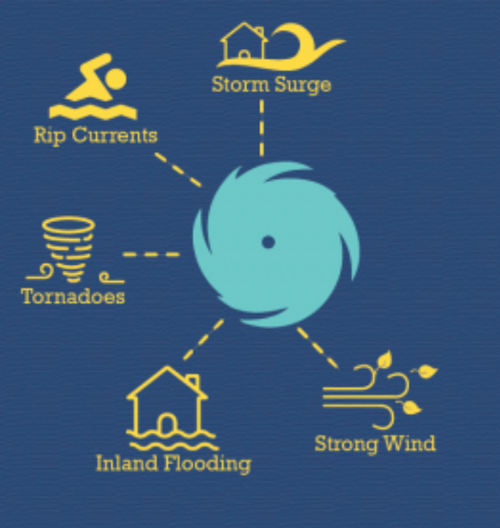
Pre-storm Preparation
What you do depends upon where you live.
Get in the habit of reading weather signs and monitoring the weather.
Notes:
We will focus on hurricanes because they can spawn many of these hazards. Hurricane impacts can be felt hundreds of miles inland. Hurricanes bring many hazards to US coastlines and inland areas, including storm surge along the coast, inland flooding due to heavy rainfall, tornadoes, strong winds, rip currents, and large waves.

Slide 4
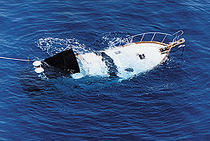
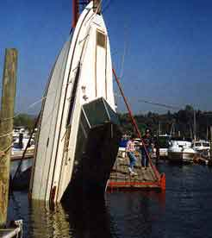
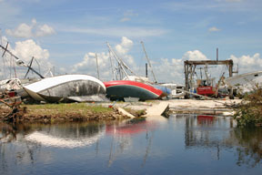
Pre-storm Preparation
Awareness is essential!
Notes:
You don’t want your boat to look like any of these.

Slide 5
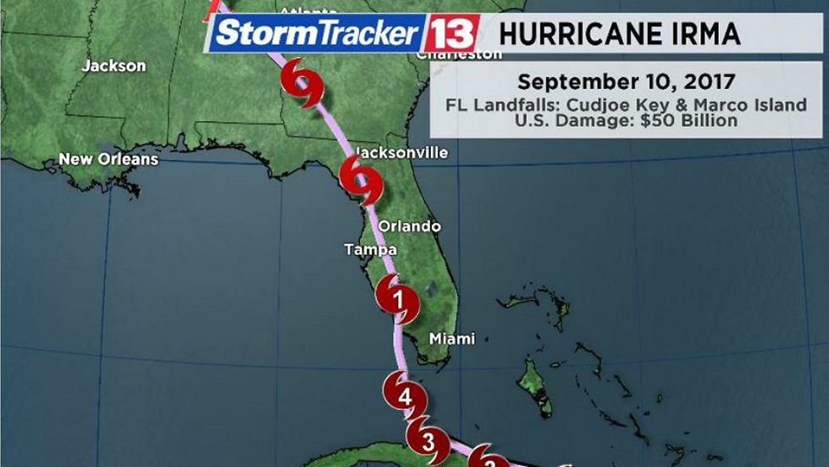
Hurricanes Have a Season
Officially, June 1 through November 30
Plan early in Hurricane Season
Gain “local knowledge” where your boat will be safe.
Notes:
Boat owners on the coast have reason to become edgy in the late summer and early fall: Each year, at least two hurricanes will come ashore somewhere along the Gulf or Atlantic coasts, destroying homes, sinking boats, and upending people’s lives for weeks, or even months. And, as we have seen recently, they can affect communities well inland when they spawn floods, tornadoes, etc. That is why every boater needs to be aware of them.
In coastal communities, a hurricane "watch" is posted when hurricane conditions threaten a specified coastal area, usually within 36 hours. Some hurricane observers believe that waiting for a watch to be posted may also be too late to head for the marina or move the boat to a safer location.
A hurricane "warning" advisory is posted when sustained winds of 74 mph or higher are expected within 24 hours or less--too late, in most situations, to head for the boat. Securing the house, gathering emergency provisions, and evacuating the family will need attention at this point.

Slide 6
There’s Lots to Do Before a Storm Is Forecast
Make an Emergency Plan
  Where would the best place be for your boat?
    In the water? On land? On a trailer?
Will you need assistance?
Do you have marine insurance?
Where and how will you evacuate?
Notes:
Your Emergency Plan is a list you make to help you remember what to do. Involve the family when you write this plan, so they know too. Remember, you may have different answers depending on the severity of the storm forecast.
You should consider insurance for your boat just like you have for your car or truck. But it’s up to you.

Slide 7
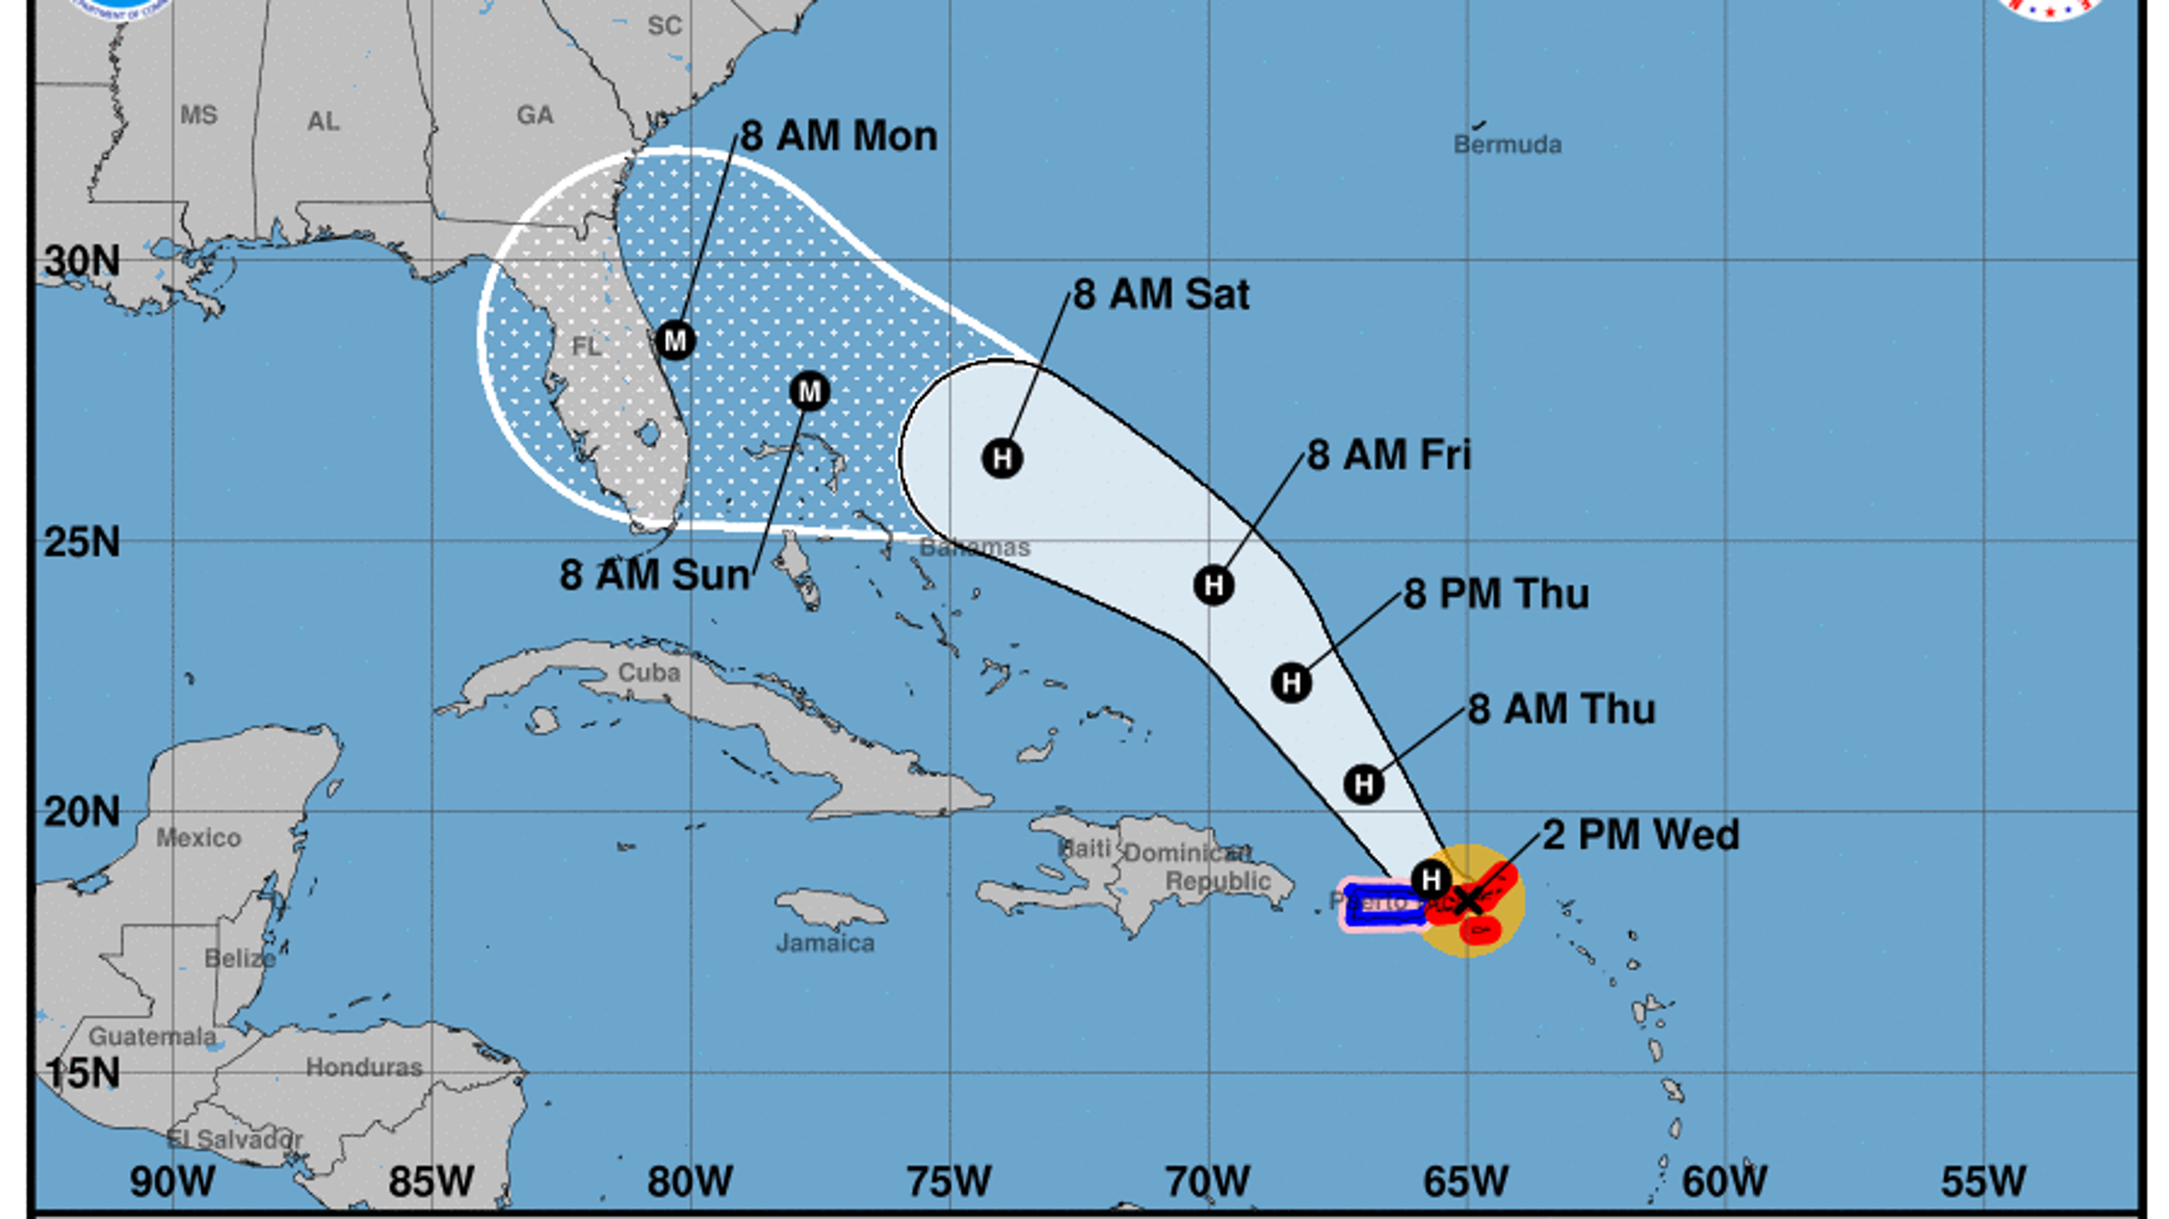
When a Storm is Forecast
Follow the predicted track carefully
  How strong will it be?
  Where will it hit?
  When?
Do the models agree?
What are local experts telling you?
Notes:
Also, remember that the “eye” of the hurricane may be far away from your area, yet you will feel significant effects of the storm locally. Visit FEMA.gov or www.nhc.noaa.gov.

Slide 8
DO NOT GO OUT TO SEA IN A RECREATIONAL BOAT TO “RIDE OUT” A HURRICANE!

Slide 9

What Do the Categories for Hurricanes Mean?
Notes:
Remember, the Saffir-Simpson scale (hurricane categories 1-5) is a hurricane WIND scale. It says absolutely nothing about any of the other hurricane hazards (storm surge flooding, rainfall flooding, tornadoes, large waves, surf, and currents). Each hurricane is unique, and its impacts on a particular geographic location and population depend on numerous factors beyond wind speed alone.

Slide 10
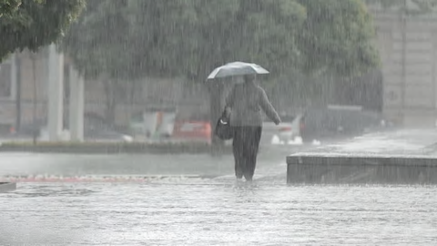
Tropical Depression
Sustained winds < 39 mph/34 knots
Some coastal flooding possible
Poorly secured boats may break away.

Slide 11
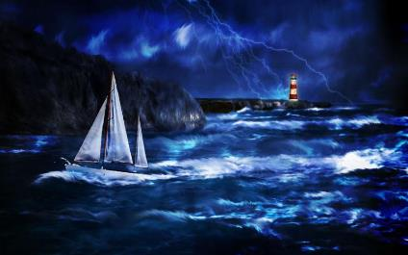
Tropical Storm
Sustained winds 39-73 mph/34-63 knots
Some coastal flooding possible
Poorly secured boats may break away.
Canvas covers, biminis, or sails may tear or blow away.

Slide 12
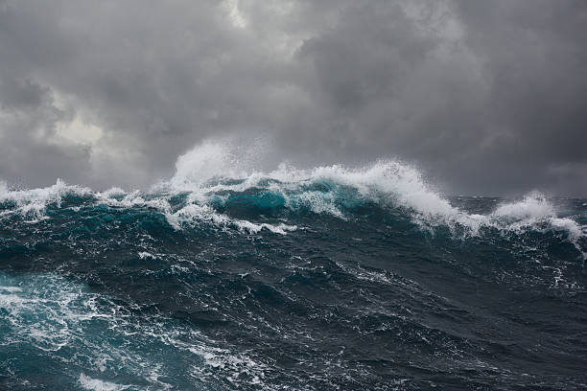
Category 1 Hurricane
Sustained winds 74-95 mph/64-82 knots
Dangerous winds/flooding
Possible damage to roofs, shingles, siding, gutters.
Boats may break loose and wash ashore
Trees damaged and uprooted
Power outages
Notes:
Damage Estimates:
Agnes – June 1972 - $2.1B
Irene – August 2011 - $13.5B
Sandy – October 2012 - $65B

Slide 13
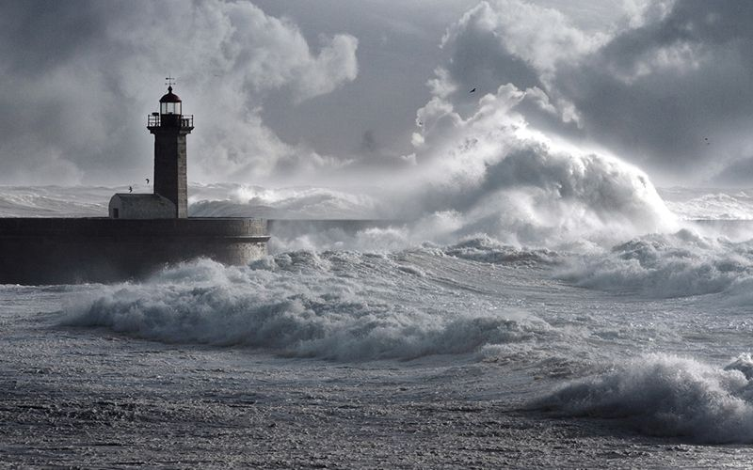
Category 2 Hurricane
Sustained winds 96-110 mph/83-95 knots
Dangerous winds/flooding
Major damage to roofs, shingles, siding, gutters.
Boats likely to break loose & wash ashore
Serious tree damage and uprooting
Sustained power outages
Notes:
Damage Estimates:
Floyd – September 1999 - $6.9B
Ike – September 2008 - $30B
Sally – September 2020 - $7.3B

Slide 14
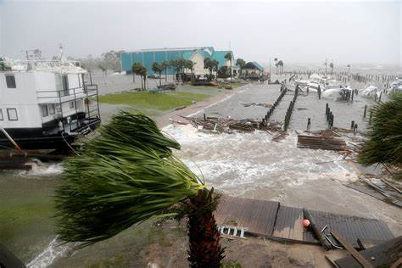
Category 3 Hurricane
Sustained winds 111-129 mph/96-112 knots
Devastating winds and flooding
Major damage to docks, decks, and buildings.
Boats likely to break loose and wash ashore or sink.
Trees downed
Sustained power outages
Notes:
Damage Estimates:
Opal – October 1995 - $5.1B
Katrina – August 2005 - $125B
Rita – September 2005 - $12B
Wilma – October 2005 - $22.4B

Slide 15
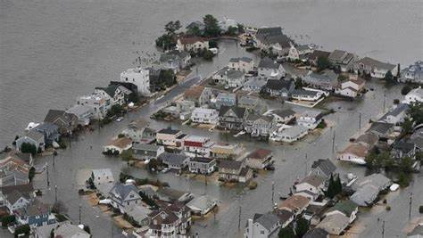
Category 4 Hurricane
Sustained winds 130-156 mph/113-136 knots
Devastating winds and flooding
Catastrophic damage to buildings & roadways.
Boats will break loose and wash ashore or sink.
Sustained power outages in some isolated areas.
Notes:
Damage estimates:
Hugo – September 1989 - $7.1B
Harvey – August 2017 - $125B
Helene – September 2024 - $78.8B

Slide 16
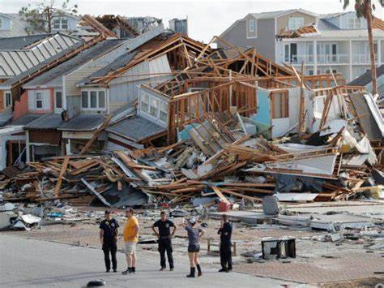
Category 5 Hurricane
Sustained winds >156 mph/136 knots
Catastrophic winds and flooding
Catastrophic damage to buildings and roadways
Boats will break loose and wash ashore or sink.
Some areas rendered uninhabitable
Significant, widespread power outages
Notes:
Damage estimates:
Camille – August 1969 - $1.4B
Andrew – August 1992 - $27.3B
Michael – October 2018 - $25B

Slide 17
A Storm is Forecast, Now What?

Slide 18
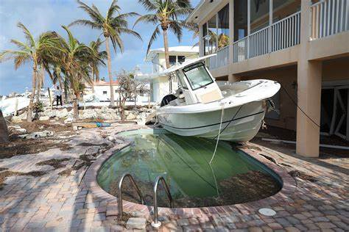
Don’t Be a Hero
It’s just a boat!
  You may be able to save a boat in a Category 2 or 3 storm.
  Have you purchased insurance?
Protect your family and yourself first!
  Be ready to evacuate if necessary.

Slide 19
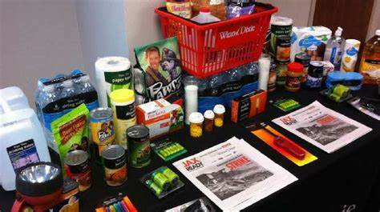
Develop a Hurricane Plan
For your family and yourself:
  What to do?
  When to go?
  Where to go?
  What to bring/leave?
For your boat:
  Where will your boat be safe?
  What to do?
  When to do it?

Slide 20
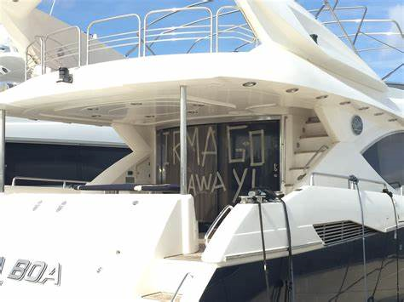
Develop a Hurricane Plan
You don’t want to be the least- prepared boat owner who causes all the damage!
Wishing won’t cut it!
Notes:
Now is the time to begin thinking about what your family will do in the event a hurricane is predicted to be anywhere near you. A day or two before a storm is not the time to begin planning.

Slide 21
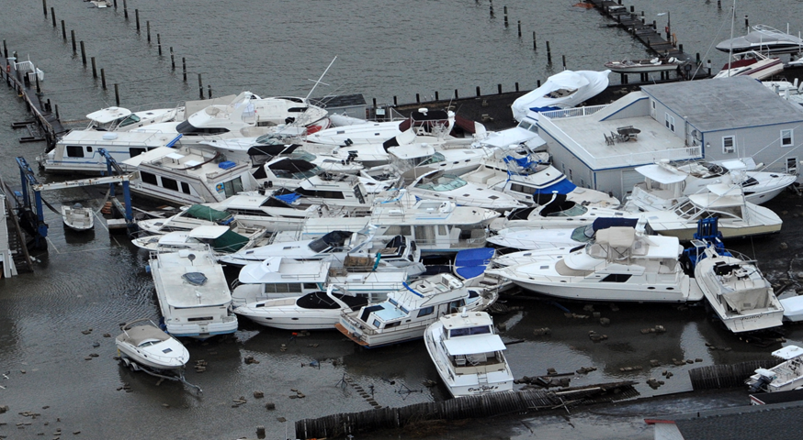
Where will my boat be safe?
In your marina?
  Do they have floating or wooden docks?
  If it’s on a lift or davits, can you get it on a trailer?
Evaluate your options:
  Secure the boat in the marina.
  Move to a mooring field.
  Haul the boat to dry land.

Slide 22
Where will my boat be safe?
In the water?
  Locate a spot where waves or storm surge have the least distance to build up.
  If you must remain dockside, use heavy-duty fender boards (2’ x 6’) and pairs of fenders behind the boards.
  Double up and secure mooring lines.
  Secure hatches.
Notes:
Canals may work if lines can be run from both sides so the boat does not pound against the dock.
Don’t raft up.

Slide 23
Where will my boat be safe?
In a storage area?
  If it’s on a trailer, can you get it out of the wind or even indoors?
  Can you at least tie it down?
In an indoor facility?
  May save your boat in a Cat 3 + storm.
  Rental storage unit
  Dry-stack storage

Slide 24
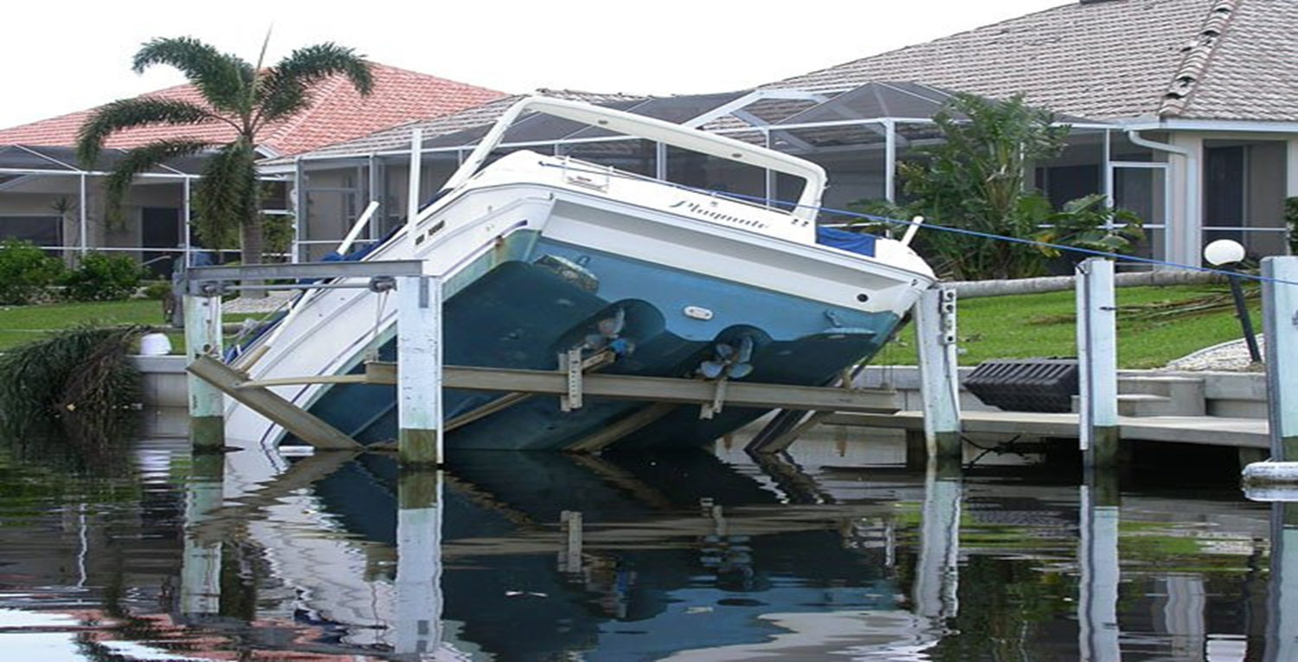
Where will my boat be safe?
On davits or lifts?
  Move to a safer location, if possible.
  If it is on a lift, lower the lift 2 feet, tie off the boat to pilings, and then raise the lift to put tension on those lines.
  Open the drain plug.
  Make sure that your battery is charged.
Notes:
The battery should be charged to activate the bilge pump, if installed.

Slide 25
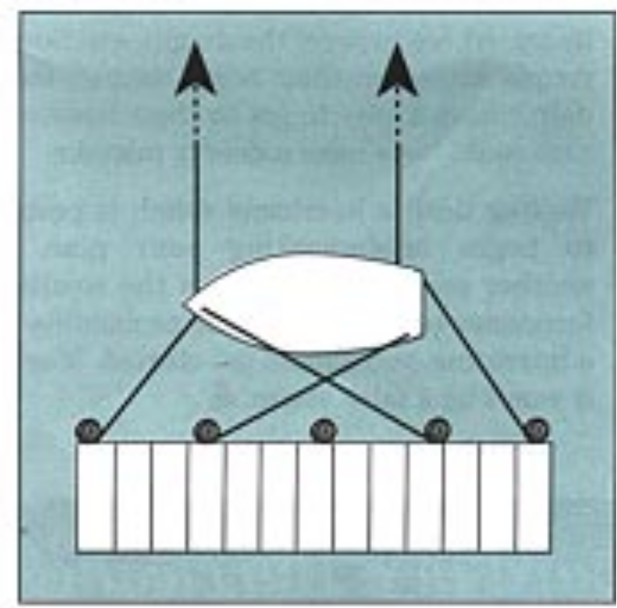
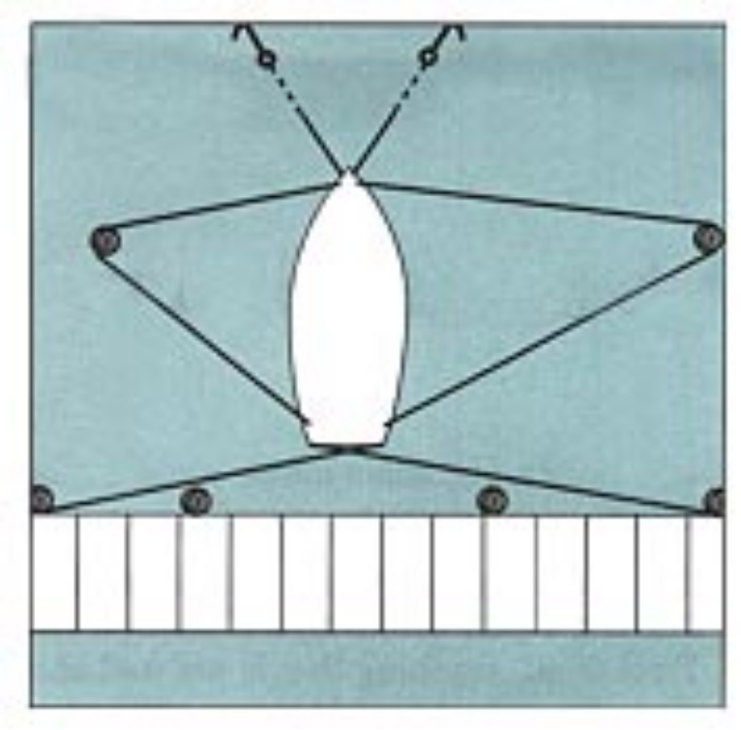
If your boat must remain in the water
Notes:
If you must leave your boat at a dock, you'll need to devise a docking plan that is likely to be far different than your normal docking arrangement. By the time preparations are completed, your boat should resemble a spider suspended in the center of a large web. This web will allow the boat to rise on the surge, be bounced around by the storm, and still remain in position.

Slide 26
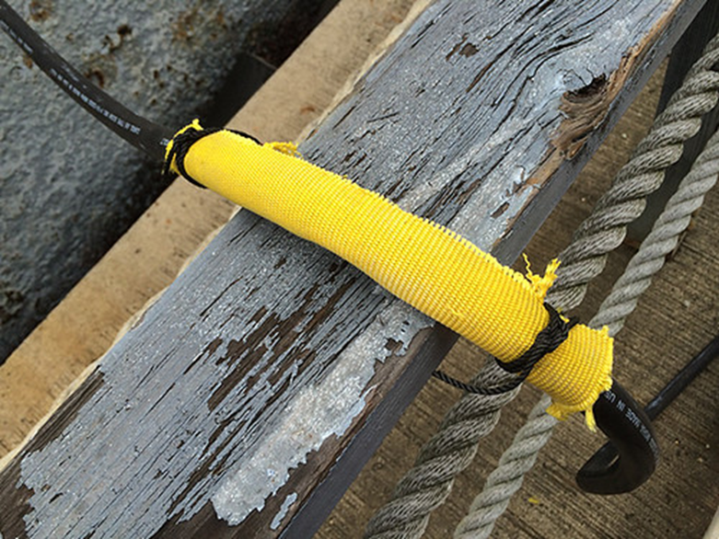
Other Considerations
Use New Dock Lines
Choose lines made of nylon, either two- or three-strand, larger than what you normally use.
Install chafing gear.
Consider:
  Dock lines with a thimble splice, and
  Mooring compensators or snubbers

Slide 27
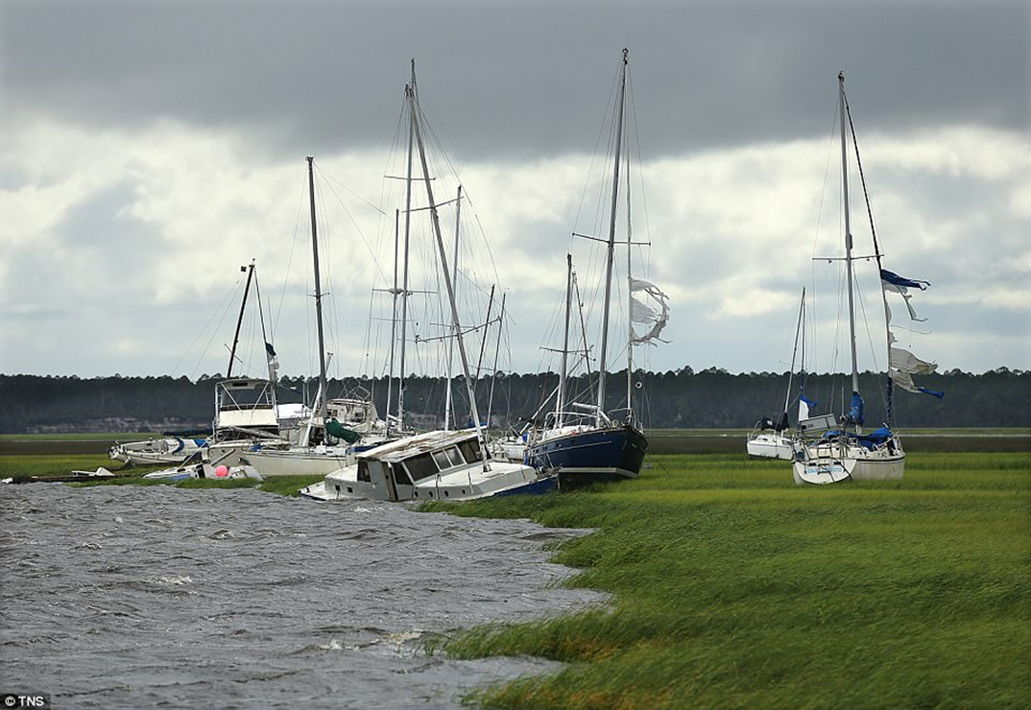
Other Considerations
If you must anchor, find a “hurricane hole.”
  "Hurricane holes" are areas where the water is deep, the bottom is sandy, and boats are protected from wind in most directions.
There will be other boats there.

Slide 28
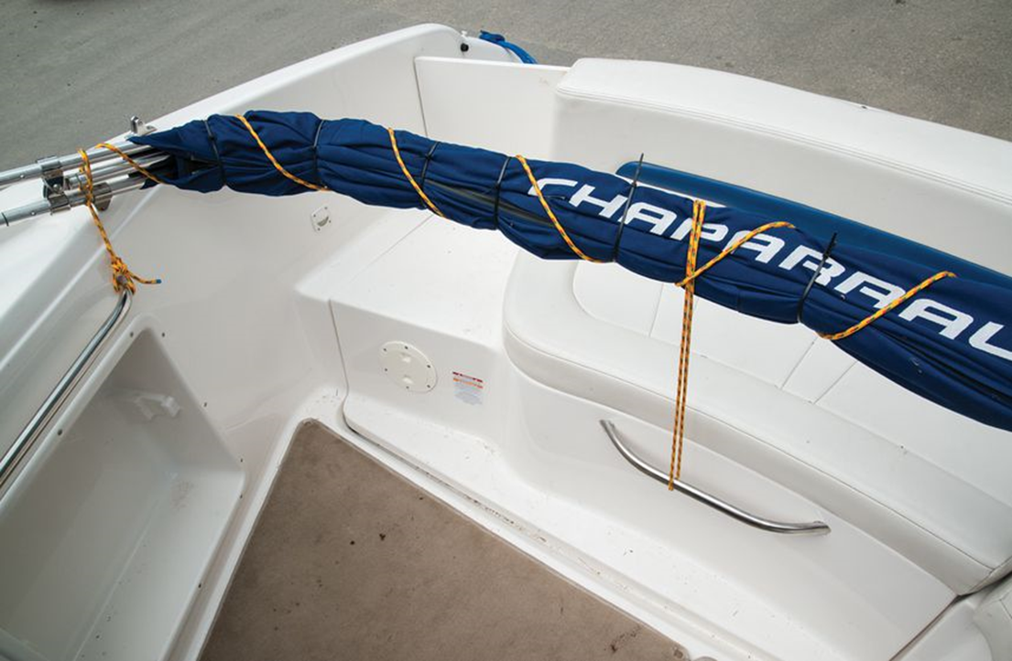
Other Considerations
Reduce windage:
  Sailboats
    Remove dodgers, furling genoa sails, and mainsails.
    Lash halyards.
  Powerboats
    Remove cockpit covers and biminis.
Tape plastic covers over hatches.

Slide 29
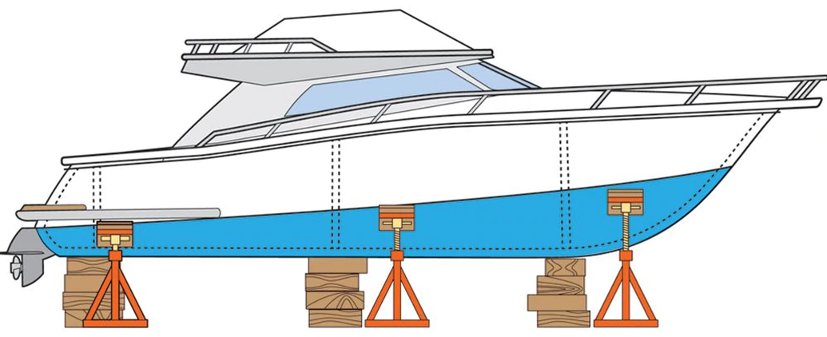
If You Can Store on Land
Coordinate moves with your marina and insurance agent.
Locate jack stands at points along the hull that are reinforced by bulkheads.
  Tie or chain jack stands together.
Notes:
Wooden boats had ribs extending to the keel that acted much like wall studs. In modern, molded fiberglass boats, bulkheads can serve the same purpose.

Slide 30
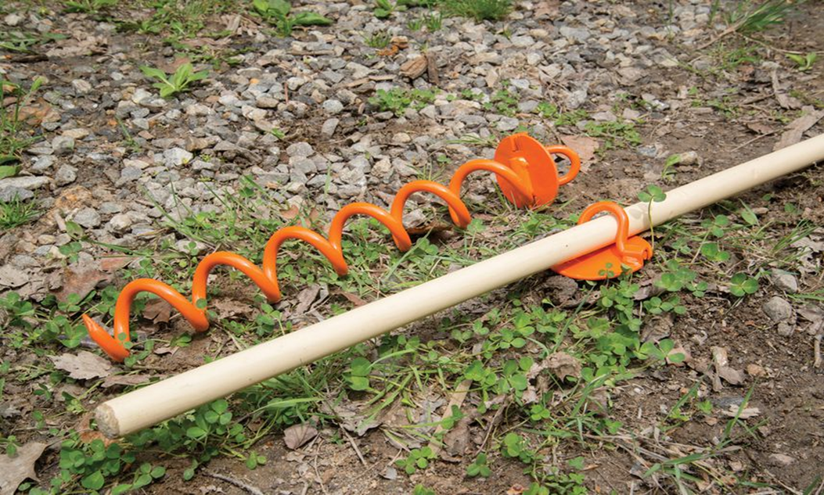
If You Store on a Trailer
If needed, find a safer area.
Be sure your tow vehicle and trailer are capable of moving the boat.
Tie down using blocks or ground augers.
Notes:
Check trailer tires, bearings, and axle long before the storm.
Once at the safe place, insert blocks under the trailer, let out half the air from the tires, and fill the boat 1/3 with water to add weight and help hold it down.
Secure the boat to the trailer and the trailer to screw anchors.
Remember trees are often blown over during a storm.

Slide 31
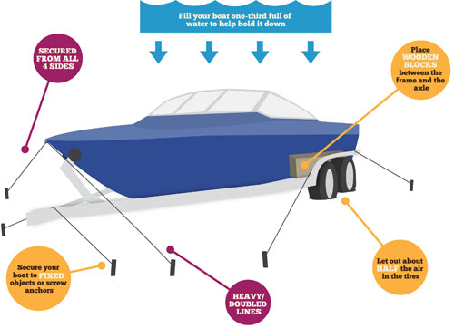
Tying Down a Trailer
Notes:
Pick your best spot for the storm.
Get the boat as close as you can to a strong building — anything to break the wind.
Place blocks beneath the trailer frame on either side of the wheels and then deflate the tires to 1/2. Use auger-type tie-down anchors to secure to the ground. Tie the boat to the trailer, then to those anchors.
Avoid being near trees, power poles, or construction sites that are known to create flying debris.

Slide 32
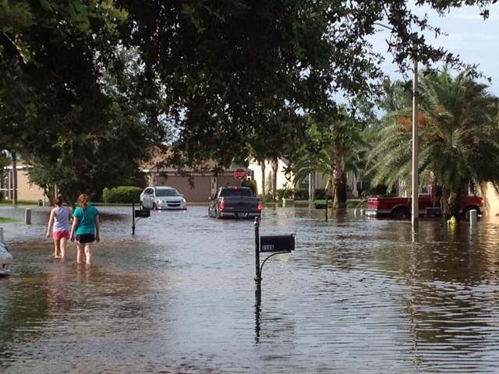
Flash Floods
Heavy rainfall can lead to flash floods:
Alvin, Texas … 43”/24 hrs
Pasco County, FL … 28”/24 hrs

Slide 33
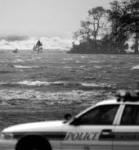
Storm Tides and Storm Surge
Storm Surge
“Dome” of water above a storm tide.
Moves quickly inland
#1 killer in a hurricane
Notes:
Storm surge is a “dome” of water on top of the storm tide that is pushed rapidly towards shore by hurricane wind. This “surge” of water is tremendously powerful, weighing hundreds of tons!
In areas that are predominantly flat, storm surges can move up to 30 miles inland.

Slide 34
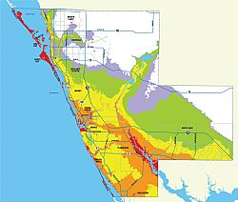
Check the Flood Zones in Your Area
Boats should be stored on high ground above the anticipated surge.
Notes:
Note: Please feel free to use the flood map from your local area if available.

Slide 35
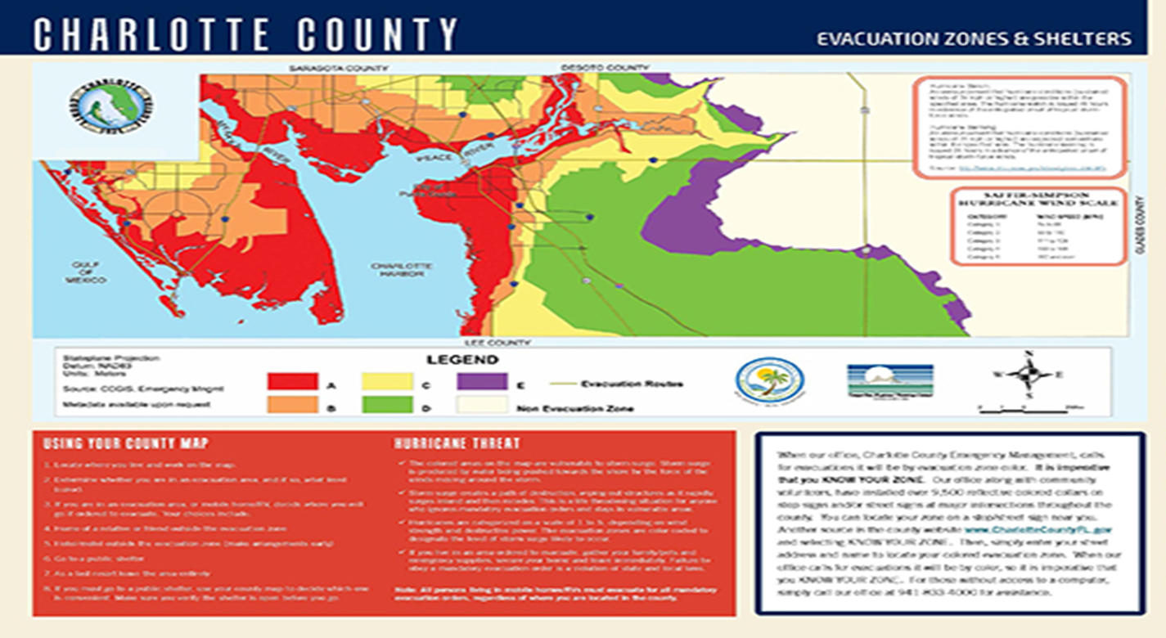
Check the Flood Zones in Your Area
Notes:
Note: Please feel free to use the flood map from your local area if available.

Slide 36
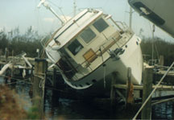
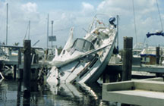
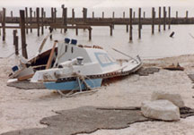
Pre-storm Preparation
A boat is no place to be during a hurricane!
Notes:
You don’t want your boat to look like any of these. And you don’t want to be in them when it happens.

Slide 37
Gather Your Records
The boat insurance policy
Recent photos of your boat/trailer
State registration
Equipment inventory
Documents with your marina/storage operator
Important telephone numbers:
  Insurance agent
  Marina operator/ harbormaster
  Neighbors
  Local law enforcement
  U.S. Coast Guard

Slide 38
Take Time to Read Your Boat’s Important Documents
Your contract with your marina/storage operator
  Some marinas require that you haul your boat in advance of a storm to protect your boat and the marina.
Your boat’s insurance policy
  Your policy may cover some of the cost of hauling or moving your boat prior to a hurricane.
  Call your agent with any questions.

Slide 39
If You Choose to Evacuate
Gather your supplies:
  Clothes, medicine, pets, face masks, snacks, portable radio
  Charge your mobile phone
Know where you are going
Take copies of important documents
Tell neighbors and family where you are going

Slide 40
You’re Caught in a Storm, Now What?

Slide 41
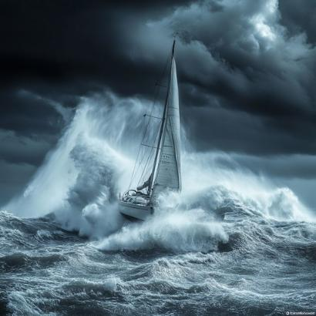
What if you’re caught out in a storm?
At the first sign of heavy weather, seek shelter.
Don’t let passengers remove life jackets.
Keep them low and centered.
Call the USCG on Channel 16 at the first sign of trouble.
Notes:
If your boat swamps, stay with it. Once you’re in the water, lash everyone together. This accomplishes several things: it conserves body heat, keeps track of everyone, and builds morale. If you have enough time before the boat goes down, make sure you grab your “ditch kit” with flares, a life jacket, a portable radio, etc.

Slide 42
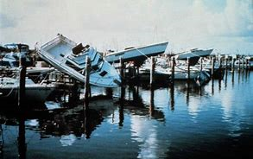
After the Storm, Now What?

Slide 43
After the Storm
Determine if there is damage to the boat as soon as possible:
  Take actions that a prudent person would take to save and preserve your property.
  If repairs can be made, obtain estimates and act quickly to get back on the water.

Slide 44
After the Storm
If you tied up in a canal, be sure to move your boat as soon as possible.
Beware of looters who may be helping themselves.
  If you experience theft, call the police or sheriff to make a report.
  Get a copy of the police report, including the report number, to share with your insurance company.

Slide 45
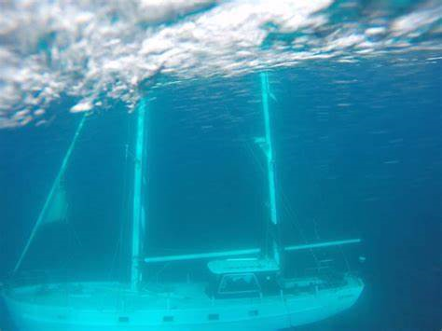
After the Storm
If you fear the vessel is a total loss, consult with your insurance company.
  The boat may have to be moved to a salvage yard’s storage area.

Slide 46
What about after the storm?
Don’t try to board a partially sunken boat; seek salvage assistance.
If the boat is washed inland, do not approach until authorities say it is safe.
Do only what can be done safely and what authorities permit.
Watch out for and report oil, gasoline, or chemical spills to the USCG and local emergency agencies.

Slide 47
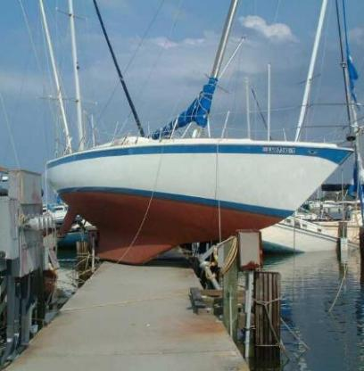
What about after the storm?
Check your state law. In many states, you can’t be kicked out of a marina or storage area.
But you could be responsible for damage caused by your boat.

Slide 48
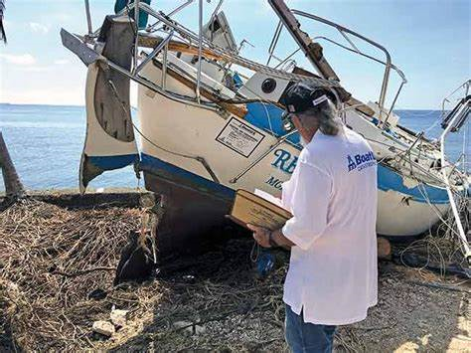
Making an Insurance Claim
Photograph the damage
Undertake only repairs necessary to prevent further damage.
Call your insurance agent:
  Be ready with your information
  A surveyor will be assigned to review the damage.
Notes:
Call your insurance agent.
Be ready with your information
Inventory.
Receipts.
A surveyor will be assigned to review the damage.
The review goes to:
The insurance company, and
You.

Slide 49
Making an Insurance Claim
You will select a repair company.
If you agree to the insurance company’s estimate, a check made out to the repair yard and the owner/mortgagee will be issued.
You have the right and authority to determine what work is to be done to or on your boat.

Slide 50
Making an Insurance Claim
Remember:
  There will be many boat owners with damaged vessels.
  Repair facilities will be busy.
  You will likely have to do the necessary preliminary work to get your boat repaired quickly.

Slide 51
Post-Hurricane Cleanup
Be careful during cleanup: wear gloves and protective clothing
Do not touch electrical equipment if it is wet or you are standing in water
Avoid wading in floodwaters
Save phone calls for emergencies
Document property damage with photographs
Be Safe!

Slide 52
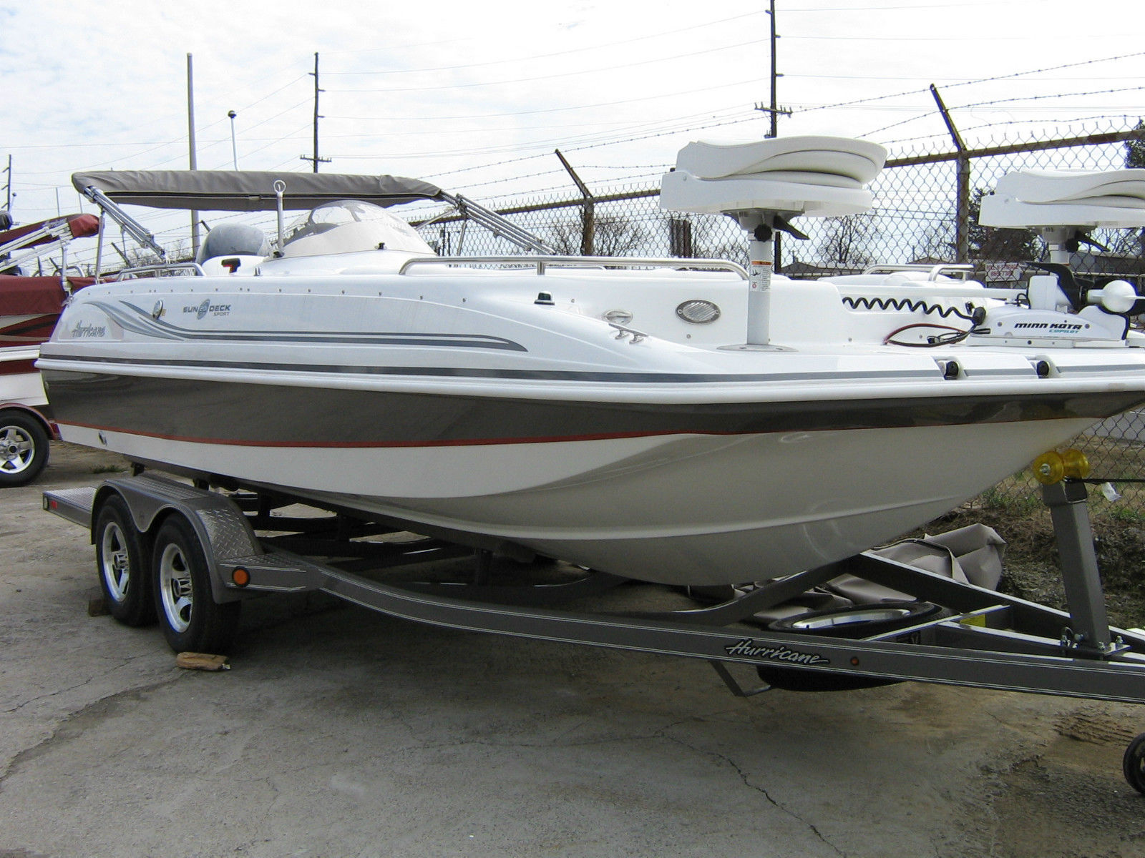
Why Do You Prepare?
What You Want to See After the Storm

Slide 53
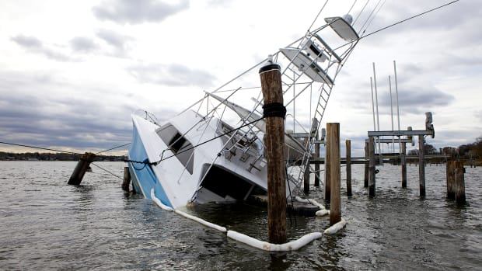
Why Do You Prepare?
What You Don’t Want to See After the Storm

Slide 54
Takeaways
Before heavy weather arrives:
  You need boat insurance.
  Plan for a storm to protect your boat.
Heavy weather is forecast.
  It’s only a boat!
  Save your family and yourself!
  It’s only a boat!
Notes:
Here’s what you need to know
Boat Insurance is a must.
A Plan is a must.
Weather information is a must.

Slide 55
RESOURCES
www.weather.gov/forecastmaps
www.weather.gov/wrn/hurricane-preparedness
https://msc.fema.gov/portal/home
www.nhc.noaa.gov
55

Slide 56
Heavy Weather is Coming
Any questions?
Notes:
Any questions?

