Slide 1
The following is a presentation of the
Public Affairs & Public Education Directorates

Slide 2
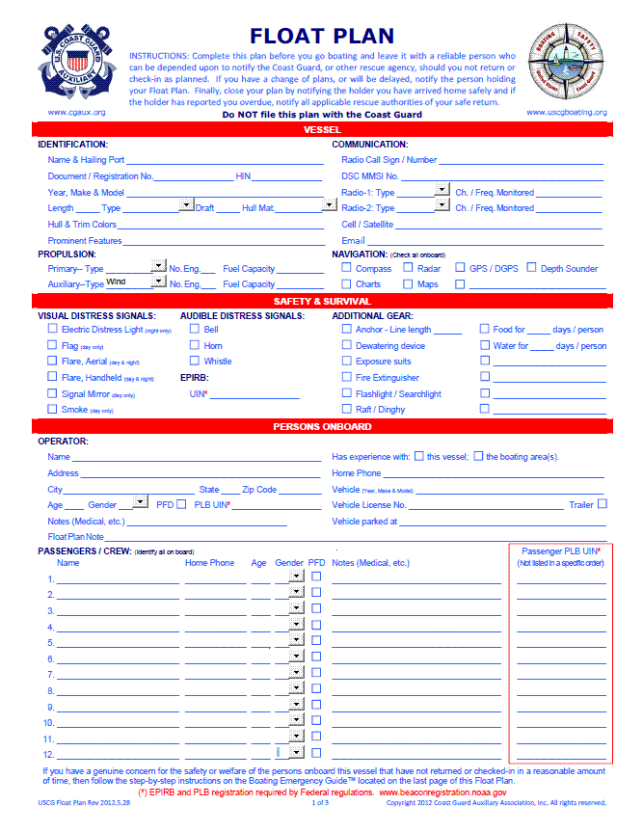
Float Plan
A
Life Saving
Device
Available only from Float Plan Central ™
A public service of the U.S. Coast Guard Auxiliary Public Affairs Directorate
Notes:
Presentation Title: “Float Plan – A Life Saving Device”
Copyright Notice: Copyright 2016 Coast Guard Auxiliary Association, Inc. All rights reserved.
Note: The last slide contains URL to download the float plan.
Credits:
PowerPoint Designer/Developer: Vern Jansky BC-AWP, U.S. Coast Guard Auxiliary, Mar 2014
USCG Float Plan Designer/Developer: Vern Jansky BC-AWP, U.S. Coast Guard Auxiliary, 1991 to present.

Slide 3
Which situation would you rather be in?

Slide 4
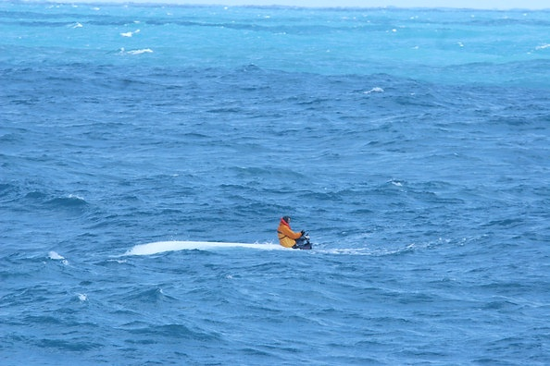
Photo courtesy of U.S. Coast Guard
… alone, with no plan for help?
Notes:
Photo 1 of 2:
Title: “Nick Schuyler waits aboard his overturned boat as the Coast Guard locates him.”
Date: Mar 2nd, 2009
Credit: Coast Guard photo by Fireman Adam Campbell
Note: See slide entitled “The Choice is yours” for full story.

Slide 5
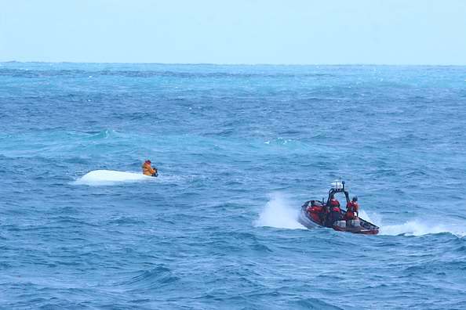
Photo courtesy of U.S. Coast Guard
… or, knowing that help will arrive?
Notes:
Photo 2 of 2:
Title: “A Coast Guard Cutter Tornado small boat rescues Nick Schuyler.”
Date: Mar 2nd, 2009
Credit: Coast Guard photo by Fireman Adam Campbell.
Note: See slide entitled “The Choice is yours” for full story.

Slide 6
The choice is yours:
Photo courtesy of U.S. Coast Guard
Photo courtesy of U.S. Coast Guard
No plan
OR
Float Plan
Notes:
“Coast Guard rescues missing boater off Clearwater”
Mar 2nd, 2009
Miami – Crewmembers from Coast Guard Air Station Clearwater, Fla., and the Coast Guard Cutter Tornado rescue Nick Schuyler from an overturned vessel 35 miles west of Tampa Bay, Fla., Monday, March 2, 2009. Watchstanders at Coast Guard Sector St. Petersburg, Fla., received a call Sunday around 1:30 a.m. reporting that four friends, Schuyler, Victor “Marquis” Cooper, Corey Smith and William Bleakley did not return from their fishing trip.
Coast Guard photos by Fireman Adam Campbell.
References:
Coast Guard photos: http://coastguardnews.com/photo-coast-guard-rescues-missing-boater-off-clearwater/2009/03/02/
Fox News story: http://www.foxnews.com/story/2009/03/04/florida-boat-accident-survivor-2-nfl-players-gave-up-hope/

Slide 7
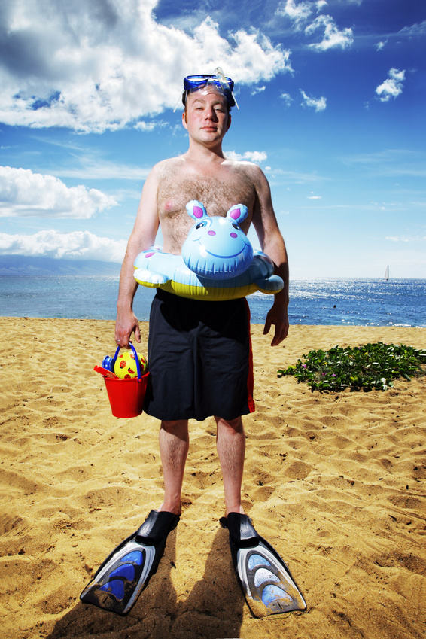
Of course,
there’s always the
“stay ashore” plan.
Photo courtesy of Microsoft
Notes:
Image Credits:
Source: Microsoft Office Image Library
Title: “Man on beach in swim gear.”
URL: http://office.microsoft.com/en-us/images/results.aspx?qu=beach#ai:MP900442474|

Slide 8
Agenda
What is a Float Plan
USCG Float Plan Structure
Creating your Master Copy
Putting your Plan in Action
Computer Requirements
Questions & Answers
Where do you get the USCG Float Plan
Notes:
Agenda
There are 4 slides in the 1st chapter.

Slide 9
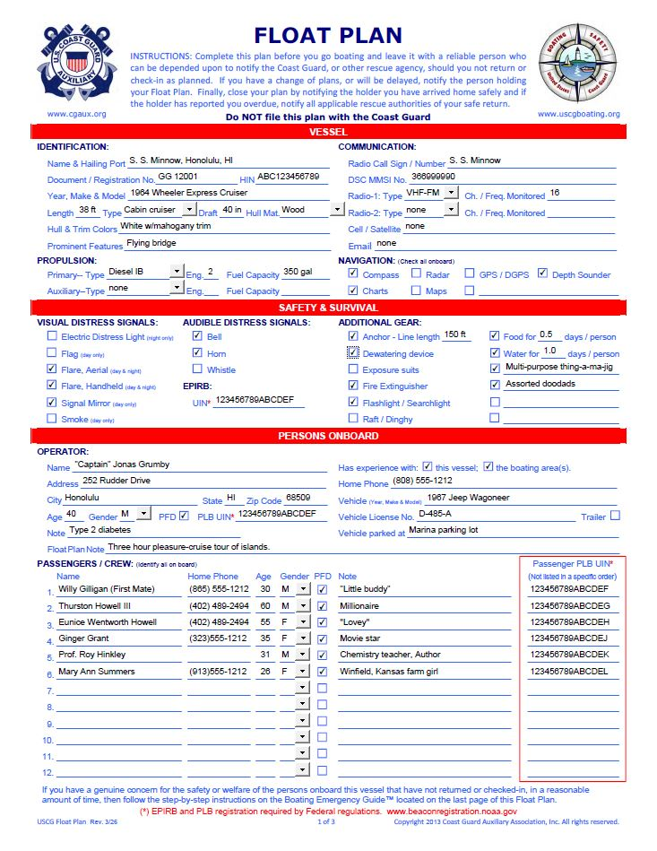
What Is A Float Plan?
A written statement filed with a person on shore – that specifically describes the vessel, equipment, crew, and itinerary of a planned voyage.
Notes:
Official definition of a float plan: A written statement (as by a skipper) of the details of an intended voyage (as of a boat or watercraft) filed with a person on shore; a document that specifically describes the vessel, equipment, crew, and itinerary of a planned voyage.

Slide 10
Why Prepare a Float Plan
Too many critical facts to remember and convey to others.
Assists rescue authorities.
Minimizes Search And Rescue time.
Increases likelihood that you will be found.
Could help in saving your life.
Notes:
Image credits:
Source: Microsoft Office Image Library
Title: “Screen bean character scratching it's head and a question mark.”
URL: http://office.microsoft.com/en-us/images/results.aspx?qu=Screen%20Beans%C2%AE#ai:MC900078711|

Slide 11
Benefits of the USCG Float Plan
Simple State-of-the-art life saving device
Easy to prepare and update.
You can create and save individual plans on your computer or mobile device.
E-mail your plan to anyone you choose.
Tells the person holding your plan exactly what to do if you don’t check-in or return as planned.
The Float Plan is periodically updated to reflect the latest improvements in boating, search and rescue practices as well as technology.
Notes:
Image credit:
Source: Microsoft Office Image Library
Title: “Screen Bean holding skeleton key.”
URL: http://office.microsoft.com/en-us/images/results.aspx?qu=Screen%20Beans%C2%AE#ai:MC900078743|

Slide 12
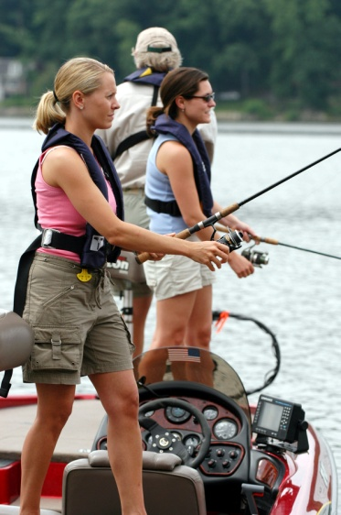
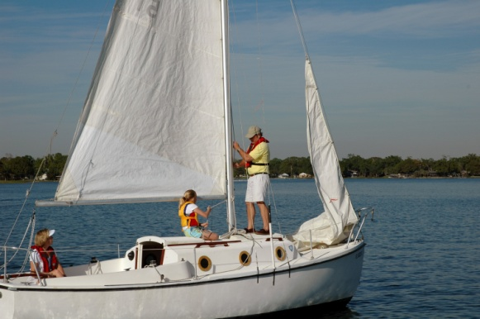
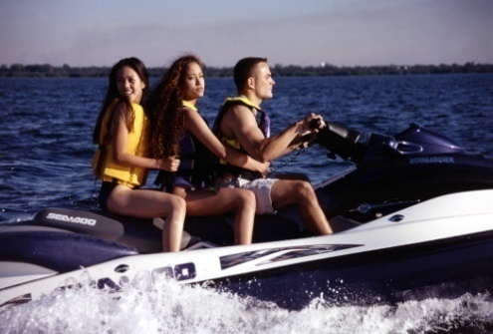
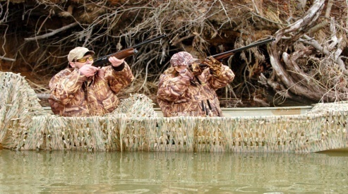
Who should prepare a float plan?
Kayakers
Rafters
Sport Fisher Enthusiasts
Water Skiers
Canoeists
Waterfowl Hunters
Family Day Outings
Jet Skiers
Power Boaters
Rowers
Sail Boaters
Private Charter Boat Services
Notes:
The list above is non-inclusive. You can prompt students for ideas of additional vessel types.
Note: Bullet points will appear automatically one at a time in a timed sequence. Clicking on the slide will stop the sequence and display all bullet points simultaneously.
Image credit:
Source: USCG Boating Safety Resource Center, Image Library
URL: http://www.uscgboating.org/gallery/default.aspx
Photos, from left to right (description & filename):
“Male and female hunters aiming their guns at their targets”, DSC_8188.jpg
“PWC”, GEN-071.jpg
“Adult male and females wearing inflatable life jackets fishing from a powerboat”, DSC_5046.jpg
“Family on sail boat”, 03_05_2_3B_0113.jpg

Slide 13
USCG Float Plan STRUCTURE
Notes:
There are 9 slides in this chapter.

Slide 14
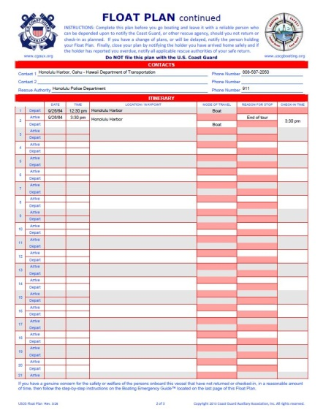
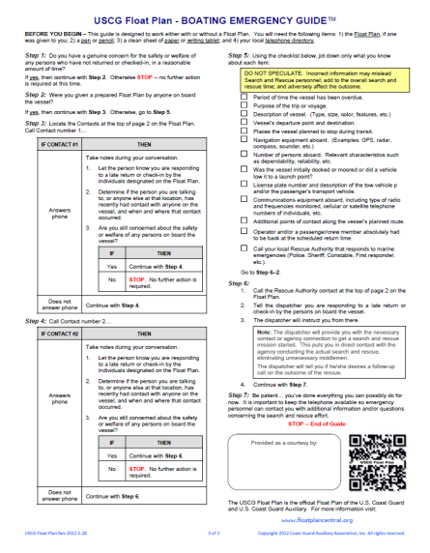
USCG Float Plan Structure
The USCG Float Plan is divided into six major sections:
First Page:
Vessel information
Safety & Survival gear
Persons Onboard
Second Page:
Contacts
Itinerary (Waypoints)
Third Page:
Boating Emergency Guide™
Notes:
All pages of the float plan have this special feature:
Each data entry field contains a pop-up “tip” to guide the preparer on what to enter or select. To display a “tip”, simply hover you mouse pointer over the desired field.

Slide 15
USCG Float Plan Structure
Instructions
Vessel Identification
Communication Equipment
Vessel Propulsion
Navigation Equipment
Distress Signals
Additional Gear
Operator Identification
Additional operator information
Personal Locator Beacon Numbers
Passengers Onboard
Critical notes about passengers onboard
Notes:
This slide displays the various parts of the USCG Float Plan.
Note:
Each of the 12 elements will appear automatically (counter-clockwise) starting at the top left corner in a timed sequence.
If you click on the slide at any time before the sequence is finished, the timed sequence will stop and all elements will be displayed.

Slide 16
USCG Float Plan Structure Vessel
1
This section contains critical details about your vessel and is used to:
Physically identify your vessel.
Determine the ability of your vessel to handle the environmental conditions that have, or will be occurring, based on your itinerary.
Communications equipment you have available.
Determine the likelihood that you will be able to find your way back to shore should you have drifted off course.

Slide 17
USCG Float Plan Structure Safety & Survival
2
Helps rescue personnel further asses the degree of severity of the incident based on:
The likelihood of you being able to signal for help under the prevailing environmental conditions.
Your ability to protect yourself and your crew from the environment.
How long can you survive until help arrives.

Slide 18
USCG Float Plan Structure Persons Onboard
3
Tells rescue authorities about:
The operators familiarity with area and the vessel.
How many people on board (P.O.B.).
Basic identifying characteristics of each person.
Where the vehicle used to transport the vessel and/or passengers is located.
Any personal or medical conditions that may elevate the degree of severity of the incident based on time and prevailing environmental conditions.

Slide 19
USCG Float Plan Structure Contacts
4
Identifies 3 key contacts:
Your initial contact person(s) where you began your voyage.
Your contact person at your destination.
Local rescue authority i.e. Police, Sheriff or other first responder(s) at the point where you began your voyage.
Notes:
The contacts are listed in the general order in which they should be called:
The first Contact is always from the area where you started your voyage.
The second Contact point is a contact at your destination. For example, if you were going to Cape Hatteras, North Carolina from Rochester, New York, the destination contact would be in the Cape Hatteras area. Your destination contact could be a marina operator where you will be mooring, a friends residence, hotel/motel, etc.
Your local “Rescue Authority” is the contact the holder of your float plan will use to start the Search & Rescue (SAR) process, should you fail to check-in or return as planned. This may be the local Police Department, Sheriff, or other first responder.

Slide 20
USCG Float Plan Structure Itinerary
5
Assists rescue personnel in determining where to begin their search, based on:
How long you've been missing since your last Check-In time.
Planned arrival and departure dates and times.
Reason and location of your last planned stop.
Your next destination.
Notes:
“Itinerary” section a.k.a. waypoints (There are 4 bullet points)
About the Itinerary:
The Itinerary section lets you identify each and every stop during your voyage, whether on-shore or off-shore.
There is a maximum of 21 possible locations (or waypoints) available.

Slide 21
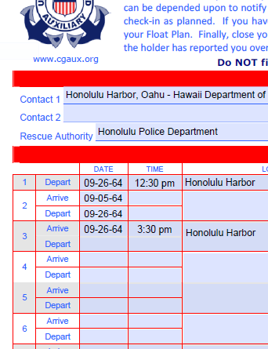
USCG Float Plan Structure Itinerary (continued)
5
The location line numbers aid in:
Communicating any change of plans between you and your Float Plan holder.
Communications between Rescue Authorities and your Float Plan holder.
Line Numbers
Notes:
Location numbers are located along the left-hand side of the “Itinerary” section of the plan, enabling quick and accurate referencing of location information.

Slide 22
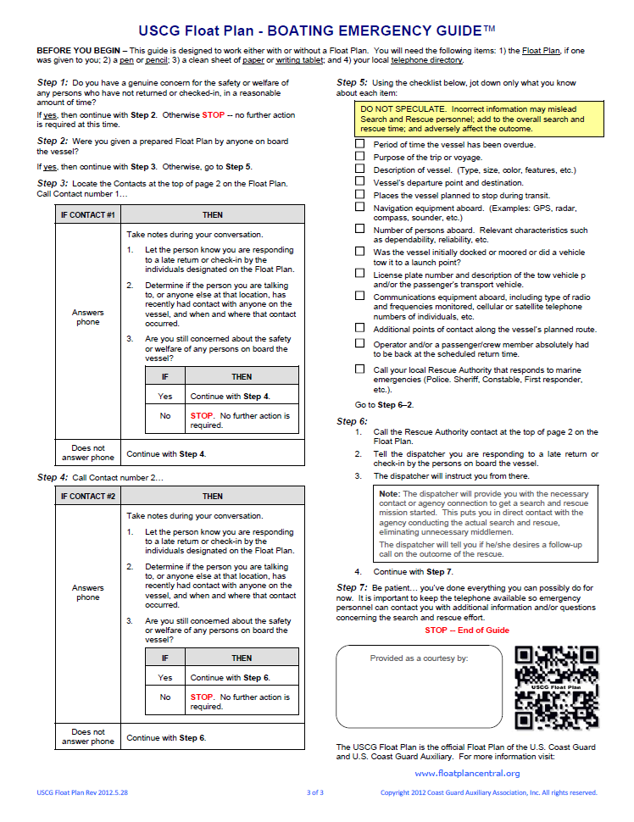
USCG Float Plan Structure Boating Emergency Guide™
6
This exclusive feature is only found in the USCG Float Plan:
No prior boating knowledge is required to use it effectively.
Gives the Float Plan Holder step by step instructions to guide them through:
what to do
when to do it
how to do it
Notes:
This tool is only available with USCG Float Plan.

Slide 23
Creating a master copy
Notes:
There are 3 slides in this chapter.

Slide 24
Creating A Master Copy
To create your master copy, do the following:
Fill out the Vessel information section of the plan.
Fill out your name and address, and tow vehicle information if applicable.
Save your work.
Notes:
Most if not all of the data contained in the “Vessel” section can be completed in advance.
This is basic information about the characteristics of the vessel that rarely, if ever, changes from one voyage to the next.
It also forms the basis of your “master” that you will use to create your future finished plans, saving you time.

Slide 25
Creating A Master Copy
You can name your master copy after the type of vessel you own i.e. Boat, Jetski, Kayak, etc.
For example:
Boat-Floatplan-MASTER.pdf
Jetski-Floatplan-MASTER.pdf
Kayak-Floatplan-MASTER.pdf
Each master serves as a basis to make a copy from, for future voyages, with that specific vessel.
When you replace a vessel, delete the old master and make a new one.
Notes:
When you sell or trade-in your old vessel for a new or different vessel, be certain that you delete all copies including the master copy that you’ve created for the replaced vessel. This ensures that you won’t inadvertently use a float plan for a vessel you no longer have. It’s just good housekeeping!

Slide 26
Types of Float Plans
There are two basic types of Float Plans:
General Purpose - Used for routine outings with the same vessel, for the same activity, at the same location. For example:
Duck Hunting
Fishing
Waterskiing
Family Outings
Trip specific - Used for a one-time outing to a unique location. For example:
Family vacation
Notes:
The USCG float plan can also be used for Canoeing or Kayaking, either individually or as a group.
For an individual:
The individual is identified in the “Operator” section.
The purpose of the canoe or kayak trip is noted in the “Float Plan Note” field.
If there are passengers in the canoe, they are entered in the “Passengers/Crew section” list.
The color of the vessel can be entered in either the “Note” field or in the “Float Plan Note” field.
The route is identified in the “Itinerary”.
For a group:
The group leader is identified in the “Operator” section.
You describe the purpose of the canoe or kayak trip in the “Float Plan Note” field.
Individual members are entered in the “Passengers/Crew section” list.
The color of their vessel is entered in the individual “Note” fields.
The route is identified in the “Itinerary”.

Slide 27
Putting your plan into action
Notes:
There are 6 slides in this chapter.

Slide 28
Putting Your Plan Into Action
1. Preparation
2. Filing
3. Changing
4. Closing
Notes:
The life cycle of a plan.

Slide 29
Putting Your Plan Into Action Step 1 - Preparation
Let’s say you’re going to use your boat.
Open up the Boat-Floatplan-MASTER.pdf master copy. Then:
Identify the “Safety & Survival” equipment and supplies you will be taking on this voyage.
Identify who will be going on the trip with you.
If you have a Personal Locator Beacon (PLB) for each PFD on-board, enter each Beacon’s 15-digit Unique Identification Number (UIN).
Save your completed plan with a new file name relative to the plans purpose or ultimate destination.

Slide 30
Putting Your Plan Into Action Step 2 – Filing Your Plan
Identify and make arrangements with someone you trust who is willing to hold your plan and follow-up, if necessary, while you are gone. This person is referred to as the “Holder”.
Choose a method of communication (text or email) that will work best for the two of you.
Let the Holder know you will contact them:
at your specified check-in times
if there is any change to your itinerary
as soon as you have returned home
E-mail your completed Float Plan to the person
you’ve chosen before you leave home.
Notes:
Item #1:
It is important to notify the person in advance and not just send the Float Plan to them assuming they will read it and act on it. They may have plans you are not aware of and not even be home to respond when necessary.
Explain why you file with a single individual versus multiple individuals:
Filing your float plan with multiple individuals adds an unnecessary degree of complexity for you by having to notify each one of them regarding any changes to you plan and/or closing your plan.
Filing with multiple individuals also increases the likelihood that one of them might get overlooked and needlessly starts a search and rescue as a result.
The person you file with does not necessarily have to live in your sub-division, city or even state. They do, however, need to:
Be dependable
Follow-up if you do not check-in or return as planned
Have a computer
Have the ability to read PDF documents on their computer (i.e. a current version of Adobe Reader installed)
Know how to email an attachment (the Float Plan)
Keep it simple: One plan, one holder. It’s all you need.
Item #2:
Identify the primary method of communication, between the two of you, to be used. Having a secondary method of communication is not a bad idea either.
Item #3:
These three points are important for the Holder to know.
Item #4:
Once you have items 1-3 addressed, you can email the float plan before you leave on your voyage. That is:
If you have to tow the vessel or drive to where it is docked/moored then before you leave the house, since driving to the launch point should also be included in the plan.
If your boat is docked at you home, then of course before you get underway.
Image credit:
Source: Microsoft Office Image Library
Title: None; search keyword is “data entry”
URL: http://office.microsoft.com/en-us/images/business-CM079001906.aspx?qu=computer&ex=1#ai:MC900059725|mt:1|

Slide 31
Putting Your Plan Into Action Step 2 – Filing Your Plan (continued)
A word about Social Media…
Don’t post your float plan on social media sites.
Don’t post changes about your plan on social media sites.
Don’t post your activities or location on social media sites during your trip.
Protect yourself:
Call, e-mail or text changes about your plan only to the person holding your plan.
Create a travel log about your trip after you return home, if that is important to you. Resist posting it on social media.
Notes:
Click to display each of the first 3 bullet points.
Part 1 – After the first three bullet points (and before the burglar appears)
Do an informal survey (show of hands) of how many students in the class post their activities on social media.
Get two or three of those that raised their hands to explain why they like to post their activities on social media and what their comfort level is with doing it.
Part 2 – Click once to display the burglar (before the jail bars appear). Then…
A detailed discussion of social media security is beyond the scope of this seminar. However, as an instructor, you can offer a few statistics/facts to justify the rational behind the first three bullet points.
Study the following “Internet Resources” below to provide justification on why you should be wary of posting your float plan, changes to your float plan, or details about your voyage (including photos) as they occur:
FACT: Over 75% of convicted burglars believe that other burglars are using social media to find targets.
FACT: Facebook's "open graph" search will allow unprecedented levels of targeting for potential thieves of users with open profiles.
FACT: Social media platforms are increasingly showing where the user has posted from by tagging where a post was made with co-ordinates. As of 2014 many cameras and most mobile phones have a built-in GPS receiver that stores the location information in the EXIF header when a picture is taken.
Burglars Using Social Networks to Target People, Report Says.
http://www.eweek.com/c/a/Midmarket/Burglars-Using-Social-Networks-to-Target-People-Report-Says-410597/
Criminals use social media in choosing their victims - Don’t give your specific location or vacation information, police say.
http://www.springfieldnewssun.com/news/news/local/criminals-use-social-media-in-choosing-their-vic-1/nMw59/
Criminal Use of Social Media
http://www.iacpsocialmedia.org/Portals/1/documents/External/NW3CArticle.pdf
Nearly 4 out of 5 of burglars use social networks to find empty homes
http://www.digitaltrends.com/social-media/nearly-4-out-of-5-of-burglars-use-social-networks-to-find-empty-homes/
Click to display the “jail bars”, which display in front of the burglar.
Part 3 – Click to display each of the 2 “Protect yourself” bullet points.
Image credit:
Source: Shutterstock
Title: Burglar
Image ID: 82551844
URL: http://www.shutterstock.com/pic-82551844/stock-photo-robber.html?src=y1w2dEB0QSdsChS-Kphk0g-4-84
Usage: The U.S. Coast Guard has an account with Shutterstock and may use downloaded images in perpetuity; Rodger Santos is the Shutterstock account representative for the U.S. Coast Guard.

Slide 32
Putting Your Plan Into Action Step 3 – Changing Your Plan
Follow these steps:
Use the method of contact you agreed on before you left.
Reference the line number which has been changed.
Identify the specific change or changes.
Line Numbers
Notes:
Some times things just don’t go as planned. The USCG Float Plan makes it easy to communicate those changes to the person holding your float plan using the Itineraries Location “Line Numbers”.
Location numbers are located along the left-hand side of the plan enabling quick and easy reference of location information.
A few possible reasons for a change:
Ending your voyage early
Cancelling a location/stop
Change in a location’s details
Prompt the class for additional reasons a change may need to be made.

Slide 33
Putting Your Plan Into Action Step 4 – Closing Your Plan
A critical part of using a plan is closing the plan.
That is, notifying the person holding your plan that:
You have returned home safely.
It’s OK for them to delete your plan from their computer.
✓
Notes:
Explain what can happen if you fail to close your plan:
Unnecessary deployment of assets & personnel.
May adversely affect the deployment of assets to another Search and Rescue mission elsewhere.

Slide 34
Computer Requirements
Notes:
There is 1 slide in this chapter.

Slide 35
USCG Float Plan Computer Requirements
Adobe Reader version 9.0 or higher
http://get.adobe.com/reader/otherversions/
Computers:
Mac OS
Linux
Windows
Smartphones:
Android
iPhone
Notes:
Only Adobe Reader version 9 (or later) will allow you to Save, Print and Send the data students enter into the USCG Float Plan.
Earlier (older) versions of Adobe Reader are not able to Save or Send data entered into the form. Any data that is entered will be lost once the program is closed. If the students currently have an older version of Adobe Reader, recommend that they download the newest version possible based on the operating system they are currently using. It is a simple process and only takes a few minutes to complete.

Slide 36
Remember…
Notes:
The first of 4 closing slides.

Slide 37
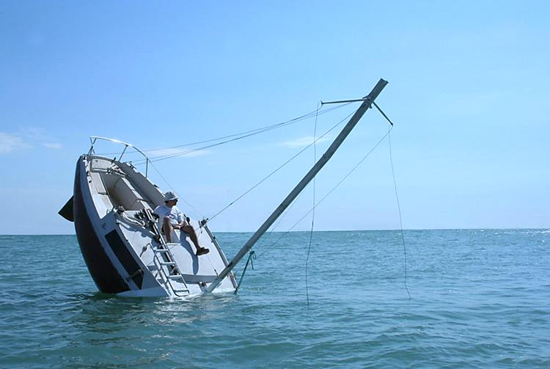
You never know when the unexpected will happen.
Photo courtesy of Julian Berthier
Notes:
Image Credit:
Artist Julien Berthier (www.julienberthier.org) created a boat called “Love Love” that appears as though it is sinking. In fact, it is a fully functioning boat that is driven in this “sinking” position. For a picture of the boat, out of the water, see: http://www.julienberthier.org/Love-love.html.
Permission to use “Love Love” photograph was granted by artist Julien Berthier on 30-SEP-2014 and is on file with the Public Education Directorate.

Slide 38
? ? ?
?
? ?
? ?
? ?
Questions
Page 1
Page 2
Page 3
Notes:
Option: If you want to hand out a copy of the float plan to each student, this is the point in the presentation when you should do it. Allow a few minutes for students to digest the form and then move to answering any questions.
Now:
Answer any final student questions.
Display the next slide.

Slide 39
An official website of the United States Coast Guard Auxiliary
www.FloatPlanCentral.org
No matter what kind of vessel you have, before you leave home, e-mail your Float Plan to someone you can depend on.
Safety is simple,
if you have a plan.
Download your copy today.
Notes:
This is the last Slide:
Remind students that they can always be assured of getting the latest version from the USCG Float Plan by visiting the Float Plan Central website: www.floatplancentral.org
Historical Note:
Some boating websites (webmasters) have physically downloaded a copy of the USCG Float Plan and placed it on heir website, instead of linking directly to the USCG Float Plan on the Float Plan Central website. And more times than not, they neglect to keep this copy it updated. It is not uncommon to for such websites to be two or more versions behind the most current release. Although this practice is less common today than it was a several years ago, some webmasters still do it.
If a students favorite boating website still follows this practice (they can determine this by hovering over the link), they contact the webmaster and request that they link directly to the USCG Float Plan on the Float Plan Central website so their customers are assured of getting the most current version: http://www.floatplancentral.org/download/USCGFloatPlan.pdf. It will save the webmaster the time and labor of having to continually check Float Plan Central to determine whether or not there has been an update. It’s a Win/Win for everyone.
It is important to note that the URL used to download the USCG Float Plan has not changed since the Float Plan Central website went live in 2003.

