Slide 1

How to Navigate the Intent to Teach Form ANSC 7023 Process
Notes:
Many exciting courses are available for flotillas to teach to the boating public—some range in length from one-day to courses designed for eight or more sessions. The key to getting students into our classes is to publicize the availability of these courses. The ANSC 7023 Form places your Public Education schedule on the National Website.
The National Website (www.cgaux.org) is the direct link for most search engines (i.e., Google, Duck Duck Go, Bing, etc.). It is also linked from most states when a potential student searches their local boating safety class options.
The following information leads you, step-by-step, to completing the ANSC 7023 form to get your classes listed. Ideally, the Public Education Officer will enter this information as soon as the class schedule is established for the year or when there is a change to the class offerings.

Slide 2

Finding the 7023 Form
First, go to:
www.cgaux.org
Go to:
  Aux Members drop-down menu
  Select Forms Warehouse
Notes:
The ANSC Form is accessed from the National Coast Guard Auxiliary Forms Warehouse – PDF Forms. To get there, go to www.cgaux.org, see the top menu, and click on the Aux Members tab. When that opens up, select Forms Warehouse.

Slide 3
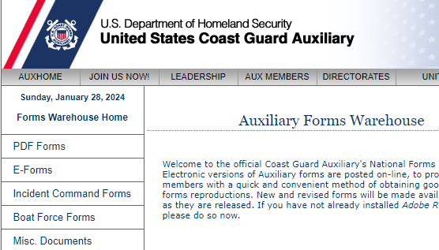
Finding the 7023 Form
Once on the Forms Warehouse page, select PDF Forms

Slide 4
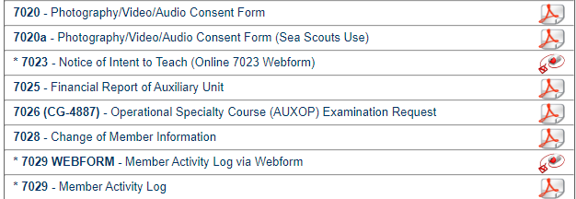
Finding the 7023 Form
Once on the PDF Forms page,
select 7023 – Notice of Intent to Teach (Online 7023 Webform)

Slide 5
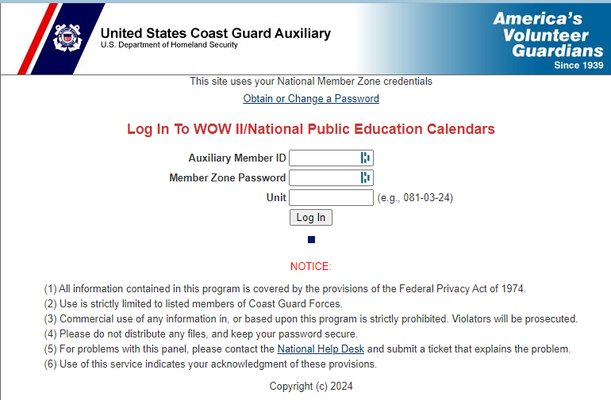
Filling Out the 7023 Form
Clicking on the 7023 Webform brings you to this page

Slide 6
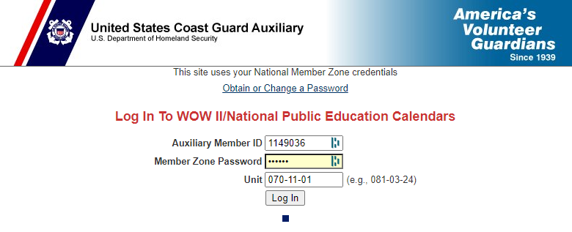
Filling Out the 7023 Form
Enter your member number
Enter your Member Zone Password
Enter your unit in the format shown

Slide 7
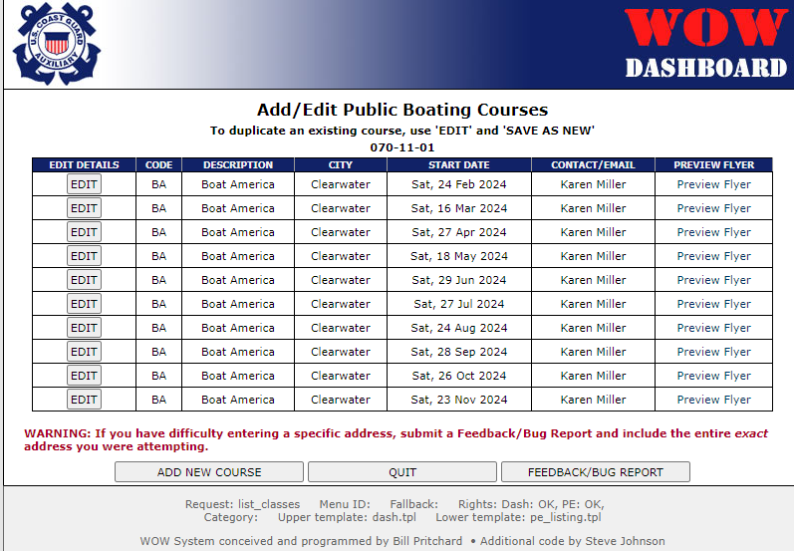
Filling Out the 7023 Form
Once you select Log In, you will see any courses your unit has already entered.
You can edit an existing course or add a new one

Slide 8
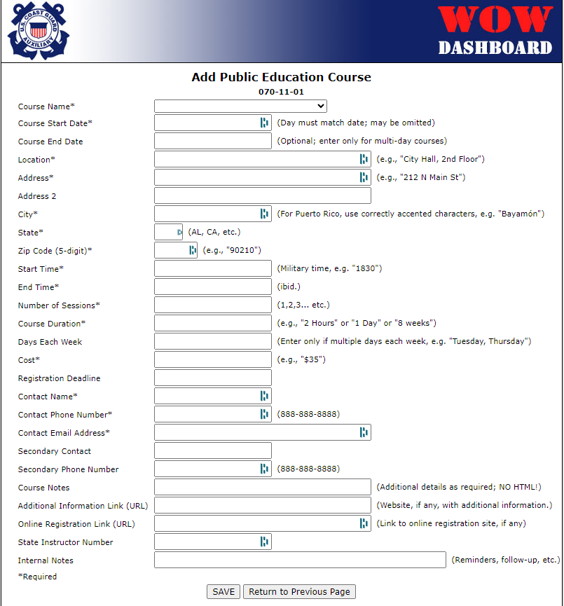
Filling Out the 7023 Form
Once you click on Add a New Course, you will see this screen.

Slide 9
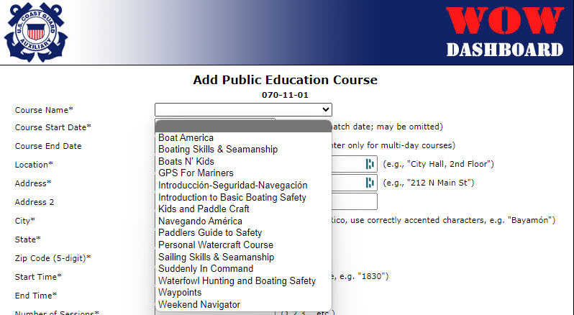
Filling Out the 7023 Form
Pick the course you will be teaching from the drop-down menu

Slide 10
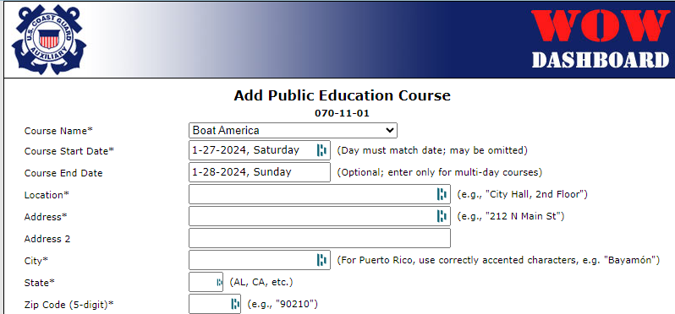
Filling Out the 7023 Form
Enter the start date and end date of the class

Slide 11
Filling Out the 7023 Form
Enter the location of the class
  See the next slide for location options

Slide 12
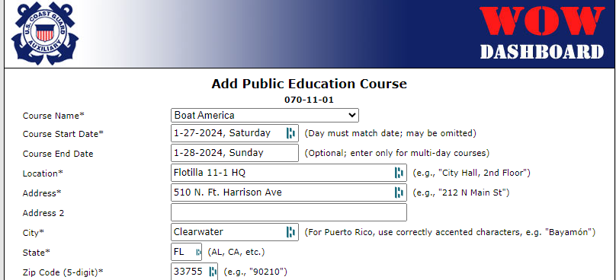
Filling Out the 7023 Form
For in-person classes, complete all the information required (items with an asterisk)
  See the next slide for virtual classes

Slide 13
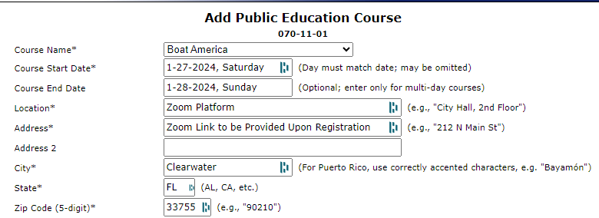
Filling Out the 7023 Form
For virtual classes, complete all the information required (see example)
  City, State, and Zip Code are required for the class finder, and must be filled in

Slide 14
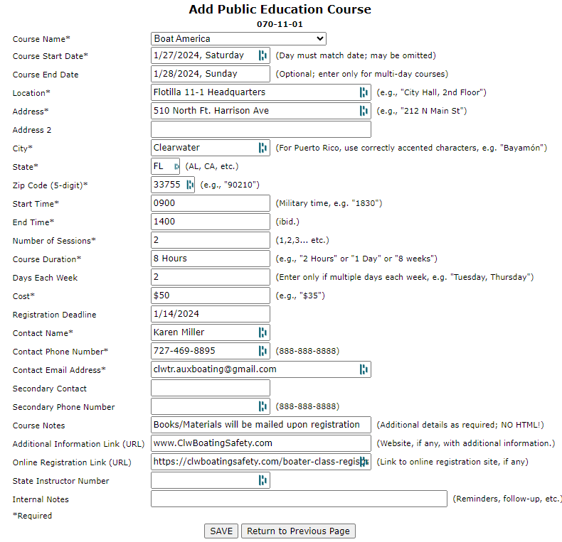
Filling Out the 7023 Form
Complete the rest of the information and click save

Slide 15
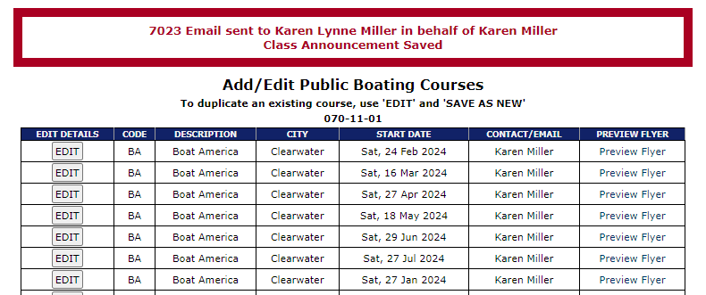
Output from the 7023 Form
Once you click save, your newly entered class will appear on the list, and an email will be sent to you.

Slide 16
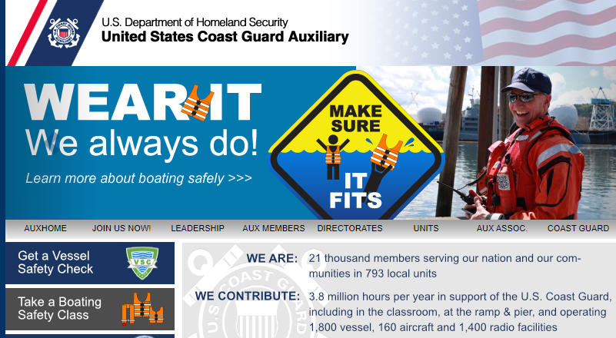
The Results from the 7023 Form
When a potential student goes to www.cgaux.org, they will click on Take a Boating Safety Class

Slide 17
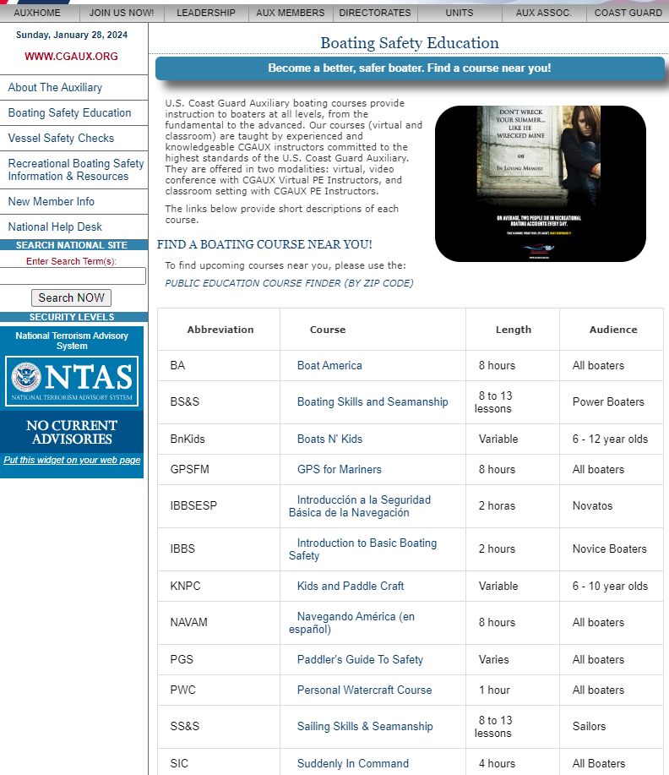
The Results from the 7023 Form
Once they click on Take a Boating Safety Class, they will be taken to this screen

Slide 18
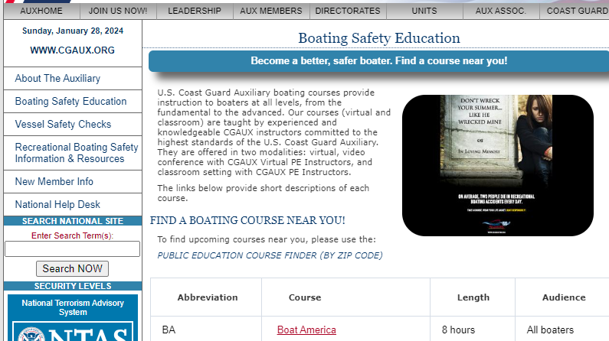
The Results from the 7023 Form
The potential student can learn about each course by clicking on the course link

Slide 19
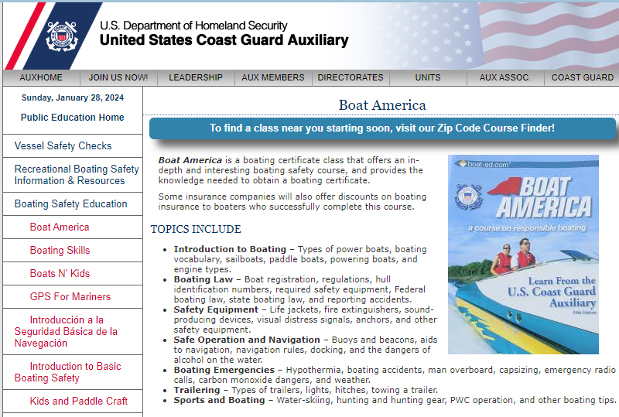
The Results from the 7023 Form
This is the information provided for the Boat America Course

Slide 20
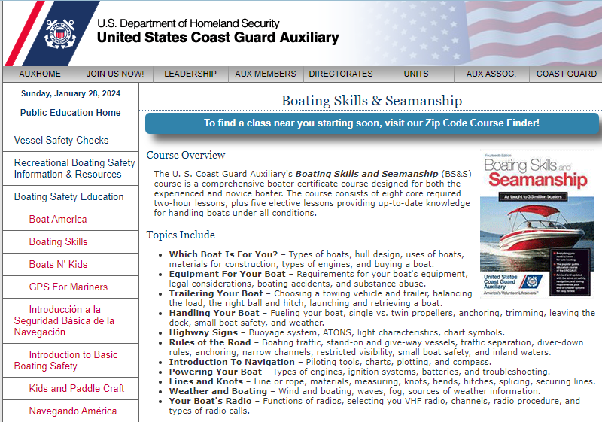
The Results from the 7023 Form
This is the information provided for the Boating Skills and Seamanship Course

Slide 21
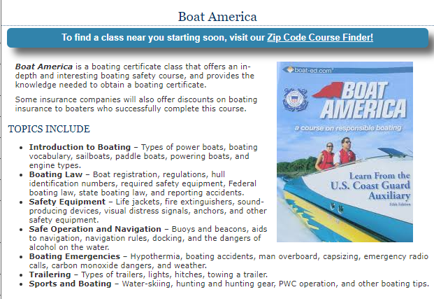
The Results from the 7023 Form
After seeing the course information the potential student can then find a course near them

Slide 22
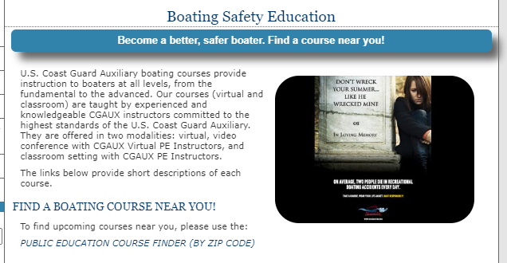
The Results from the 7023 Form
As an alternative, the potential student can find a course nearby by clicking on the course finder

Slide 23
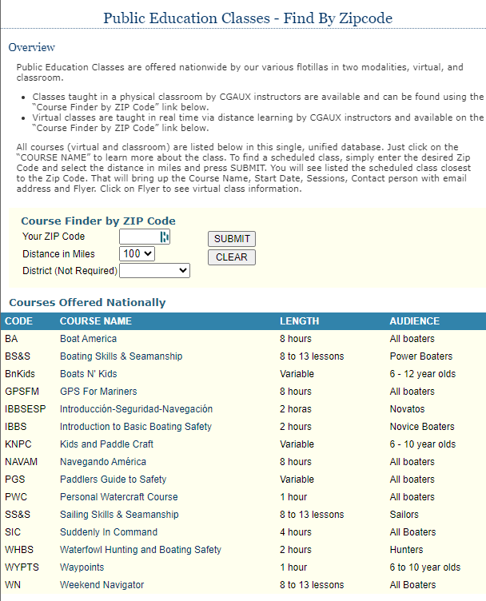
The Results from the 7023 Form
Clicking on either course finder will bring the potential student to this page

Slide 24
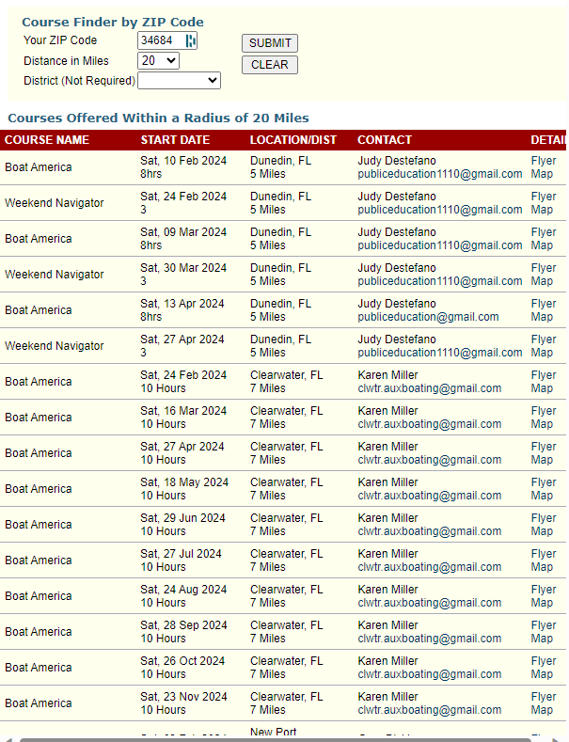
The Results from the 7023 Form
Once the student clicks submit, all classes entered on the 7023 will show with the distance from the zip code entered

Slide 25
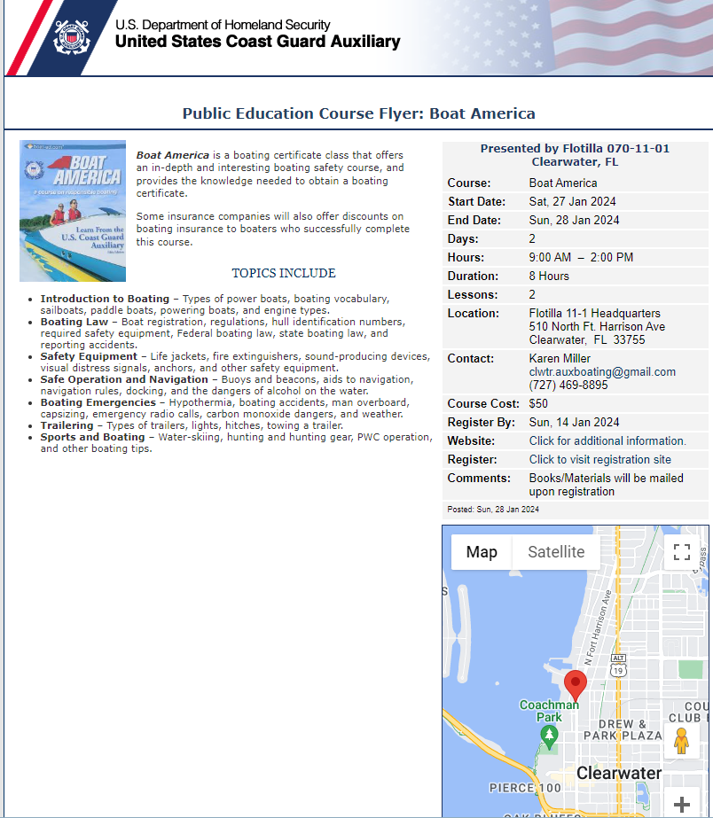
The Results from the 7023 Form
If the student clicks on the Flyer link, they will see this for an in-person class

Slide 26
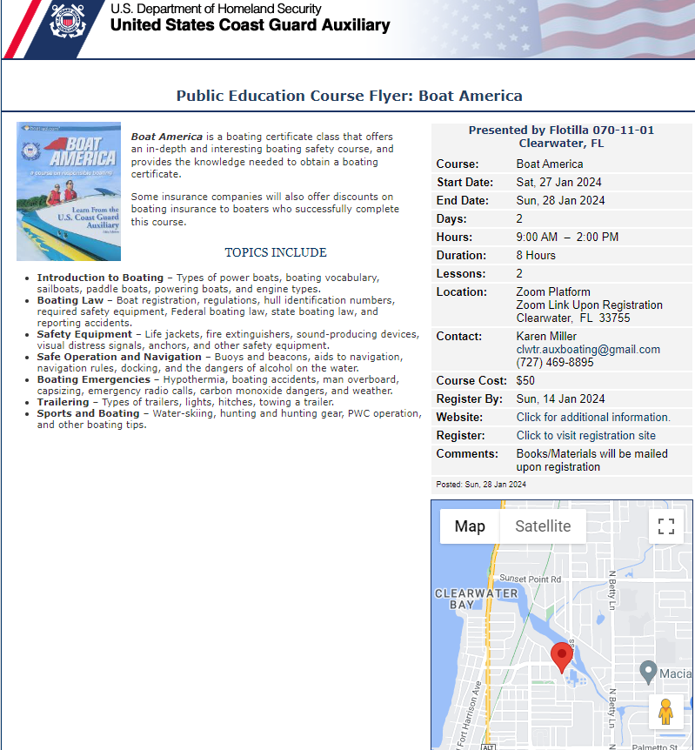
The Results from the 7023 Form
If the student clicks on the Flyer link, they will see this for a virtual class

Slide 27

Thank You
  If you have any questions, contact the appropriate E-Directorate Staff, following the Chain of Leadership and Management
  You may email the E-Directorate at
  pe.feedback@cgauxnet.us
Notes:
It’s the policy of the CG Auxiliary that we solve issues at the lowest level. If the problem, question, or matter cannot be handled at this lower level, follow the Chain and press the issue higher.
All issues should be solved at the lowest possible level and elevated as needed through the chain of leadership and management to address the issue. It is NOT appropriate to go outside our organization for answers to education-related problems unless specifically instructed by the staff of the Education Directorate. Inquiries posed outside our organization confuse our partners and delay a proper response.
The entire staff of the E Directorate is standing by to answer any education questions that cannot be answered at a lower level.
The E-Directorate also maintains a feedback email address to assist members with answers they could not find anywhere else within the Auxiliary.
Members must understand they should not contact the Chief Director’s office or anyone outside the CG Auxiliary Chain of Leadership and Management. Any requests outside the Chain unnecessarily tie up resources answering these questions at BSX, NASBLA, and the BLA offices for internal Auxiliary queries. At the very least, it paints the Auxiliary as undisciplined and unable to communicate internally. At worst, it threatens our credibility at a national level with these national partners, which can have significant ramifications on future relationships.
You may email the E-Directorate at:
pe.feedback@cgauxnet.us

