Slide 1
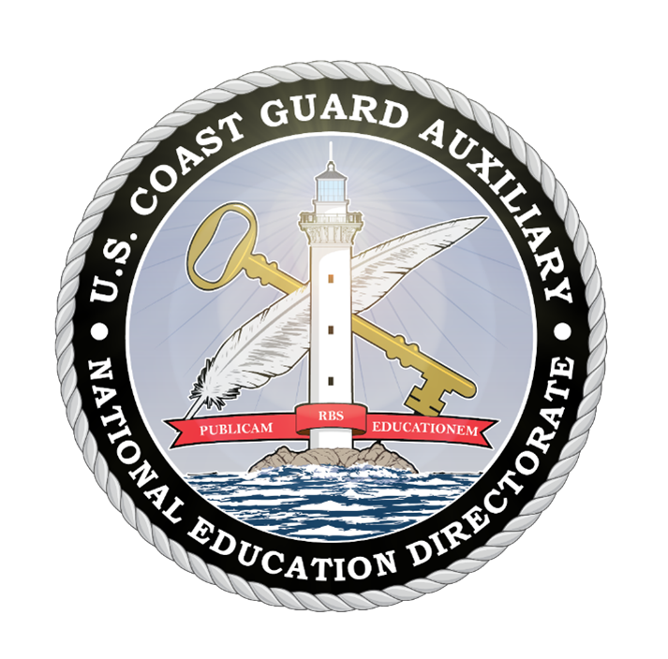
National Public Education Directorate
Instructor Workshop 2024
Notes:
This is the Instructor Workshop for 2024. Members can read the material and submit a self-attestation form, or a qualified facilitator can present the material.
We highly recommend presenting this workshop by a qualified facilitator who has made themselves thoroughly familiar with these extensive instructor notes. The notes are intended to supplement the brief information presented on the slides. A careful reading and understanding of the notes are required to understand the concept and details of the slide. Just reading the slides is not enough. Facilitators should spend sufficient time developing their lesson plans before presenting this material. Everyone will benefit from the proper preparation and delivery of this workshop.
All photos appearing in this workshop were taken by Karen Miller, DVC-EID, during CG Auxiliary missions or found on the Auxiliary Stock Photos and Graphics on Flickr maintained by the Public Affairs Directorate. Miscellaneous graphics are from royalty-free Unsplash.

Slide 2
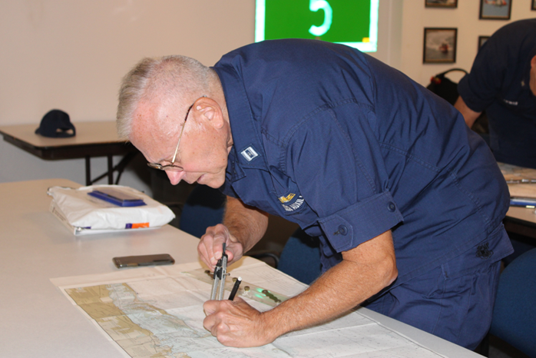
Who Should Take this Workshop?
All members involved in public education
All members involved in member training
All members mentoring new members
All members!
Notes:
Whether we’re instructors in public education or member training, we’re involved with teaching and mentoring.
Furthermore, many flotilla members who are not instructors serve as mentors to new members, assist at classes, do vessel safety checks, and help recruit.
This workshop is for all members!

Slide 3
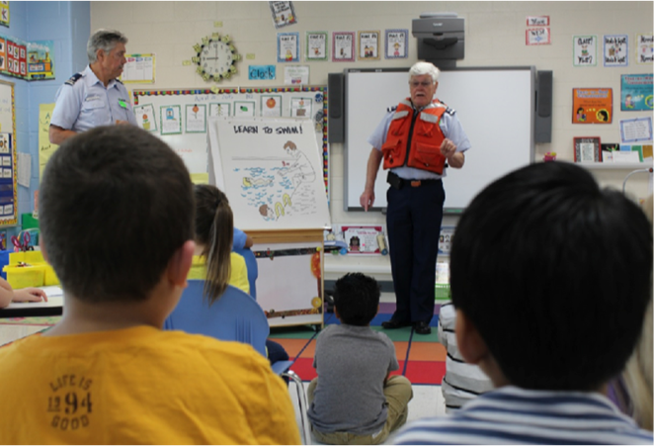
Why an Instructor Workshop?
Public Education (PE) classes are often our first contact with the public
PE classes are a source of new members
Member Training (MT) affects member satisfaction
Notes:
The first impression most people get of us, the Coast Guard Auxiliary, is in a boating class. The members involved in Public Education (PE) are front-line ambassadors.
The ability to present our organization as a team of professionals largely rests on the shoulders of our instructors.
Likewise, once a new member has been recruited and joined a flotilla, the satisfaction they derive from membership is mainly proportional to the quality of the training they receive. Our member training (MT) instructors are also front-line ambassadors.
Our organization’s first impression rests largely on our instructors.
New member satisfaction = the quality of the training received.
The high quality of both PE and MT Instructors results in Recruiting and Retention!
Our members need to understand that our purpose in assembling this workshop is to accomplish two intertwined objectives:
Improve the quality of the instruction delivered to our members and to the public
Update our instructors relative to key issues in Member Training and Public Education

Slide 4
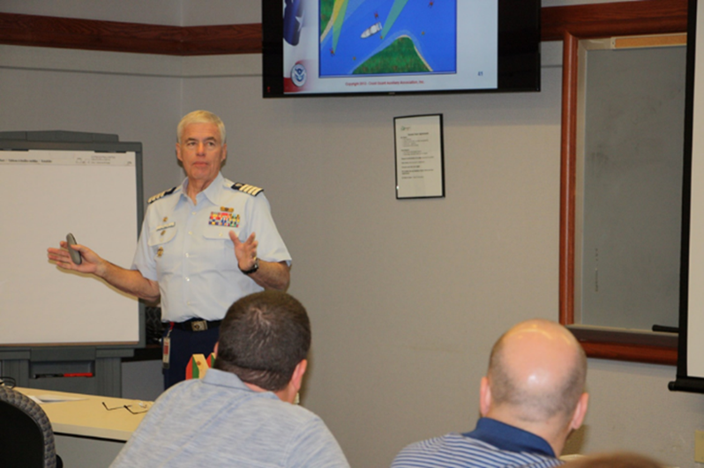
Why an Instructor Workshop?
Professional, quality instructors equal:
  Better recruiting
  Higher retention
Instructors need to practice their craft!
Notes:
The idea that professional quality instructors contribute to better recruiting and higher retention rates revolves around the notion that skilled, knowledgeable, and engaging instructors create a positive and effective learning environment.
The quality of instructors plays a crucial role in shaping the overall learning experience. Organizations that prioritize professional development for instructors and emphasize the importance of high-quality teaching are likely to see benefits in terms of attracting and retaining students and members. This positive cycle of effective teaching, satisfied students, and a strong reputation can lead to long-term success for the Coast Guard Auxiliary.
Groups with professional quality instructors often build a positive reputation. Word-of-mouth from satisfied learners contributes to a favorable perception, making us more attractive to potential students. Skilled instructors are often better equipped to adapt to diverse learning styles and needs. This adaptability is crucial in catering to a broad range of students, making the learning experience more inclusive and effective.
Higher-quality instructors contribute to our long-term success. Students and members with positive learning experiences are more likely to recommend the Coast Guard Auxiliary to others, contributing to a cycle of continued growth and success.
Instructors need to study, train, teach, and practice constantly. While two hours of instruction are all that are required to retain certification, instructors are highly encouraged to go beyond the minimum. Proficiency and effectiveness come with practice – practice teaching students. Consider setting a personal goal of substantially increasing your instructional hours over the previous year.

Slide 5
The Instructor Mindset
I am here to have a two-way conversation with my students
  I am not here to read the material to my students
  I am not here to read the PowerPoint to my students
  I am not here to read the manual to my students
Notes:
The term "instructor's mindset" generally refers to the attitudes, beliefs, and perspectives that instructors bring to their roles in education. It encompasses their approach to teaching, their views on learning, and their overall philosophy of education. The instructor's mindset can significantly impact the learning environment and the effectiveness of their teaching. Here are some key aspects often associated with a positive instructor's mindset:
Student-Centered Approach: A good instructor focuses on the needs and abilities of the students. They understand that each student is unique and may have different learning styles and preferences.
Continuous Learning: An effective instructor embraces a mindset of continuous learning. They are open to new ideas, teaching methods, and technologies. They seek to stay informed about developments in their field and are willing to adapt their teaching strategies accordingly.
Passion for Teaching: Instructors with a positive mindset are passionate about their subject matter and the act of teaching itself. This enthusiasm can be contagious and contribute to a more engaging learning experience for students.
More on the next slide

Slide 6
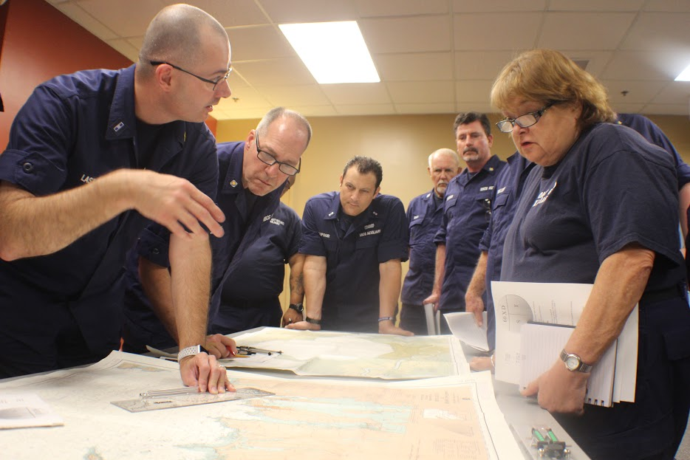
The Instructor Mindset
I am here to look at my students, gauge their reactions, and interact with them in a dialogue about the course
I am here to listen as hard as I can and seek their understanding
Notes:
Flexibility: A good instructor is flexible and adaptable. They can adjust their teaching methods based on the needs of the students, the context of the learning environment, and any unforeseen challenges that may arise.
Empathy and Understanding: The instructor's mindset includes empathy and understanding for their students. They recognize that learners come from diverse backgrounds, may face various challenges, and have different levels of prior knowledge.
Clear Communication: Effective communication is crucial in teaching. Instructors with a positive mindset strive to communicate clearly and ensure that students understand the material. They also encourage open communication and feedback.
High Expectations: A positive instructor's mindset includes setting high expectations for students. This doesn't mean being overly demanding but rather believing in the potential of each student and encouraging them to achieve their best.
Assessment for Learning: Instead of merely focusing on grading, an instructor with a positive mindset sees assessment as a tool for learning. They use assessments to gauge student understanding and tailor their teaching accordingly.
It's important to note that the instructor's mindset can vary among individuals, and different teaching contexts may require different approaches. Effective teaching often involves ongoing reflection and a willingness to refine one's mindset based on experience and feedback.

Slide 7
Key Points
Risk Management
Instructor Responsibility
Instructor Development 2020/2024
Awards
New/Updated AUXDATA II Codes
Embracing Diversity
Marketing PE Classes
Notes:
This workshop is designed to assist all members involved with Public Education and Member Training: Staff Officers for Member Training and Public Education at all levels, Instructors, and their elected officers. The material in this presentation will provide the members with ways to improve class presentations and take advantage of the material on the Public Education Directorate website.
Emphasis will be on the items listed, including:
The role of Risk Management in our classrooms and other learning environments
Responsibility of our Instructors when conducting classes and how to retain members through training.
Instructor Development 2020/2024 – this section will introduce the ID2020 program and the related Performance Qualification Standard (PQS). It will also cover the expected 2024 update.
Awards – The winners of the 2022 Maxim Award were selected and announced at NACON 2023. It’s now time to get the 2023 packages in. There are also two new awards: the Golden Key Award and the Lighthouse Award.
Diversity and accommodations are necessary and consistent with the Commandant and National Commodore’s programs.
Marketing Our Classes – this area will provide concrete suggestions for marketing our PE classes.

Slide 8
Key Points
Boat America and Boating Skills and Seamanship
Spanish Language Classes
How-to for a Public Education Officer
Instructor Currency Maintenance
Recruiting via PE Classes
Retention via MT Classes
What’s New
Notes:
Boat America and Boating Skills and Seamanship (BS&S) – Review of Boat America resources and an update on the recertification of both courses with the National Association of State Boating Law Administrators (NASBLA).
Spanish Language Classes – when reviewing boating accident and fatality statistics, it became apparent that the Hispanic and Latin population was underserved. The E-Directorate has responded with several translations.
How-to for a PE Officer – many Flotilla Staff Officers-Public Education are new to the position. This section will present an overview of resources available on the E-Directorate website.
Recertifying after REYR – if an instructor has gone REYR (Yearly Requirement Not Met), here are instructions on re-certifying.
How to parlay the class participants into members and look at ways to recruit from PE.
The value of member training in retaining members
What’s New – new course on Personal Watercraft (PWCs) and Water ‘n Kids, a complete program for teaching America’s youth about safety in, on, and around the water.

Slide 9
E-Directorate Missions
Provide exceptional boating education to reduce:
  Loss of life
  Personal injury
  Property damage
Provide timely materials to support:
  All Instructors
  Public Education Staff Officers
Notes:
The mission of the Public Education Directorate of the US Coast Guard Auxiliary is two-fold: to provide exceptional boating safety education to the American public to reduce loss of life, personal injury, and property damage to recreational boaters and to deliver the highest possible quality training, resources, and timely materials in support of our flotilla instructors and public education staff officers at every level who are furnishing such boating safety education.
The Public Education Directorate is committed to helping realize those goals by reaching as many people with safe boating information as possible, especially high-risk boaters.
In addition, we have these goals:
Develop and/or maintain up-to-date and effective educational materials;
Continue to focus on the segment of the boating public most at risk;
Increase flotilla-taught basic boating safety education by at least 10% annually;
Provide and promote ongoing quality instructor development;
Make use of appropriate technological resources;
Adopt e-learning as a viable way to reach boaters;
Utilize e-learning to challenge and grow our instructor corps;
Partner with outside organizations where applicable to further boating education;
Continue to team with the experience and expertise of the other National Departments to provide solid programs and course content.

Slide 10
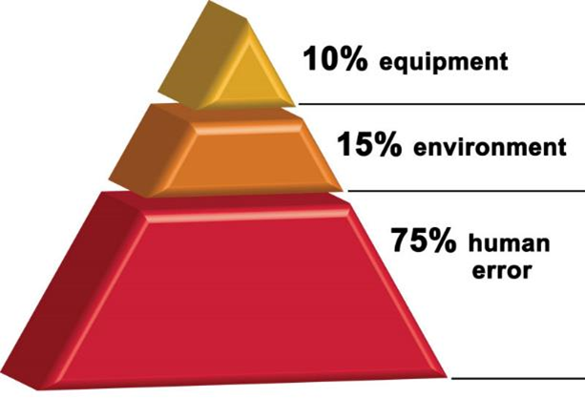
Risk Management
RM integrates human factors that are crucial for safe and effective mission execution:
  Mission analysis
  Leadership
  Adaptability and Flexibility
  Situational Awareness
  Decision-making
  Communication
  Assertiveness
Not just for operations – for all missions
Notes:
Deliberate risk management (RM) is critical to mission performance, safety, and asset preservation. Risk assessments provide the necessary information to plan, brief, execute, and monitor operations. Risk management training is intended to reinforce the principles and concepts of RM and to demonstrate how the information collected during the RM process is used during the critical phases of mission analysis, mission briefing, mission execution, and mission debriefing.
The emphasis is on deliberate RM and not waiting until the mission activity is imminent to begin RM actions. RM is essential to integrate the critical human factors (e.g., mission analysis, leadership, adaptability and flexibility, situational awareness, decision-making, communication, and assertiveness) that are indispensable for safe and effective mission execution.
Most of us think of risk management as related to underway operations. But there is a reason that members must take the Introduction to Risk Management to be certified as Instructors: risk is inherent in everything we do.
Clearly establishing the objective(s) of the mission/activity, identifying potential challenges that can compromise the safety and success of the mission, and discussing controls and mitigations for hazards establish expectations and a common operating picture. This process is critical for preventing common failures associated with human factors (e.g., leadership, adaptability and flexibility, situational awareness, decision-making, communication, and assertiveness). The RM process provides the necessary data for members to leverage the human factors during mission execution. For example, discussing hazards and corresponding controls during the brief will enhance communication, situational awareness, decision-making, and assertiveness since this common mental model is established. Without a common mental model, each member relies on their mental model to decide if/how they communicate, what is relevant for situation awareness, etc. RM is indispensable and directly influences critical human factors.

Slide 11
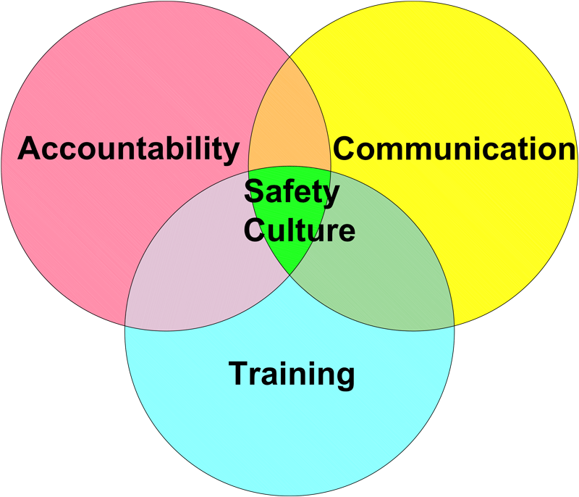
Risk Management
Culture of Safety
  Instructor Qualifications
  Practical Skills
  Interactive Learning
  Continuous Professional Development
Notes:
The culture of safety within the Coast Guard Auxiliary extends to its instructional activities, emphasizing the importance of educating both members and the public on safe maritime practices. We are a safety organization at our roots, and it’s part of our DNA.
Structured Training Programs:
Safety is integrated into various instructional courses, ensuring members receive a thorough education on safe boating practices, navigation, and emergency procedures.
Standardized Curriculum:
The Auxiliary uses standardized curricula for its training courses designed to meet or exceed established safety standards. This consistency helps ensure that all instructors convey essential safety information to students uniformly.
Instructor Qualifications:
Instructors undergo rigorous training and certification processes. This includes expertise in the subject matter, a deep understanding of instructional methods, and a commitment to emphasizing safety throughout their teaching.
Focus on Practical Skills:
Instructional activities often include hands-on, practical exercises that reinforce safety principles. Whether it's demonstrating the proper use of safety equipment or simulating emergency scenarios, the emphasis is on translating knowledge into practical skills.
Interactive Learning:
The instructional culture encourages interactive learning experiences, allowing participants to engage in discussions, ask questions, and share safety-related experiences. This approach fosters a more dynamic and effective learning environment.
Continuous Professional Development:
Instructors within the Coast Guard Auxiliary are encouraged to pursue continuous professional development. This includes staying informed about updates to safety regulations, technological advancements, and best practices in instructional techniques.

Slide 12

Risk Management
Culture of Safety
  Adherence to Regulations
  Safety Demonstrations
  Evaluation and Feedback
  Community Outreach
Notes:
Adherence to Regulations:
Safety instruction aligns with and reinforces relevant maritime regulations and standards. Instructors emphasize the importance of compliance with rules and regulations to ensure the safety of individuals on the water.
Safety Demonstrations:
Instructors utilize safety demonstrations to provide visual and hands-on examples of safety practices. This may include demonstrating the proper use of life jackets, emergency signaling devices, and other safety equipment.
Evaluation and Feedback:
The culture of safety encourages regular evaluation and feedback. Instructors assess the effectiveness of their training sessions and seek input from participants to identify areas for improvement. This feedback loop contributes to ongoing enhancements in safety instruction.
Community Outreach:
Instructors actively engage in community outreach efforts to educate on safe boating practices. This may involve conducting boating safety classes, workshops, and other events to raise awareness and promote a culture of safety beyond the Auxiliary membership.
By integrating safety principles into instruction and fostering a culture that values continuous learning and improvement, the Coast Guard Auxiliary ensures its members are well-equipped to educate others on safe maritime practices.

Slide 13
Risk Management
Culture of Safety
Review the Classroom Safety Checklist on the E-Directorate Website in What’s New
http://edept.cgaux.org/pdf/Classroom%20Safety%20Checklist.pdf
Notes:
Risk management in a classroom setting involves identifying, assessing, and mitigating potential risks to ensure the safety, well-being, and effective students' and instructors' safety, well-being, and effective learning. Here are key considerations for risk management in a classroom:
Physical Safety:
Classroom Layout: Arrange furniture and equipment to minimize physical hazards and allow for easy movement.
Emergency Exits: Ensure clear and accessible emergency exits.
Equipment Safety: Regularly inspect and maintain classroom equipment to prevent accidents.
Health and Wellness:
Hygiene Practices: Promote good hygiene practices to prevent the spread of illnesses. This includes handwashing and proper disposal of tissues.
First Aid: Have a well-stocked first aid kit and ensure that instructors are trained in basic first aid procedures. If an AED is present, the instructor or aide should know how to use it.
Behavioral Management:
Classroom Rules: Clearly communicate and enforce classroom rules to maintain a positive and respectful learning environment.
Conflict Resolution: Equip instructors with skills for effective conflict resolution to address interpersonal issues among students.
Digital Safety:
Device Security: Implement measures to secure digital devices and protect against unauthorized access.
Emergency Preparedness:
Emergency Plans: Develop and regularly review emergency response plans, including procedures for natural disasters and other potential crises.
See the infographic on the E-Directorate website at: http://edept.cgaux.org/pdf/Classroom%20Safety%20Checklist.pdf

Slide 14

“Continuous improvement is better than delayed perfection.”
Mark Twain
Notes:
The quote "Continuous improvement is better than delayed perfection" is often attributed to Mark Twain, although there is some debate about its origin. Regardless of the source, the quote’s meaning is clear and relevant in various contexts.
The quote emphasizes the value of ongoing progress and gradually refining things rather than waiting for a perfect outcome. It suggests that constant, incremental improvements are preferable to striving for absolute perfection, which may result in delays or inaction.
In a practical sense, it encourages individuals and organizations to focus on making consistent strides toward improvement rather than getting bogged down by pursuing an idealized, flawless result. It acknowledges that perfection may be elusive and time-consuming and that the pursuit of continuous improvement allows for adaptability, learning from mistakes, and evolving over time.
This mindset is particularly relevant in the Coast Guard Auxiliary and our instructors, where the emphasis is on learning from experience, making adjustments, and steadily moving forward rather than waiting for an impractical level of perfection that may never be achieved.

Slide 15
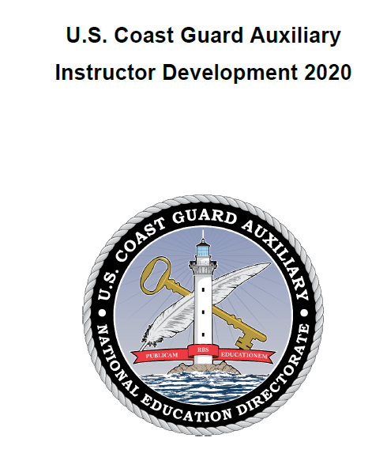
Instructor Responsibility
Self-preparation
Why is this important?
What are some ways to self-prepare?
Continue to educate yourself in areas of interest
Take advantage of our many training courses
Notes:
We must reassess our teaching techniques and lesson plans constantly. Besides using lesson plans for all classes you teach, make sure to update those lesson plans with lessons learned.
Ask other flotilla Instructors to give you a critique of your instruction. Ideally, in a classroom setting, set up a smartphone to record your class instruction. Similarly, in a virtual environment, enable the record function. You will be amazed at how much you can learn about your instructional techniques and easily pinpoint areas that require improvement.
Take advantage of any and all training opportunities that will further your knowledge of the subjects you want to teach or mentor.
To help instructors and would-be instructors get the best training possible, the E-Directorate will be updating the Instructor Development (ID2020) with an ID2024 course that should be available within the first quarter of 2024. All instructors will be encouraged to upgrade their skills by learning the material in this updated version.

Slide 16
Instructor Responsibility
Planning the lesson
Room setup
Classroom hands-on exercises
Discussions
Example: “MOB- what would you do?”
Humor- when and how
Guest speakers or other resources
Paperwork
Notes:
These are essential topics. These apply to both PE and MT classes.
Can everyone in the room see the screen or whiteboard?
The instructor needs to walk around the room while setting up and make sure.
Is the room set up to make facilitation and learning more accessible?
Many feel that “U” shaped table arrangements are better suited for discussions than the traditional “classroom” style of tables in rows. Can the instructor freely circulate around the room and interact with the class?
How can you make the material in the class as close to the participant’s real-life boating experiences as possible?
Use hands-on exercises that get the class involved in doing. Get the class involved through discussion. There is a wealth of experience within every group; a good instructor will realize and capitalize on that.
Humor as an icebreaker works well. Use it tastefully and never at anyone in the class’s expense.
Use other “subject matter experts.” Firefighters, EMTs, Harbor Patrol, Park Rangers, sailing instructors, and others are excellent resources who can bring a depth of knowledge to the session.
You’ve heard the expression, “If it’s not in AUXDATA II, it didn’t happen.” Send the appropriate 7030s to your FSO-IS to record your hard work in MT or PE. Even better, get familiar with AUXDATA II and complete the entries directly yourself. Or follow district or division policy.

Slide 17
Instructor Development (ID2020)
Updated material and exam
Introduced in January 2020
New instruction techniques
Emphasis on learning rather than memorizing
Includes:
  Use of electronic media
  Compliance with ADA
  Value and use of lesson plans
http://wow.uscgaux.info/content.php?unit=E-DEPT&category=2020-instructor-dev
Notes:
This course helps the Auxiliary instructor perfect their presentation skills. It is required for initial qualification and recommended as a refresher for seasoned instructors.
The eight units emphasize learning the information through practical application rather than memorizing theoretical instructor material. It focuses on the latest and most effective methods for teaching, facilitation, multi-media, and demonstration of skills.
The units include:
14 instructor competencies
Lesson planning
Using Media Effectively
Effective Communications Skills
Handling Difficult situations
Accommodating all students
Learning with Electronic Technologies
There are also several appendices:
Instructional equipment
Presentation tips and best practices
The performance qualification standard
We recommend that even seasoned instructors review the ID2020 Student Study Guide and then go to NTC and take the new exam. There’s a lot to be learned this way. The new instructor qualification course is based on demonstrating skills in instructing. This will allow the instructor candidate ample time with a mentor to develop their skills.
The focus of ID2020 is facilitating an effective learning environment. Mentor instructors will have check sheets of tasks the trainee needs to accomplish. Both mentor and trainee will benefit from the course and the time spent practicing the art of teaching.
Access the ID2020 material at:
http://wow.uscgaux.info/content.php?unit=E-DEPT&category=2020-instructor-dev

Slide 18
Instructor Development (ID2024)
Scheduled for First Quarter 2024
Updated based on:
  Experience teaching ID2020 in numerous MT classes
  Lessons learned – what worked and what could use improvement
Will employ concrete examples and sample questions
Supporting material will be updated – instructor notes and slide deck
Notes:
With a view toward continuous improvement and the value of lessons learned, the E-Directorate will update ID2020 in the first quarter of 2024 to ID2020.
The emphasis of the course will still be on the practical aspects of Auxiliary instruction. But the material will be supplemented with concrete examples, sample questions to use in a classroom, and more information on virtual classrooms using platforms like Zoom, Webex, and Teams.
ID2024 will build on ID2020 and will take advantage of four years of use that trained many new Auxiliary instructors.

Slide 19
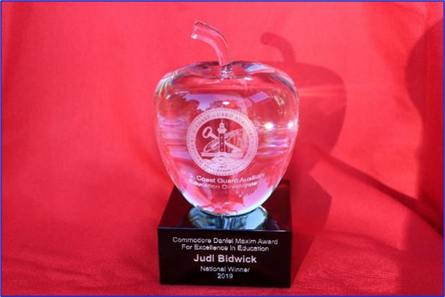
Awards
Maxim Award is intended to motivate instructors:
  To achieve excellence in instruction
  Develop innovative methods and training aids
  Increase mentorship
  Nominated by flotilla no later than February 28th
Notes:
The Commodore Daniel Maxim Award for Excellence in Education was established to motivate and inspire the entire Instructor cadre to reach beyond the comfortable or ordinary to achieve the extraordinary. Some of the goals of the Award are to increase the diversity of courses offered by flotillas and additional numbers of classes offered; to improve Public Education and Member Training Instructor effectiveness and performance; to improve mentorship of newer or lesser experienced Instructors; to develop new and innovative teaching methods and techniques; to develop new and innovative teaching aids.
Visit the E-Directorate website for examples of past winners’ submission packages and award templates for division and flotilla candidates. A best practice that has been suggested is that a flotilla compile a list of their best candidate(s) with bullet points of their assets as instructors. Work with the DSO-PE to see about fleshing out the package for actual development into an award submission.
The Commodore Daniel Maxim Award for Excellence in Education material is found at:
http://wow.uscgaux.info/content.php?unit=E-DEPT&category=maxim-award
Flotillas should consider assembling a team now to begin accumulating supporting documentation for the number of courses taught, the number of graduates, the variety of courses taught, and all other data and testimonials deemed pertinent to preparing the nominee package. Flotilla nomination packages will be due to their DSO-PE on February 28.
NOTE: Schedule
Package from flotillas to DSO-PE: 28Feb.
The district selected package to Dir-E and Dir-Ed: 30 Apr.
NOTE: Eligibility
All instructors in the CG Auxiliary are eligible if nominated for the Maxim Award except a prior National Prize Winner or a member of the Public Education Directorate.

Slide 20
Awards
Golden Key and Lighthouse
Designed to reward instructors:
  Instructing 50-99 lead hours in a year – Golden Key Award
  Instructing 100 or more lead hours in a year – Lighthouse Award
Recognizes our instructors who go over and above – our superstars
Notes:
The E-Directorate has created two additional award certificates to recognize your hard work and dedication to teaching. These new certificates acknowledge the sheer number of instruction hours that instructors have logged in a single year. The current Auxiliary Annual PE Service Performance ribbon recognizes those who have completed 30 hours of instruction. But we all know that there are some instructors out there who go way beyond that mark. Those instructors will be rewarded with the prestigious E-Directorate Golden Key Award for any combination of 50 lead hours of Public Education and/or Member Training instruction!
For those truly exceptional instructors who have gone the extra mile, there's the illustrious E-Directorate Lighthouse Award. This award is reserved for instructors who have put in an incredible combination of 100 PE and/or MT lead hours. It's an achievement that shines like a beacon in the night, guiding others toward excellence.
If you're an instructor who's been working tirelessly, pushing yourself to new heights, then these awards are for you. These awards let the world know that you're a true superstar in the field of teaching and that your dedication and hard work have not gone unnoticed. This is a marvelous opportunity to be recognized for your extraordinary commitment to education. If you're ready to shine bright like a lighthouse or unlock the golden door to success, start putting in those lead hours and let the Education Directorate reward you for your hard work and dedication!
Whether you're striving for the Golden Key or the Lighthouse Award, you know you're part of an elite group of instructors who are making a real difference in the world. Get ready to shine because the Education Directorate has just turned up the excitement factor to 11!

Slide 21
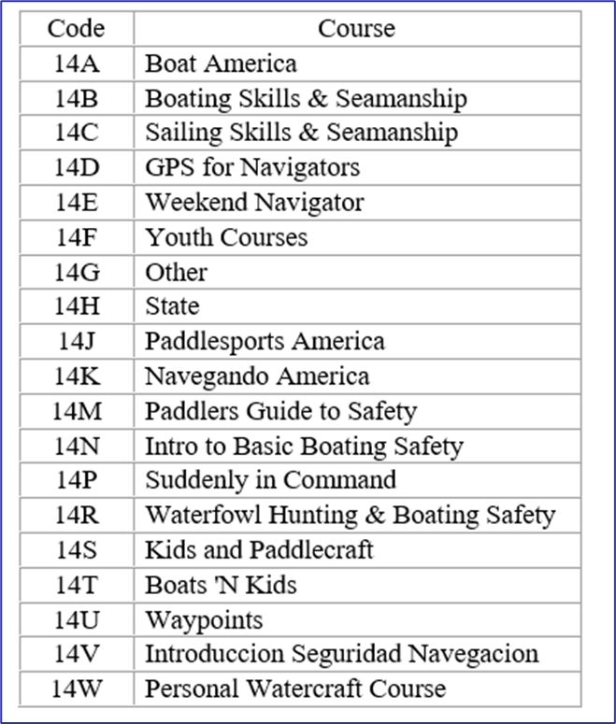
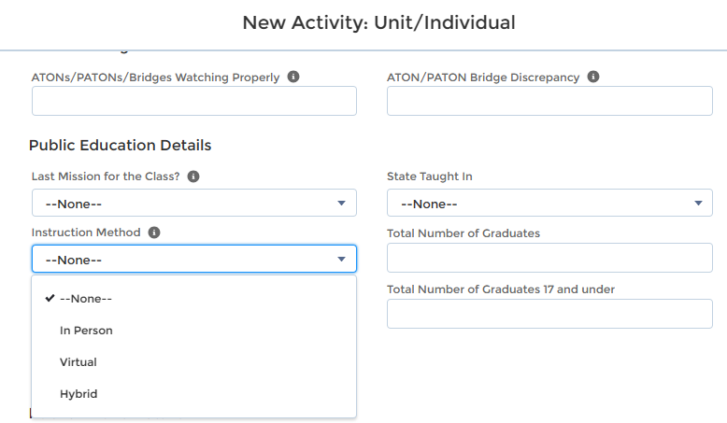
New AUXDATA II Codes
AUXDATA II Public Education Codes Updated
Additional courses added
Checkbox for in-person, virtual, or hybrid classes
Notes:
The following mission activity code descriptions have been updated to clarify the reporting of efforts related to the Auxiliary Public Education mission:
14A Boat America
14B Boating Skills & Seamanship
14C Sailing Skills & Seamanship
14D GPS for Navigators
14E Weekend Navigator
14F Youth Courses
14G Other
14H State
14J Paddlesports America
14K Navegando America
14M Paddlers Guide to Safety
14N Intro to Basic Boating Safety
14P Suddenly in Command
14R Waterfowl Hunting & Boating Safety
14S Kids and Paddlecraft
14T Boats 'N Kids
14U Waypoints
14V Introduccion Seguridad Navegacion
14W Personal Watercraft Course
There is now a drop-down box to indicate if the class is in-person, virtual, or hybrid. This was implemented to help the E-Directorate provide valid data in various reports to support requests from multiple agencies.

Slide 22

Embracing Diversity
Top Issue for Commandant
and National Commodore
  Welcome students to classes, regardless of differences
  Provide for students’
  disabilities in classes
  Watch your language
Notes:
Coast Guard Commandant Linda Fagan pledges to seek diversity in ranks. She says, “The heartbeat of our Coast Guard is our workforce.“ She added, "I am particularly concerned that diversity decreases with rank, leaving little opportunity for women and minorities at the top." Admiral Linda Fagan pledged the Coast Guard will re-double its efforts to be more inclusive. “The reason it’s critical is because diverse work teams outperform homogenous teams. They’re just stronger, more resilient, have better perspective and deeper strength of thought.”
National Commodore Gus Formato states, “As someone who is committed to diversity and inclusion, I understand that providing training is one of the strategies that help to build an inclusive environment, which is crucial to attracting and retaining top talent, building member engagement, and fostering creativity and innovation.” He adds, “The diversity of thoughts, ideas, and competencies of our people keeps the Auxiliary strong and empowers us to achieve mission readiness and excellence.”
Many people face physical challenges that leave them with permanent special needs. When our courses are open to the general public, people with special learning needs may require reasonable accommodations. Some students in the courses may face various types of physical challenges.
The Americans with Disabilities Act of 1990, as Amended by the ADA Amendments Act of 2008 (ADA), specifies certain requirements for public events, including Coast Guard Auxiliary courses. It mandates, for example, full access to public facilities. In addition, accommodations for students with special needs must be made in class and when administering examinations. When planning an educational experience, physical access to the site is one of the first, but not the only, considerations that must be considered. Some people cannot climb stairs, walk even short distances, sit in the chairs provided, or be in a wheelchair. As for the classroom, some people have hearing problems, while others face visual challenges such as difficulty in seeing or color blindness. Every instructor must anticipate and provide reasonable ways to deal with these possibilities.
Instructors need to remember to keep their language gender-neutral. Not all coxswains or captains are men. Not all Culinary Assistants are women. Flotilla Commanders may be of any gender. It is generally acceptable to use they and their instead of she/he or his/her. This recognition of what we say will keep us from offending students in our classes – member training or public education.

Slide 23
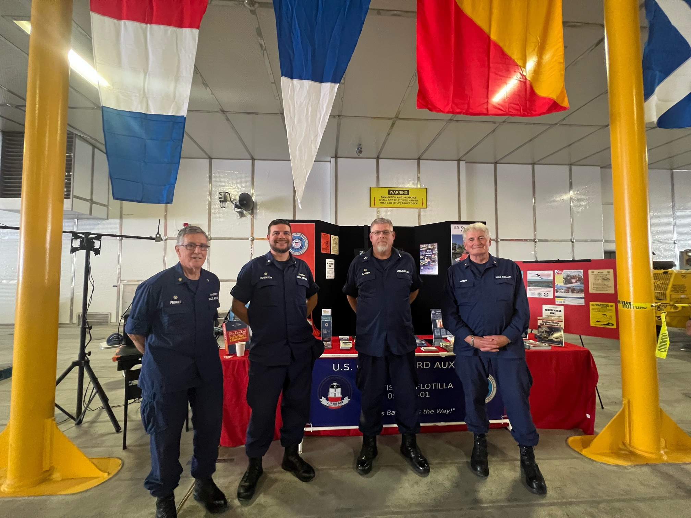
Marketing Public Education Classes
  During VSCs and RBS Program Visits
  Conduct a media blitz
  Tell the world - use the Web and Social Media
  Talk it up!
  Sign them up at boat shows
Notes:
During Vessel Safety Checks (VSCs) and Recreational Boating Safety (RBS) Program Visits:
Go with the Vessel Examiner (VE) or Program Visitor (PV) or provide schedules.
Conduct a media blitz:
The Flotilla Staff Officer-Public Affairs (FSO-PA) can help.
Tell the world - use the Web:
Post your schedule on your website and keep it current.
Social Media presence
Fill out the 7023 form for all courses offered
Talk it up:
Tell everyone you meet.
Sign them up at boat shows:
Don’t just hand out schedules; sign them up on the spot! Use your laptop to key their information while they wait!
Collect course fees and give receipts.
Consider a raffle for a free PE class.
More people will enter their names.
Use as contacts later for classes.
When promoting PE classes, making the registration and course payment as frictionless and seamless as possible is essential. There are numerous programs/applications that flotillas have used successfully. Some of these are:
Eventbrite
SignUpGenius
Google Forms
PayPal
Square
Collecting payment up front greatly enhances the probability that the students will attend the class. Make this a good customer service experience for the student if they have a conflict and must change dates or give them a refund if that is the right thing to do. Approach the experience from the student’s point of view when you set up your system to handle payments and registration. Make it as friction-free and easy as possible.
Note: The E-Directorate has detailed instructions to help a flotilla set up payments via PayPal at:
http://wow.uscgaux.info/content.php?unit=E-DEPT&category=virtual-pe-classes

Slide 24
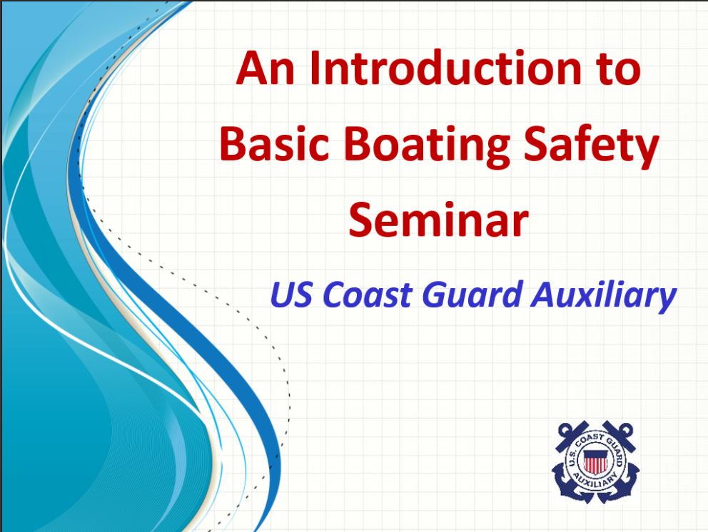

Marketing Public Education Classes
  Contact the local court
  Liaison with local insurance agents
  Use “bite-sized” seminar courses
  Think “non-traditional”
  Take advantage of “word of mouth”
Notes:
Contact the local court:
Offer Boat America or Boating Skills and Seamanship for boating infractions.
Liaison with local insurance agents:
Ask them to share your Public Education (PE) class schedule with clients. Insurance offices are also ideal locations for Program Visitors to set up as Program Partners.
Use “bite-sized” courses:
Mini-classes/seminar courses for clubs and schools.
Seminar courses work well for yacht and fishing clubs.
Sign them up for a full class on the spot!
Think “non-traditional:”
Hunting and fishing clubs.
Paddlesports clubs.
Public Works departments.
Referrals are among the best ways to drive students to our classes. A class member who had a good experience will talk up the class to their family and friends.
The E-Directorate offers numerous documents to assist the flotillas in marketing their courses. Go to
http://wow.uscgaux.info/content.php?unit=E-DEPT&category=marketing for access to these documents behind the Member Zone firewall.

Slide 25
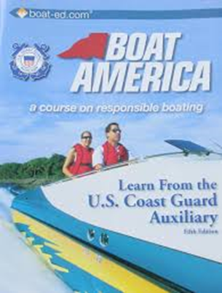
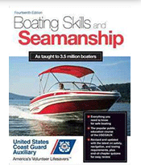
Boat America and BS&S
  Boat America and BS&S offered as NASBLA-approved certificate courses
  Order from AUXCEN (Shop Auxiliary)
    https://auxcen.com/public-education/
  Find the slides with instructor notes and the state supplement slides at:
    http://wow.uscgaux.info/content.php?unit=E-DEPT&category=nasbla-courses
Notes:
The E-Directorate encourages flotillas to embrace Boat America and/or Boating Skills and Seamanship (BS&S). The slides and instructor notes are included on the E-Directorate website under a Member Zone-protected section titled PE Courses.
The state supplements are also on the website for Boat America and BS&S, thus ensuring ease of use for flotillas teaching these certificate courses. Whenever a state requests changes to its slides and/or test, the Division Chief for Course Development implements the updates and then notifies the appropriate DSO-PE, who passes the information down to the SOs-PE and FSOs-PE.
Flotillas are encouraged to add to the slides any appropriate material that will enhance the presentation and make it applicable to the local area. Remember, you can’t delete material but can add appropriate items to explain a point better, such as additional slides, videos, etc.
These courses work well for both in-person delivery and via virtual platforms.
Find the slides with instructor notes and the state supplement slides at:
http://wow.uscgaux.info/content.php?unit=E-DEPT&category=nasbla-courses
The Auxiliary Manual, Chapter 2, section B.13.d, states: The Coast Guard Auxiliary Association, Incorporated (CGAuxA, Inc.) develops and publishes and/or acquires and distributes course materials and examinations. These materials are to be used to conduct all Auxiliary PE courses. …Course materials are only purchased from Coast Guard Auxiliary district material centers or the Auxiliary Center (AUXCEN). Course books, appropriate tests, marking templates, and evaluation forms are sold and shipped according to the current pricing available on the AUXCEN website. (https://auxcen.com/public-education/)
Auxiliary National Supply Center: ANSC supplies Auxiliary units with a wide variety of brochures that are appropriate to supplement the course book and class information at no charge to the flotilla. The current ANSC catalog lists all the materials available to the public education instructor. The materials officer usually does the ordering. The catalog is located in the AUX MEMBERS drop-down menu on cgaux.org.

Slide 26
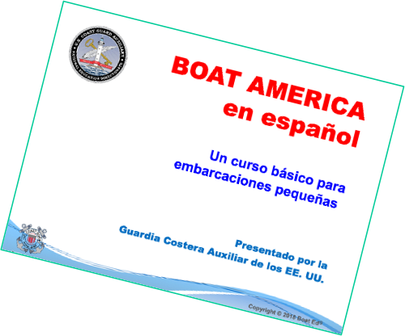
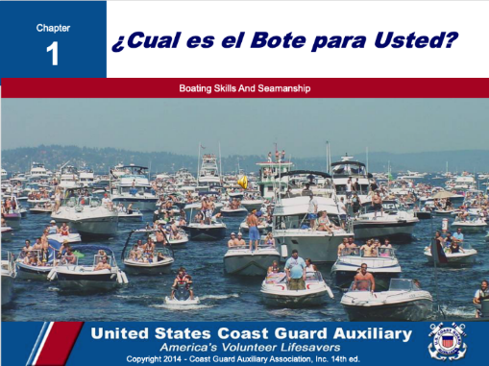
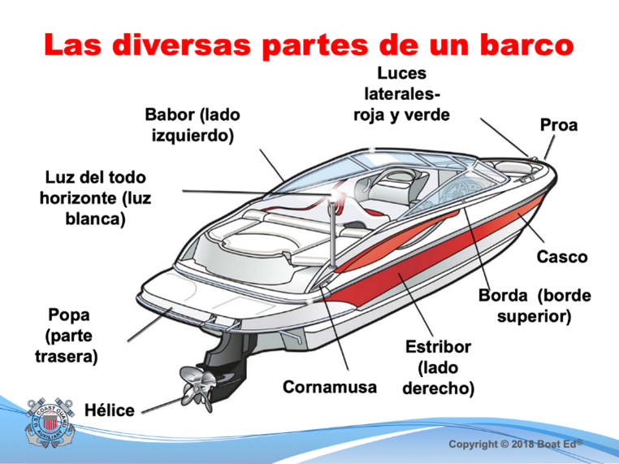
Spanish Language Classes
  Spanish-speaking boaters:
    Represent fast-growing boat buyers
    Emerging market of first-time boat buyers
    Under-served boating education market
  All slides, instructor notes, and exams in Spanish - books are offered only in English
Notes:
A 2017 study published by the National Marine Manufacturers Association, Recreational Boating & Fishing Foundation, and Discover Boating showed that Spanish-speaking boaters represent a fast-growing, emerging market of first-time boat buyers. In response, the E-Directorate is rolling out a series of courses translated into Spanish. All supplemental material – PowerPoint Slides, Instructor Notes, and Final Exams are all in Spanish; the textbooks will remain in English.
These Spanish language courses can be found on the Public Education website on the left menu under PE Courses (protected by the Member Zone password). The first two below are both National Association of State Boating Law Administrators (NASBLA) courses, and the other is a Seminar Course.
Boat America
Boating Skills and Seamanship
Introduction to Basic Boating Safety
The Spanish language courses are available at:
http://wow.uscgaux.info/content.php?unit=E-DEPT&category=pe-courses
A team of bi-lingual CG Auxiliary members converted all Boat America and Boating Skills and Seamanship slides, instructor notes, and examinations into Spanish. This effort is intended to help educate Hispanic community members about safe boating in their native language. Similarly, they converted the seminar course Introduction to Basic Boating Seminar. This is often an introductory course leading to students signing up for the NASBLA-certified courses.

Slide 27

I’m the Flotilla Staff Officer-Public Education, Now What?
  Available on the E-Directorate Website
Notes:
One of our most important missions is to offer safe boating classes to the recreational public. This new training course is designed for both the new Flotilla Staff Officer-Public Education (known as FSO-PE) and for those returning to the position who want to learn best practices.
The FSO-PE position is critical to the Coast Guard Auxiliary’s Recreational Boating Safety mission and the flotilla’s finances. Once a member has mastered the Flotilla Position, there’s the Division Staff Officer, Assistant District Staff Officer, and even District Staff Officer. Each position is a learning experience and can prepare the member to advance to more responsibility.
As the FSO-PE you:
Supervise and schedule qualified Auxiliarists to perform specific activities in support of the Public Education Program.
In close coordination with the FSO-PA, plan, organize, and direct programs and activities to promote and publicize boating safety and Auxiliary Public Education Courses.
Ensure that the Human Resources Staff Officer is given time to discuss the Auxiliary and Auxiliary membership in every public education course.
Maintain close liaison with the Division PE Officer to implement the public education programs established for nationwide, district, and division use.
Coordinate and cooperate with the FSO-MT to increase the number of qualified instructors.
Maintain close contact with flotilla instructors to encourage increased activity and maintain uniformly high standards.
Forward to the Division PE such methods, training aids, course materials, or other educational tools developed within the flotilla that may have division-wide applications.
Encourage and assist in developing training aids for use by flotilla instructors.
Be familiar with the course content and instructional requirements of all approved PE courses.
Ensure that instructors have coordinated in advance to have necessary training aids, screens, projectors, and handouts on hand before class. Report as required to the Flotilla Vice Commander and Division Public Education Officer all progress and activities in the field of public education.
Enter the class information (instructor time, graduates, etc.) into AUXDATA II and submit student information to the state (if required)

Slide 28
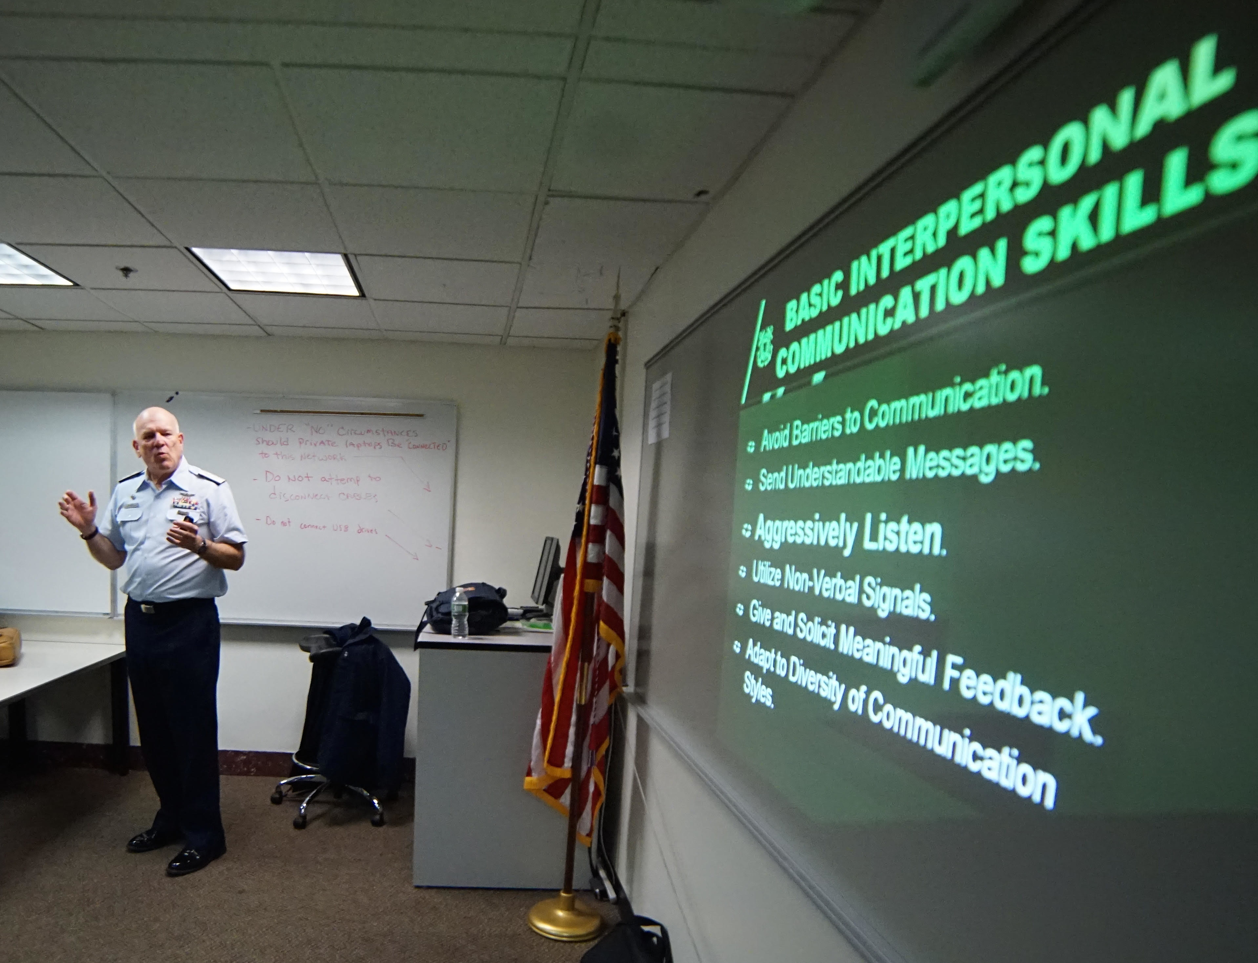
Instructor Currency Maintenance
  2024 Instructors must meet standard currency maintenance requirements
    Two hours as a lead instructor or;
    Four hours as a non-lead instructor or;
    A combination of both
  Missed 2023 Required Instructor Hours?
Notes:
With most COVID-19 restrictions lifted, instructor currency policy has reverted to the “standard” in place pre-COVID.
The current policy is that instructors must maintain currency in 2024. This includes:
Two hours as a lead instructor or;
Four hours as a non-lead instructor or;
A combination of both;
Plus highly recommended: completion of the 2024 instructor workshop.
If a member failed to complete the required hours as lead and/or non-lead instructor in 2023, they became REYR – required yearly task not met – for 2024 and need to make up the deficit during 2024 to recertify as an instructor.
If the member failed to instruct for two hours as lead or, four hours as non-lead, or a combination of both, they need to complete the missing hours in 2024 as a trainee and have those hours entered into AUXDATA II. The member needs to complete the 2024 workshop; they must review it and sign the self-attestation form. This form is then submitted to the Information Services Officer for entry into AUXDATA II.
Once the trainee hours and self-attestation form are entered in AUXDATA II, the Flotilla Commander needs to notify their district DIRAUX according to district policy to re-certify the member as an instructor.
To remain an instructor in 2024 after being recertified, the member must teach:
Two hours as a lead instructor or;
Four hours as a non-lead instructor or;
A combination of both;
NOTE: This all assumes the member is current in Core Training.

Slide 29
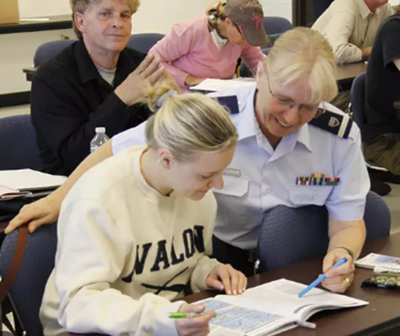
Recruiting via Public Education
  Plenty of handouts
  Show common interests
  Diversity and inclusion
  Actively mention your flotilla
  needs
  Be approachable
  Talk to students, not to each
  other
  Work in local pictures or anecdotes onto slides
  The Auxiliary message, every time!
Notes:
Our Public Education classes can be very effective recruiting opportunities. Here are some ideas:
Offer meetings with the Flotilla Staff Officer-Human Resources (FSO-HR) and other Flotilla Staff Officers.
Distribute plenty of handouts to the students. Showcase various Auxiliary missions.
Show common interests. Build rapport with students.
Remember diversity and inclusion. The Auxiliary has a place for personal growth.
Actively mention your flotilla needs. Not just boats- finance, computer skills, etc.
Be approachable. Set the mood and establish rapport with students when they arrive in the classroom. Engage in conversation to find out about them one-on-one. Don’t wait for class introductions. You want to break down barriers that will allow you to have two-way communication once the class begins. Spend as much time as you can one-on-one with students rather than just using lectures. Use your class aides to assist whenever possible – be a team.
Walk around the room; don’t remain behind the podium. During breaks, remain available for students to ask questions. Ask students about their boats, boating experience, and boating mishaps.
Talk to students, not to each other. Instructor cliques scream – “don’t bother talking to me – you are not part of my world.” Talk up our missions to them individually. Whenever possible, instructors should make themselves available to the students and avoid congregating in groups of other Auxiliarists. Avoid “inside jokes” and “acronym lingo” when having discussions with students. Always use plain English – use “life jackets” and not “PFDs.”
What does your flotilla need?
Work in local pictures or anecdotes.
The Auxiliary message, every time! Work recruiting topics into every session. Make recruiting part of the lesson plan. Deliver benefits of membership constantly. Show your enthusiasm for what you do. Showcase a local event/experience every class. If you are not having fun presenting the class, it will show and destroy the image you are trying to create. Remain positive and highlight the successes of your flotilla, division, or district.

Slide 30
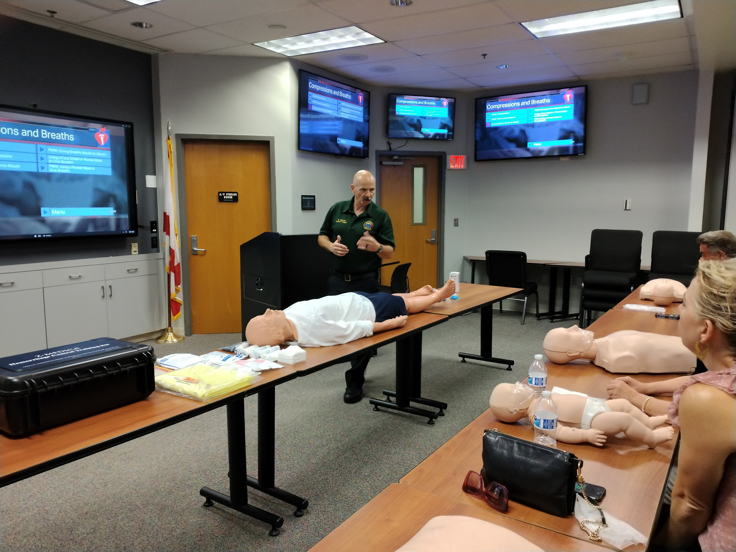
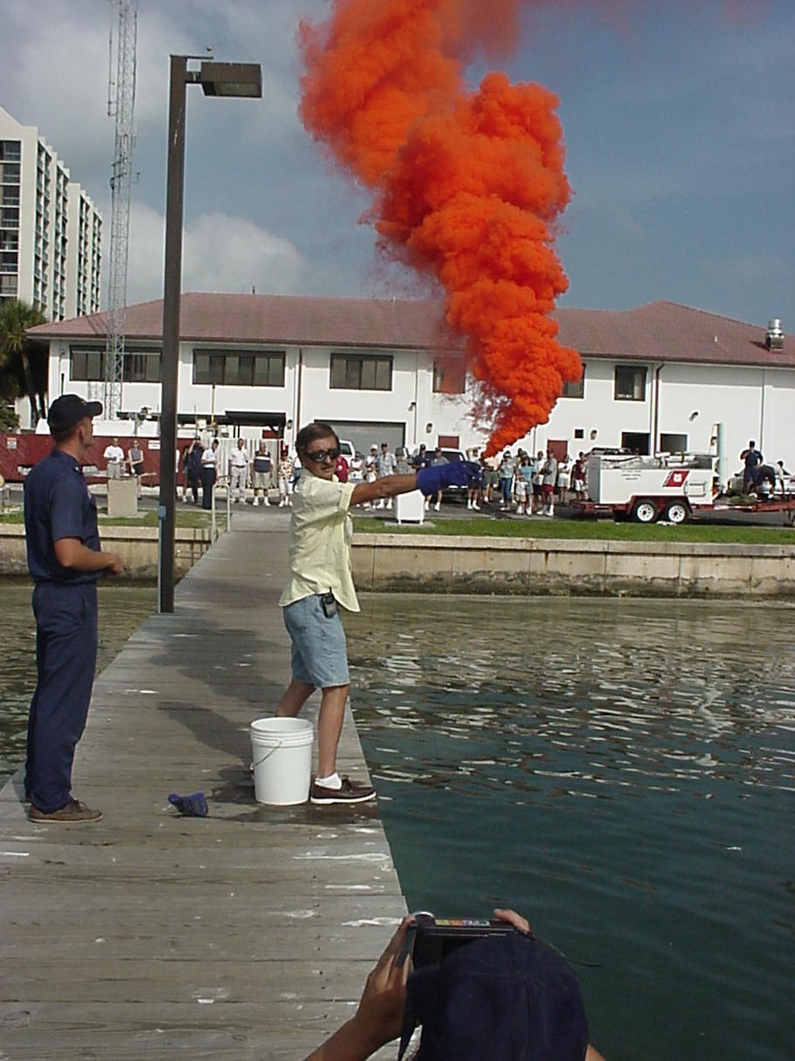
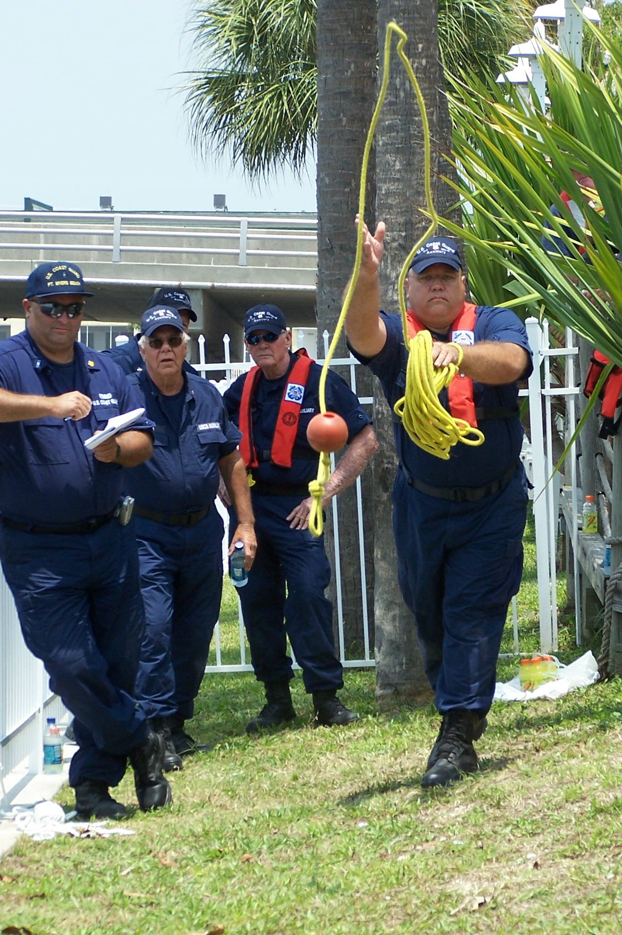
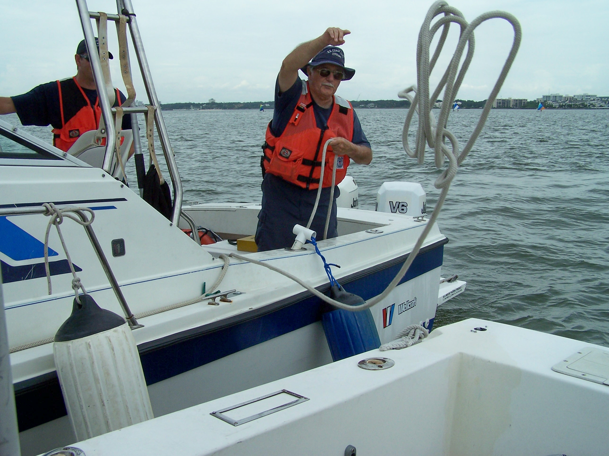
Retention via Member Training
  Strength of membership = quality of training
  Ensures a dedicated/proficient force multiplier
  Builds confidence in a member’s competence
  Training fosters teamwork/camaraderie
  Continuous learning
  Recognition and rewards
Notes:
In any organization, the strength of its membership is directly tied to the quality of training provided. This principle holds true for the United States Coast Guard Auxiliary, where member training is pivotal in fostering a strong and committed community. The value of member training extends far beyond skill acquisition; it is a cornerstone of member retention, ensuring a dedicated and proficient force ready to serve the nation.
Building Competence: One of the primary benefits of member training is the development of essential skills and competencies. From navigation to search and rescue techniques, training equips members with the knowledge and capabilities needed to carry out their duties effectively. A well-trained member is not only more confident in their role but also more likely to find fulfillment in their service, fostering a sense of purpose and commitment.
Enhancing Team Cohesion: We rely on teamwork and collaboration to execute our multifaceted missions successfully. Comprehensive training programs create a shared foundation of knowledge among members, fostering a sense of unity and cohesion. As members undergo training together, they develop a common language and understanding of procedures, promoting effective communication and cooperation during operations. This shared experience builds strong bonds within the organization, making members more likely to stay engaged and committed over the long term.
Fostering a Culture of Continuous Learning: A commitment to ongoing education is a key factor in member retention. We operate in a dynamic and ever-evolving environment, necessitating continuous learning to stay abreast of new technologies, techniques, and policies. Training programs that emphasize a culture of continuous learning empower members to adapt to change and stay relevant in their roles. This adaptability not only benefits the individual member but also contributes to the overall resilience and effectiveness of the entire Auxiliary.
Recognizing and Rewarding Achievement: Member training provides opportunities for recognition and reward, further bolstering retention efforts. Acknowledging and celebrating members' accomplishments, whether through certifications or commendations, reinforces their sense of value within the organization. Recognition serves as a powerful motivator, encouraging members to stay committed and strive for excellence in their roles.

Slide 31
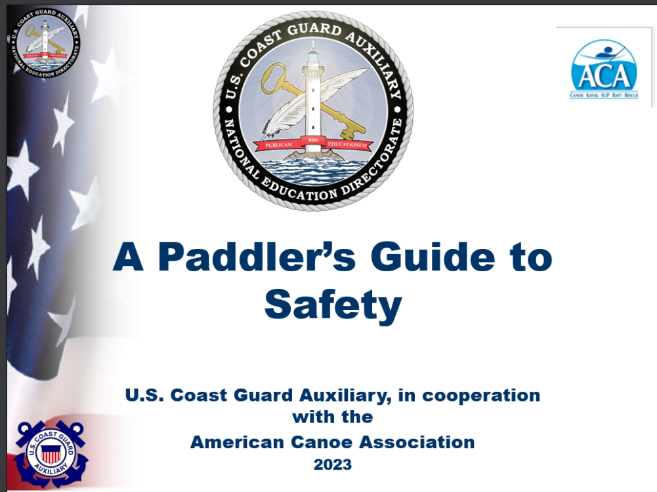
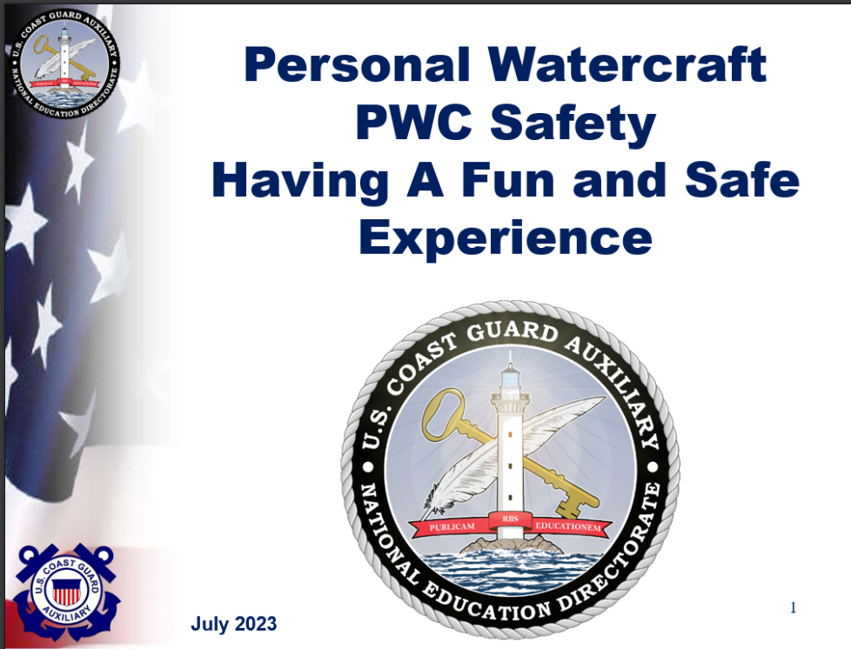
What’s New
  A Paddler’s Guide to Safety Course
  NOAA Whales’ Education
  Personal Watercraft (PWC) Seminar Course
  Water N’ Kids Youth Course
Notes:
A Paddler’s Guide to Safety: Introduced in April 2023, this is a refreshed and modernized version of A Paddler’s Guide to Safety. This long-awaited course, along with its up-to-date graphics and detailed and comprehensive instructor notes, dramatically enhances the ability of instructors to provide safety classes to the ever-growing paddling community throughout the nation. Members of the Educational Directorate, the Recreational Boating Safety Outreach Directorate, and the American Canoe Association carefully vetted the material in this updated presentation. The improvements made to both its course content and its visual appeal render this an almost entirely new course. With the growing number of paddlers on the waterways, please go to the E-Directorate website and download this refreshed presentation to help educate a safe paddling community.
NOAA Whales Education: As part of our ongoing collaboration with NOAA, they have produced additional content on boating safely around Whales for use in Public Education classes. This new material includes a four-slide PowerPoint slide deck that can be added to our courses and seminars. Also available are handouts that instructors can use in classrooms or share with students if teaching virtually. While this material targets New England and Mid-Atlantic states, it contains useful information for use anywhere you could encounter whales.
Personal Watercraft (PWC) Seminar Course: An exciting and comprehensive course designed to enhance safety, skills, and knowledge for PWC enthusiasts. This seminar course is designed for instructors who want to expand their flotilla’s course offerings. It is designed to teach participants the basics of safe PWC operation, including how to operate a PWC in a variety of conditions; how to avoid accidents and injuries; and how to be a courteous and responsible PWC operator. It is estimated that the presentation of the material will require approximately one and one-half hours.
Water N’ Kids Youth Course: Designed to enhance safety, skills, and knowledge for students ages 8 to 10 years (third and fourth grade). This course includes many support templates to help instructors contact schools, teachers, parent information, a general lesson plan, and more for those instructors who want to expand their flotilla’s course offerings. Water N’ Kids is designed to teach basic water safety topics to young students.
We recommend you regularly check the E-Directorate website for new courses and review the course catalog to see about expanding your class offerings.

Slide 32

Reminder and Thank You
  Submit your self-attestation form if you studied this workshop outside of a facilitated session.
  If you have any questions, contact the appropriate E-Directorate Staff, following the Chain of Leadership and Management
  You may email the E-Directorate at
  pe.feedback@cgauxnet.us
Notes:
It’s the policy of the CG Auxiliary that we solve issues at the lowest level. If the problem, question, or matter cannot be handled at this lower level, follow the Chain and press the issue higher.
All issues should be solved at the lowest possible level and elevated as needed through the chain of leadership and management to address the issue. It is NOT appropriate to go outside our organization for answers to education-related problems unless specifically instructed by the staff of the Education Directorate. Inquiries posed outside our organization confuse our partners and delay a proper response.
The entire staff of the E Directorate is standing by to answer any education questions that cannot be answered at a lower level.
The E-Directorate also maintains a feedback email address to assist members with answers they could not find anywhere else within the Auxiliary.
Members must understand they should not contact the Chief Director’s office or anyone outside the CG Auxiliary Chain of Leadership and Management. Any requests outside the Chain unnecessarily tie up resources answering these questions at BSX, NASBLA, and the BLA offices for internal Auxiliary queries. At the very least, it paints the Auxiliary as undisciplined and unable to communicate internally. At worst, it threatens our credibility at a national level with these national partners, which can have significant ramifications on future relationships.
You may email the E-Directorate at:
pe.feedback@cgauxnet.us

Slide 33
E-Directorate Contacts
  Director: David Fuller
  Deputy: Robert Brandenstein
  Division Chief-Course Development:
  Gregory Fonzeno
  Division Chief-Course Management:
  COMO Michael Morris
  Division Chief-Communication Services:
  Dan Stroup
  Division Chief-Instructor Development:
  Karen Miller
  Division Chief-Special Projects: Andy Kelly
  Contact info available in AuxDirectory
  https://auxofficer.cgaux.org/auxoff/index.php

Slide 34

Conclusion
  Effective Auxiliary instructors are
    Professional
    Enthusiastic
    Constantly practicing their craft
  Our members and students deserve it!
Notes:
Never lose the desire to improve. Whether you are an instructor in public education, member training, or engaged in mentoring in any of the flotilla missions, the satisfaction you and those you teach depends on the quality of your instruction.
Continue to practice and find ways to improve!

