Slide 1

National Public Education Directorate
Instructor Workshop 2025
Notes:
2025 Instructor Workshop Delivery Options
Option 1: Self-Study: This option allows instructors to review workshop materials at their own pace, independently. Upon completion, they are required to submit a self-attestation form.
Review workshop materials independently
Submit the self-attestation form to your Information Services Officer upon completion
Option 2: Facilitated Workshop (Recommended): This option is led by a qualified instructor and provides an interactive learning environment. Participants benefit from enhanced understanding through group discussions.
Led by a qualified instructor
Interactive learning environment
Enhanced understanding through group discussion
Facilitator Guidelines: The success of this workshop depends on thorough preparation. Facilitators must:
Master the comprehensive instructor notes
Develop detailed lesson plans
Understand concepts beyond slide content
Prepare relevant examples and discussion points
Benefits of Facilitated Delivery:
Deeper understanding through expert guidance
Opportunity for peer learning
Real-time clarification of complex topics
Shared experiences enhance learning
All photos appearing in this workshop were taken by Karen Miller, DVC-ED, during CG Auxiliary missions or found on the Auxiliary Stock Photos and Graphics on Flickr maintained by the Public Affairs Directorate.

Slide 2
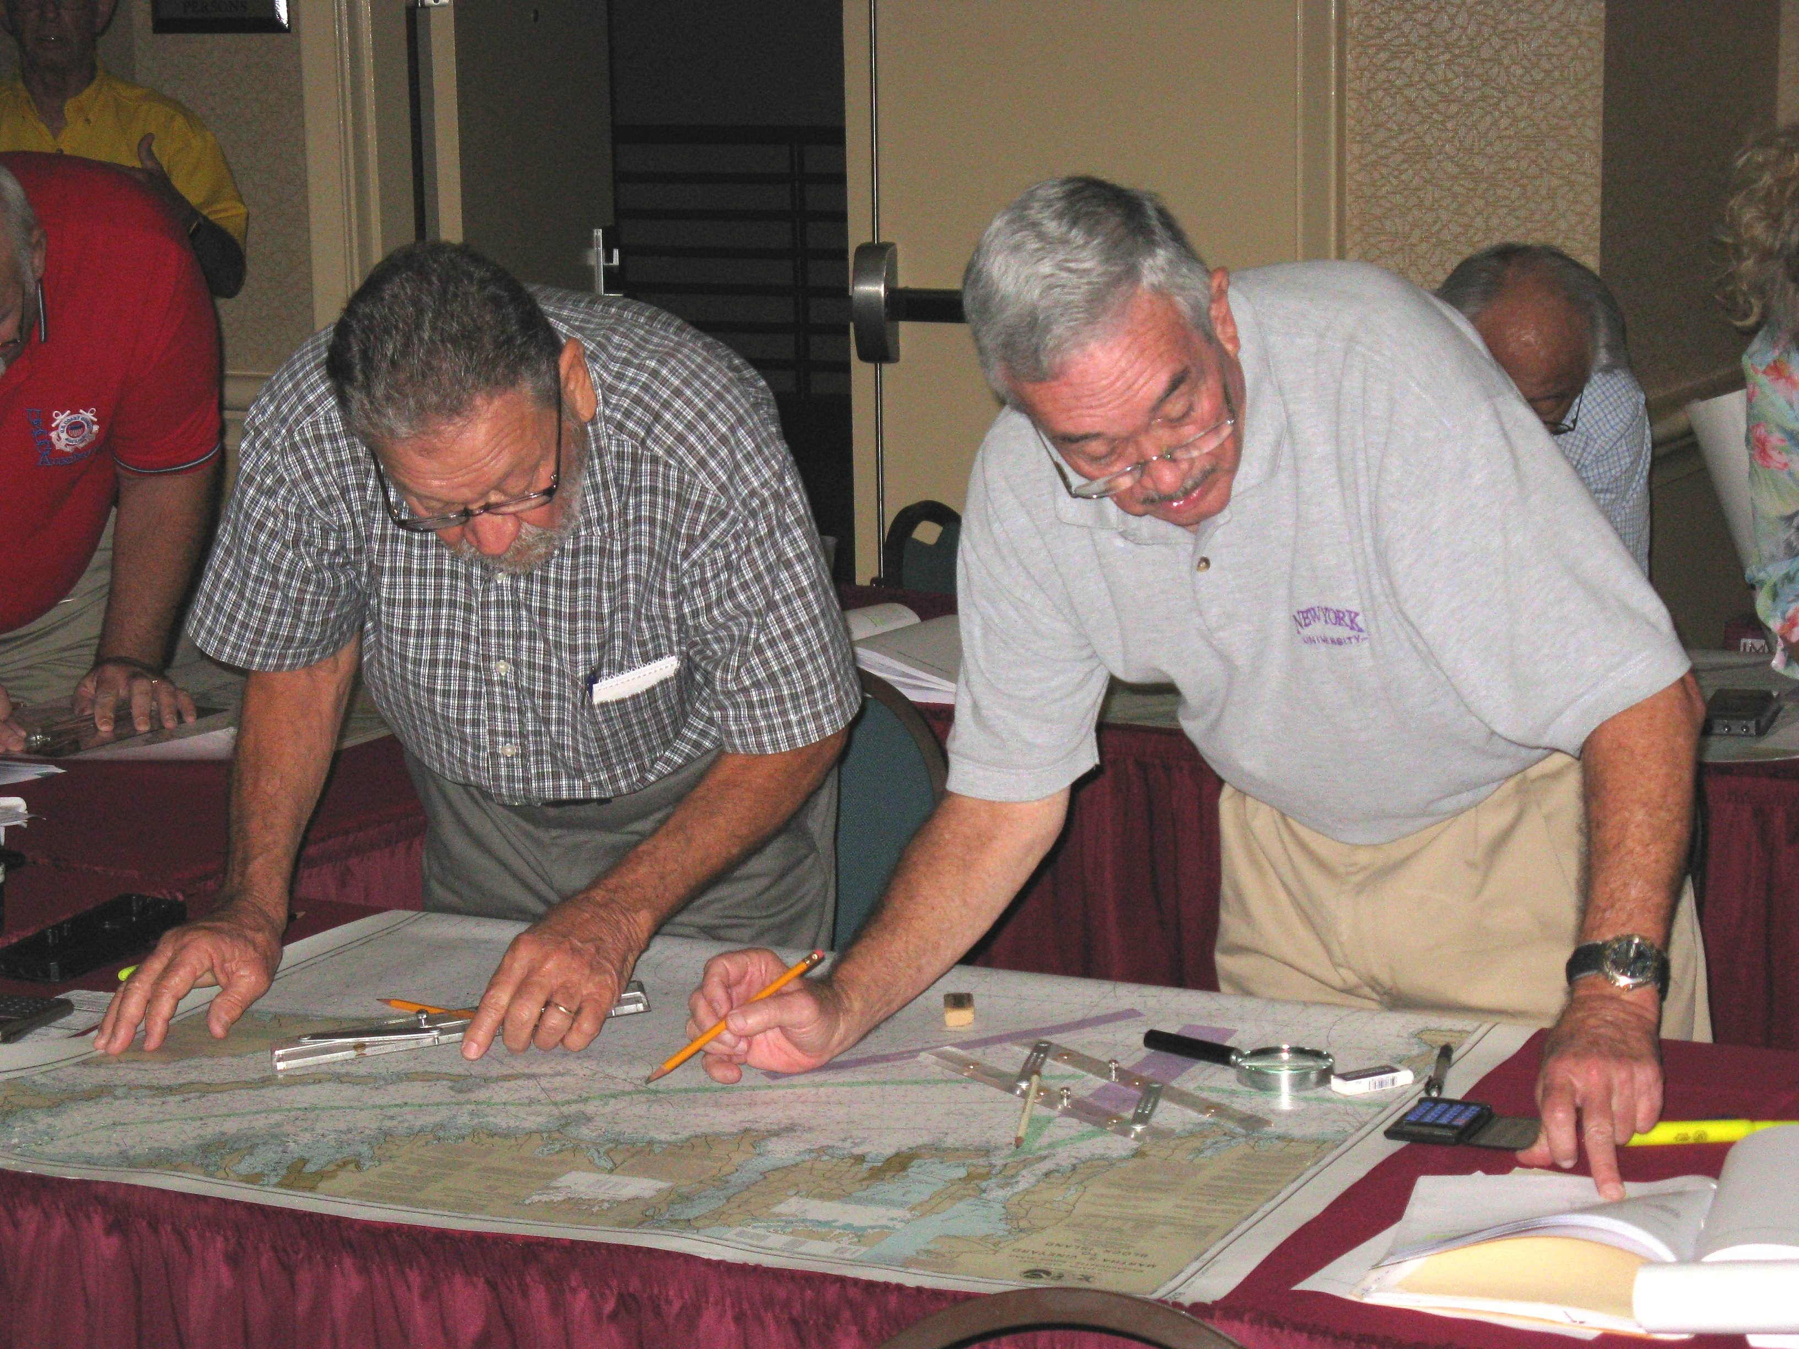
Who Should Take this Workshop?
All members involved in public education
All members involved in member training
All members mentoring new members
All members!
Notes:
Whether we’re instructors in public education or member training, we’re involved with teaching and mentoring.
Furthermore, many flotilla members who are not instructors serve as mentors to new members, assist at classes, do vessel safety checks, and help recruit.
This workshop is for all members!
This workshop is suggested for all members of the Coast Guard Auxiliary, regardless of their specific roles or responsibilities. This could be particularly beneficial for members who are interested in developing their leadership skills, improving their communication abilities, or simply expanding their knowledge and expertise.
The CG Auxiliary Instructor Workshop is a valuable opportunity for a wide range of members within the organization, particularly those involved in education, training, and mentoring. By attending this workshop, participants can enhance their skills, improve their effectiveness, and contribute to the overall success of the Coast Guard Auxiliary.

Slide 3
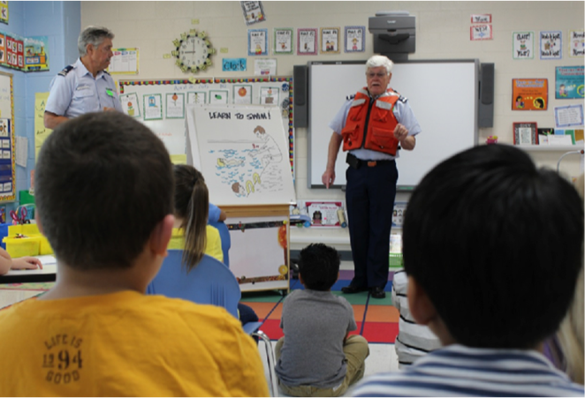
The Power of Education
Public Education classes serve as our gateway to the community
Quality instruction drives new member recruitment
Member Training directly
impacts satisfaction and
retention
Notes:
The Power of Education
Public Education classes are the Auxiliary’s first impression
These encounters shape public perception of our entire organization
First impressions are lasting impressions
Quality teaching reflects our professionalism
Role in recruitment:
Many new members first discover us through public education classes
Engaging instruction sparks interest in deeper involvement
Students often ask about membership during well-taught classes
Impact on current members:
Training quality directly affects member experience
Well-trained members are more confident and active
Quality instruction encourages continued participation

Slide 4
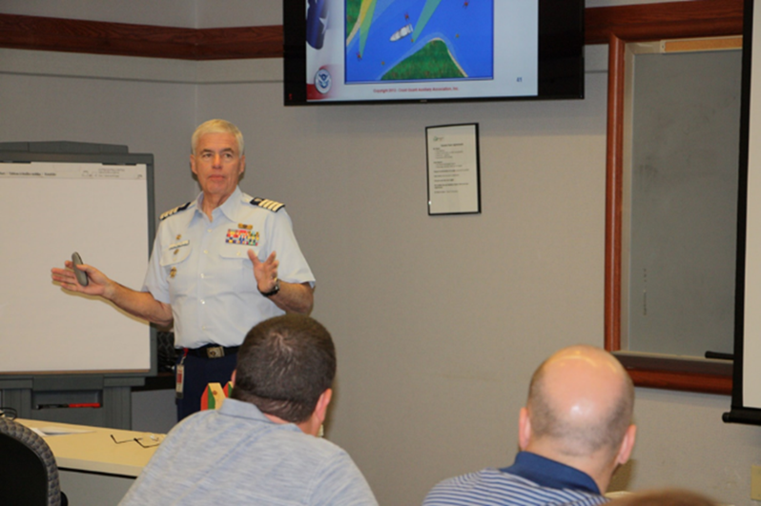
Why Instructor Excellence Matters
Professional instruction leads to:
  Stronger member recruitment
  Better member retention
  Enhanced program credibility
Teaching is a skill that requires continuous practice
Notes:
Why Instructor Excellence Matters
Professional instruction benefits:
Recruitment: Skilled instructors attract potential members
Retention: Quality training keeps members engaged
Credibility: Professionalism enhances our reputation in the community as the recreational boating safety experts
Teaching as a skill:
Like any skill, teaching requires regular practice
Even experienced instructors need refresher training
Teaching methods evolve - we must stay current
Continuous improvement is essential

Slide 5
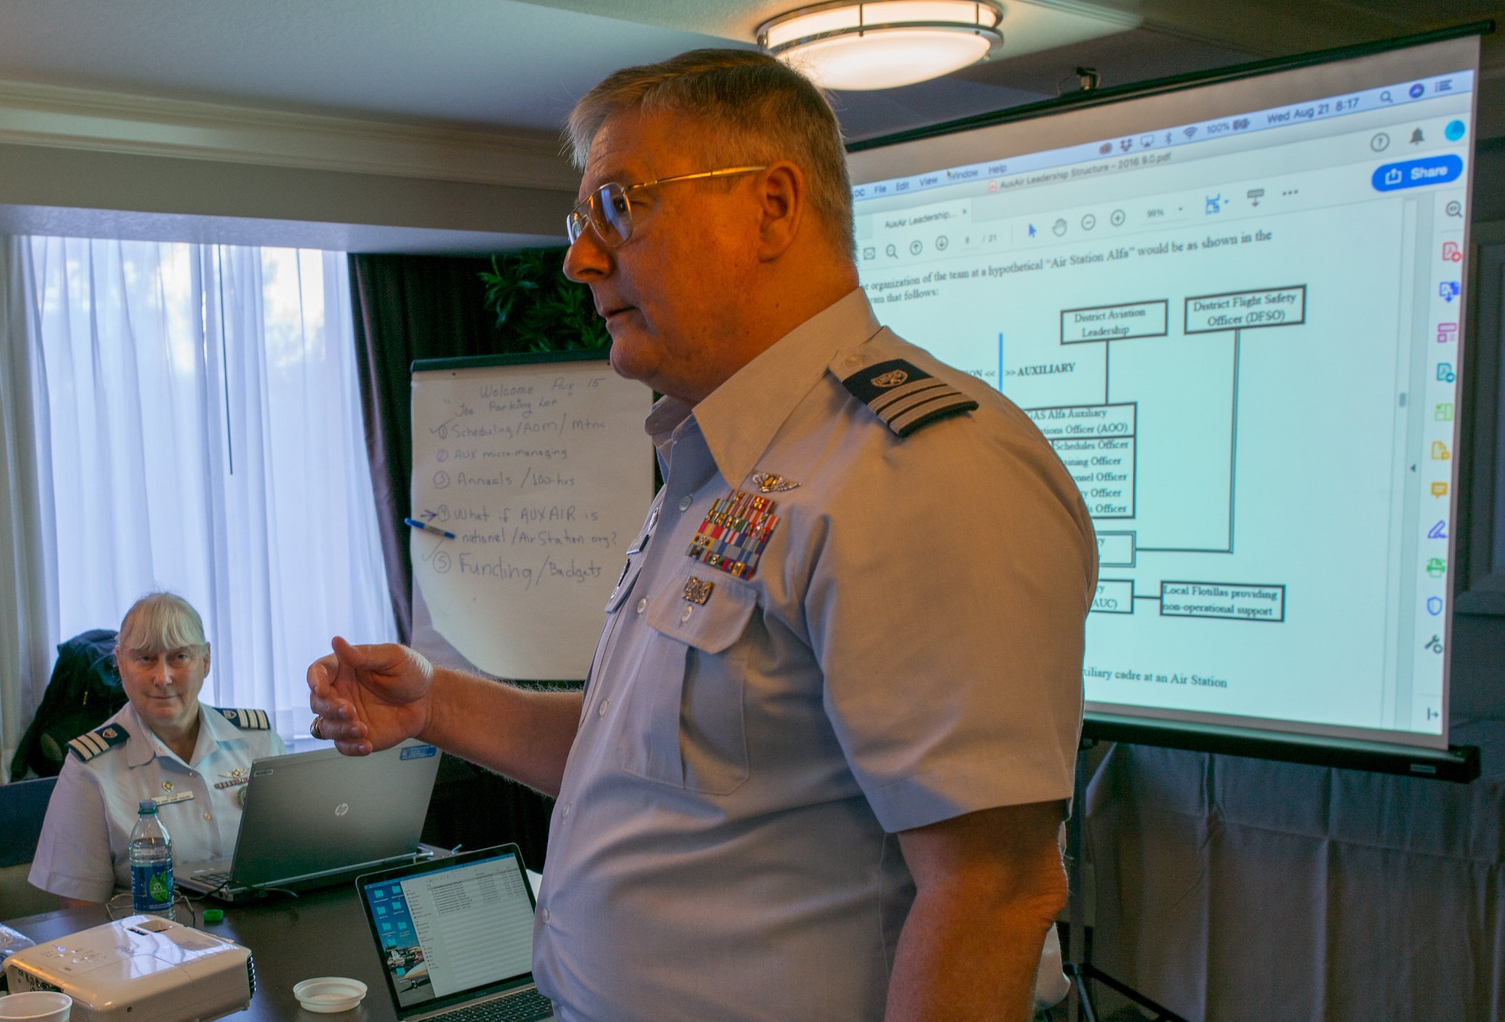
Workshop Goals
Enhance instructor quality and capabilities
Expand our instructor pool
Boost teaching effectiveness
Inspire more members to become instructors
Notes:
Workshop Goals
Enhancing quality:
Focus on proven teaching techniques
Share best practices among instructors
Address common challenges
Provide tools for improvement
Expanding instructor pool:
We need more qualified instructors to meet demand
Identify and encourage potential instructors
Create a supportive environment for new instructors
Provide mentorship opportunities
Boosting effectiveness:
Introduce newer teaching methods
Enhance presentation skills
Improve student engagement
Strengthen evaluation techniques
Instructor delivery tips to enhance quality and boost effectiveness:
Maintain eye contact
Speak with enthusiasm
Use a conversational tone
Allow time for questions
Share relevant personal experiences
Connect points to real-world situations

Slide 6
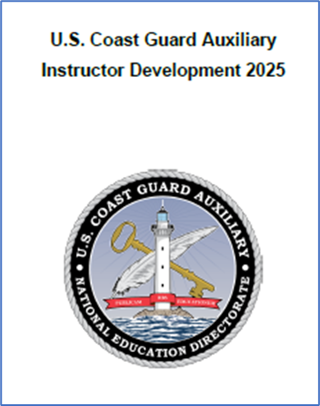
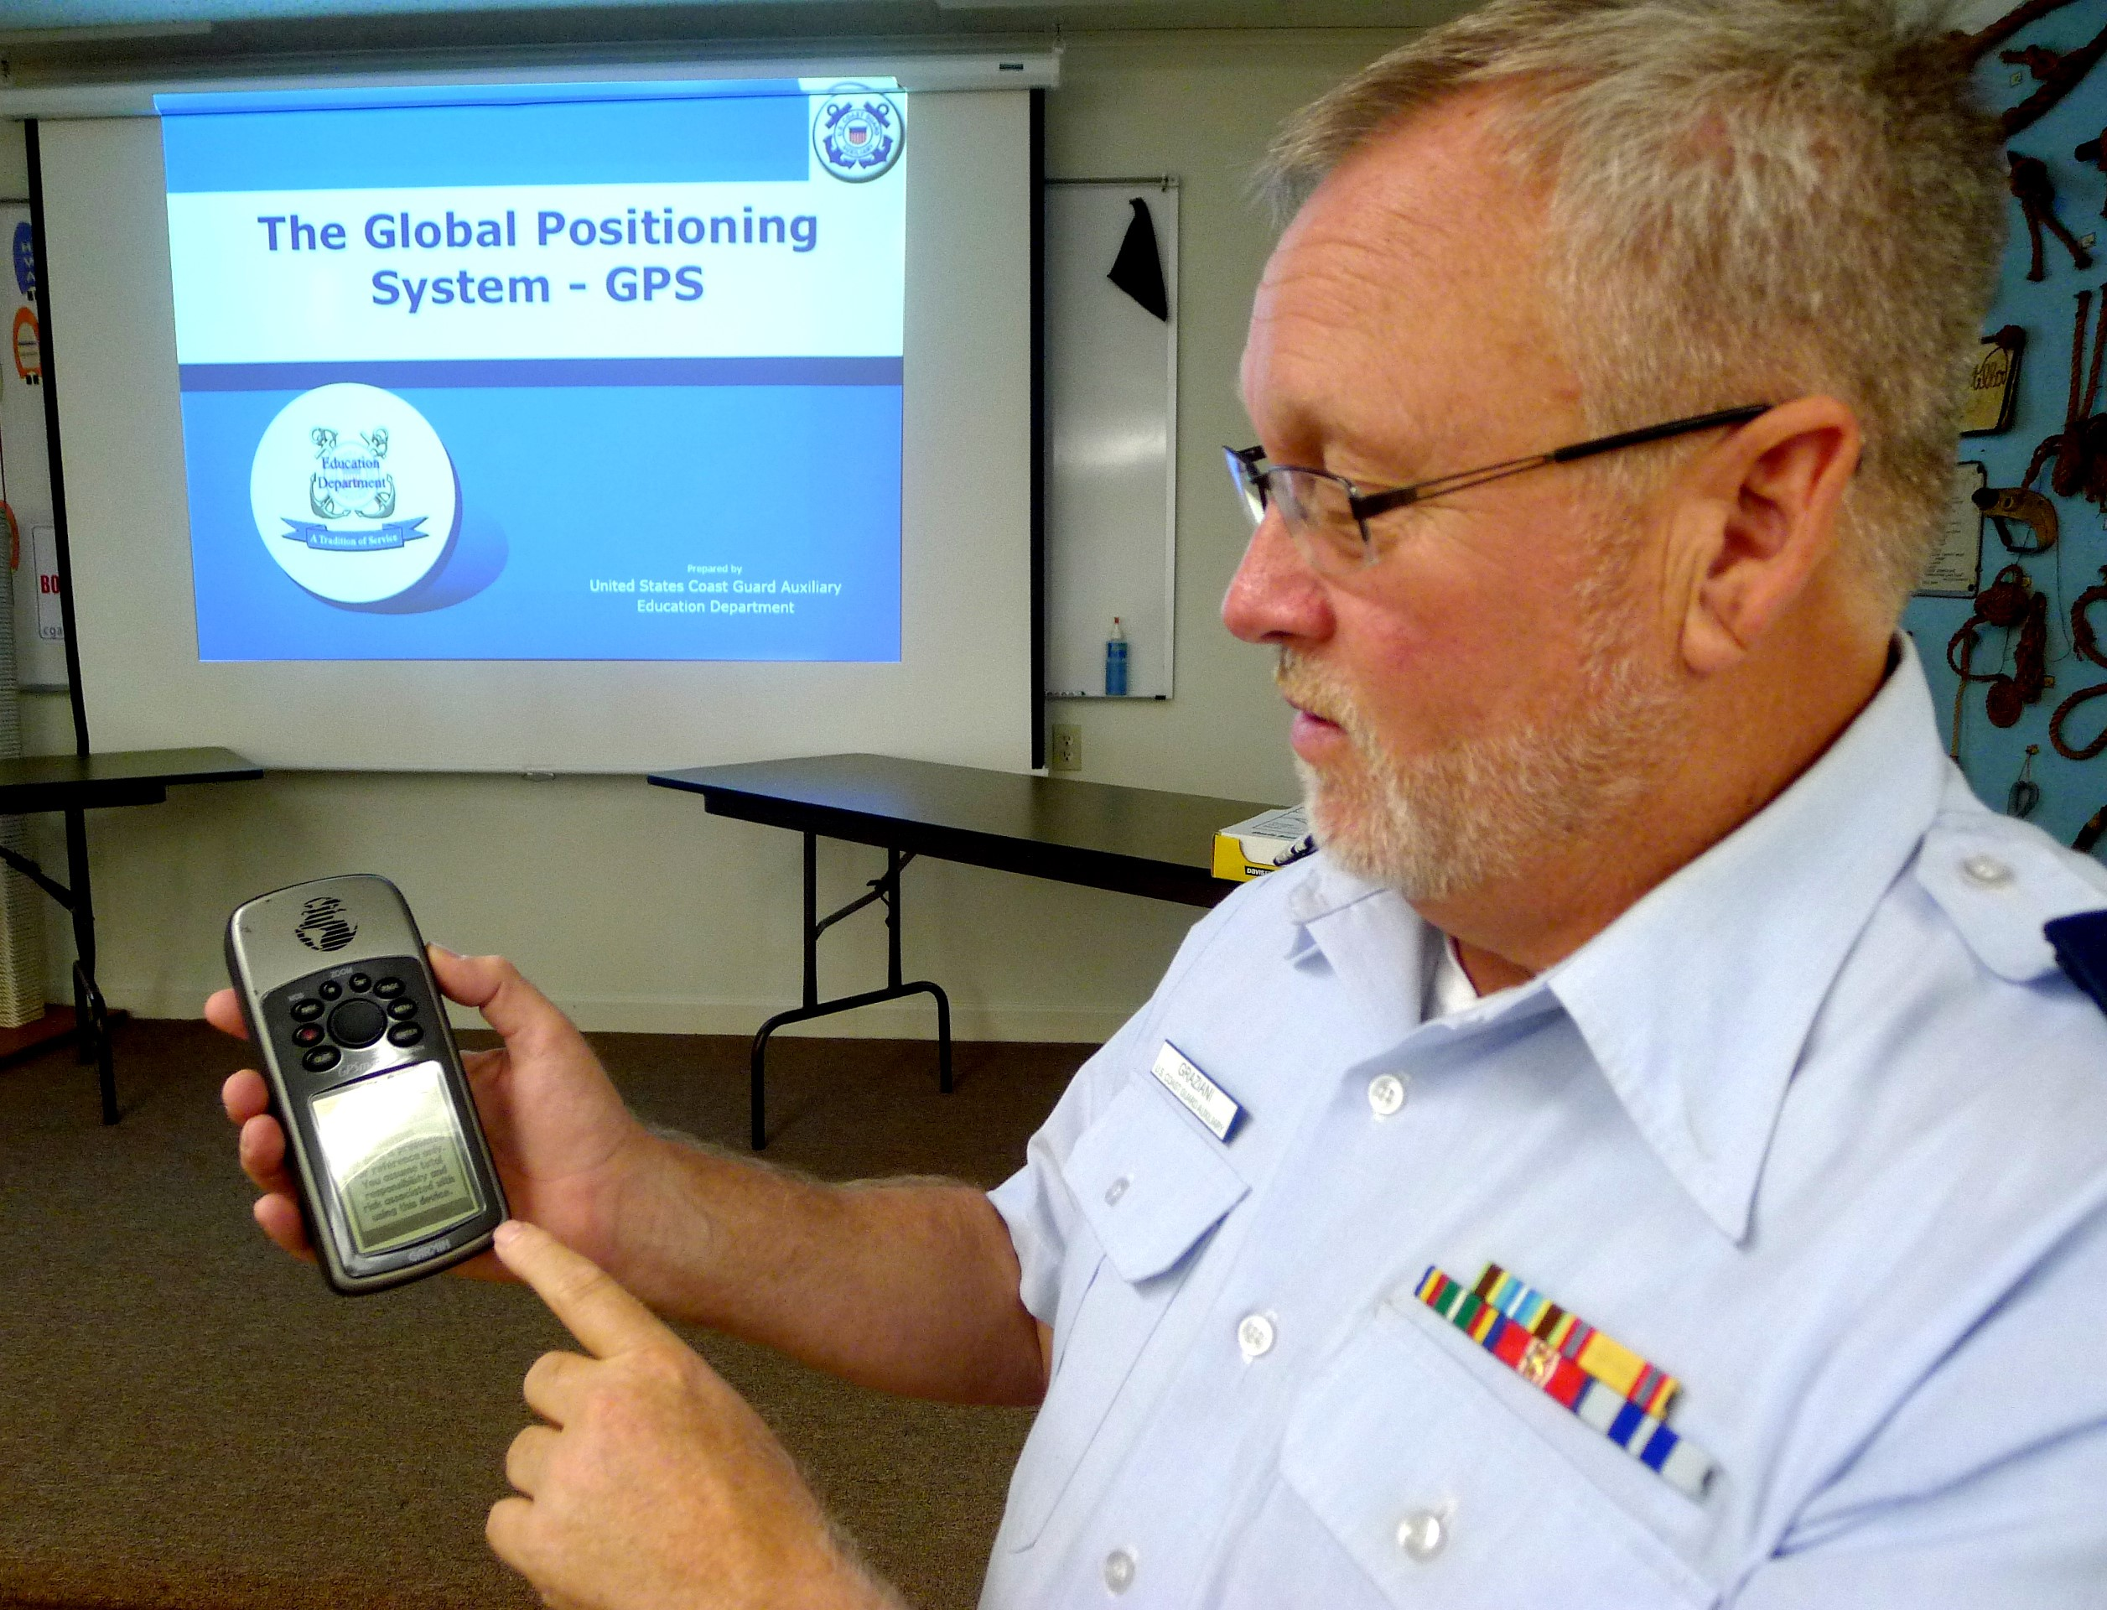

Key Points: Safety & Responsibility
Risk Management Protocols
Core Instructor Responsibilities
Vision 2025: Instructor Development Goals
Notes:
Safety & Responsibility
Risk Management Protocols
Safety is our top priority in every class setting
Review current risk assessment procedures
Discuss incident reporting requirements
Cover health/safety protocols
Core Instructor Responsibilities
Understand the scope of instructor authority
Maintaining professional standards
Following the approved curriculum
Managing classroom dynamics
Complete proper record-keeping requirements
Vision 2025: Instructor Development
Instructor Development 2025 (ID2025) has been updated with the latest best practices
ID2025 incorporates lessons learned from five years of Instructor Development 2020

Slide 7
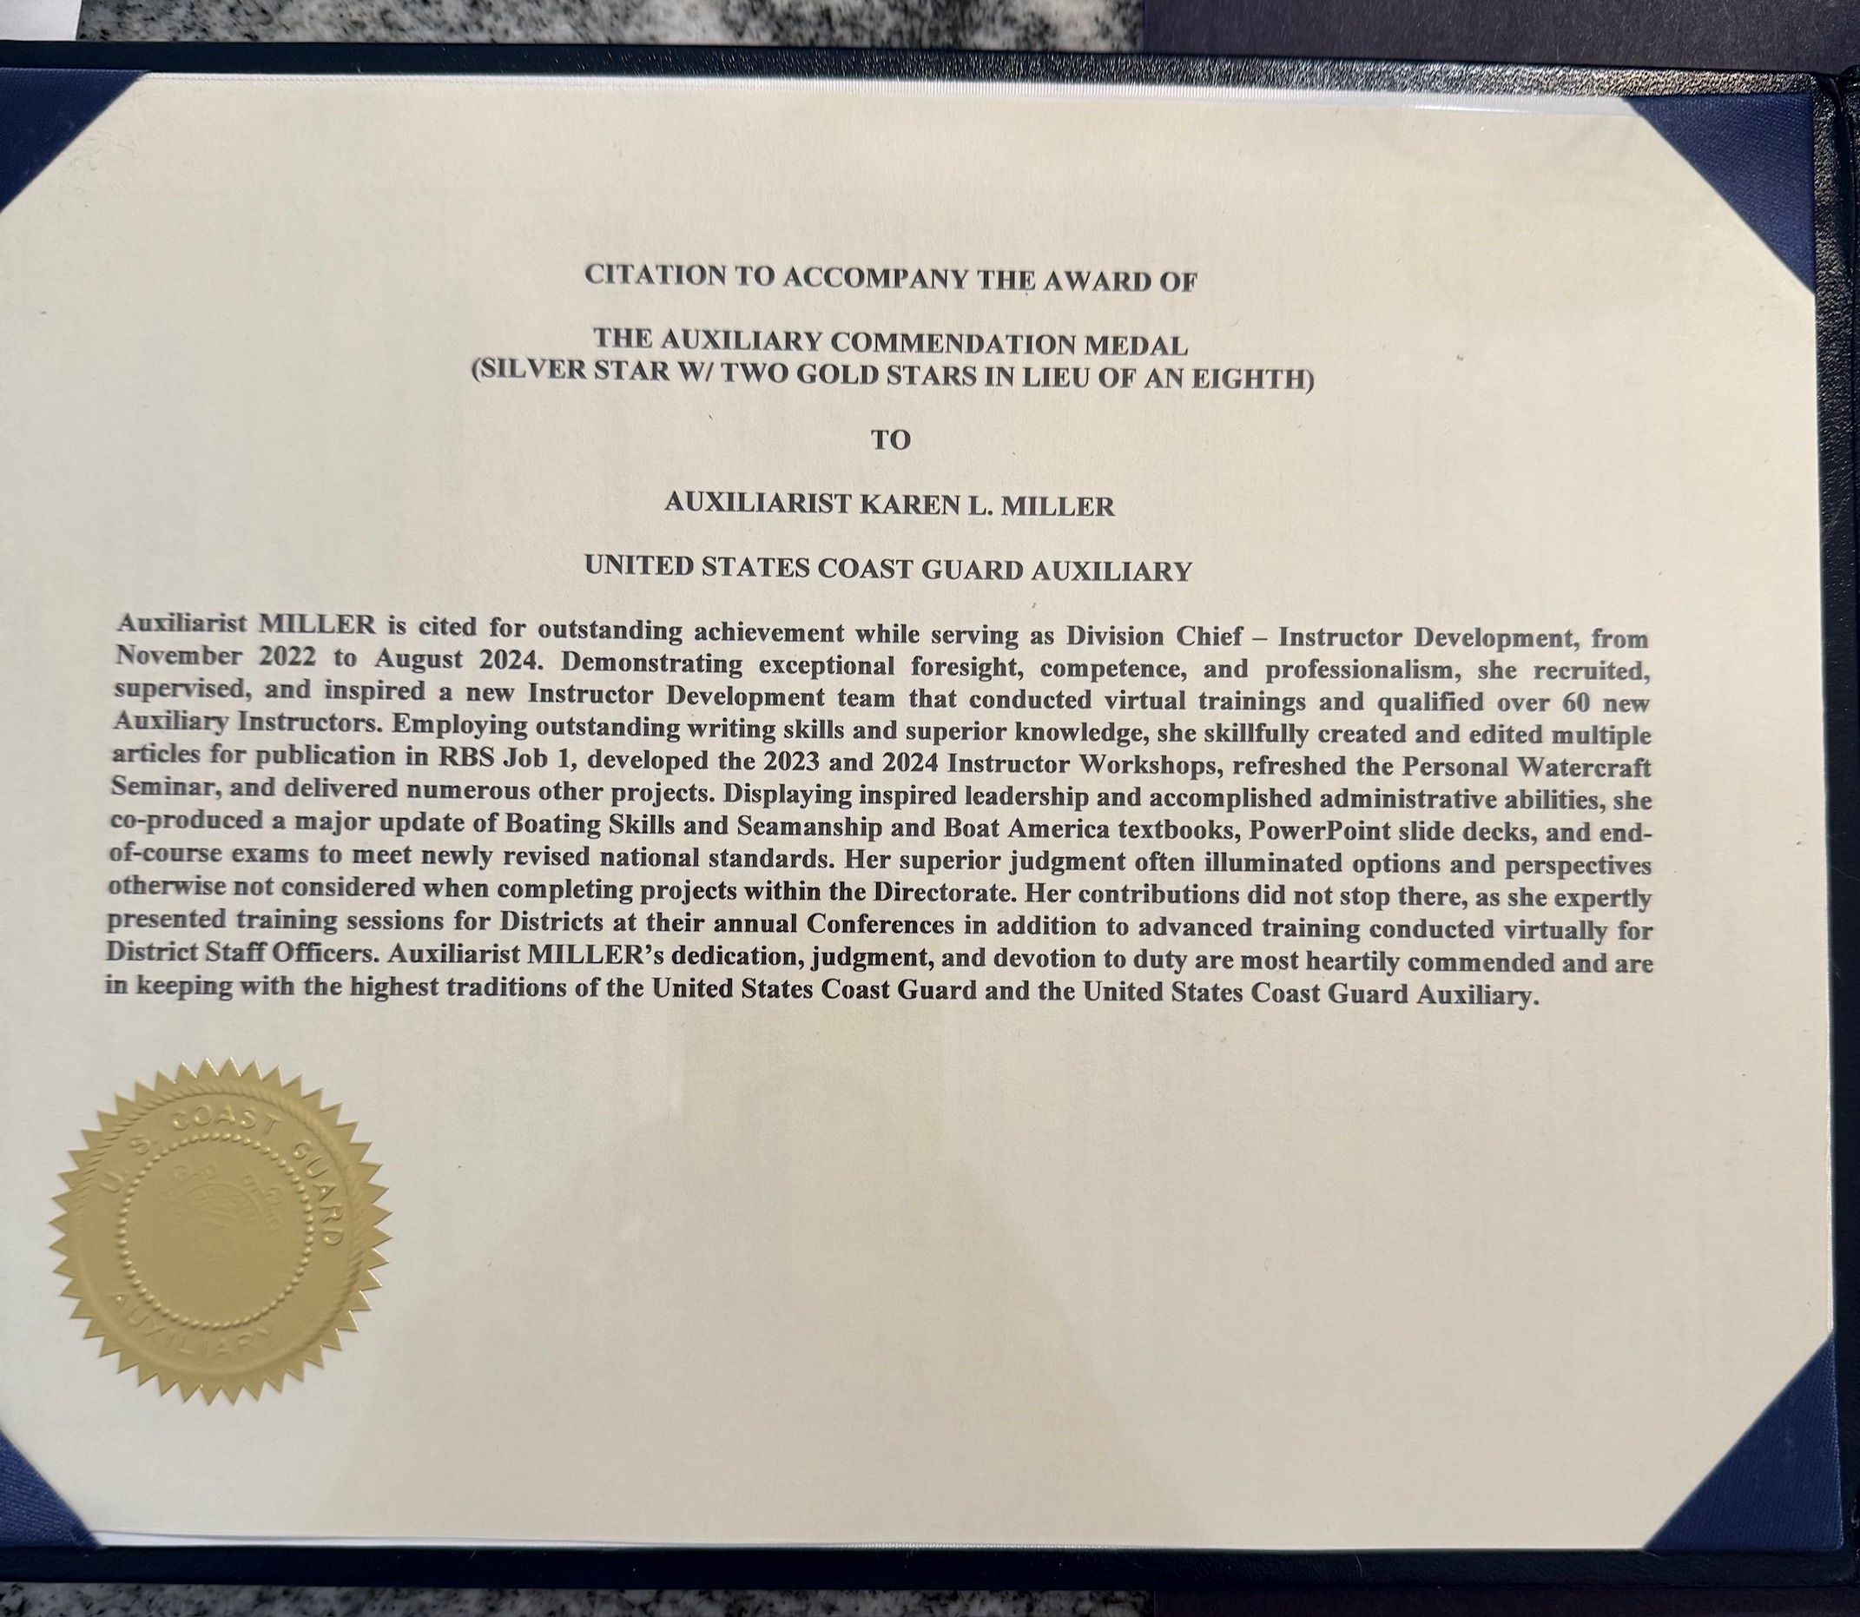
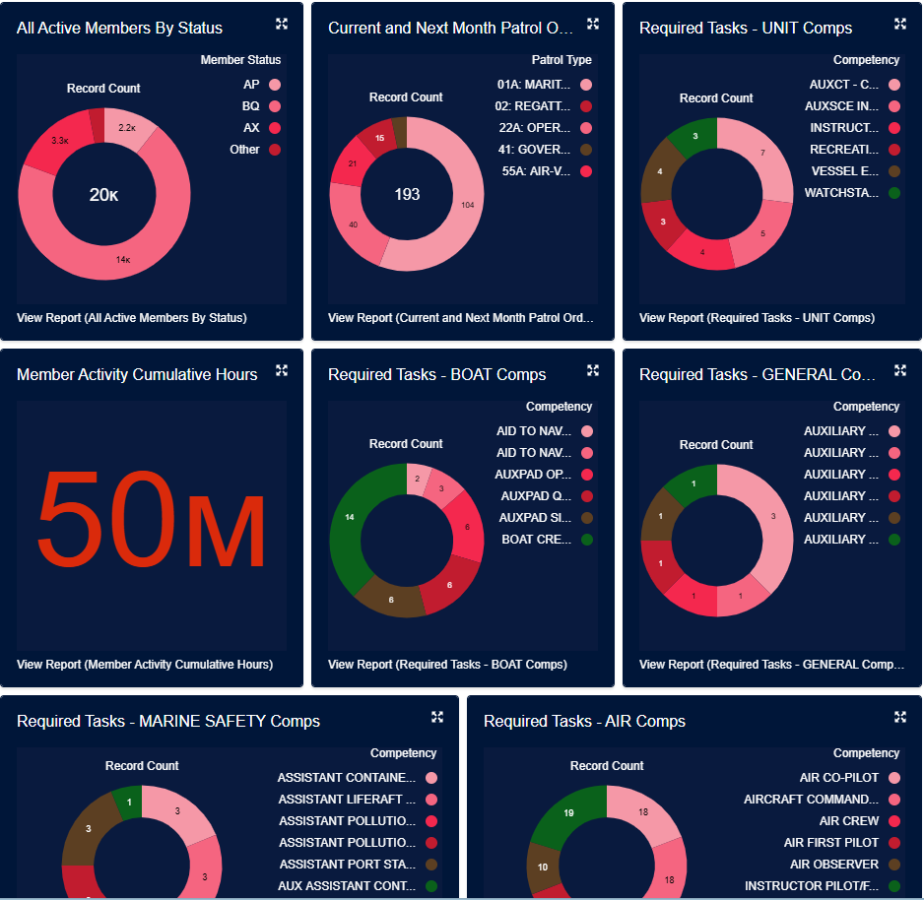
Key Points: Program Management
Recognition and Awards Program
New AUXDATA II System Updates
Notes:
Program Management
Recognition & Awards Program
Overview of available awards
Nomination process
Documentation requirements
Submission deadlines
Success stories and examples
AUXDATA II System Updates
New course codes and definitions
Where to find help resources

Slide 8
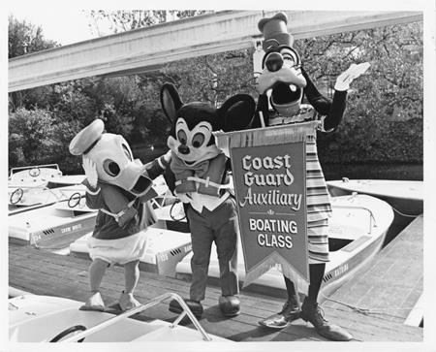
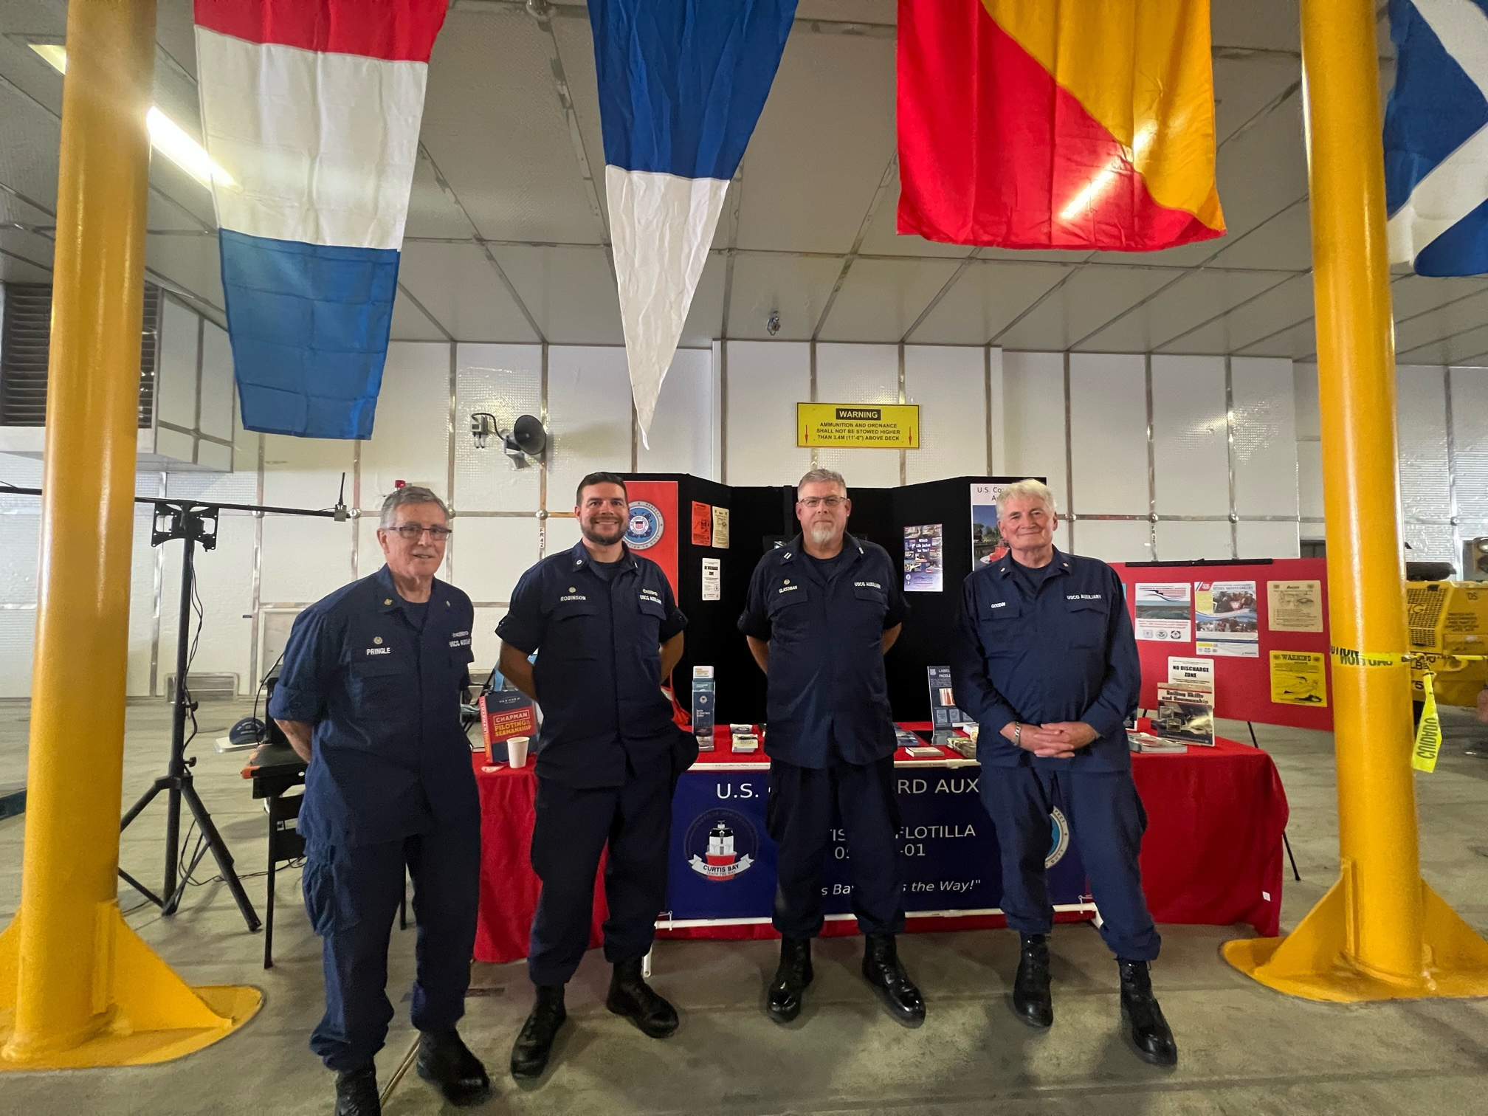
Key Points: Program Growth
Marketing Public Education Classes
Expanding Community Outreach
Notes:
Program Growth
Marketing Public Education Classes
Effective promotion strategies
Using social media effectively
Community partnership opportunities
Best practices for class announcements
Success stories from other units
Expanding Community Outreach
Identifying target audiences
Building community relationships
Coordinating with partner organizations
Measuring program impact
Setting growth goals

Slide 9
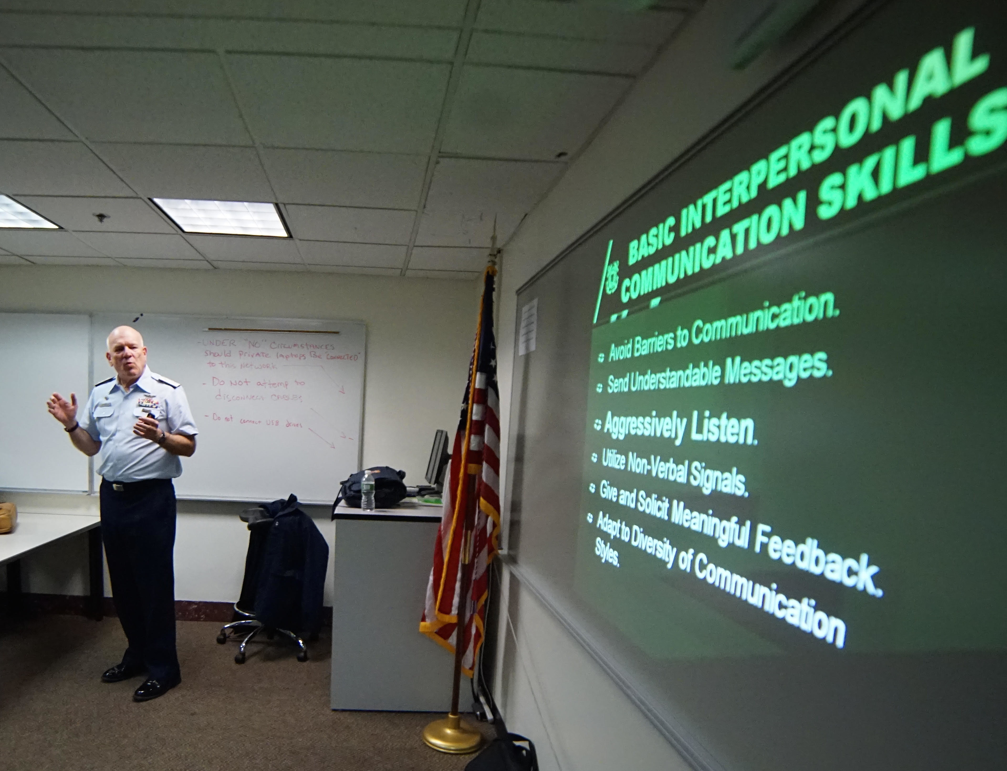
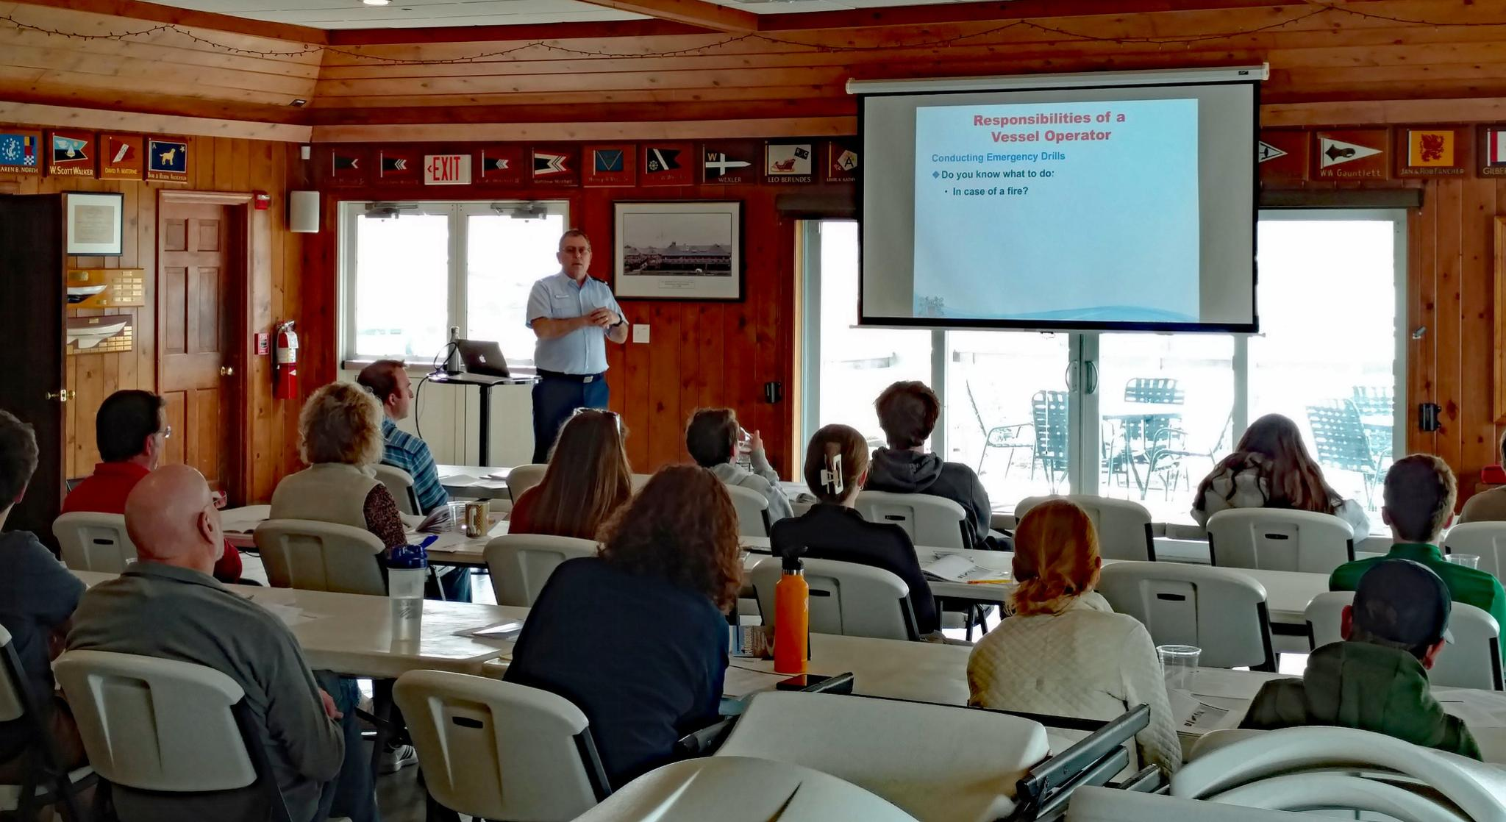
Key Point: Course Management
Boat America and Boating Skills & Seamanship Overview
Spanish Language Course Offerings
Public Education Officer Guidelines
Instructor Currency Requirements
Notes:
Course Management
Boat America and Boating Skills & Seamanship
Key differences between courses
State requirements and certifications
Updates to course materials
Scheduling considerations
Common student questions/concerns
Spanish Language Course Offerings
Available materials and resources
Instructor qualifications
Cultural considerations
Marketing to Spanish-speaking communities
Success stories and best practices
Public Education Officer Guidelines
Key responsibilities
Required documentation
Communication channels
Resource management
Timeline expectations
Instructor Currency Requirements
Annual teaching requirements
Continuing education expectations
Documentation procedures
Deadline reminders
Requalification process if needed

Slide 10


Key Point: Program Impact and Updates
Recruitment Through Public Education
Member Retention via Training
What's New for 2025
Notes:
Program Impact & Updates
Recruitment Through Public Education
Converting students to members
Effective recruitment techniques
Following up with interested students
Building relationships during class
Member Retention via Training
Connection between training and retention
Engaging members through advanced courses
Creating progression paths
Mentorship opportunities
What's New in 2025
New course offerings
Technology updates
Policy modifications
Future initiatives

Slide 11
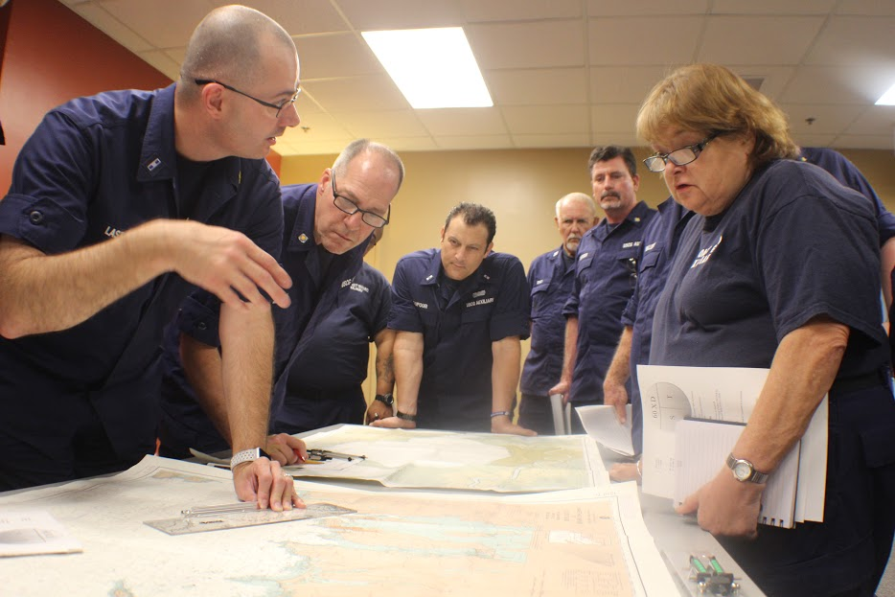
Effective Teaching
Engaging with students through meaningful dialogue and observation
Actively listening to ensure student comprehension
Creating interactive, two-way learning experiences
Notes:
Effective Teaching Practices:
Engaging through dialogue and observation
Watch for signs of understanding or confusion in students' facial expressions and body language
Note which concepts spark interest or generate puzzled looks
Use these visual cues to adjust your pace and explanation style
Call on students who seem eager to contribute
Pay attention to students who appear hesitant or confused
Active listening for comprehension
Ask open-ended questions to gauge understanding
Give students time to fully express their thoughts
Listen for misconceptions that need addressing
Notice patterns in student questions to identify challenging concepts
Validate student contributions while gently correcting misunderstandings
Creating interactive learning experiences
Start discussions with thought-provoking questions
Incorporate real-world examples that students can relate to
Encourage students to challenge ideas and share perspectives
Build on student responses to deepen understanding

Slide 12
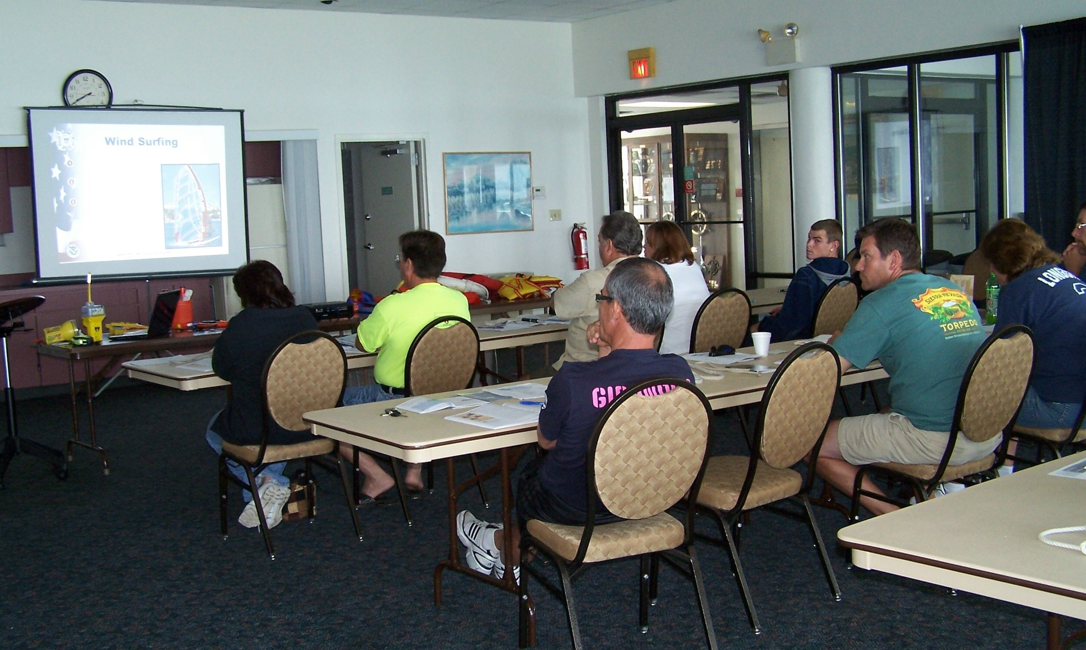
Effective Teaching
What to Avoid:
  Simply reading from slides or textbooks
  One-way information delivery
  Passive presentation of course materials
Notes:
What to Avoid:
Reading directly from materials
Slides should support your lecture, not be your lecture
Students can read slides themselves; your role is to provide context and deeper insight
Reading verbatim suggests a lack of preparation and expertise
One-way information delivery
Lecturing without pause for student input creates passive learners
Students retain less when they're not actively participating
Monotonous delivery can lead to disengagement and poor attendance
Passive presentation
Simply going through the motions defeats the purpose of in-person teaching
Students need guidance in applying knowledge, not just receiving it
Missing opportunities for valuable peer-to-peer learning
Remember:
Your expertise goes beyond the course materials
Students benefit from your real-world insights and examples
The classroom should be a space for active learning and discovery
Your role is to facilitate understanding, not just deliver information
Every class is an opportunity to inspire curiosity and critical thinking

Slide 13
E-Directorate Missions
Provide exceptional boating education to reduce:
  Loss of life
  Personal injury
  Property damage
Provide timely materials to support:
  All Instructors
  Public Education Staff Officers
Notes:
The mission of the Public Education Directorate of the US Coast Guard Auxiliary is two-fold: to provide exceptional boating safety education to the American public to reduce loss of life, personal injury, and property damage to recreational boaters and to deliver the highest possible quality training, resources, and timely materials in support of our flotilla instructors and public education staff officers at every level who are furnishing such boating safety education.
The Public Education Directorate is committed to helping realize those goals by reaching as many people with safe boating information as possible, especially high-risk boaters.
In addition, we have these goals:
Develop and/or maintain up-to-date and effective educational materials;
Continue to focus on the segment of the boating public most at risk;
Increase flotilla-taught basic boating safety education by at least 10% annually;
Provide and promote ongoing quality instructor development;
Make use of appropriate technological resources;
Adopt e-learning as a viable way to reach boaters;
Utilize e-learning to challenge and grow our instructor corps;
Partner with outside organizations where applicable to further boating education;
Continue to team with the experience and expertise of the other National Departments to provide solid programs and course content.

Slide 14
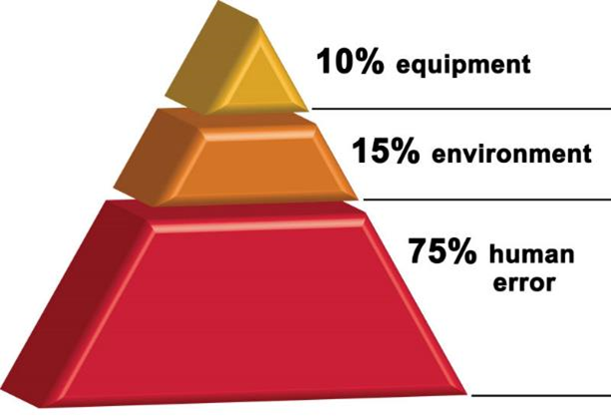
Risk Management
RM integrates human factors that are crucial for safe and effective mission execution:
  Mission analysis
  Leadership
  Adaptability and Flexibility
  Situational Awareness
  Decision-making
  Communication
  Assertiveness
Not just for operations – for all missions
Notes:
Deliberate risk management (RM) is critical to mission performance, safety, and asset preservation. Risk assessments provide the necessary information to plan, brief, execute, and monitor operations. Risk management training is intended to reinforce the principles and concepts of RM and to demonstrate how the information collected during the RM process is used during the critical phases of mission analysis, mission briefing, mission execution, and mission debriefing.
The emphasis is on deliberate RM and not waiting until the mission activity is imminent to begin RM actions. RM is essential to integrate the critical human factors (e.g., mission analysis, leadership, adaptability and flexibility, situational awareness, decision-making, communication, and assertiveness) that are indispensable for safe and effective mission execution.
Most of us think of risk management as related to underway operations. But there is a reason that members must take the Introduction to Risk Management to be certified as Instructors: risk is inherent in everything we do.
Clearly establishing the objective(s) of the mission/activity, identifying potential challenges that can compromise the safety and success of the mission, and discussing controls and mitigations for hazards establish expectations and a common operating picture. This process is critical for preventing common failures associated with human factors (e.g., leadership, adaptability and flexibility, situational awareness, decision-making, communication, and assertiveness). The RM process provides the necessary data for members to leverage the human factors during mission execution. For example, discussing hazards and corresponding controls during the brief will enhance communication, situational awareness, decision-making, and assertiveness since this common mental model is established. Without a common mental model, each member relies on their mental model to decide if/how they communicate, what is relevant for situation awareness, etc. RM is indispensable and directly influences critical human factors.

Slide 15
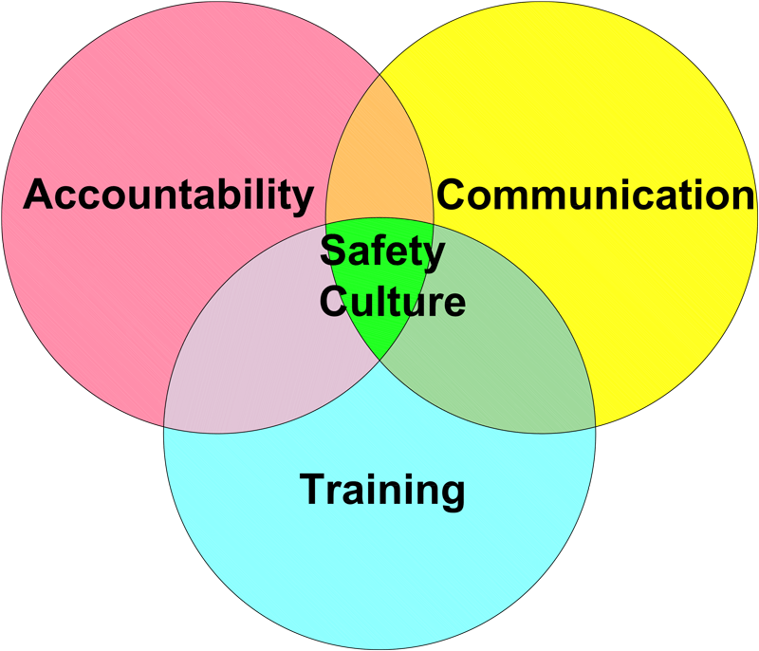
Risk Management
Culture of Safety
  Instructor Qualifications
  Practical Skills
  Interactive Learning
  Continuous Professional Development
Notes:
The culture of safety within the Coast Guard Auxiliary extends to its instructional activities, emphasizing the importance of educating both members and the public on safe maritime practices. We are a safety organization at our roots, and it’s part of our DNA.
Structured Training Programs:
Safety is integrated into various instructional courses, ensuring members receive a thorough education on safe boating practices, navigation, and emergency procedures.
Standardized Curriculum:
The Auxiliary uses standardized curricula for its training courses designed to meet or exceed established safety standards. This consistency helps ensure that all instructors convey essential safety information to students uniformly.
Instructor Qualifications:
Instructors undergo rigorous training and certification processes. This includes expertise in the subject matter, a deep understanding of instructional methods, and a commitment to emphasizing safety throughout their teaching.
Focus on Practical Skills:
Instructional activities often include hands-on, practical exercises that reinforce safety principles. Whether it's demonstrating the proper use of safety equipment or simulating emergency scenarios, the emphasis is on translating knowledge into practical skills.
Interactive Learning:
The instructional culture encourages interactive learning experiences, allowing participants to engage in discussions, ask questions, and share safety-related experiences. This approach fosters a more dynamic and effective learning environment.
Continuous Professional Development:
Instructors within the Coast Guard Auxiliary are encouraged to pursue continuous professional development. This includes staying informed about updates to safety regulations, technological advancements, and best practices in instructional techniques.

Slide 16

Risk Management
Culture of Safety
  Adherence to Regulations
  Safety Demonstrations
  Include safety brief/
  safety moment before each
  class
  Evaluation and Feedback
  Community Outreach
Notes:
Adherence to Regulations:
Safety instruction aligns with and reinforces relevant maritime regulations and standards. Instructors emphasize the importance of compliance with rules and regulations to ensure the safety of individuals on the water.
Safety Brief/Safety Moment:
Include a safety briefing/safety moment before each teaching session. This is especially important since we are trying to keep the culture of safety in the forefront.
Safety Demonstrations:
Instructors utilize safety demonstrations to provide visual and hands-on examples of safety practices. This may include demonstrating the proper use of life jackets, emergency signaling devices, and other safety equipment.
Evaluation and Feedback:
The culture of safety encourages regular evaluation and feedback. Instructors assess the effectiveness of their training sessions and seek input from participants to identify areas for improvement. This feedback loop contributes to ongoing enhancements in safety instruction.
Community Outreach:
Instructors actively engage in community outreach efforts to educate on safe boating practices. This may involve conducting boating safety classes, workshops, and other events to raise awareness and promote a culture of safety beyond the Auxiliary membership.
By integrating safety principles into instruction and fostering a culture that values continuous learning and improvement, the Coast Guard Auxiliary ensures its members are well-equipped to educate others on safe maritime practices.

Slide 17
Risk Management
Culture of Safety
Review the Classroom Safety Checklist on the E-Directorate Website in What’s New
http://edept.cgaux.org/pdf/Classroom%20Safety%20Checklist.pdf
Notes:
Risk management in a classroom setting involves identifying, assessing, and mitigating potential risks to ensure the safety, well-being, and effective students' and instructors' safety, well-being, and effective learning. Here are key considerations for risk management in a classroom:
Physical Safety:
Classroom Layout: Arrange furniture and equipment to minimize physical hazards and allow for easy movement.
Emergency Exits: Ensure clear and accessible emergency exits.
Equipment Safety: Regularly inspect and maintain classroom equipment to prevent accidents.
Health and Wellness:
Hygiene Practices: Promote good hygiene practices to prevent the spread of illnesses. This includes handwashing and proper disposal of tissues.
First Aid: Have a well-stocked first aid kit and ensure that instructors are trained in basic first aid procedures. If an AED is present, the instructor or aide should know how to use it.
Behavioral Management:
Classroom Rules: Clearly communicate and enforce classroom rules to maintain a positive and respectful learning environment.
Conflict Resolution: Equip instructors with skills for effective conflict resolution to address interpersonal issues among students.
Digital Safety:
Device Security: Implement measures to secure digital devices and protect against unauthorized access.
Emergency Preparedness:
Emergency Plans: Develop and regularly review emergency response plans, including procedures for natural disasters and other potential crises.
See the infographic on the E-Directorate website at: http://edept.cgaux.org/pdf/Classroom%20Safety%20Checklist.pdf

Slide 18

“Continuous improvement is better than delayed perfection.”
Mark Twain
Notes:
The quote "Continuous improvement is better than delayed perfection" is often attributed to Mark Twain, although there is some debate about its origin. Regardless of the source, the quote’s meaning is clear and relevant in various contexts.
The quote emphasizes the value of ongoing progress and gradually refining things rather than waiting for a perfect outcome. It suggests that constant, incremental improvements are preferable to striving for absolute perfection, which may result in delays or inaction.
In a practical sense, it encourages individuals and organizations to focus on making consistent strides toward improvement rather than getting bogged down by pursuing an idealized, flawless result. It acknowledges that perfection may be elusive and time-consuming and that the pursuit of continuous improvement allows for adaptability, learning from mistakes, and evolving over time.
This mindset is particularly relevant in the Coast Guard Auxiliary and our instructors, where the emphasis is on learning from experience, making adjustments, and steadily moving forward rather than waiting for an impractical level of perfection that may never be achieved.

Slide 19
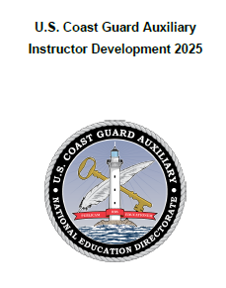
Instructor Responsibility
Self-preparation
  Why is this important?
  What are some ways to self-prepare?
Continue to educate yourself in areas of interest
  Take advantage of our many training courses
Notes:
We must reassess our teaching techniques and lesson plans constantly. Besides using lesson plans for all classes you teach, update those lesson plans with lessons learned.
Ask other flotilla Instructors to give you a critique of your instruction. Ideally, in a classroom setting, set up a smartphone to record your class instruction. Similarly, in a virtual environment, enable the record function. You will be amazed at how much you can learn about your instructional techniques and easily pinpoint areas that require improvement.
Take advantage of any and all training opportunities that will further your knowledge of the subjects you want to teach or mentor.
To help instructors and would-be instructors get the best training possible, the E-Directorate will be updating the Instructor Development (ID2020) with an ID2025 course that should be available within the first quarter of 2025. All instructors will be encouraged to upgrade their skills by learning the material in this updated version.

Slide 20
Instructor Responsibility
Planning the lesson
Room setup
Classroom hands-on exercises
Discussions
  Example: “MOB- what would you do?”
Humor- when and how
Guest speakers or other resources
Paperwork
Notes:
These are essential topics. These apply to both Public Education and Member Training classes.
Can everyone in the room see the screen or whiteboard? The instructor needs to walk around the room while setting up and make sure.
Is the room set up to make facilitation and learning more accessible? Many feel that “U” shaped table arrangements are better suited for discussions than the traditional “classroom” style of tables in rows. Can the instructor freely circulate around the room and interact with the class?
How can you make the material in the class as close to the participant’s real-life boating experiences as possible? Use hands-on exercises that get the class involved in doing. Get the class involved through discussion. There is a wealth of experience within every group; a good instructor will realize and capitalize on that.
Humor as an icebreaker works well. Use it tastefully and never at anyone in the class’s expense.
Use other “subject matter experts.” Firefighters, EMTs, Harbor Patrol, Park Rangers, sailing instructors, active-duty Coast Guard, and others are excellent resources who can bring a depth of knowledge to the session.
You’ve heard the expression, “If it’s not in AUXDATA II, it didn’t happen.” Send the appropriate 7030s to your FSO-IS to record your hard work in MT or PE. Even better, get familiar with AUXDATA II and complete the entries directly yourself. Or follow district or division policy.

Slide 21
Instructor Development (ID2025)
Scheduled for First Quarter 2025
Updated based on:
  Experience teaching ID2020 in numerous MT classes
  Lessons learned – what worked and what could use improvement
Employs concrete examples and sample questions
Supporting material is updated – instructor notes and slide deck
Notes:
With a view toward continuous improvement and the value of lessons learned, the E-Directorate will update ID2020 in the first quarter of 2025 to ID2025.
The emphasis of the course will still be on the practical aspects of Auxiliary instruction. But the material will be supplemented with concrete examples, sample questions to use in a classroom, and more information on virtual classrooms using platforms like Zoom, Webex, and Teams.
ID2025 will build on ID2020 and will take advantage of five years of use that trained many new Auxiliary instructors.

Slide 22
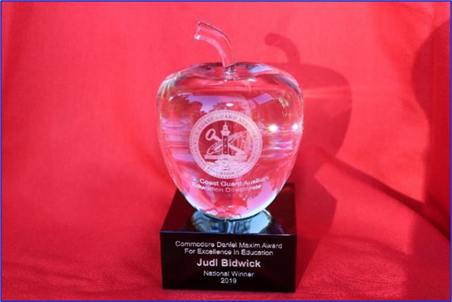
Awards
Maxim Award is intended to motivate instructors:
  To achieve excellence in instruction
  Develop innovative methods and training aids
  Increase mentorship
  Nominated by flotilla no later than February 28th
Notes:
The Commodore Daniel Maxim Award for Excellence in Education was established to motivate and inspire the entire Instructor cadre to reach beyond the comfortable or ordinary to achieve the extraordinary. Some of the goals of the Award are to increase the diversity of courses offered by flotillas and additional numbers of classes offered; to improve Public Education and Member Training Instructor effectiveness and performance; to improve mentorship of newer or lesser experienced Instructors; to develop new and innovative teaching methods and techniques; to develop new and innovative teaching aids.
Visit the E-Directorate website for examples of past winners’ submission packages and award templates for division and flotilla candidates. A best practice that has been suggested is that a flotilla compile a list of their best candidate(s) with bullet points of their assets as instructors. Work with the DSO-PE to see about fleshing out the package for actual development into an award submission.
The Commodore Daniel Maxim Award for Excellence in Education material is found at:
http://wow.uscgaux.info/content.php?unit=E-DEPT&category=maxim-award
Flotillas should consider assembling a team now to begin accumulating supporting documentation for the number of courses taught, the number of graduates, the variety of courses taught, and all other data and testimonials deemed pertinent to preparing the nominee package. Flotilla nomination packages will be due to their DSO-PE on February 28.
NOTE: Schedule
Package from flotillas to DSO-PE: 28Feb.
The district selected package to Dir-E and Dir-Ed: 30 Apr.
NOTE: Eligibility
All instructors in the CG Auxiliary are eligible if nominated for the Maxim Award except a prior National Prize Winner or a member of the Public Education Directorate.

Slide 23
Awards
Golden Key and Lighthouse
Designed to reward instructors:
  Instructing 50-99 lead hours in a year – Golden Key Award
  Instructing 100 or more lead hours in a year – Lighthouse Award
Recognizes our instructors who go over and above – our superstars
Notes:
The E-Directorate has created two additional award certificates to recognize your hard work and dedication to teaching. These new certificates acknowledge the sheer number of instruction hours that instructors have logged in a single year. The current Auxiliary Annual PE Service Performance ribbon recognizes those who have completed 30 hours of instruction. But we all know that there are some instructors out there who go way beyond that mark. Those instructors will be rewarded with the prestigious E-Directorate Golden Key Award for any combination of 50 lead hours of Public Education and/or Member Training instruction!
For those truly exceptional instructors who have gone the extra mile, there's the illustrious E-Directorate Lighthouse Award. This award is reserved for instructors who have put in an incredible combination of 100 PE and/or MT lead hours. It's an achievement that shines like a beacon in the night, guiding others toward excellence.
If you're an instructor who's been working tirelessly, pushing yourself to new heights, then these awards are for you. These awards let the world know that you're a true superstar in the field of teaching and that your dedication and hard work have not gone unnoticed. This is a marvelous opportunity to be recognized for your extraordinary commitment to education. If you're ready to shine bright like a lighthouse or unlock the golden door to success, start putting in those lead hours and let the Education Directorate reward you for your hard work and dedication!
Whether you're striving for the Golden Key or the Lighthouse Award, you know you're part of an elite group of instructors who are making a real difference in the world. Get ready to shine because the Education Directorate has just turned up the excitement factor to 11!

Slide 24
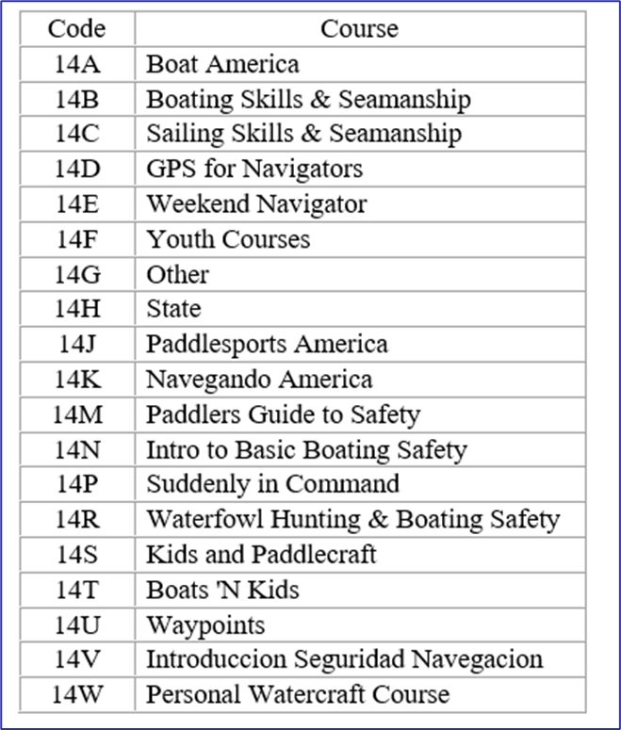
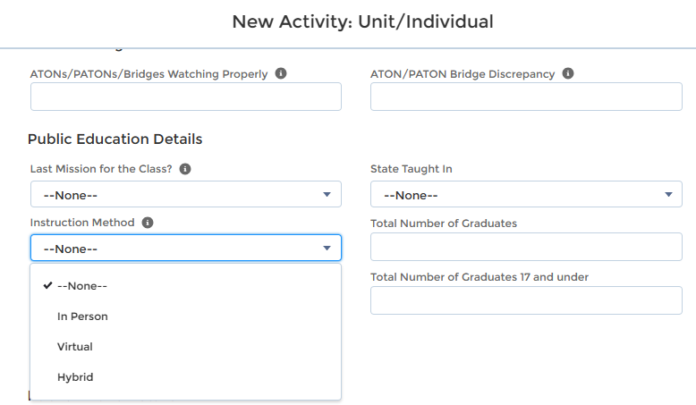
New AUXDATA II Codes
AUXDATA II Public Education Codes Updated
Additional courses added
Checkbox for in-person, virtual, or hybrid classes
Notes:
The following mission activity code descriptions have been updated to clarify the reporting of efforts related to the Auxiliary Public Education mission:
14A Boat America
14B Boating Skills & Seamanship
14C Sailing Skills & Seamanship
14D GPS for Navigators
14E Weekend Navigator
14F Youth Courses
14G Other
14H State
14J Paddlesports America
14K Navegando America
14M Paddlers Guide to Safety
14N Intro to Basic Boating Safety
14P Suddenly in Command
14R Waterfowl Hunting & Boating Safety
14S Kids and Paddlecraft
14T Boats 'N Kids
14U Waypoints
14V Introduccion Seguridad Navegacion
14W Personal Watercraft Course
There is now a drop-down box to indicate if the class is in-person, virtual, or hybrid. This was implemented to help the E-Directorate provide valid data in various reports to support requests from multiple agencies.

Slide 25
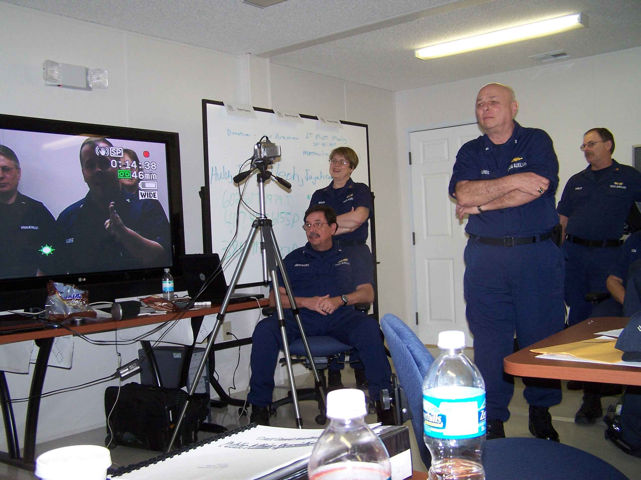

Marketing Public Education Classes
  During VSCs and RBS Program Visits
  Conduct a media blitz
  Tell the world - use the Web and Social Media
  Talk it up!
  Sign them up at boat shows
Notes:
During Vessel Safety Checks (VSCs) and Recreational Boating Safety (RBS) Program Visits:
Go with the Vessel Examiner (VE) or Program Visitor (PV) or provide schedules.
Conduct a media blitz:
The Flotilla Staff Officer-Public Affairs (FSO-PA) can help.
Tell the world - use the Web:
Post your schedule on your website and keep it current.
Social Media presence
Fill out the 7023 form for all courses offered
Talk it up:
Tell everyone you meet.
Sign them up at boat shows:
Don’t just hand out schedules; sign them up on the spot! Use your laptop to key their information while they wait!
Collect course fees and give receipts.
Consider a raffle for a free PE class.
More people will enter their names.
Use as contacts later for classes.
When promoting PE classes, making the registration and course payment as frictionless and seamless as possible is essential. There are numerous programs/applications that flotillas have used successfully. Some of these are:
Eventbrite
SignUpGenius
Google Forms
PayPal
Square
Collecting payment up front greatly enhances the probability that the students will attend the class. Make this a good customer service experience for the student if they have a conflict and must change dates or give them a refund if that is the right thing to do. Approach the experience from the student’s point of view when you set up your system to handle payments and registration. Make it as friction-free and easy as possible.
Note: The E-Directorate has detailed instructions to help a flotilla set up payments via PayPal at:
http://wow.uscgaux.info/content.php?unit=E-DEPT&category=virtual-pe-classes

Slide 26
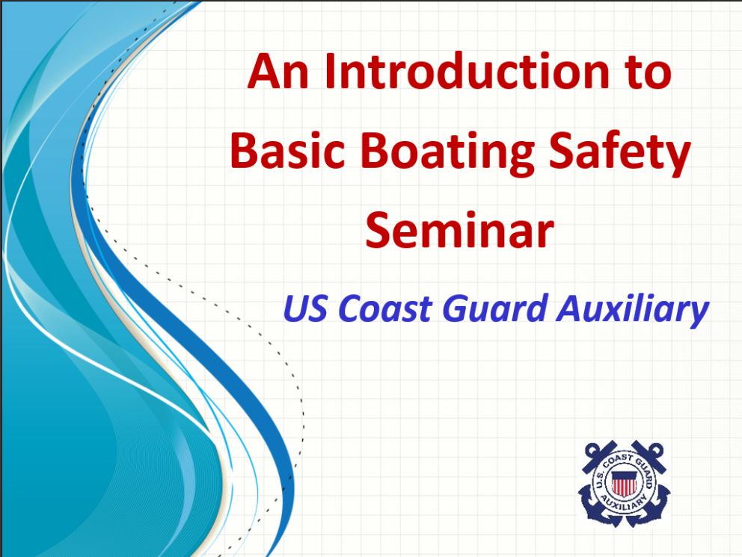

Marketing Public Education Classes
  Contact the local court
  Liaison with local insurance agents
  Use “bite-sized” seminar courses
  Think “non-traditional”
  Take advantage of “word of mouth”
Notes:
Contact the local court:
Federal and local law enforcement agencies often include mandatory boating education as part of the penalty for boating violations. By collaborating with local courts, flotillas can propose offering the 'Boat America' course as a solution for addressing these infractions
Liaison with local insurance agents:
Ask them to share your Public Education (PE) class schedule with clients. Insurance offices are also ideal locations for Program Visitors to set up as Program Partners.
Use “bite-sized” courses:
Mini-classes/seminar courses for clubs and schools.
Seminar courses work well for yacht and fishing clubs.
Sign them up for a full class on the spot!
Think “non-traditional:”
Hunting and fishing clubs.
Paddlesports clubs.
Public Works departments.
Referrals are among the best ways to drive students to our classes. A class member who had a good experience will talk up the class to their family and friends.
Ask students to post their class participation on their social media
Design gift certificates that graduates can buy for friends and family
The E-Directorate offers numerous documents to assist the flotillas in marketing their courses. Go to
http://wow.uscgaux.info/content.php?unit=E-DEPT&category=marketing for access to these documents behind the Member Zone firewall.

Slide 27
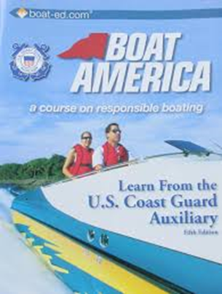
Boat America
  Boat America offered as NASBLA-approved certificate course
  Order from AUXCEN (Shop Auxiliary)
    https://auxcen.com/public-education/
  Find the slides with instructor notes and the state supplement slides at:
    http://wow.uscgaux.info/content.php?unit=E-DEPT&category=nasbla-courses
Notes:
The E-Directorate encourages flotillas to embrace Boat America. The slides and instructor notes are included on the E-Directorate website under a Member Zone-protected section titled PE Courses.
The state supplements are also on the website for Boat America, thus ensuring ease of use for flotillas teaching this certificate course. Whenever a state requests changes to its slides and/or test, the Division Chief for Course Development implements the updates and then notifies the appropriate District Staff Officer-Public Education (DSO-PE), who passes the information down to the Division and Flotilla Staff Officers-Public Education (SOs-PE and FSOs-PE).
Flotillas are encouraged to add to the slides any appropriate material that will enhance the presentation and make it applicable to the local area. Remember, you can’t delete material but can add appropriate items to explain a point better, such as additional slides, videos, etc.
This course works well for both in-person delivery and via virtual platforms.
Find the slides with instructor notes and the state supplement slides at:
http://wow.uscgaux.info/content.php?unit=E-DEPT&category=nasbla-courses
The Auxiliary Manual, Chapter 2, section B.13.d, states: The Coast Guard Auxiliary Association, Incorporated (CGAuxA, Inc.) develops and publishes and/or acquires and distributes course materials and examinations. These materials are to be used to conduct all Auxiliary PE courses. …Course materials are only purchased from Coast Guard Auxiliary district material centers or the Auxiliary Center (AUXCEN). Course books, appropriate tests, marking templates, and evaluation forms are sold and shipped according to the current pricing available on the AUXCEN website. (https://auxcen.com/public-education/)
Auxiliary National Supply Center: ANSC supplies Auxiliary units with a wide variety of brochures that are appropriate to supplement the course book and class information at no charge to the flotilla. The current ANSC catalog lists all the materials available to the public education instructor. The materials officer usually does the ordering. The catalog is located in the AUX MEMBERS drop-down menu on cgaux.org.

Slide 28
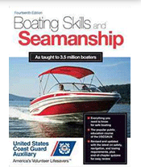
Boating Skills and Seamanship
  No longer offered as NASBLA-approved certificate courses
  Suggestion: Teach Boat America and use the Boat America Exam, then add BS&S chapters for a full course.
+
Notes:
It is unfortunate, however, Boating Skills and Seamanship (BS&S) is no longer NASBLA-approved. The process and cost were too much.
The Public Education Directorate suggests that flotillas teach Boat America and use the state-appropriate Boat America exam. Then, if the flotilla wants (or needs) to expand the lessons to include all the chapters normally included in Boating Skills and Seamanship, they can add them.
The Public Education Directorate is exploring updating the supplemental chapter of BS&S to make it even more practical to offer Boat America plus the remaining BS&S units.
Flotillas are encouraged to add to the slides any appropriate material that will enhance the presentation and make it applicable to the local area. Remember, you can’t delete material but can add appropriate items to explain a point better, such as additional slides, videos, etc.
These courses work well for both in-person delivery and via virtual platforms.
Find the slides with instructor notes and the state supplement slides at:
http://wow.uscgaux.info/content.php?unit=E-DEPT&category=nasbla-courses
The Auxiliary Manual, Chapter 2, section B.13.d, states: The Coast Guard Auxiliary Association, Incorporated (CGAuxA, Inc.) develops and publishes and/or acquires and distributes course materials and examinations. These materials are to be used to conduct all Auxiliary PE courses. …Course materials are only purchased from Coast Guard Auxiliary district material centers or the Auxiliary Center (AUXCEN). Course books, appropriate tests, marking templates, and evaluation forms are sold and shipped according to the current pricing available on the AUXCEN website. (https://auxcen.com/public-education/)
Auxiliary National Supply Center: ANSC supplies Auxiliary units with a wide variety of brochures that are appropriate to supplement the course book and class information at no charge to the flotilla. The current ANSC catalog lists all the materials available to the public education instructor. The materials officer usually does the ordering. The catalog is located in the AUX MEMBERS drop-down menu on cgaux.org.

Slide 29
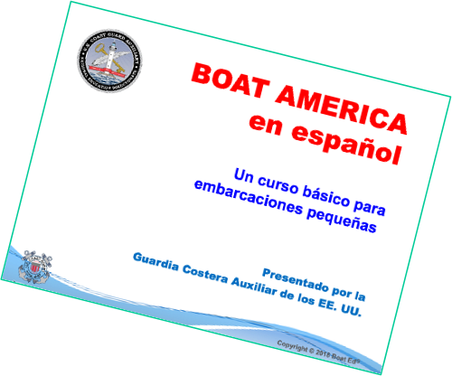
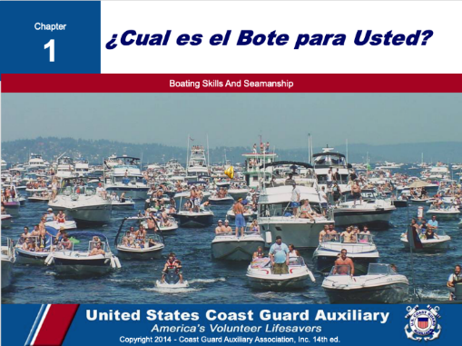
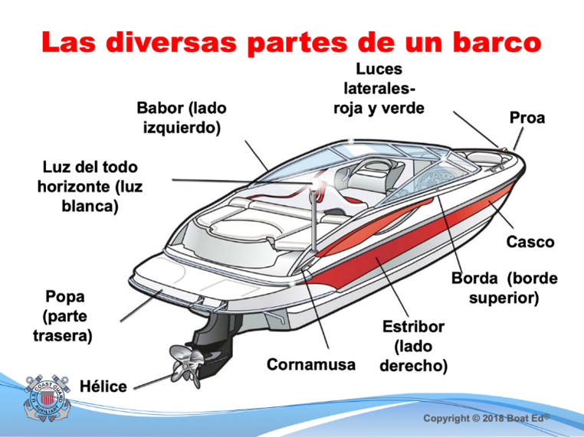
Spanish Language Classes
  Spanish-speaking boaters:
    Represent fast-growing boat buyers
    Emerging market of first-time boat buyers
    Under-served boating education market
  All slides, instructor notes, and exams in Spanish - books are offered only in English
Notes:
A 2017 study published by the National Marine Manufacturers Association, Recreational Boating & Fishing Foundation, and Discover Boating showed that Spanish-speaking boaters represent a fast-growing, emerging market of first-time boat buyers. In response, the E-Directorate is rolling out a series of courses translated into Spanish. All supplemental material – PowerPoint Slides, Instructor Notes, and Final Exams are all in Spanish; the textbooks will remain in English.
These Spanish language courses can be found on the Public Education website on the left menu under PE Courses (protected by the Member Zone password). The first one below is a National Association of State Boating Law Administrators (NASBLA) course. Boating Skills and Seamanship can be combined with Boat America to make it NASBLA-approved. The other is a Seminar Course.
Boat America
Boating Skills and Seamanship
Introduction to Basic Boating Safety
The Spanish language courses are available at:
http://wow.uscgaux.info/content.php?unit=E-DEPT&category=pe-courses
A team of bi-lingual CG Auxiliary members converted all Boat America and Boating Skills and Seamanship slides, instructor notes, and examinations into Spanish. This effort is intended to help educate Hispanic community members about safe boating in their native language. Similarly, they converted the seminar course Introduction to Basic Boating Seminar. This is often an introductory course leading to students signing up for the NASBLA-certified course.

Slide 30

I’m the Flotilla Staff Officer-Public Education, Now What?
  Available on the E-Directorate Website
Notes:
One of our most important missions is to offer safe boating classes to the recreational public. This new training course is designed for both the new Flotilla Staff Officer-Public Education (known as FSO-PE) and for those returning to the position who want to learn best practices.
The FSO-PE position is critical to the Coast Guard Auxiliary’s Recreational Boating Safety mission and the flotilla’s finances. Once a member has mastered the Flotilla Position, there’s the Division Staff Officer, Assistant District Staff Officer, and even District Staff Officer. Each position is a learning experience and can prepare the member to advance to more responsibility.
As the FSO-PE you:
Supervise and schedule qualified Auxiliarists to perform specific activities in support of the Public Education Program.
In close coordination with the FSO-PA, plan, organize, and direct programs and activities to promote and publicize boating safety and Auxiliary Public Education Courses.
Ensure that the Human Resources Staff Officer is given time to discuss the Auxiliary and Auxiliary membership in every public education course.
Maintain close liaison with the Division PE Officer to implement the public education programs established for nationwide, district, and division use.
Coordinate and cooperate with the FSO-MT to increase the number of qualified instructors.
Maintain close contact with flotilla instructors to encourage increased activity and maintain uniformly high standards.
Forward to the Division PE such methods, training aids, course materials, or other educational tools developed within the flotilla that may have division-wide applications.
Encourage and assist in developing training aids for use by flotilla instructors.
Be familiar with the course content and instructional requirements of all approved PE courses.
Ensure that instructors have coordinated in advance to have necessary training aids, screens, projectors, and handouts on hand before class. Report as required to the Flotilla Vice Commander and Division Public Education Officer all progress and activities in the field of public education.
Enter the class information (instructor time, graduates, etc.) into AUXDATA II and submit student information to the state (if required)

Slide 31
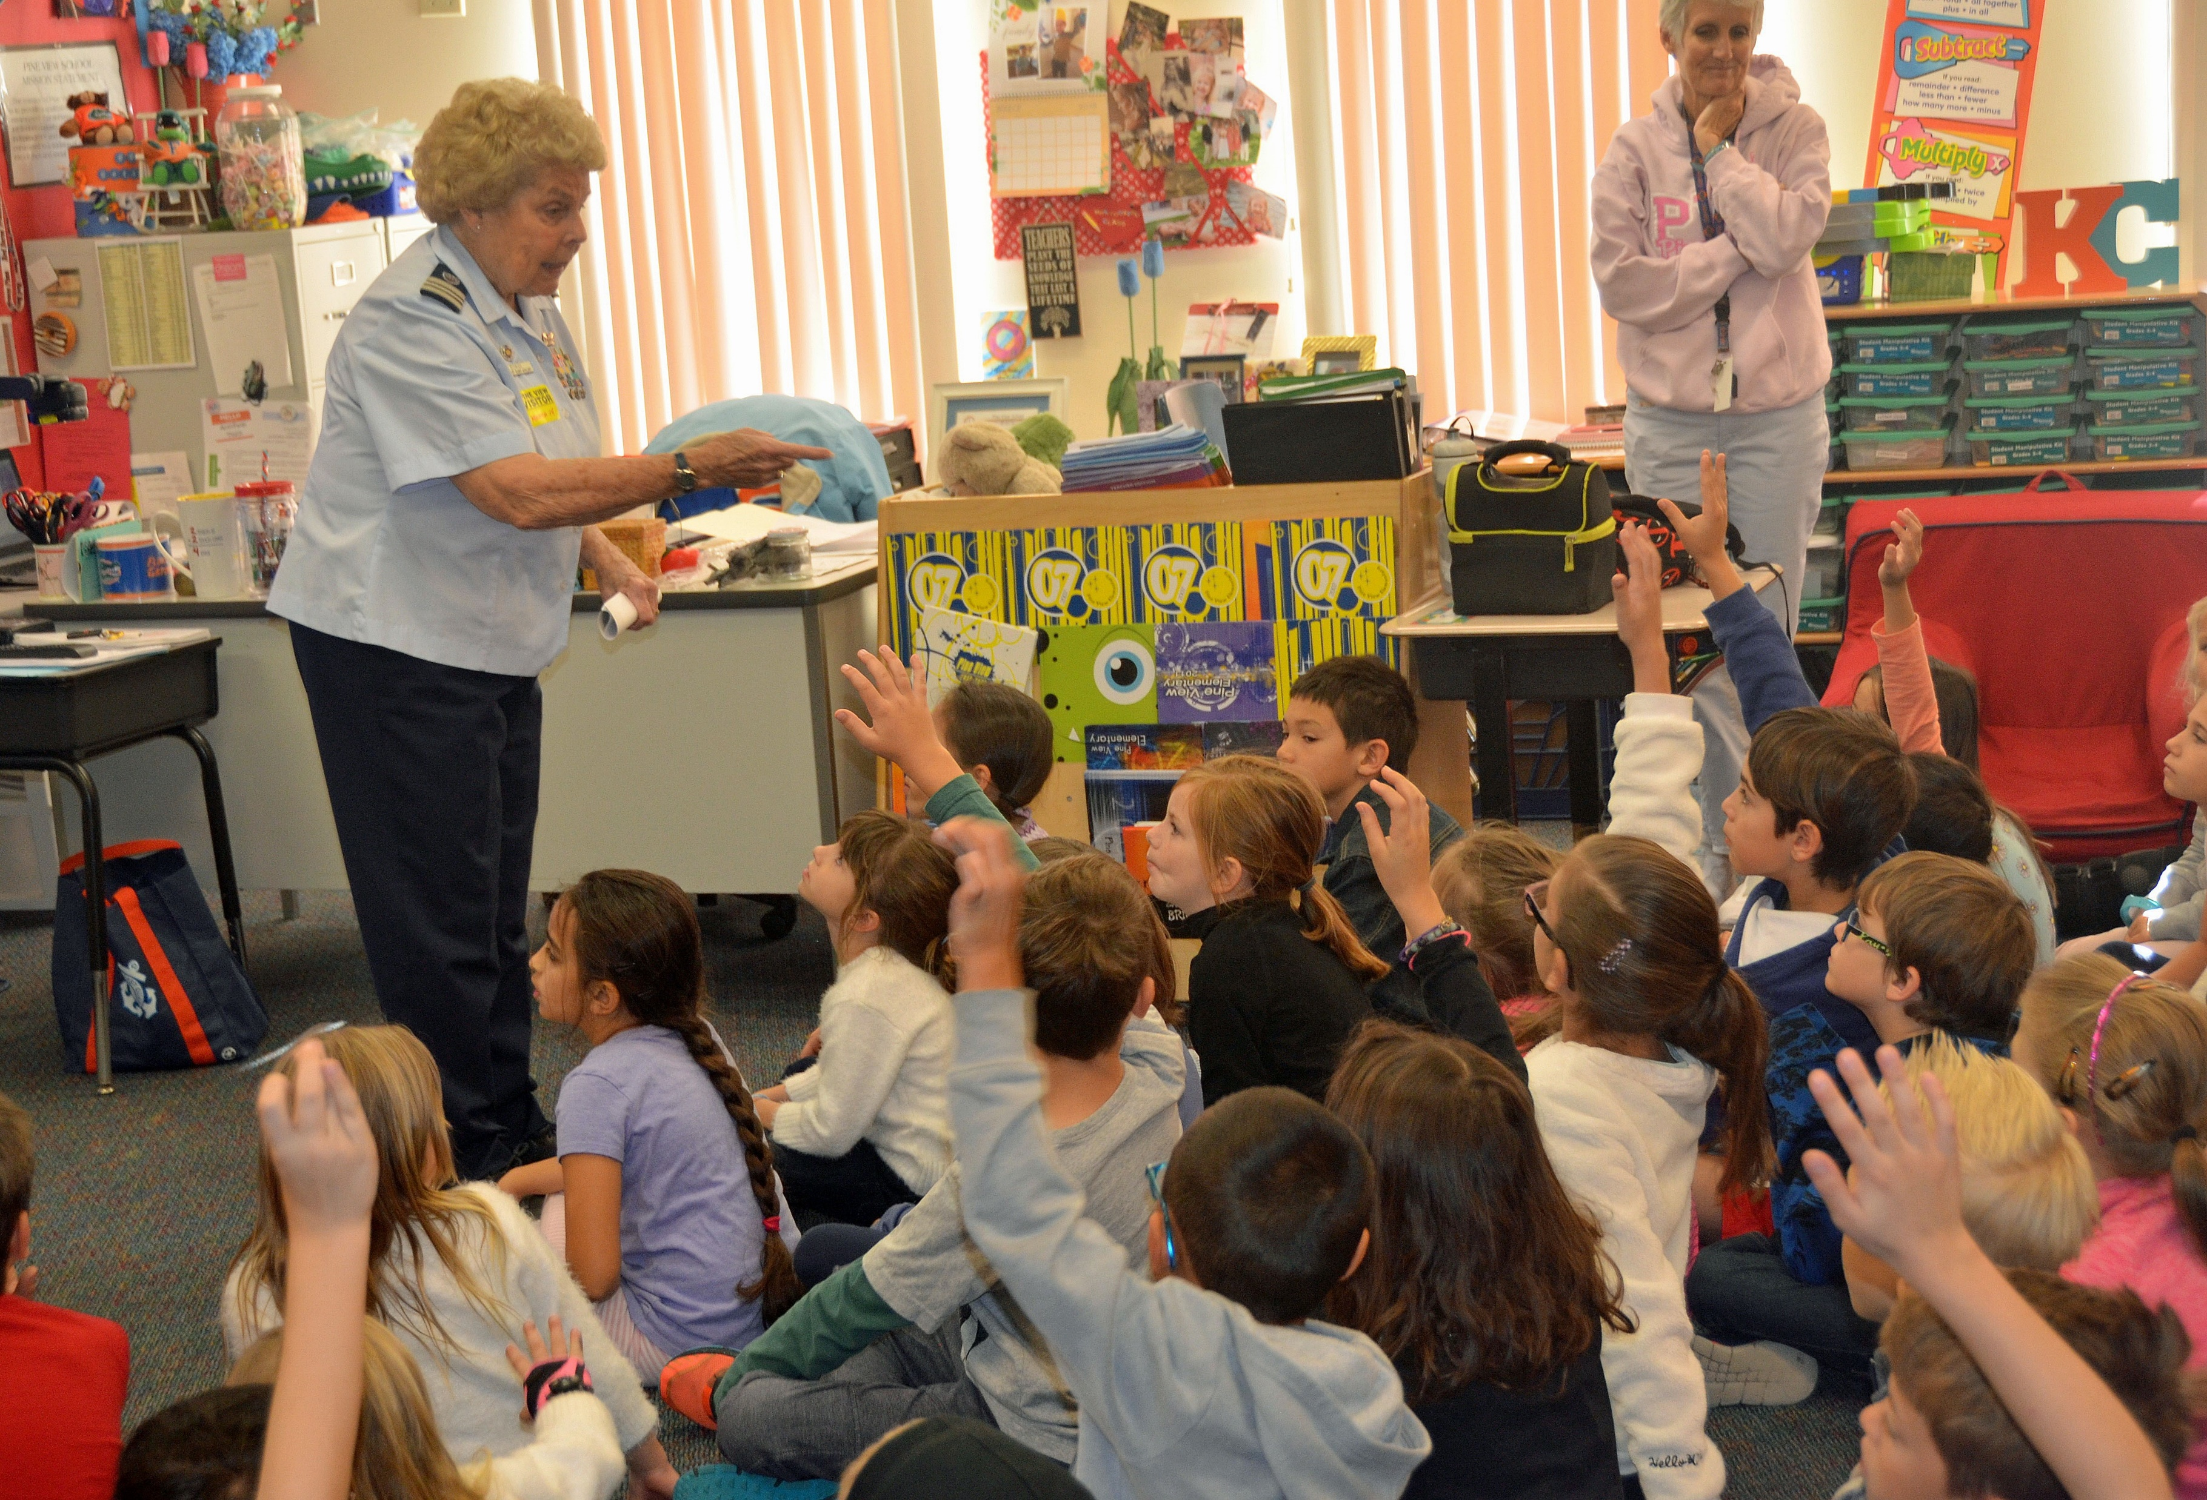
Instructor Currency Maintenance
  2025 Instructors must meet standard currency maintenance requirements
    Two hours as a lead instructor or;
    Four hours as a non-lead instructor or;
    A combination of both
  Missed 2024 Required Instructor Hours?
Notes:
The current policy is that instructors must maintain currency in 2025. This includes:
Two hours as a lead instructor or;
Four hours as a non-lead instructor or;
A combination of both;
Plus, it is highly recommended that the 2025 instructor workshop be completed.
If a member failed to complete the required hours as lead and/or non-lead instructor in 2024, they became REYR – required yearly task not met – for 2025 and need to make up the deficit during 2025 to recertify as an instructor.
If the member failed to instruct for two hours as lead or, four hours as non-lead, or a combination of both, they need to complete the missing hours in 2025 as a trainee and have those hours entered into AUXDATA II. The member needs to complete the 2025 workshop; they must review it and sign the self-attestation form. This form is then submitted to the Information Services Officer for entry into AUXDATA II.
Once the trainee hours and self-attestation form are entered in AUXDATA II, the Flotilla Commander needs to notify their district DIRAUX according to district policy to re-certify the member as an instructor.
To remain an instructor in 2025 after being recertified, the member must teach:
Two hours as a lead instructor or;
Four hours as a non-lead instructor or;
A combination of both;
NOTE: This all assumes the member is current in Core Training.

Slide 32
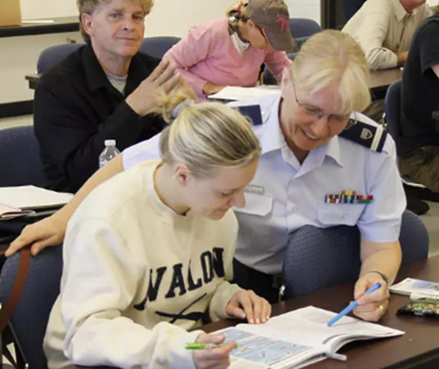
Recruiting via Public Education
  Plenty of handouts
  Show common interests
  Actively mention your flotilla
  needs
  Be approachable
  Talk to students, not to each
  other
  Work in local pictures or anecdotes onto slides
  The Auxiliary message, every time!
Notes:
Our Public Education classes can be very effective recruiting opportunities. Here are some ideas:
Offer meetings with the Flotilla Staff Officer-Human Resources (FSO-HR) and other Flotilla Staff Officers.
Distribute plenty of handouts to the students. Showcase various Auxiliary missions.
Show common interests. Build rapport with students.
Actively mention your flotilla needs. Not just boats- finance, computer skills, etc.
Be approachable. Set the mood and establish rapport with students when they arrive in the classroom. Engage in conversation to find out about them one-on-one. Don’t wait for class introductions. You want to break down barriers that will allow you to have two-way communication once the class begins. Spend as much time as you can one-on-one with students rather than just using lectures. Use your class aides to assist whenever possible – be a team.
Walk around the room; don’t remain behind the podium. During breaks, remain available for students to ask questions. Ask students about their boats, boating experience, and boating mishaps.
Talk to students, not to each other. Instructor cliques scream – “don’t bother talking to me – you are not part of my world.” Talk up our missions to them individually. Whenever possible, instructors should make themselves available to the students and avoid congregating in groups of other Auxiliarists. Avoid “inside jokes” and “acronym lingo” when having discussions with students. Always use plain English – use “life jackets” and not “PFDs.”
What does your flotilla need?
Work in local pictures or anecdotes.
The Auxiliary message, every time! Work recruiting topics into every session. Make recruiting part of the lesson plan. Deliver benefits of membership constantly. Show your enthusiasm for what you do. Showcase a local event/experience every class. If you are not having fun presenting the class, it will show and destroy the image you are trying to create. Remain positive and highlight the successes of your flotilla, division, or district.

Slide 33
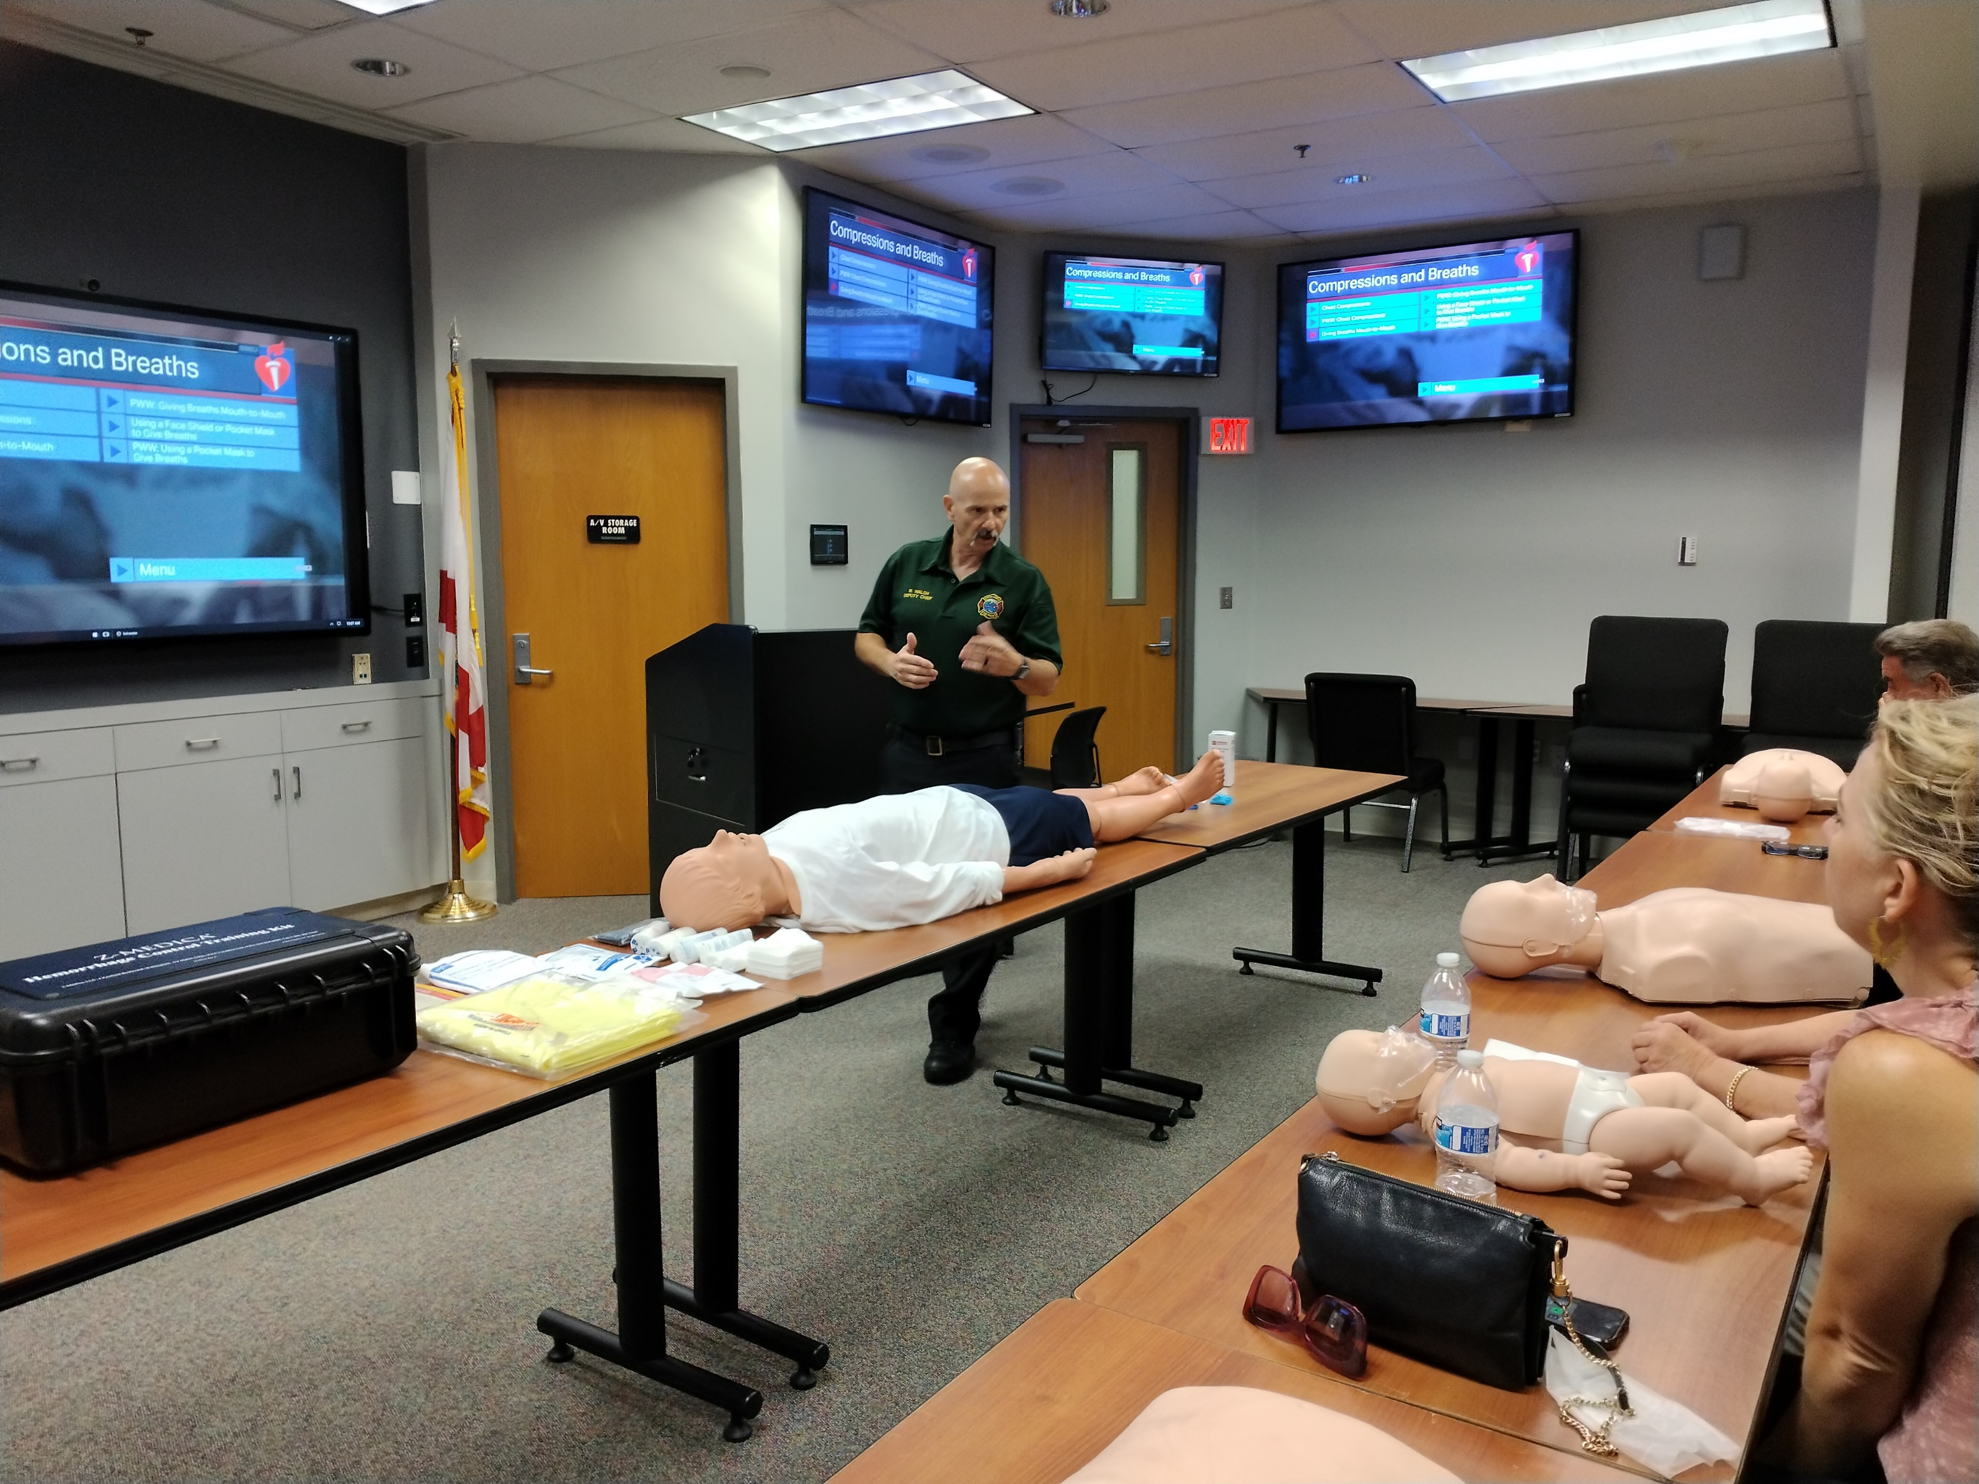
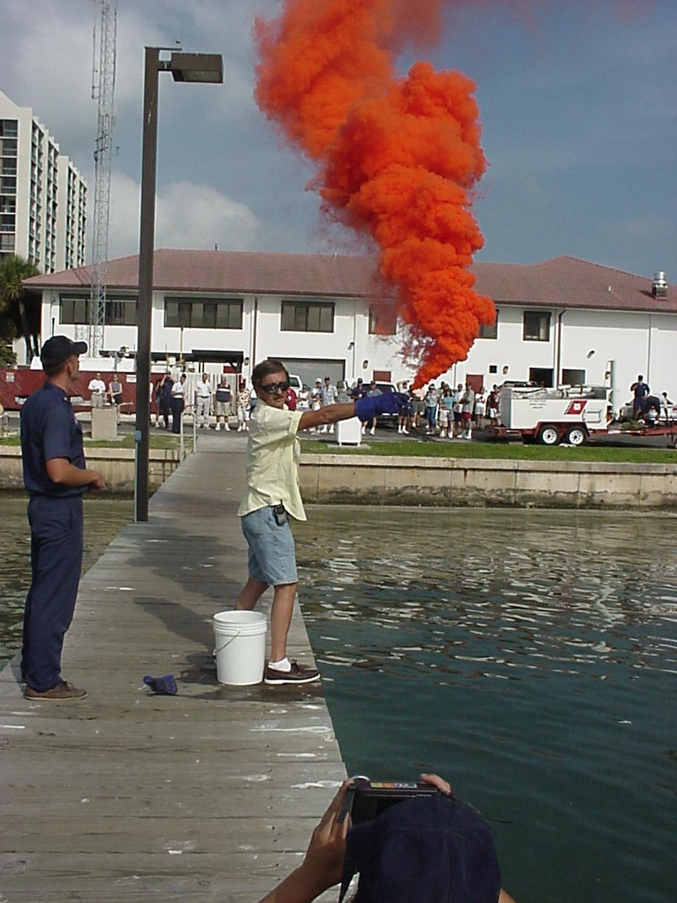
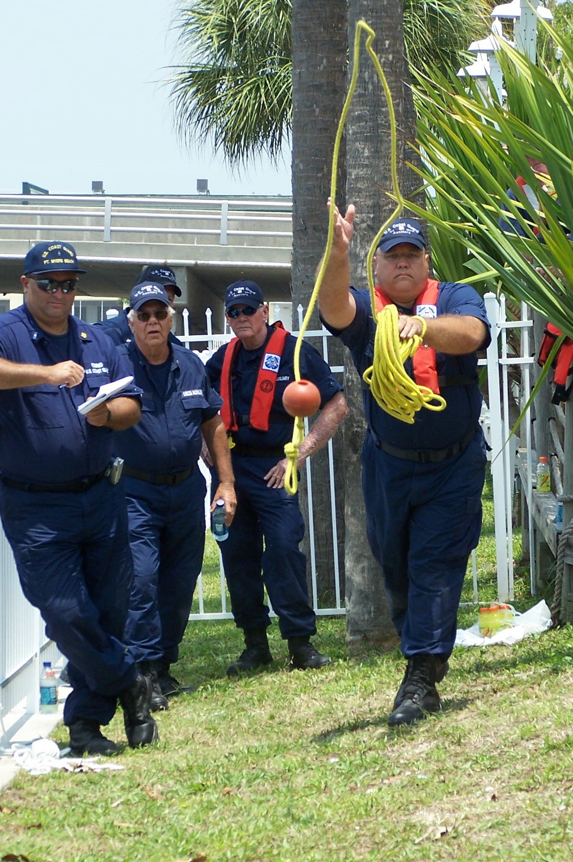
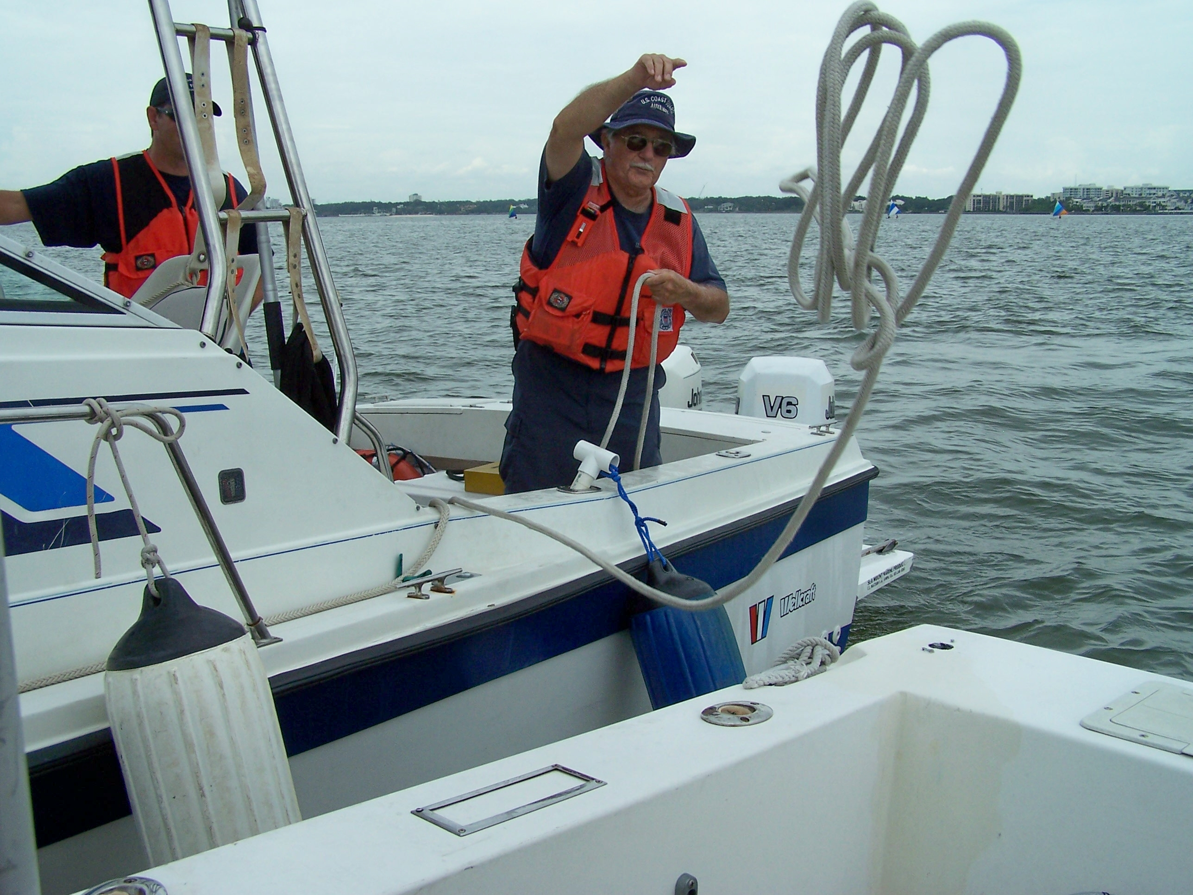
Retention via Member Training Excellence
  Quality Training = Strong Membership
  Building Competent, Confident Members
  Fostering Team Unity and Camaraderie
  Promoting Continuous Growth
  Recognizing Achievement
Notes:
Quality Training = Strong Membership
Direct correlation between training quality and member engagement
Well-trained members stay active longer
Professional instruction reflects organizational values
Investment in training shows commitment to member development
Share specific examples of how quality training improved unit performance
Building Competent, Confident Members
Competence breeds confidence
Members who feel capable take on more responsibilities
Reduced anxiety in operational situations
Better preparedness for real-world scenarios
Members become mentors to others
Fostering Team Unity and Camaraderie
Training creates natural networking opportunities
Shared experiences build lasting connections
Group learning strengthens unit cohesion
Members support each other's growth
Training events become team-building opportunities
Promoting Continuous Growth
Learning never stops
New challenges keep members engaged
Advanced training opportunities
Cross-training benefits
Career development pathways
Recognizing Achievement
Celebrate training milestones
Acknowledge instructor contributions
Share success stories
Awards and recognition programs
Highlight member advancement

Slide 34
What’s on the Horizon?
  Updated Suddenly in Command
  Instructor Development 2025
  Workshop and Instructor Development on Auxiliary Classroom
  Marketing to current CG Auxiliary members to achieve Instructor certification
  Marketing to recruit new members who are already teachers/professors
  Master Instructor
Notes:
We recommend you regularly check the E-Directorate website for new courses and review the course catalog to see about expanding your class offerings.
What's on the Horizon? There are several exciting initiatives planned for 2025. These projects aim to enhance our instructional capabilities and expand our instructor pool while maintaining the high standards the public expects from the Coast Guard Auxiliary.
The 'Suddenly in Command' course is being refreshed to incorporate new boating technologies, updated emergency procedures, and real-world scenarios from recent incidents. This vital course helps prepare boaters for emergencies when they unexpectedly need to take control of a vessel. The updates will ensure that the material remains relevant and practical for today's recreational boaters.
Our Instructor Development program is evolving to meet modern educational needs. We're incorporating more digital teaching methods, hybrid learning options, and updated pedagogical techniques. This modernization will help our instructors better connect with diverse learning styles and age groups while maintaining our commitment to hands-on, practical instruction.
We're expanding our virtual training capabilities through the Auxiliary Classroom platform. This initiative includes this workshop and Instructor Development 2025. The goal is to make our training more accessible while maintaining its effectiveness.
We're launching a focused campaign to encourage more Auxiliary members to become certified instructors. We'll highlight the personal growth opportunities, the satisfaction of sharing maritime knowledge, and the vital role instructors play in promoting recreational boating safety. The campaign will include mentor partnerships and internal marketing materials.
We're developing a targeted outreach program to attract professional educators to the Auxiliary. Their teaching experience, combined with our boating expertise, creates an ideal combination. We'll emphasize how their skills can immediately contribute to our mission while offering them new challenges and opportunities in maritime education.
The Master Instructor program recognizes and develops our most experienced instructors. These individuals will serve as mentors, help develop curriculum, and lead instructor training programs. This initiative creates a career path for instructors while ensuring we maintain high instructional excellence throughout our educational programs.

Slide 35

Reminder and Thank You
  Submit your self-attestation form if you studied this workshop outside of a facilitated session.
  If you have any questions, contact the appropriate E-Directorate Staff, following the Chain of Leadership and Management
  You may email the E-Directorate at
  pe.feedback@cgauxnet.us
Notes:
It’s the policy of the CG Auxiliary that we solve issues at the lowest level. If the problem, question, or matter cannot be handled at this lower level, follow the Chain and press the issue higher.
All issues should be solved at the lowest possible level and elevated as needed through the chain of leadership and management to address the issue. It is NOT appropriate to go outside our organization for answers to education-related problems unless specifically instructed by the staff of the Education Directorate. Inquiries posed outside our organization confuse our partners and delay a proper response.
The entire staff of the E Directorate is standing by to answer any education questions that cannot be answered at a lower level.
The E-Directorate also maintains a feedback email address to assist members with answers they could not find anywhere else within the Auxiliary.
Members must understand they should not contact the Chief Director’s office or anyone outside the CG Auxiliary Chain of Leadership and Management. Any requests outside the Chain unnecessarily tie up resources answering these questions at BSX, NASBLA, and the BLA offices for internal Auxiliary queries. At the very least, it paints the Auxiliary as undisciplined and unable to communicate internally. At worst, it threatens our credibility at a national level with these national partners, which can have significant ramifications on future relationships.
You may email the E-Directorate at:
pe.feedback@cgauxnet.us

Slide 36
E-Directorate Contacts
  Director: Robert Brandenstein
  Deputy: Gregory Fonzeno
  Division Chief-Course Development:
  Gregory Fonzeno
  Division Chief-Course Management: Clark Godshall
  Division Chief-Instructor Development:
  Karen Miller
  Division Chief-Special Projects: Andy Kelly
  Contact info available in AuxDirectory
  https://auxofficer.cgaux.org/auxoff/index.php

Slide 37

Conclusion
  Effective Auxiliary instructors are
    Professional
    Enthusiastic
    Constantly practicing their craft
  Our members and students deserve it!
Notes:
Always maintain the desire to improve. As instructors, we hold a unique position of trust and influence. We can make a lasting impact every time we step in front of a class or mentor a shipmate. The quality of our instruction directly affects boating safety and potentially saves lives. This isn’t just about teaching – it’s about excellence in mission delivery. Continuous improvement matters:
Impact on Safety. Every concept we teach could mean the difference between a safe day on the water or an emergency. When we improve our teaching methods, we increase the likelihood that students will retain and apply critical safety knowledge. Better instruction leads to better-prepared boaters.
Student Engagement. Today’s learners expect dynamic, relevant, and engaging instruction. By continuously improving, we can incorporate new teaching techniques, update our examples with current scenarios, adapt to different learning styles, and better connect with diverse audiences.
Personal Growth. Teaching is a skill that can always be refined. Each class is an opportunity to try new approaches, perfect your delivery, learn from student feedback, and share experiences with fellow instructors.
Professional Development Opportunities. Observe other instructors and learn from their techniques, attend workshops and training sessions, stay current with new boating technologies and regulations, and seek feedback from students and peers.
Practical Ways to Improve. Record and review your presentations, ask for peer evaluations, stay updated on current boating trends and incidents, practice new teaching techniques in a safe environment, mentor new instructors (teaching others often improves your own skills), and network with other instructors to share best practices.
Remember that the satisfaction derived from teaching comes not just from delivering information but from seeing real understanding and growth in your students. When you commit to improving your instructional skills, you build confidence in your abilities, enhance student learning outcomes, contribute to the overall excellence of the Auxiliary's educational mission, create a more engaging and effective learning environment, and help maintain the high standards of Coast Guard Auxiliary education Your commitment to improvement ripples through every aspect of our mission. Whether you're teaching a basic boating safety course or mentoring a new vessel examiner, your dedication to excellence makes our waters safer and our organization stronger. Stay curious, stay engaged, and never stop learning – because the best instructors are lifelong students themselves!

