Slide 1

I’m the Flotilla Staff Officer-Public Education, Now What?
Notes:
Welcome to the US Coast Guard Auxiliary Public Education Directorate. One of our most important missions is offering safe boating classes to the recreational boating public. This course is designed for both the new Flotilla Staff Officer-Public Education (known as FSO-PE) and for those returning to the position and who want to learn best practices. Sit back, grab the helm, put on your life jacket, and attach the engine cutoff switch. Enjoy the ride!

Slide 2

Congratulations!
General FSO-PE Job Description
FSO-PE - Public Education: Exercise staff responsibility and supervision over all matters pertaining to the public education program, which includes the scheduling, organization and conduct of flotilla public education activities; and keep flotilla members informed of all developments in the program. Unless otherwise directed, you are to schedule qualified Auxiliarists to perform specific activities in support of the public education program. The schedule must include a specified time and place for the activity. Maintain close liaison with the Division Public Education Staff Officer (SO-PE) in order to implement the public education programs established for nation-wide, district-wide and division-wide use. Coordinate and cooperate with the Flotilla Member Training Officer (FSO-MT) to increase the number of qualified instructors. Maintain a close contact with flotilla instructors to encourage increased activity, and maintenance of uniformly high standards. Forward to the SO-PE such methods, training aid, course materials, or other educational tools developed within the flotilla that may have division-wide application.
Notes:
Congratulations! Whether you volunteered for this important flotilla staff position or had left the room and were “volun-told” upon your return, the FSO-PE position is critical to the Coast Guard Auxiliary’s Recreational Boating Safety mission and the flotilla’s finances. Let’s go over a quick but detailed review of your job description, most of which should be included in your appointment letter.
Supervise and schedule qualified Auxiliarists to perform specific activities in support of the Public Education Program. The schedule should include a specified time and place for the activity.
In close coordination with the FSO-PA, plan, organize, and direct programs and activities to promote and publicize boating safety and Auxiliary Public Education Courses.
Ensure that the Human Resources Staff Officer is given time to discuss the Auxiliary and Auxiliary membership in every public education course.
Maintain close liaison with the Division PE Officer to implement the public education programs established for nationwide, district, and division use.
Coordinate and cooperate with the FSO-MT to increase the number of qualified instructors.
Maintain close contact with flotilla instructors to encourage increased activity, and maintenance of uniformly high standards. CONTINUED

Slide 3
Job Description Continued
General FSO-PE Job Description
FSO-PE - Public Education: Exercise staff responsibility and supervision over all matters pertaining to the public education program, which includes the scheduling, organization and conduct of flotilla public education activities; and keep flotilla members informed of all developments in the program. Unless otherwise directed, you are to schedule qualified Auxiliarists to perform specific activities in support of the public education program. The schedule must include a specified time and place for the activity. Maintain close liaison with the Division Public Education Staff Officer (SO-PE) in order to implement the public education programs established for nation-wide, district-wide and division-wide use. Coordinate and cooperate with the Flotilla Member Training Officer (FSO-MT) to increase the number of qualified instructors. Maintain a close contact with flotilla instructors to encourage increased activity, and maintenance of uniformly high standards. Forward to the SO-PE such methods, training aid, course materials, or other educational tools developed within the flotilla that may have division-wide application.
Notes:
Forward to the Division PE such methods, training aids, course materials, or other educational tools developed within the flotilla that may have division-wide application.
Encourage and assist in the development of training aids for use by flotilla instructors.
Assist the FSO-MT in organizing periodic workshops and any required national approved seminars, in the training of instructors, and in instructor improvement programs.
Maintain familiarity with the course content and instructional requirements of all approved public education courses.
Ensure that instructors have coordinated in advance to have necessary training aids, screens, projectors, and handouts on hand before class. Provide spare bulbs to be on hand in the classroom at all times.
Coordinate with FSO-PA on the schedule of PE classes so media notices of each class will appear at least four weeks before the start of the class.
Coordinate with FSO-FN and FSO-MA so that a sufficient supply of publications is on hand before each PE class.
In coordination with the FSO-MA, maintain an up-to-date inventory and custody list of all Coast Guard and flotilla-owned property used for Public Education.
Report as required to the Flotilla Vice Commander and Division Public Education Officer all progress and activities in the field of public education

Slide 4

Simplifying the Job with a Checklist
Prior to the Class
What class(es) to teach?
    What platform? Face-to-Face? Virtual? Hybrid?
Timeframe?
Put on flotilla calendar
Complete 7023 Form
Notes:
The Public Education Directorate has many resources to help you be the best Public Education Officer you can be. One of those aids is a Checklist. Although it was originally designed for virtual classes, the information on this checklist works just as well for face-to-face classes.
The first items we will look at are done before offering the classes.
1. Decide on what course(s) you want to offer. Boat America, Boating Skills and Seamanship, Suddenly in Command, Youth-oriented courses, etc.
2. Decide how you want to offer the classes – face-to-face or virtual
3. Decide what timeframe you want to offer the courses. For example, on a virtual offering, you probably don’t want to keep the students sitting in front of their screens for more than 2 ½ hours. If the class is face-to-face and the course can accommodate it, decide whether you’ll offer the class all in one weekend day, over two weekend days, over four nights, or a combination of these. This is a good time to check with your predecessor to see what they did for the classes you want to offer.
4. Once you have decided on your course offerings, calendar out the entire year if you can. Remember conflicts such as flotilla and division meetings, national holidays, and religious holidays.
5. Then, complete the 7023 form for each of your classes to get them on the course finder. The E-Directorate website provides a step-by-step guide.

Slide 5
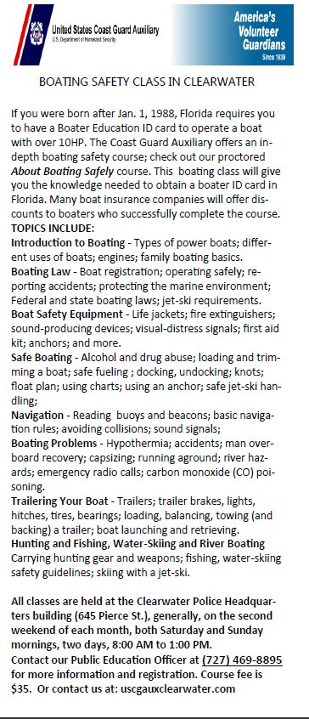
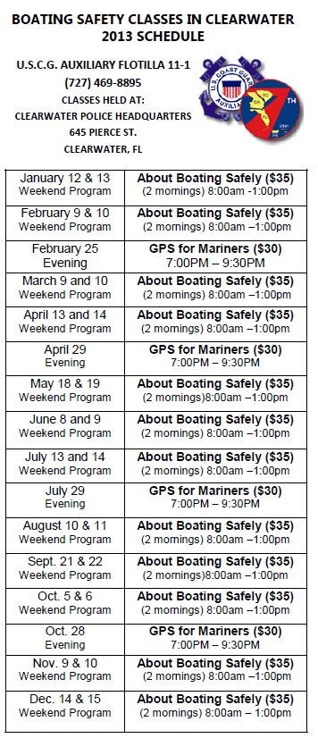
Simplifying the Job with a Checklist - continued
Prior to the Class
  Advertise
  Public Affairs
  Officer
  Vessel Examiners
  Recreational
  Boating Safety
  Program Visitors
Notes:
Now, we need to let our potential students know about our course offerings. It’s time to advertise and work with your Public Affairs Officer and other outlets like Vessel Examiners and Program Visitors.
You may want to consider designing a course-offering rack card that your Program Visitors can insert in their Partners' display boxes. The card should include the class schedule, contact information (more on that later), cost, a small description of the course, and any relevant state law mandating PE. Your Office Depot discount card should go a long way toward minimizing the cost of rack card printing.

Slide 6
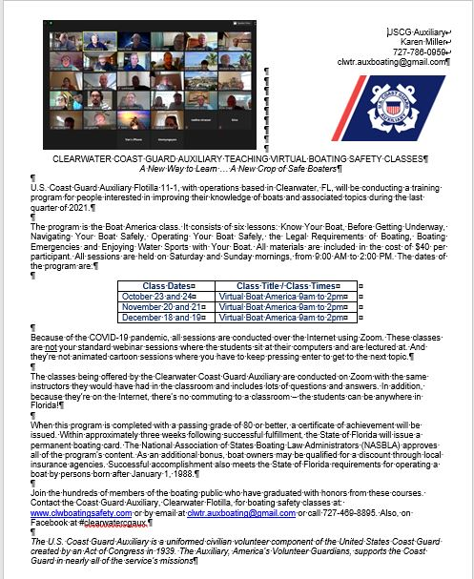
Simplifying the Job with a Checklist - continued
Prior to the Class
  Advertise with a
  press release
  Share with local
  press
  Vital Info
    What
    When
    Where
    Cost
Notes:
Well ahead of the first class meeting, the FSO-PE begins coordinating with the FSO-PA to promote the upcoming class or classes actively. It is disheartening to start a class where the instructors outnumber the students. By actively marketing the class ahead of time, the chances of such an occurrence are reduced. From an instructor's point of view, it is easier to "psych" up to teach a class if there is an adequate audience.
Work with the Public Affairs Staff Officer to develop press releases. If your flotilla doesn’t have a PA officer and the Division PA Officer isn’t available, then it’s on you.
Make sure your press release contains the vital information: the name of the course, when offered, where offered (classroom location or virtual), description of the audience (i.e., adults, youth, all boaters, first mates on a recreational boat, etc.), duration of the course, and cost. Include your name, position (spelled out—no acronyms), and contact information—phone, email, and flotilla website—as well as how to register and any deadlines.
Do some research (i.e., Google) for the local newspapers and send the press release to each of the editors and local reporters.

Slide 7
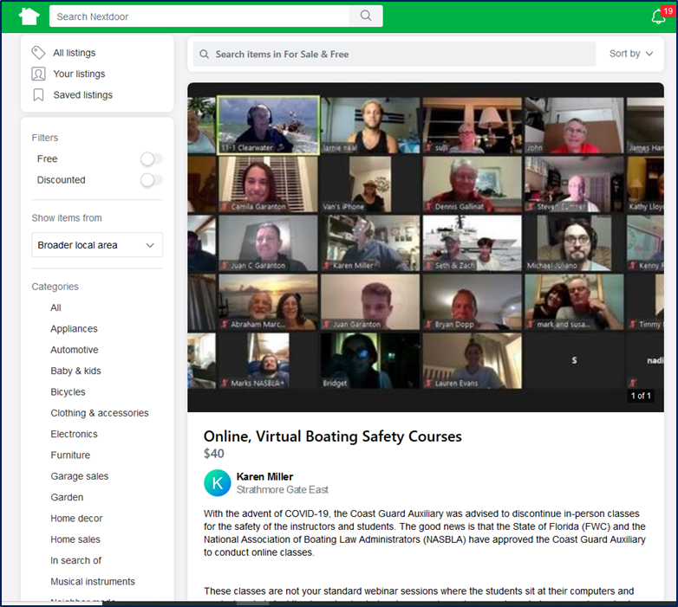
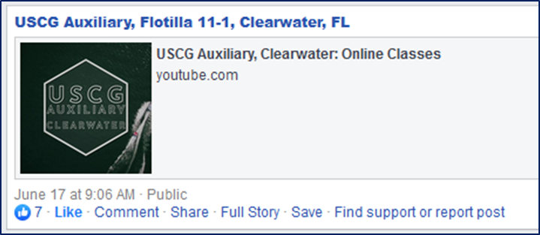
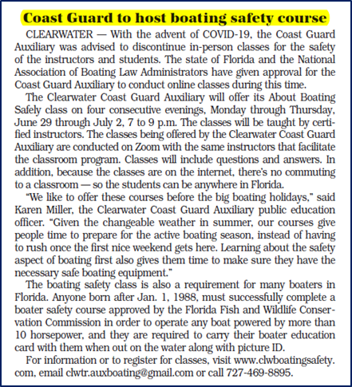
Simplifying the Job with a Checklist - continued
Prior to the Class
  Publicize
    Webpage
    Facebook
    NextDoor
    Neighborhood
    Craig’s List
Notes:
Publicity for the class needs to be supplemented by additional outlets.
Flotilla Website: There should be a place on your flotilla website listing your classes. Make sure your site contains the vital information: name of course, when offered, where offered (classroom location or virtual), description of the audience (i.e., adults, youth, all boaters, first mates on a recreational boat, etc.), duration of the course, and cost. Include your name, position (spelled out – no acronyms), and contact information – phone, email, how to register, and any deadlines. Some flotillas have purchased supplemental websites from companies like GoDaddy or WIX that link from their flotilla website to provide great flexibility, including online registration forms and online payment options like PayPal.
Flotilla Facebook Page: Many flotillas maintain a Facebook page. Often, it is the responsibility of the Communications Services Officer, and sometimes, a social media member is assigned the task. Regardless, the Facebook page is an ideal medium to showcase your class schedule and post pictures (with student permission) after the class for all to see. Ask the students to post their participation in the class on their Facebook pages, too. It’s a great way to get friends and family interested, too.
Nextdoor, Neighborhood, Craig’s List: These sites offer free listings of items for sale in the local area and sometimes will generate student interest in a class. It’s worth it to try since they’re free.

Slide 8
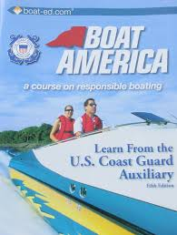
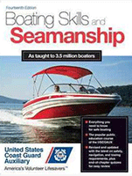
Simplifying the Job with a Checklist - continued
Prior to the Class
  Presentation Material
    Textbooks (https://auxcen.com/)
    PowerPoint Presentations
    (http://cgaux.org/boatinged/class_finder/index.php)
    Federal Regulations
    State Laws
    Miscellaneous Brochures (cgaux.org/members/ANSC_Catalog_Jan%202021.pdf)
Notes:
While all this advertising is going on, you also need to work with your Flotilla Materials Officer to order the necessary textbooks and brochures.
PowerPoint presentation material is available through the Auxiliary National Public Education website at http://wow.uscgaux.info/content.php?unit=E-DEPT&category=pe-courses.
This material may be enhanced to keep it current and relevant to the local area. However, the basic content of the National Association of State Boating Law Administrators (known as NASBLA) approved courses may not be eliminated. Additional material must be added to support the specific state boating regulations that differ from the Federal regulations.
Student textbooks are available for purchase from the Coast Guard Auxiliary Center store at https://auxcen.com/.
Only textbooks authorized by and available through the USCG Auxiliary shall be used for public education classes.
Material to support the course work, i.e., pamphlets, booklets, adhesive labels, etc., are available through the Auxiliary National Supply Center (known as ANSC) at no charge at cgaux.org/members/ANSC_Catalog_Jan%202021.pdf
Since you don’t have students registered yet, you need to use your “best guess” on how much material you have to order. If you order too little, you may have to limit the number of students you can include in the class. If you order too much, you have tied up flotilla financial resources until you can replenish them with student registration fees.

Slide 9

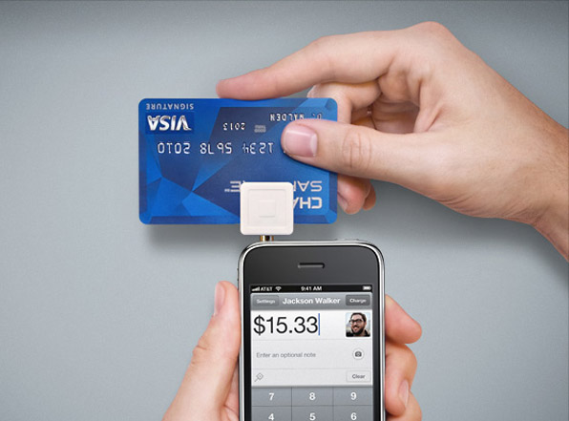
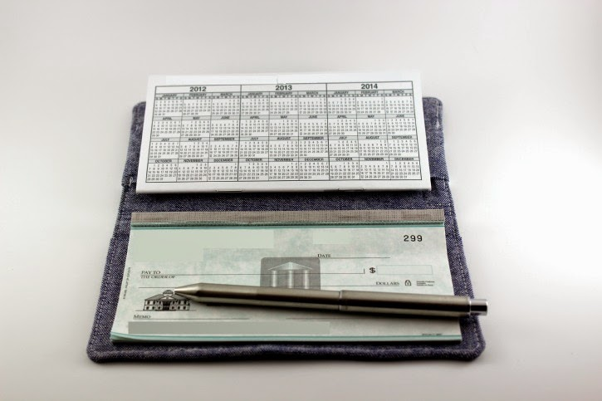
Simplifying the Job with a Checklist - continued
Prior to the Class
  Payment
    PayPal
    Cash
    Check
    Square
Notes:
Now that you have decided on the schedule and advertised the class, you have potential students interested. We need them to register (and pay) and receive their materials. Your method of payment and material distribution may differ depending on the type of class—in-person or face-to-face.
With the advent of virtual classes, newer methods of course fee collection have been implemented. The most prominent is the use of PayPal. This enables the flotilla to collect fees from the class members in advance and keys the book and brochure to the student. The easiest way to set up a PayPal account for the flotilla is detailed on the Public Education Directorate website.
Some flotillas are still accepting checks as the primary way of paying. This check is often written to the flotilla and sent to the Finance Staff Officer or the Public Education Officer. Once received, this keys the shipping of materials.
Face-to-face classes can learn from virtual classes. Receiving the course fee before the commencement of the class essentially ensures that the student will actually attend the class rather than just register. Then, rather than mailing out the materials, they can be handed out at the first session.
Some flotillas have a registration day before the start of class, where students come by, pay for the course, and pick up their books and brochures.
These are just some of the most common methods. Your flotilla’s methods may be different.

Slide 10




Simplifying the Job with a Checklist - continued
Prior to the Class
  Delivering the class
  material
    Mail to Student
    Provide in Person
Notes:
For flotillas that plan on mailing out the books and brochures, the first action after ensuring you have adequate inventory is ordering mailing/shipping supplies from the Auxiliary National Supply Center (called ANSC and pronounced ANN CEE). Through your Materials Officer, you can order stamps and envelopes at no cost to the flotilla.
If you leave enough time in days before class starts to send out the class materials, you can use media mail, which is substantially less expensive than priority mail. Government stamps from ANSC are totally acceptable to both the post office and approved by the Auxiliary legal officers.
Media mail and priority mail include tracking so you can confirm when the students have received their course material.

Slide 11
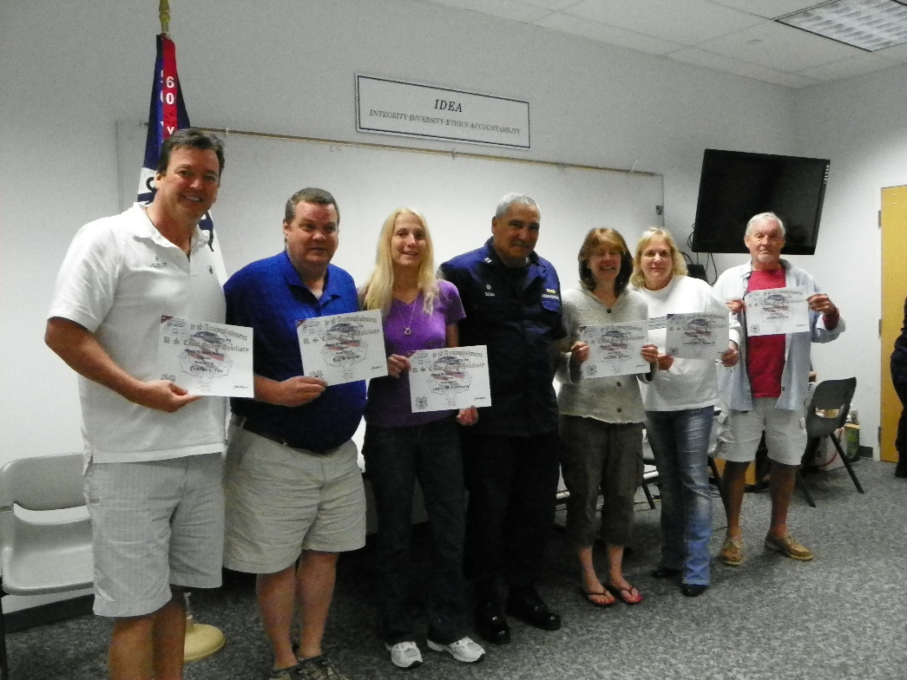
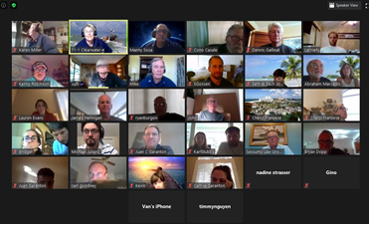
Simplifying the Job with a Checklist - continued
Prior to the Class
  Preparing for the Class
    Line up instructors
    Make sure presentation materials and
    examinations are current
Notes:
OK, now we have to conduct the class. Make sure to get a list of your certified instructors and work with them to determine their willingness to conduct a chapter or two of your class. It will help if they’re familiar with the material from prior teaching sessions, but, if not, make sure to get them the supporting material for the chapter, including the textbook, PowerPoint slides, relevant brochures, training aids, and test questions relating to that chapter.
It’s a good idea to make sure all the instructors who will be teaching the class have the latest materials since our primary NASBLA courses have regular updates to keep them compliant with state requirements. These can be downloaded from the Public Education Directorate’s website.
Since you determined way earlier whether you were offering your classes face-to-face or virtually, you can now work with your instructors to determine their willingness to instruct in which or both environments.
It would be very helpful if you familiarized yourself with each chapter so you can help the other instructors with your lesson plans, special notes, etc. Also, you can be a backup if an instructor can’t teach when assigned.
Make sure you know how long each chapter is going to take so you can allocate the proper time for each instructor. If your flotilla has been teaching this material for a while, the instructors should have a good idea of how long each chapter takes. Remember to insert frequent 10-minute breaks. Share the schedule with all instructors. Keep track of the time and set up a signal with the instructor to warn them if they’re exceeding the time allocated to the chapter. Make sure to comply with NASBLA course time requirements.

Slide 12
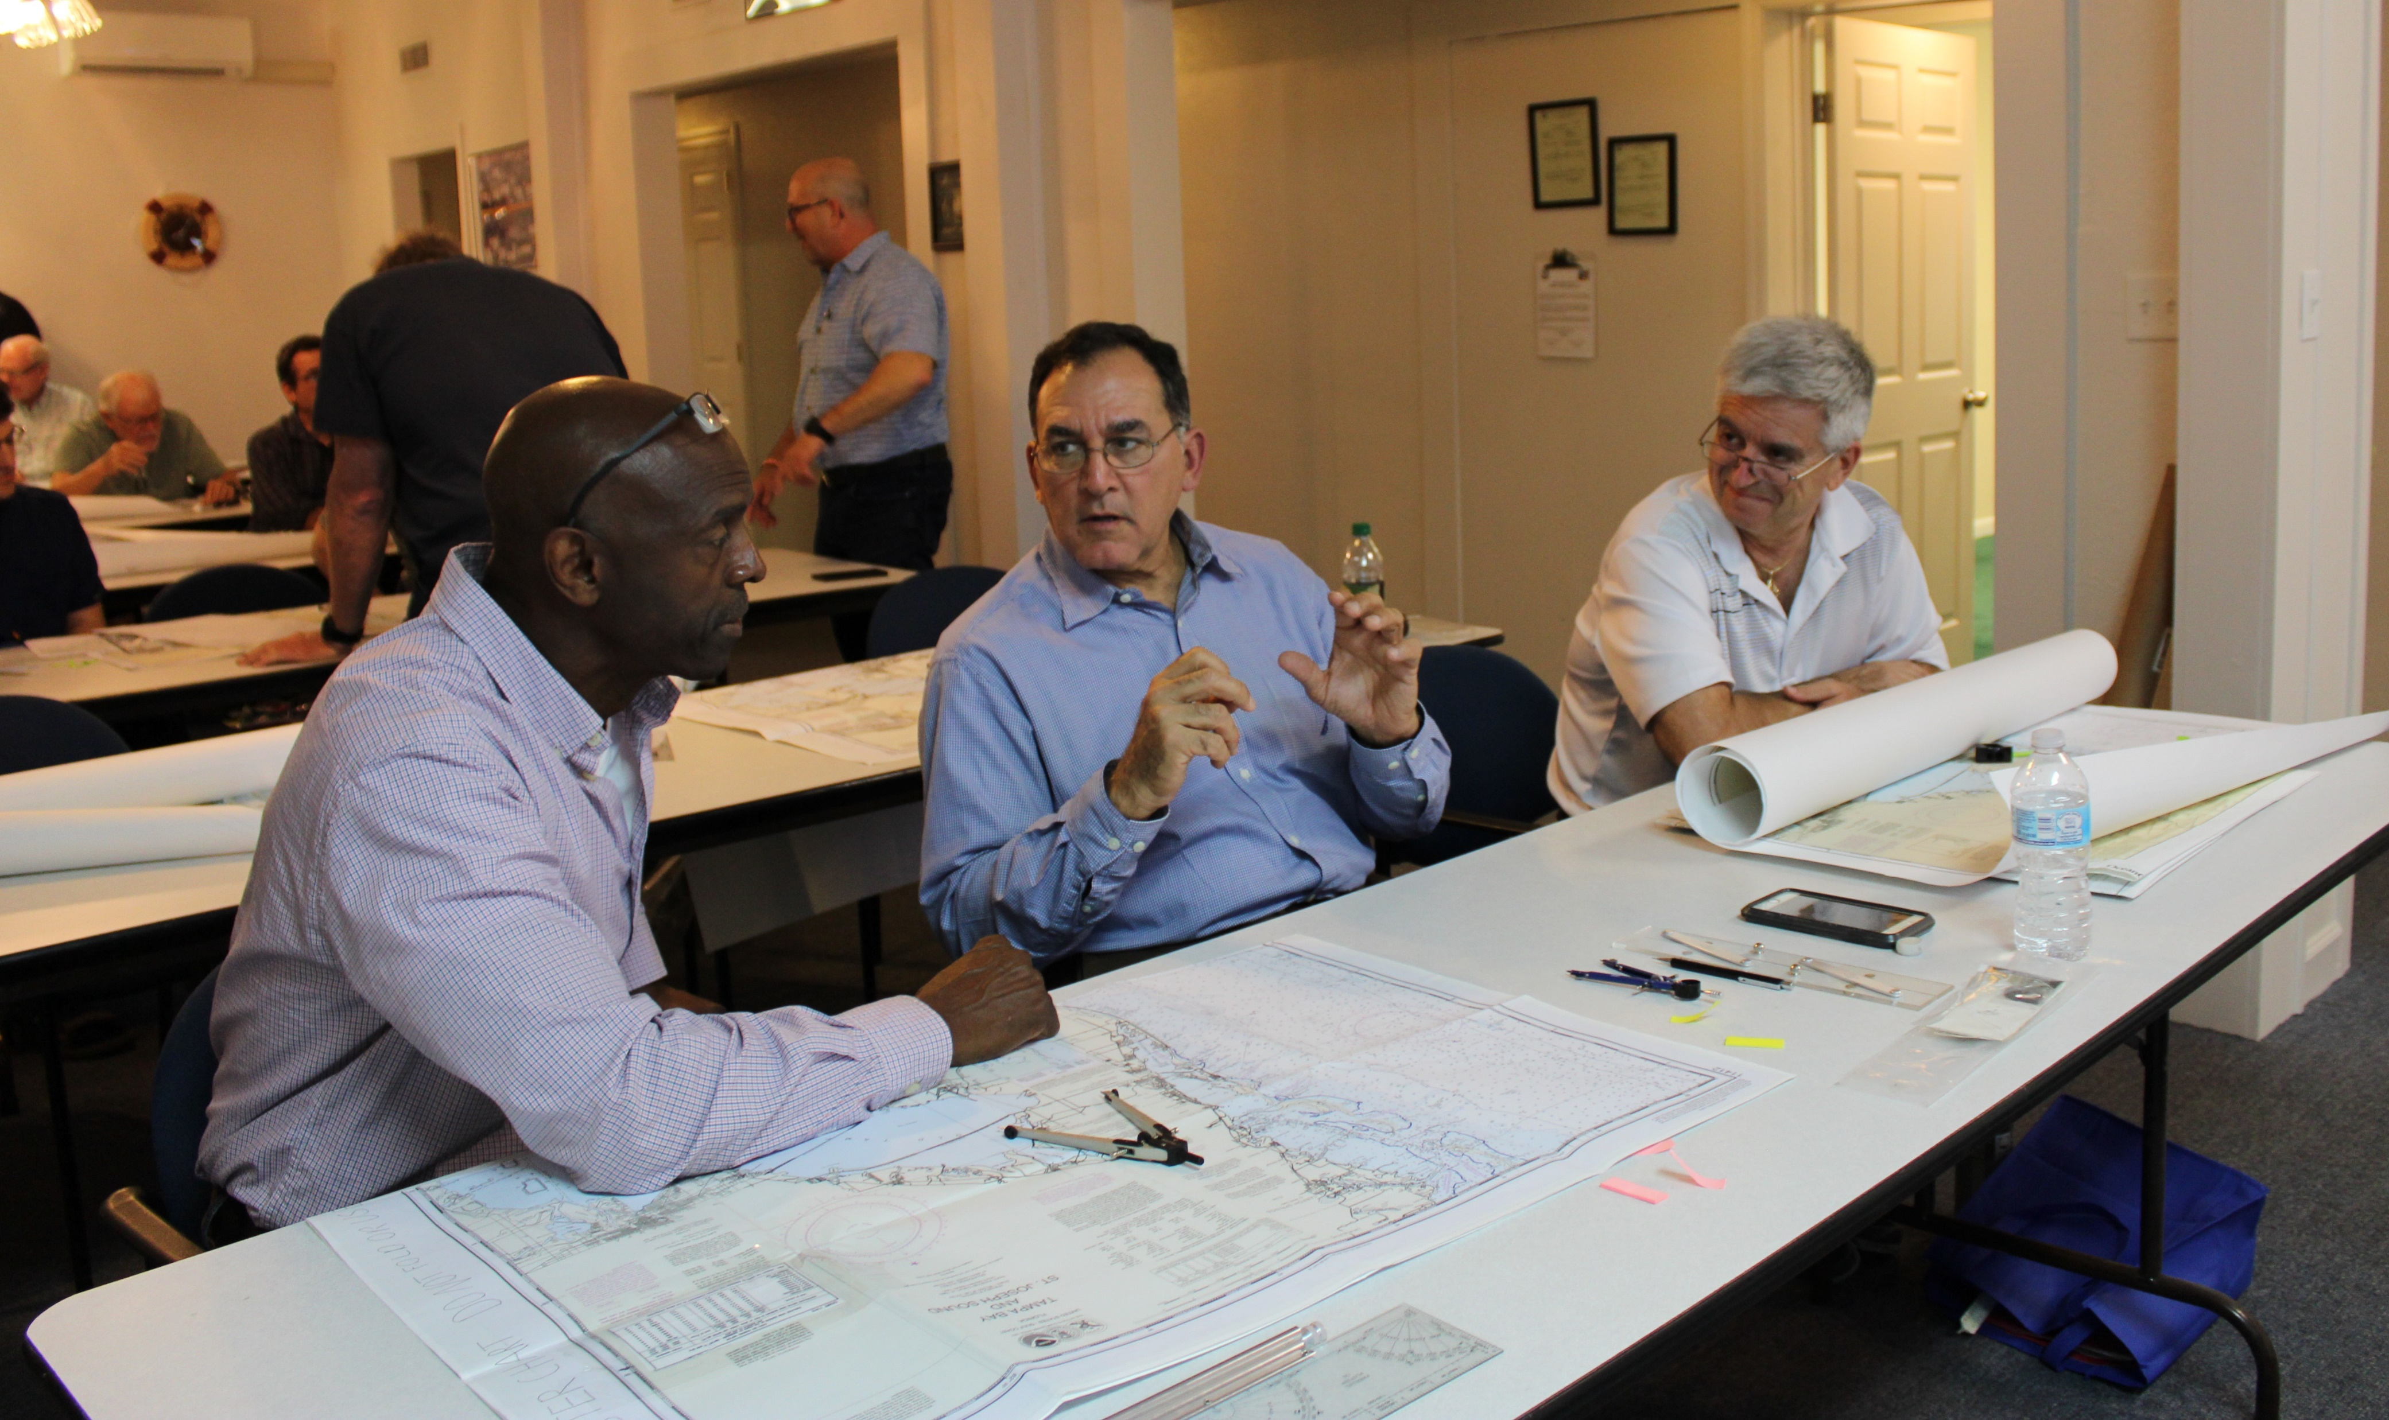
Simplifying the Job with a Checklist
Conducting the class in person?
  Check Equipment
  Check Presentation Materials
  Conduct Sound Check
  Use Safety Checklist
Notes:
If you conduct the class face to face, check out the classroom and equipment. Ensure everything you need for each chapter is available and in good condition. This includes training aids, projectors, microphones, handouts, registration forms, Wi-Fi, etc.
Make sure to review the Safety Checklist on the Public Education Directorate website.
Assign the uniform of the day, usually Tropical Blue. The new Alternative Work Uniform (AWU) is also acceptable.

Slide 13
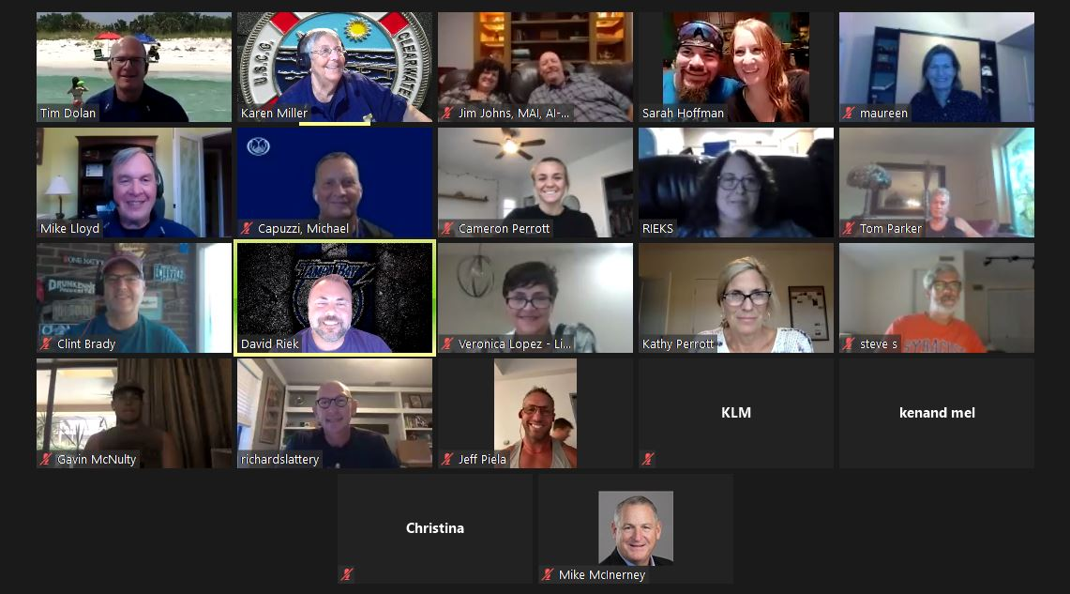
Simplifying the Job with a Checklist
Conducting the class virtually?
  Check Presentation Materials
  Check Platform
    Invitation Links
    Sound check – built in mic
    or headsets
    Assign co-hosts
  Practice, Practice, and Practice
Notes:
If you plan to conduct the class virtually, you need to check out the platform, invitation links, computer equipment, headphones, microphones, etc.
Then, you should set aside some time to practice with your instructors. There is a lot of good information on the Public Education Directorate on conducting virtual classes. Also, feel free to contact the E-Directorate via their feedback link with questions.
Assign the uniform of the day, usually Tropical Blue or the new Auxiliary Work Uniform.

Slide 14
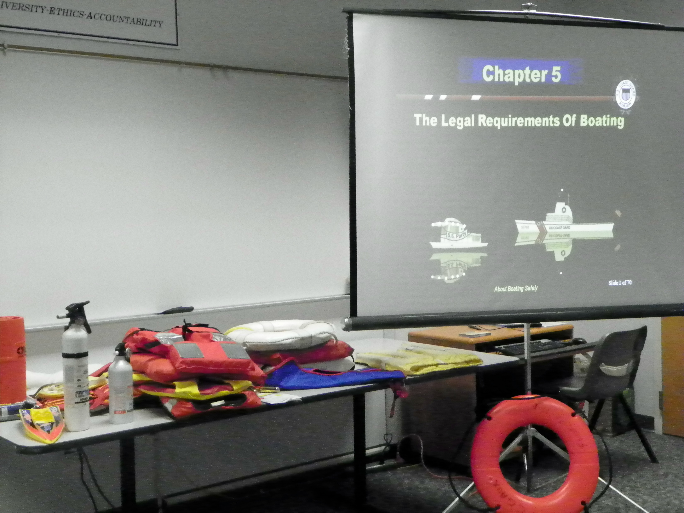
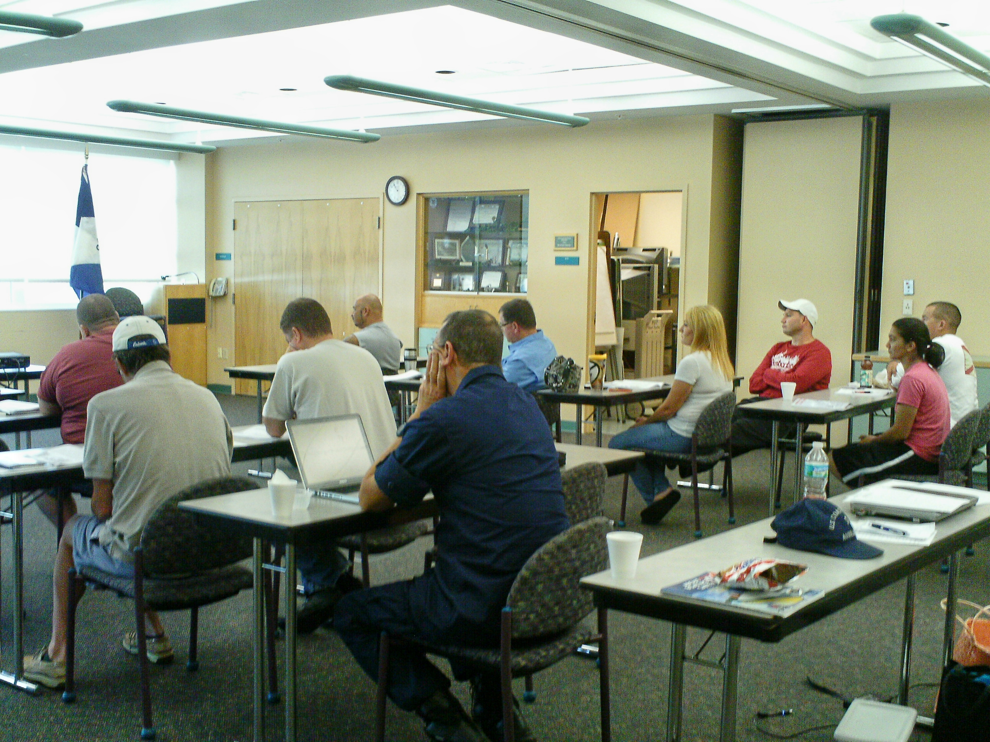
Simplifying the Job with a Checklist
Conduct the class
  Don’t read the slides to the students
  Face the students – not the screen
  Watch class schedule
  Have a second instructor or aide to note questions from students
Notes:
Okay, you have completed all the preliminaries to get the class going, and now the students are in their seats. Go back to the basics:
Don’t read the bullet points on the slides
Don’t “talk” to the screen, face the students
Keep aware of the time allocated to the class and make sure to keep to the schedule
Even if conducting virtually, remember everyone can see you on-screen (and should) so be careful of bad visuals (not appropriate lighting, camera angle, touching the face, eating, snoozing, etc.).

Slide 15
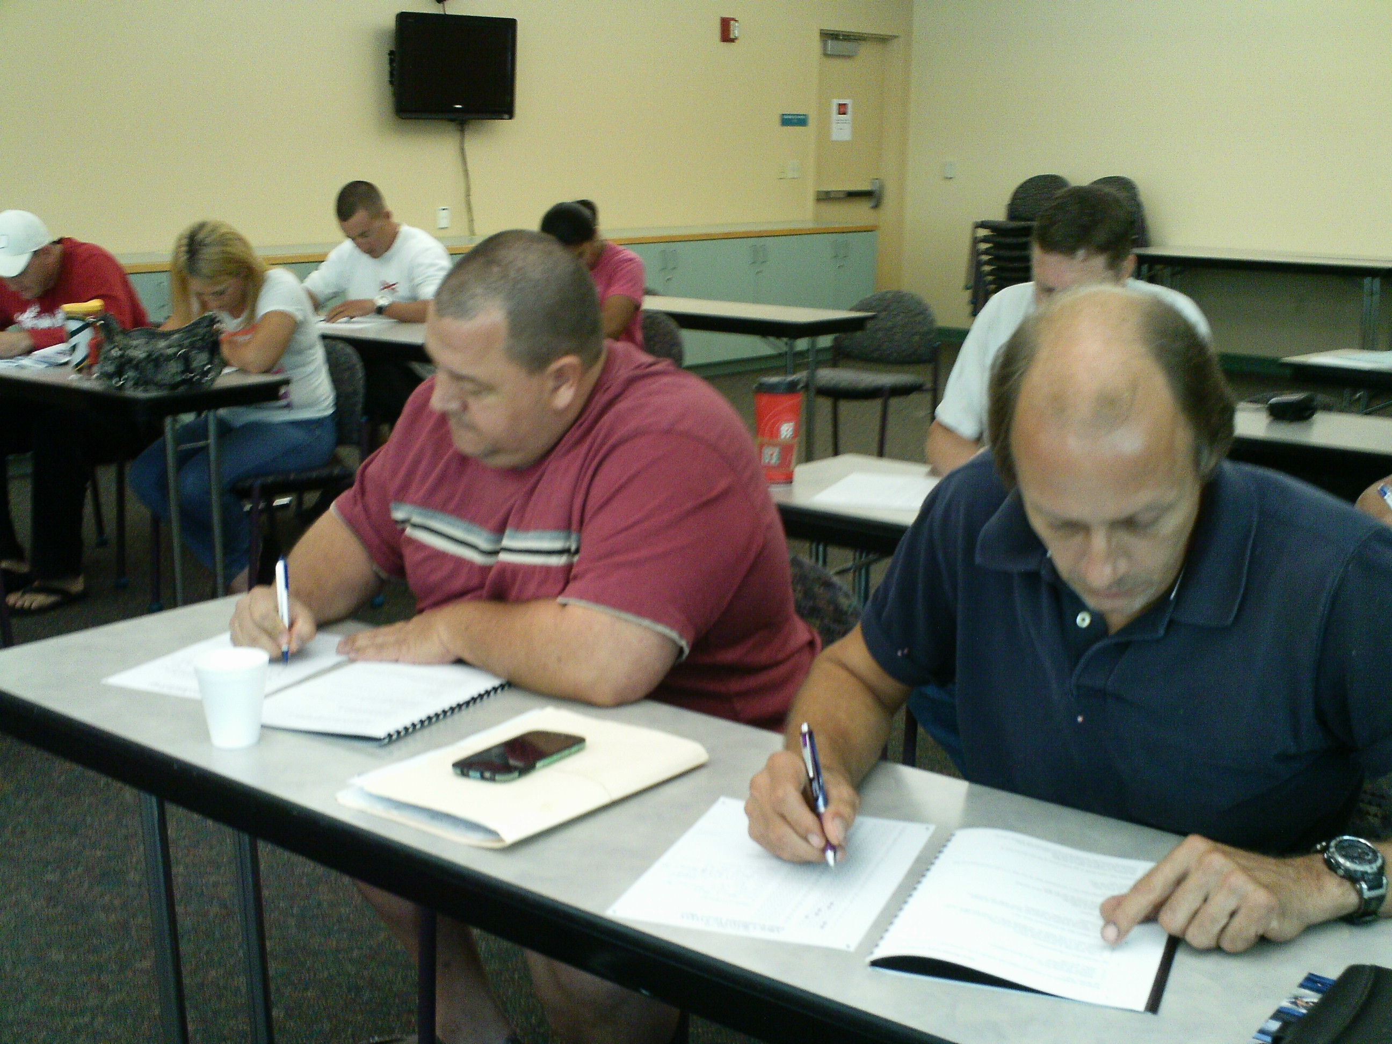
Simplifying the Job with a Checklist
The last class
  Consider offering a review
  Explain the examination
    Passing grade
    Multiple choice
    If the student needs help
  Mark the examination
  Celebrate 100%?
  Class photo – get the OK to publish
  Course evaluation
Notes:
For the last class, you may want to precede the examination with a review of each chapter.
Explain the examination to the students, including what constitutes a passing grade, how many questions there are, and what they can do if they need help with the exam.
Remind the students that the examination is closed book, closed neighbor, closed spouse, closed friends, etc.
Once the student completes the examination, decide what to do with them:
Have them remain for a “graduation”? If so, have the students congregate away from the students still taking the exam
If so, you may want to celebrate any member who achieved 100% on the exam
Take a photo of the graduates for subsequent publishing locally or on the Internet.
Remember to get written permission from parents/guardians of anyone under 18.
Or, have the youngsters cover their faces with their certificates
Have them leave and send them the certificate? Postal mail or PDF?
Before the students leave, have them complete a course evaluation survey.
There’s one in the package from AUXCEN or develop your own.
Use these for both kudos and lessons learned

Slide 16
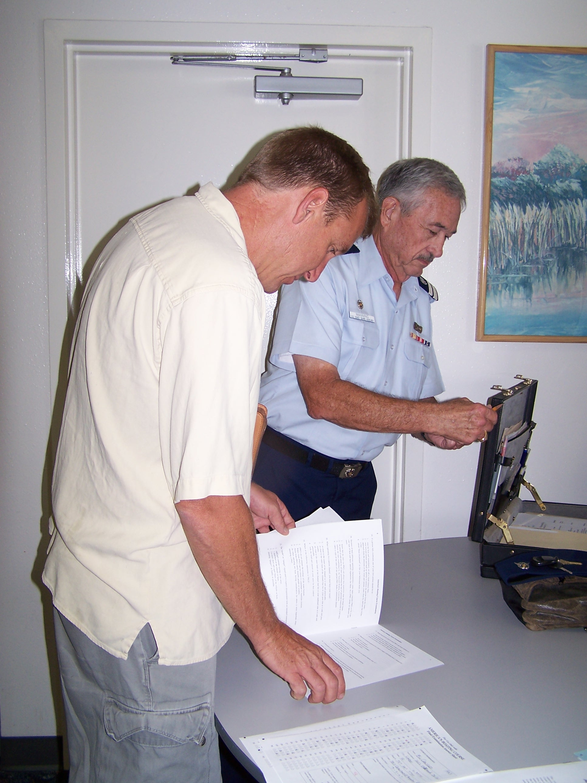
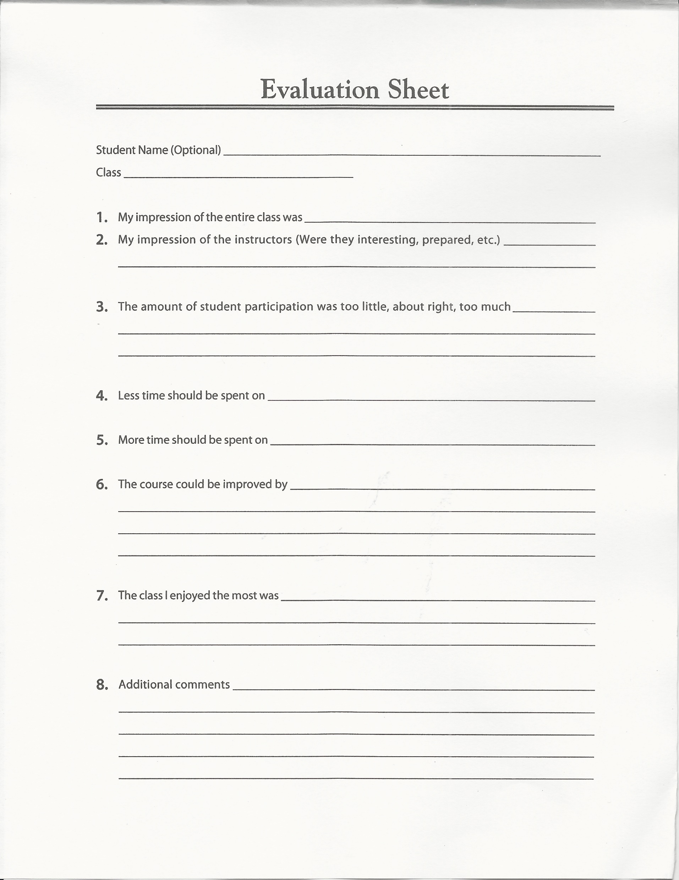
Simplifying the Job with a Checklist
After the class
  Send graduates’ information to state authority if required
  Enter data into AUXDATA II
  Review student evaluations
  Debrief instructors
Notes:
Once the class is over, your efforts aren’t over. Here’s some more work that needs to be done.
If your state requires graduate registration for course completion or even proof of passing, provide that information in whatever format is required.
Enter all the class data in AUXDATA II. The E-Directorate website has a short document explaining how to do this.
Go over the student/course evaluations to use for multiple purposes:
Review what could be improved
Review what went well
Review what changes you may have to introduce to improve the class
Select quotes for future publicity, use them in your report to the flotilla at the meeting, in your report to the Division Staff Officer-Public Education, and even use them for a Word Cloud.
Discuss the class with the other instructors with the goal of continuous improvement

Slide 17

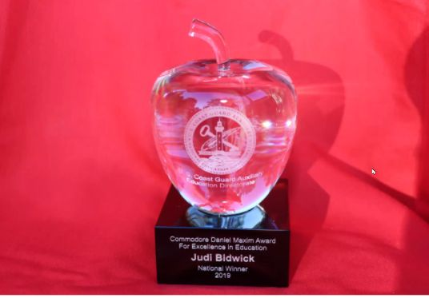
Other Items to Know
Instructor Awards
  Public Education Performance
  Award
  Instructor Program Ribbon
  Meritorious Team Commendation
  COMO Daniel Maxim Award
  Golden Key and Lighthouse
  Awards
Notes:
Various awards are available to instructors, and the FSO-PE should be familiar with them.
The first ribbon a member can achieve as an instructor is the Instructor Program Ribbon
After performing 30 hours as lead or 60 hours as an aide or a combination of them, the member can earn the Public Education Performance Award
At the end of the year, the Flotilla Commander or even the FSO-PE should consider writing up a formal award for the instructor cadre; the Coast Guard Meritorious Team Commendation might be appropriate.
A relatively recent award (2019) is the COMO Daniel Maxim Award for Excellence in Education. Based on feedback from Districts requesting additional incentives and recognition for the best Instructors, the Education Directorate developed a prestigious national-level award recognizing the best-of-the-best Instructors.
Golden Key and Lighthouse Awards 50 and 100 hours of lead instruction.

Slide 18
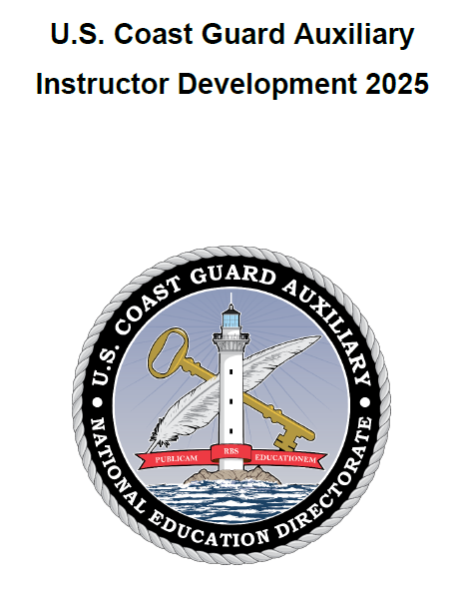
ID 2025
Instructor Development Course 2025
Stay up to date on the latest teaching techniques
  Download the ID2025 Student Study Guide and Presentation Material
    Study the information, and review the Performance Qualification Standard (PQS)
    Take the latest examination
Notes:
In 2020, the Public Education Directorate released a completely updated Instructor Course called ID2020. This course and the accompanying Student Study Guide were ideal resources for instructors. They contained excellent material to help instructors and would-be instructors organize their teaching, use modern technology, and even accommodate special needs students.
Then, in 2025, ID2025 was introduced. It updates ID2020 with best practices learned over the last five years of offering the course nationwide. There is additional emphasis on lesson plans and their importance in organization and excellence in presentation. Additionally, there is a whole chapter on instructing adults.
We recommend that the FSO-PE download all the material, study it, complete the PQS, and even take the final examination.

Slide 19
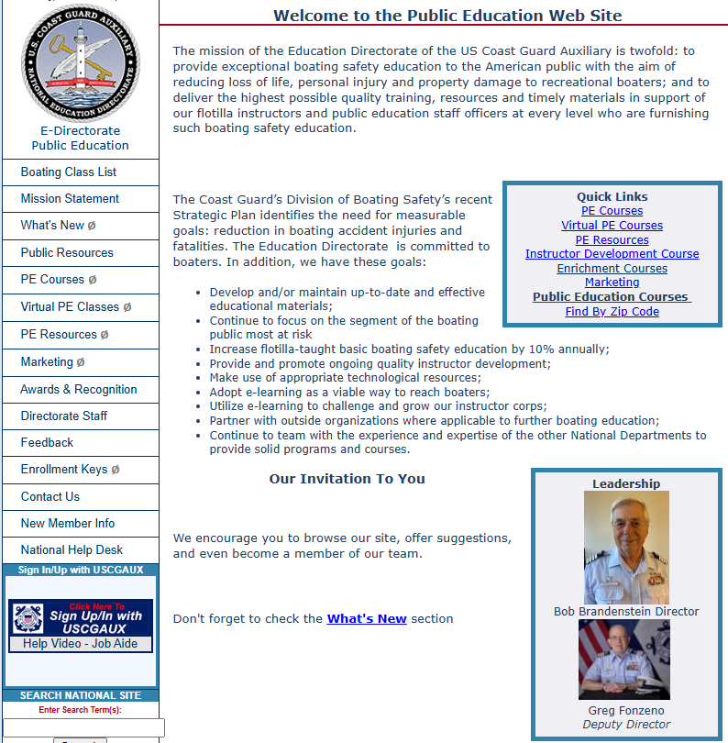
Thank You
Review the Public Education Directorate Website at: http://wow.uscgaux.info/content.php?unit=E-DEPT
You may email the E-Directorate at: pe.feedback@cgauxnet.us
Notes:
We are very interested in your successes. What has worked well for you that you want to share with others? What has not worked so well?
We also welcome your feedback and suggestions. We are always looking to enhance how we support your efforts to teach our boating public. Please do reach out to us and give us your ideas.
And, of course, please feel free to email us with your questions. We are always happy to help you in any way that we can.
We promise to listen carefully and give your comments our fullest attention.
You may email the E-Directorate at pe.feedback@cgauxnet.us.

