Slide 1

Auxiliary Instructor Certification
Notes:
The USCG released the 2024 Recreational Boating Statistics. Key takeaways from these statistics are that accidents, injuries, and deaths are down, but lack of life jacket wear, boating safety courses, and alcohol use remain the top contributors.
Our mission of Recreational Boating Safety remains a high priority!
One of our most important missions is offering recreational boaters safe boating classes. Plus, we need to prepare our shipmates to offer good courses to our members to keep them motivated.
So sit back, put on your life jacket, grab the helm, and attach the engine cutoff switch. Enjoy the ride!

Slide 2
The Instructor
How to be an Idol
Notes:
A Coast Guard Sector Commander is famous for saying that operations has definitive statistics on how many lives they have saved or assisted and the property value of those cases. When we look at instructors, especially in public education, we very, very rarely get to know whose death or injury we helped prevent.
Instructors in the Coast Guard Auxiliary play a vital role in providing training and education to members and the public.
Overall, the value of an instructor in the Coast Guard Auxiliary lies in their ability to educate, mentor, and inspire others. They ultimately promote safety, professionalism, and a strong sense of community within the organization and the maritime community we serve.
Instructors in the CG Auxiliary contribute to the organization’s mission by providing essential training, promoting safety, supporting operational readiness, and making a positive impact on the community. Their dedication and expertise significantly enhance the capabilities and effectiveness of the Coast Guard Auxiliary.

Slide 3
The Instructor
Your Value
Training and Education
Notes:
Training and Education: Instructors are responsible for imparting knowledge and skills to CG Auxiliary members and the public. They play a vital role in delivering training courses, seminars, and workshops on topics such as boating safety, navigation,
seamanship, and other areas relevant to Coast Guard operations. By sharing their expertise, instructors help enhance the knowledge and proficiency of members and promote safe practices among boaters and mariners.

Slide 4
The Instructor
Your Value
Promotion of Safety
Notes:
Safety Promotion: The Coast Guard Auxiliary places a strong emphasis on promoting boating safety. Instructors contribute to this mission by educating individuals on safe boating practices, rules and regulations, emergency procedures, and the use of safety equipment. By providing comprehensive training, instructors help prevent accidents, minimize risks, and save lives on the water.

Slide 5
The Instructor
Your Value
Support of Operations
Notes:
Support to Operations: Instructors are crucial in preparing CG Auxiliary members for operational tasks. They provide specialized training for various missions, including search and rescue, maritime security, and environmental protection. By equipping members with the necessary skills and knowledge, instructors help ensure the readiness and effectiveness of the CG Auxiliary in supporting the Coast Guard's operations.

Slide 6
The Instructor
Your Value
Community Engagement
Notes:
Community Engagement: Instructors actively engage with the community by conducting public education programs, boating safety classes, and outreach initiatives. By interacting with the public, they raise awareness about Coast Guard missions, foster a sense of responsibility among boaters, and promote a culture of maritime safety. Instructors serve as ambassadors for the CG Auxiliary, building positive relationships and representing the organization’s values.

Slide 7
The Instructor
How to be an Idol
Notes:
How do you get to be a Coast Guard Auxiliary Instructor?
There are two paths. The ideal way is to find a facilitated course taught by a seasoned CG Auxiliary instructor who has been through the course themselves.
If a member can’t accommodate the time to attend a formal class, they can self-study the material and then work with a certified instructor to complete the mentored aspects of the course.
The Public Education Directorate has developed a presentation detailing the Ten Steps to Instructor Certification. It is available on the E-Directorate website under Resources.

Slide 8
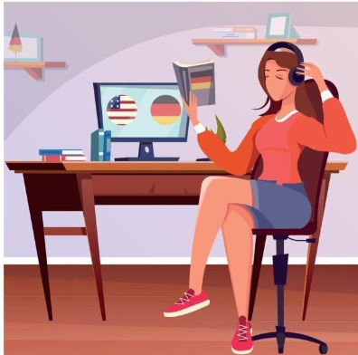
The Instructor
Self Study
Notes:
To become an instructor in the Coast Guard Auxiliary, there are several steps you need to go through:
• Download and study the ID2025 student study guide
• Once you have completed studying the material in the ID2025 student study guide, go to the National Testing Center and take the open-book IT exam with a score of 90% or better.
• Seek out a certified instructor, a valuable resource who will guide you through completing the personal qualification standard (PQS). Their expertise and feedback will be instrumental in your journey.
• An important part of your journey is the development of a lesson plan and the delivery of a presentation. This presentation, on any topic of your choice, should last between 15 to 30 minutes. A certified instructor will be present to critique your lesson plans and presentation. If they approve, they will sign off on that item in the PQS, marking your progress.
• Assuming your short presentation was successful, complete a lesson plan and give a presentation on a CG Auxiliary topic that is one to two hours long. Have the certified instructor critique your lesson plan and presentation. If ok, the instructor
will sign off that item in the PQS.
• Take Introduction to Risk Management
• Have all the presentations and Introduction to Risk Management recorded in
AUXDATA II.
• Download, read, and attest to completion of the current Instructor Workshop
• Give the PQS with all the sign-offs to your Flotilla Commander, who will sign off on the final item and submit your paperwork to DIRAUX per district policy.

Slide 9
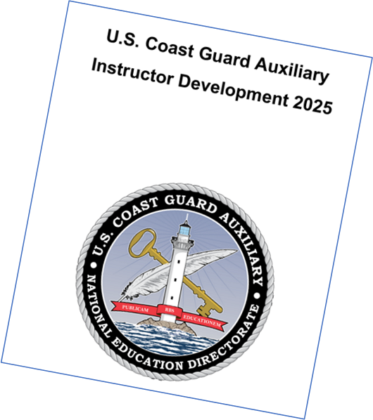
The Instructor
Facilitated Course
Notes:
The National Public Education Directorate has been offering ID2025 two to three times a year throughout the country to 12 students at a time. Notice – we can handle only 12 students at a time to keep the sessions down to five nights.
Locally, flotillas, divisions, and districts can offer the course on their own schedule to accommodate both the students and instructors.

Slide 10
Becoming a Coast Guard Auxiliary Instructor
  Requirements:
  Download and read the Student Study Guide
  Take the National Testing Center IT Exam
  Complete Introduction to Risk Management
  Complete the current Instructor Workshop
  Prepare and present, with lesson plans, a 15 to 30 minute teaching session on any subject
  Successfully complete the PQS with a mentor
  Prepare and present, with lesson plans, a one to two hour PE or MT teaching session

Slide 11
The Instructor
The Benefits of Being an Instructor
• Share your knowledge and expertise
• Make a difference
• Gain valuable experience
• Network
Notes:
Here are some additional benefits of being an instructor in the CG Auxiliary:
•You will have the opportunity to share your knowledge and expertise with others.
•You will be able to make a difference in the lives of others by helping them to learn new skills and knowledge.
•You will gain valuable experience in teaching and training.
•You will have the opportunity to network with other instructors and
members of the CG Auxiliary.
If you are looking for a rewarding way to give back to your community and to make a difference in the lives of others, then becoming an instructor in the CG Auxiliary is a great option.

Slide 12
Conclusion
Effective Auxiliary instructors are
• Professional
• Enthusiastic
• Constantly practicing their craft
Our members and students deserve it!
Notes:
Never lose the desire to improve. Whether you certify as an instructor in public education or member training or are engaged in mentoring in any of the flotilla missions, the satisfaction you and those you teach depends on the quality of your instruction.

Slide 13

Thank You
Are you ready to be an idol?
Consider adding this specialty – the Coast Guard Auxiliary needs instructors.
An instructor is an agent of change who seeks opportunities to positively impact teaching quality and student achievement.

Slide 14
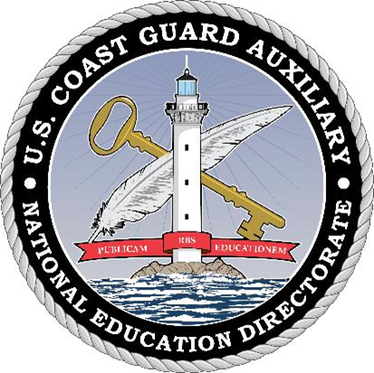
Thank You
  If you have any questions, contact the appropriate E-Directorate Staff, following the Chain of Leadership and Management
  You may email the E-Directorate at
  pe.feedback@cgauxnet.us
Notes:
It’s the policy of the CG Auxiliary that we solve issues at the lowest level. If the problem, question, or matter cannot be handled at this lower level, follow the Chain and press the issue higher.
All issues should be solved at the lowest possible level and elevated as needed through the chain of leadership and management to address the issue. It is NOT appropriate to go outside our organization for answers to education-related problems unless specifically instructed by the staff of the Education Directorate. Inquiries posed outside our organization confuse our partners and delay a proper response.
The entire staff of the E Directorate is standing by to answer any education questions that cannot be answered at a lower level.
The E-Directorate also maintains a feedback email address to assist members with answers they could not find anywhere else within the Auxiliary.
Members must understand they should not contact the Chief Director’s office or anyone outside the CG Auxiliary Chain of Leadership and Management. Any requests outside the Chain unnecessarily tie up resources answering these questions at BSX, NASBLA, and the BLA offices for internal Auxiliary queries. At the very least, it paints the Auxiliary as undisciplined and unable to communicate internally. At worst, it threatens our credibility at a national level with these national partners, which can have significant ramifications on future relationships.
You may email the E-Directorate at:
pe.feedback@cgauxnet.us

