Slide 1
Chapter 6
Enjoying Water Sports With Your Boat

Slide 2
Key Topics
Responsibilities of a Vessel Operator
Small Boats and Paddlecraft
Water-Skiing
Scuba Diving and Snorkeling
Windsurfing and Sailing
Fishing and Hunting

Slide 3
Objectives
You should be able to…
Explain a vessel operator’s responsibility to his or her passengers.
Explain a vessel owner’s responsibility when allowing others to use his or her vessel.
Explain the boater’s responsibility to the environment.
Notes:
Add text here

Slide 4
Objectives
You should be able to…
Explain a vessel operator’s responsibility to others using the waterways.
List the safety guidelines for small boat operators.
Properly tow skiers and recognize skier hand signals.
Explain how to fish or hunt safely from a boat.
Notes:
Add text here

Slide 5
Responsibilities of a Vessel Operator
Responsibility to Your Passengers
Pre-Departure Checklist
Check the weather forecast.
Check the steering and throttle controls.
Check all lights.
Check for any fuel or oil leaks.
Check hose connections and clamps.
Drain all water from the engine compartment.
Notes:
As the captain of your vessel, you are responsible for the safety and comfort of all those aboard your boat.

Slide 6
Responsibilities of a Vessel Operator
Be sure the bilge plug is replaced and secure.
Make sure you have enough fuel.
Make sure your engine battery and fire extinguishers are fully charged.
Attach the engine cut-off switch and lanyard.
Make sure you have the required number of personal flotation devices (PFDs).
Leave a float plan.

Slide 7
Responsibilities of a Vessel Operator
Before casting off, discuss safety.
Where is the emergency equipment?
Who needs a life jacket?
Locations of life jackets?
What are the laws for:
Reckless operation?
Required equipment?
Waste disposal?

Slide 8
Responsibilities of a Vessel Operator
Conducting Emergency Drills
Do you know what to do:
In case of a fire?
If someone falls overboard?
In case of a storm?
How do you:
Signal for help or make a MAYDAY call?
Anchor the vessel and handle lines (ropes)?

Slide 9
Responsibilities of a Vessel Operator
Responsibility to Others You Allow to Operate Your Vessel
Before allowing others to operate your vessel, make sure they:
Meet the minimum age and boater education requirements.
Know basic boating safety and navigation rules.

Slide 10
Responsibilities of a Vessel Operator
Know how to use lanyard with the engine cut-off switch.
Understand the importance of speed restrictions.
Understand the need to keep a proper lookout.

Slide 11
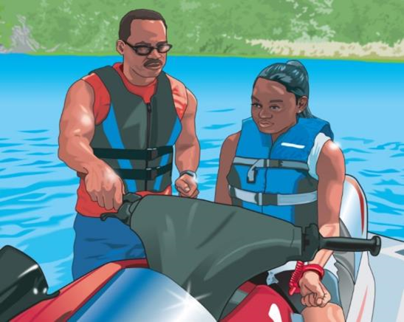
Responsibilities of a Vessel Operator
Before allowing others to drive your PWC, make sure they:
Meet the minimum age and boater education requirements.
Know they have the same responsibilities as any other vessel operator.

Slide 12
Responsibilities of a Vessel Operator
Take their first rides in an uncrowded area.
Know how to steer and control the personal watercraft (PWC).
Know to check carefully before turning.

Slide 13
Responsibilities of a Vessel Operator
Responsibility to the Environment
Keep waters clean and disease-free by disposing of waste and litter properly.
Practice the three “Rs”— Reduce, Reuse, and Recycle.
Reduce throttle to “no wake” speed when close to a shoreline.
Don’t use toxic substances on your vessel or around water.

Slide 14
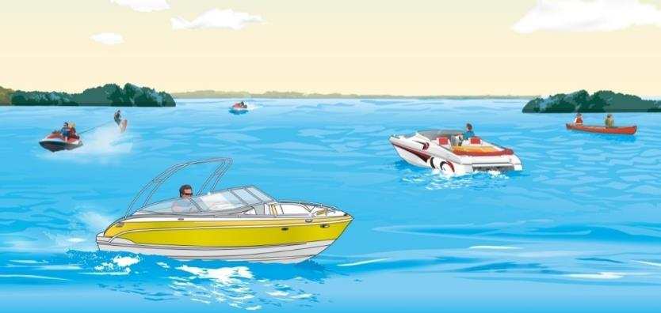
Responsibilities of a Vessel Operator
Responsibility to Others Using the Waterways
Stay aware of others in or on the water.
Control the noise of your boat or PWC.
Notes:
Discuss courtesy on the water to other boaters and people near the shoreline. You are legally responsible for damage and injuries caused by the wake of your boat or PWC.

Slide 15
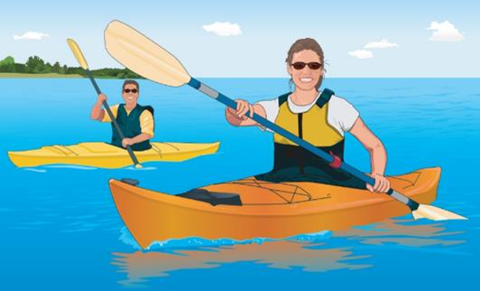
Small Boats and Paddlecraft
Includes canoes, kayaks, and rafts.
To prepare for safety:
Always wear a life jacket.
Never paddle alone.
Never overload your craft.
Keep low center of gravity.
Be alert and aware of surroundings.

Slide 16
Small Boats and Paddlecraft
Practice reboarding in water.
Dress properly for the weather.
Check your craft for leaks.
Map a general route and timetable when embarking on a long trip.
Know conditions before you head out.
Watch the weather. Keep close to shore.

Slide 17
Small Boats and Paddlecraft
Be alert for river hazards:
Low-head dams
Rapids
Strainers
If you capsize:
Do not try to stand or walk in swift-moving water.
Float on your back on the upstream side of your craft.
Point your feet downstream.
Take precautions to avoid hypothermia.
Notes:
Discuss the dangers of low-head dams both above and below the dam. Explain how to get out of the wash of the dam if you go under water.

Slide 18
Water-Skiing
Before towing a skier, the operator should:
Have an observer on board.
Review hand signals with skier.
Make sure skier is wearing an approved life jacket.
Be familiar with area and any hazards.
Make sure tow lines are same length for multiple skiers.
Never tow a skier at night.
Notes:
Review your state’s specific laws regulating skiing and towing people.

Slide 19
Water-Skiing
While towing a skier, the operator should:
Start engine after making sure no one is near the propeller.
Go slowly until ski rope is tight.
Keep skier at a safe distance from the shoreline.
Avoid congested areas.
Watch for other vessels and obstructions.
Always respond to skier’s signals.

Slide 20
Water-Skiing
When a skier falls, circle slowly to return the towline.
If required, display red or orange flag to alert others that skier is down.
Shut off engine before skier reboards.
Notes:
Does your state require a skier-down flag?

Slide 21
Water-Skiing
When in the water, the skier should:
Wear a life jacket.
Use hand signals.
Never ski under the influence of drugs or alcohol.
Never spray swimmers, vessels, or other skiers.
Never wrap tow rope around your body.
Hold ski up out of the water after falling.
Not approach the back of the boat until the engine is off.

Slide 22
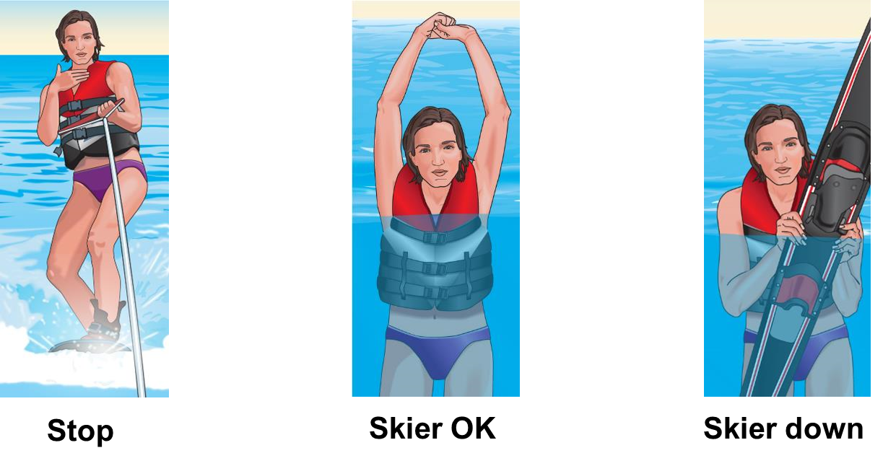
Water-Skiing
Hand Signals for Skiers

Slide 23
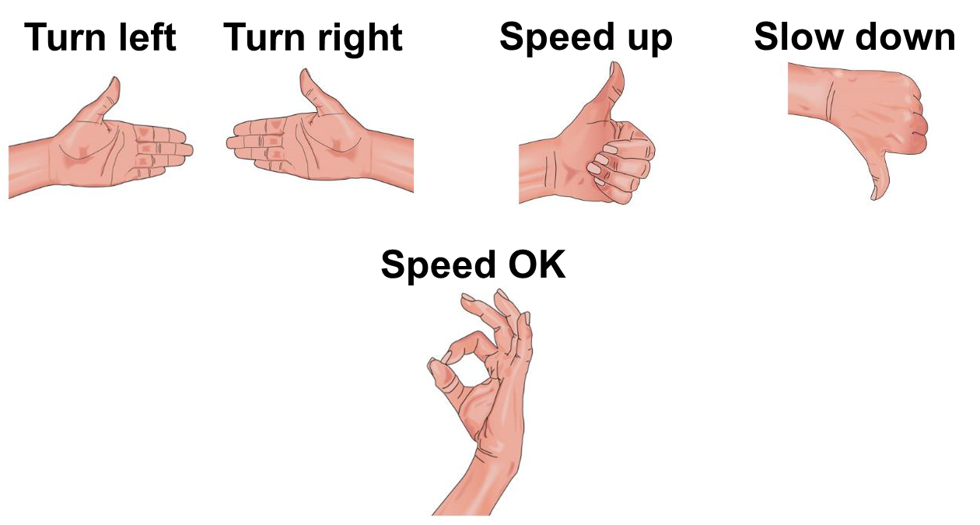
Water-Skiing
Hand Signals for Skiers

Slide 24
Scuba Diving and Snorkeling
Vessel operators should:
Be able to recognize a diver-down flag.
Stay the legal distance away from a flag.
Look for bubbles.
Notes:
Review your state’s rule regarding the use of diver-down flags and alpha flags. The NAV Rules do give some specific requirements form recreational vessels engages in diving and snorkeling. During the day the vessel must exhibit “Alpha” flag. Each state may have a specific requirement regarding the use of the diver-down flag, specifically regarding the distance the boater must remain away from the flag.

Slide 25
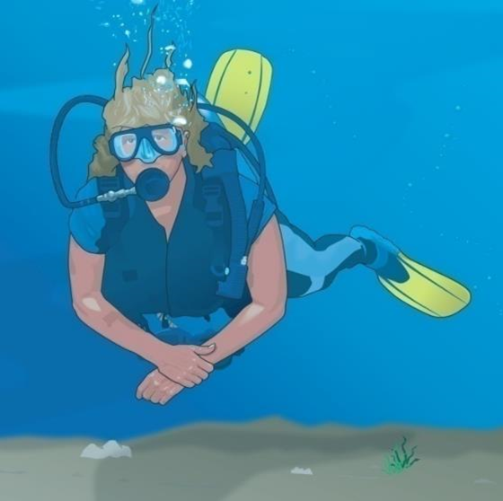
Scuba Diving and Snorkeling
Divers should:
Display the diver-down flag and stay close to it.
Select a suitable boat.
Avoid overloading the vessel.
Never dive or snorkel alone.

Slide 26
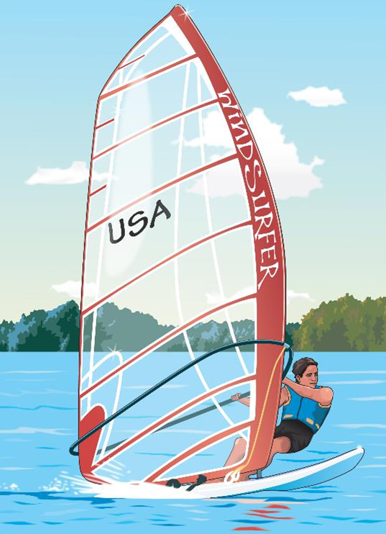
Windsurfing
Dress appropriately.
Tell someone your plans.
Do not become fatigued.
Watch for vessels.
Don’t go too far from shore.

Slide 27
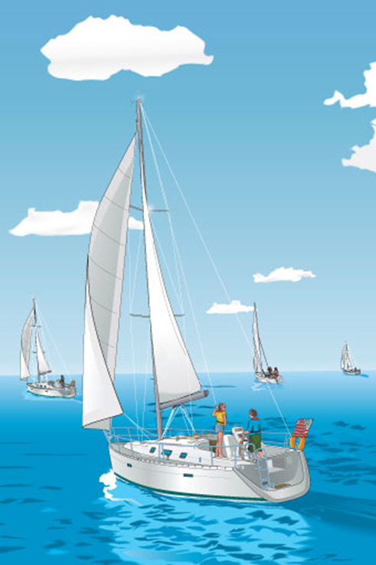
Sailing
Sailboats are usually the stand-on vessel.
Small sailboats are prone to capsizing and swamping.
Falling overboard is common. Always wear a life jacket.
Sailors should always be aware of water temperature.
A certified sailing course is recommended.

Slide 28
Sailing
For safety:
Stay off water during storms or high winds.
Carry a flashlight.
Make sure sailboats with an engine have red, green, and white navigation lights.
Be aware of mast clearance when passing under power lines and bridges.

Slide 29
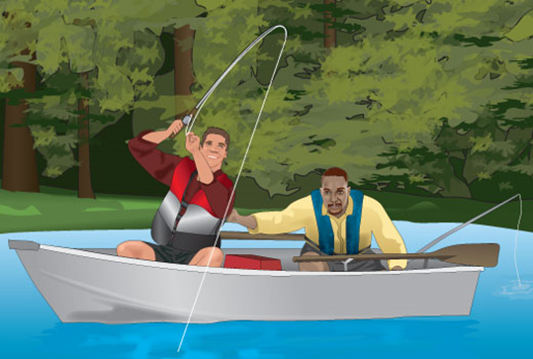
Fishing
Anglers using a vessel to fish should:
Know and follow all safe boating laws and requirements.
Not overload the vessel.
Wear a life jacket.
Recycle or toss used fishing line into receptacles on shore.
Take care of the fishing boat.

Slide 30
Fishing
Operators of other vessels should:
Slow down when approaching fishing boats or give them wide berth.
Never run over fishing lines.
Never make a large wake near a fishing boat.

Slide 31
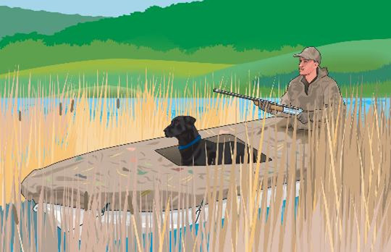
Hunting
If using a vessel to hunt, you should:
Obey all boating laws.
Take extra precautions to avoid capsizing or swamping.
Wear a life jacket at all times.
Dress in several layers under your PFD on cold water.

Slide 32
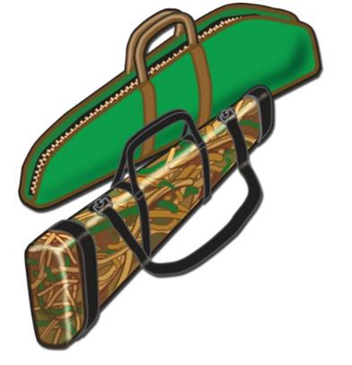
Hunting
Check the weather and stay close to shore.
Not fire shots or release arrows until vessel is stopped and secured. Remain seated when shooting.
Take these steps while transporting a firearm:
Obey all laws.
Keep firearms unloaded with the safety on and in a gun case.

Slide 33
Chapter 6 Review
Notes:
Add text here

Slide 34
Review Exercises
Everyone on board a vessel should understand basic safety practices. Who is responsible for ensuring this?
The vessel operator.
The dock attendant.
The most experienced passenger.
An adult at least 18 years of age.
Notes:
Add text here

Slide 35
Review Exercises
What should the vessel operator tell everyone on board before departing?
How far the vessel can go without running out of fuel.
Where to find the life jackets and fire extinguishers.
What time they should expect to return to the dock.
What food and drink are on board the vessel.
.
Notes:
Add text here

Slide 36
Review Exercises
What should the vessel operator do to make sure everyone knows what do to in case of an emergency?
Throw a passenger overboard unexpectedly.
Explain what do to as an actual emergency occurs.
Have everyone take a written exam until they can pass it.
Conduct an emergency drill with the passengers.
Notes:
Add text here

Slide 37
Review Exercises
What is the main role of the second person on a vessel towing a skier?
To help the skier get back into the vessel.
To watch out for other vessels and hazards.
To signal directions from the operator to the skier.
To act as an observer to watch the towed person.
Notes:
Add text here

Slide 38
Review Exercises
What should paddlers do to protect against capsizing their canoe or kayak?
Keep a low center of gravity and three points of contact.
Stand up in the craft while getting ready to dock.
Lean one shoulder over the side while paddling.
Move to the side of the craft closest to the shoreline.
Notes:
Add text here

Slide 39
Review Exercises
What should anglers and hunters do when they are fishing or hunting from a boat?
Anchor in the middle of the waterway.
Wear a life jacket at all times.
Keep clothing to a minimum.
Take along extra food and gear.
Notes:
Add text here

Slide 40
End Chapter 6
Notes:
Add text here

