Slide 1
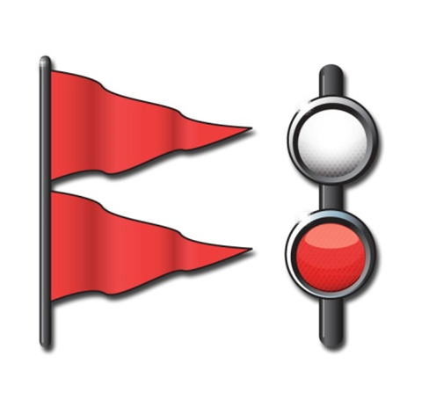
Chapter 5
Boating Emergencies…What to Do
Notes:
In chapter 4 we talked about “The Legal Requirements of Boating”.
Now in chapter 5 we will be discussing “Boating Emergencies…What to Do”
There is a difference between what the minimum law requirements are and what a prudent mariner carries on a boat.

Slide 2
Key Topics
Risk Management
Boating Accidents
Personal Injuries
Weather Emergencies
Summoning Help
Notes:
Mention these items as an overview of this chapter. More detail will be covered on each topic.
When you go boating. You will encounter hazards and risks.
It’s important to make a boating emergency less likely to happen by taking the proper precaution; but it’s equally important to be prepared and know what to do if an emergency occurs.
Mention these items as an overview of this chapter. More detail will be covered on each topic.
When you go boating. You will encounter hazards and risks.
It’s important to make a boating emergency less likely to happen by taking the proper precaution; but it’s equally important to be prepared and know what to do if an emergency occurs.

Slide 3
Objectives
You should be able to…
Explain how to practice risk management while boating.
Describe the effects of boating stressors.
Explain how dehydration occurs and how to recognize and prevent it.
Explain the increased effects of alcohol on the body when on the water.
Notes:
Add text here

Slide 4
Objectives
You should be able to…
Find the personal flotation device (PFD) that is the proper size for the wearer and check a PFD’s condition.
Explain how to handle situations involving capsizing, swamping, or falling overboard.
Avoid collisions.
Respond properly to a fire emergency.
Take the proper steps if a vessel runs aground
Notes:
Add text here

Slide 5
Objectives
You should be able to…
Explain the danger and stages of cold water immersion and what to do to survive.
Recognize the symptoms of carbon monoxide poisoning and explain how to prevent it.
Obtain weather forecasts, recognize weather warnings, and explain what to do if caught in severe weather.
Summon help quickly if a serious boating emergency occurs.
Notes:
Add text here

Slide 6
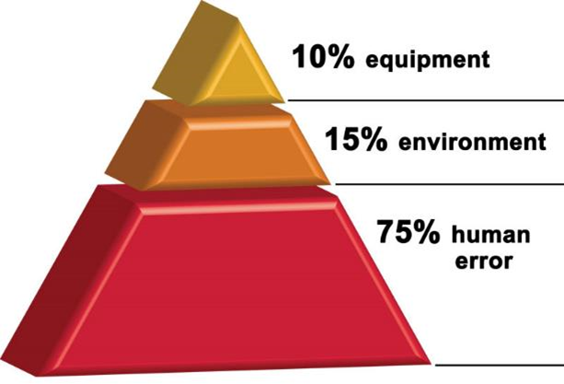
Risk Management
Profile of a Typical U.S. Boating Fatality
PFDs are on board but not in use
Vessel is small boat of open design
⅓ of the time alcohol is involved
Daylight, good weather
Operator is male, 26 to 50, with boating experience
Nearly all accidents are preventable
Notes:
In fatal boating accidents >80% had no training
87% had no life jacket
A large % include alcohol
Most fatalities were swimmers

Slide 7
Risk Management
Risk management is:
Recognizing dangerous situations and reducing chance that they will happen.
Lessening effects of accidents if they do happen
Notes:
Ask students to think about what they learned in the previous chapters. How can they reduce the risk of accidents?

Slide 8
Risk Management
Increased Risk Due to Boating Stressors
Stressors such as the sun’s glare and heat, motion, and engine noise and vibration increase the risk of a boating accident.
Stressors weaken your body and mind enough to make the risk of an accident greater.
Notes:
Ask: What are three of the natural stressors that can effect boaters?
Motion
Noise
Vibration

Slide 9
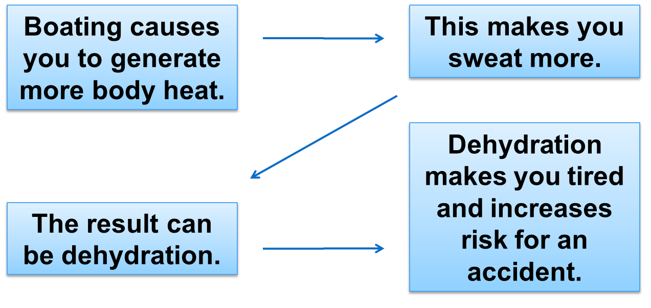
Risk Management
Increased Risk Due to Dehydration
Notes:
If a class member has experienced dehydration, ask them to explain what it was like.
If no one responds, ask students what causes are

Slide 10
Risk Management
Increased Risk Due to Hyperthermia (Body Heat)
Symptoms:
High body temperature.
Hot, red, dry skin.
Fast pulse.
Headache.
Dizziness.
Nausea.
Confusion.
Unconsciousness.
Notes:
Just as cold water can be dangerous (Hypothermia), so too can very high temperatures which can lead to Hyperthermia.
Keeping cool and drinking water can help avoid Hyperthermia. Be sure to watch for these symptoms

Slide 11
Risk Management
Increased Risk Due to Hyperthermia (Body Heat)
Cool Down:
Cool wraps or towels on the skin.
Drink cool water (hydrate).
Drink sports drinks with electrolytes.
Cool wraps or towels under the armpits and neck.
Place under the shade or in the cabin.
If serious, go back to the dock and call for help.
Notes:
If Hyperthermia is indicated, be sure to get the victim into a sharded area and begin to try cooling the body.
If the situation is extremely serious, get back to the dock immediate and call for help.

Slide 12
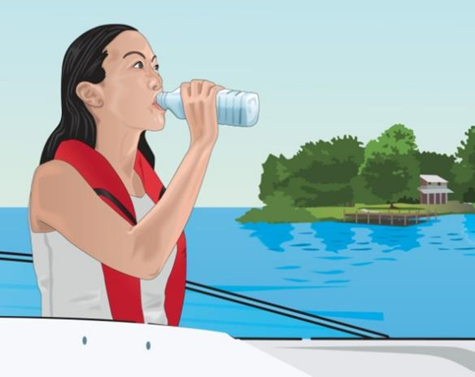
Risk Management
Increased Risk Due to Dehydration
To prevent dehydration, drink some water every 15–20 minutes.
If dehydration occurs, drink plenty of water and get out of the sun.
Notes:
Most people wait to drink water until they feel thirsty. If you feel thirsty you are already experiencing dehydration.

Slide 13
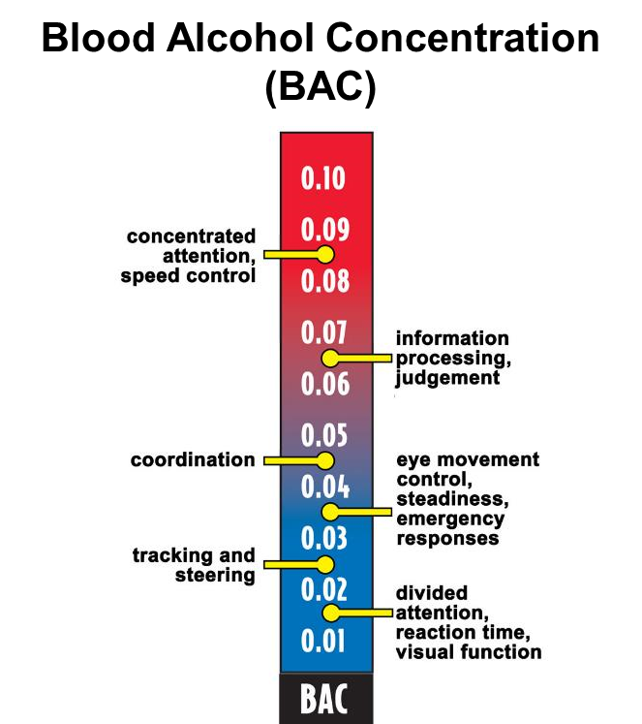
Risk Management
Avoiding Alcohol
Alcohol increases natural stressors.
It takes less alcohol to make a person legally intoxicated on water.
Notes:
Discuss the legal limits of alcohol consumption for the state in which you are teaching.
Remind the participants that using drugs and/or alcohol while boating is a leading cause of boating accidents.
Discuss the legal limits of alcohol consumption for the state in which you are teaching.
Remind the participants that using drugs and/or alcohol while boating is a leading cause of boating accidents

Slide 14
Risk Management
Drinking while boating increases likelihood of accidents.
Make sure everyone wears a PFD.
Designate non-drinking boaters to operate the vessel.
To minimize the risk of an accident–Don’t drink and boat!
Notes:
It is always a good idea that at least 2 people avoid drinking while on the boat in case something happens to the operator.

Slide 15
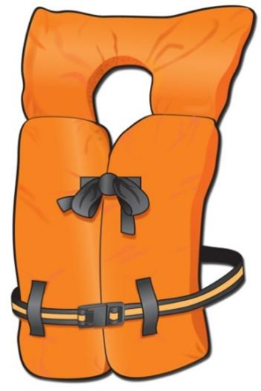
Risk Management
Minimize Risk of Drownings—Wear PFDs
Have everyone on board wear a PFD.
Follow the requirements:
Readily accessible
Proper size
Good and serviceable condition
Notes:
Discuss what is “readily accessible”.
Classroom aid: Demonstrate the test for proper fit. Using a student, place a PFD that is too large on the student and show how the PFD will come off when the person falls into the water.

Slide 16
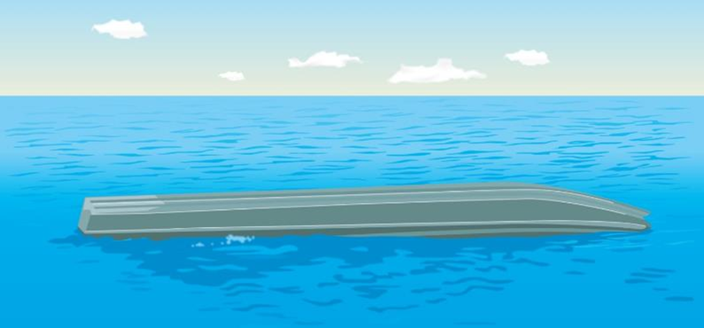
Boating Accidents
Capsizing, Swamping, or Falling Overboard
Capsizing―boat turns on its side or turns completely over.
Swamping―boat stays upright and fills with water.
Notes:
Review the definition of “capsize” and “swamping.” Both are dangerous, can be more so in cold water and weather.

Slide 17
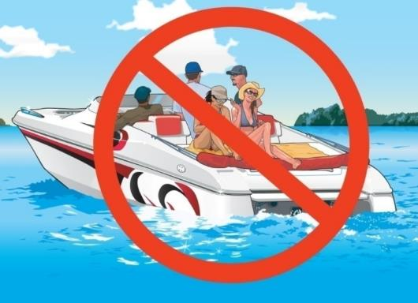
Boating Accidents
Capsizing, Swamping, or Falling Overboard
For safety:
Ask everyone to wear a PFD.
Attach engine cut-off switch lanyard to wrist, clothes, or PFD.
Don’t allow anyone to sit on any area not designed for seating.
Notes:
You should always have an engine cut-off switch. This will prevent the boat from running if the operator falls overboard.

Slide 18
Boating Accidents
Don’t overload your boat.
Keep centered in the boat with your center of gravity low.
Don’t let anyone lean a shoulder beyond gunwale in a small boat.
Slow down when turning.
Don’t boat in rough water or bad weather.
Secure the anchor line to the bow.
Notes:
In order to prevent capsizing, be sure to follow these rules.

Slide 19
Boating Accidents
If you capsize or swamp your boat or fall overboard:
Stay with the boat if appropriate to do so
Put a PFD on. Have your passengers do the same.
Take a head count.
Signal for help.
Notes:
Whenever possible, stay with the boat. It will present a larger target for search and rescue personnel to find you.
It will also help keep you out of the cold water.

Slide 20
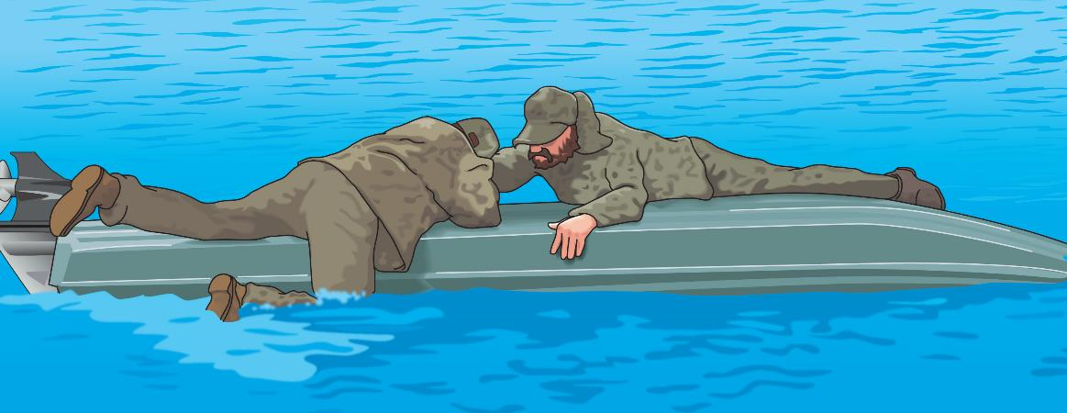
Boating Accidents
If your boat is still floating, try to reboard or climb onto it.
If your boat sinks or floats away, look for other items to help support you.

Slide 21
Boating Accidents
If the boat sinks or floats away:
Don’t panic―remain calm and wait for help.
Make sure your PFD is securely fastened or find something to help you float.
Notes:
Emphasize this as a reason to ALWAYS wear the life jacket, and not have it only readily accessible.
Once in the water, it is nearly impossible to put the PFD on. If a person had hit their head or it hurt, they cannot put one one at all. It should be on at all times.

Slide 22
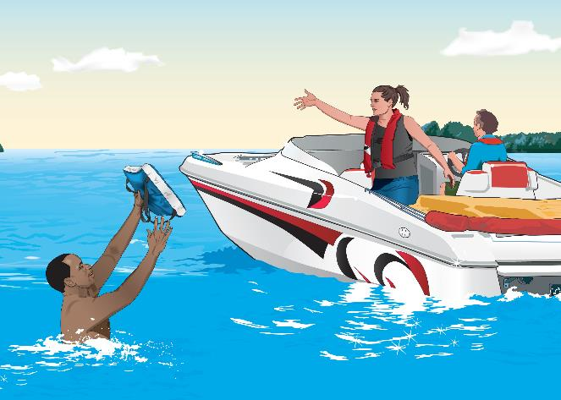
Boating Accidents
If someone falls overboard
Shout “Man Overboard.”
Slow down.
Toss the victim a PFD.
Slowly pull alongside the victim.
Stop the engine.
Pull aboard at the stern.
Notes:
Discuss why each item is important. Remind the participants that the first person to see someone go overboard should shout so loudly, ensuring the helmsman hears. Discuss why you pull the person aboard at the stern: lowest point of the boat, perhaps swim platform. Be sure engine is off.

Slide 23
Boating Accidents
Follow the rules of navigation.
Pay attention to navigation aids.
Keep a sharp watch and appoint a lookout.
Maintain a safe speed.
Notes:
Remind students why these rules are important and how they can prevent collision.
The primary causes of boating accidents include not having a proper lookout, not maintaining a safe speed, and drinking while boating.

Slide 24
Boating Accidents
Look in all directions before turning.
Use caution when traveling into the sun’s glare.
Never operate when fatigued or stressed, or while consuming alcohol.
Watch for floating debris.

Slide 25
Boating Accidents
Onboard Flooding Prevention:
Inspect hull for cracks or damage.
Drain plug properly secured.
If bilge pump on board, is it working properly?
If no bilge pump, are there bailer on board.
Know local weather and water conditions.
Avoid overcrowding and stay within capacity limits.
Notes:
Boating education, vessel maintenance and a thorough knowledge of local conditions can greatly reduce the chance your vessel will flood or become swamped. Here’s what to consider:
• Do a regular inspection of the hull, paying attention to seams and rivets. Inspect thru-hull fittings for possible leaks due to faulty gaskets and seals, and make sure that the boat plug is properly seated and secured prior to launch. Be sure the bilge pump is in good working order.
• Know the area in which you’ll be operating, including currents, shoals and fixed underwater hazards. Consult area charts and maintain a proper lookout to avoid partially submerged floating objects.
• Always check the weather forecast before heading out. At marinas, small craft advisories, storm warnings, and other alerts warn boaters of higher wind and waves, either imminent or expected within the next 24 hours. For extended outings, track the five-day forecast, either on local AM/FM radio or television, or on Internet weather sites like the National Oceanographic and Atmospheric Administration’s (NOAA) Marine Forecast and information web page at www.weather.gov/om/marine/home.htm.
• Travel at a speed that allows you to maneuver your boat clear of any obstacles. When slowing down, be mindful of your own wake and reduce your speed gradually. Reducing your speed too quickly can cause your own backwash to swamp your boat by washing water in over the transom.
• Make sure that the number of passengers and weight of your gear are within the capacity limits of your boat, bearing in mind that capacity is calculated based on fair weather conditions and an even distribution of the load. Secure equipment so it doesn’t shift while you’re underway.

Slide 26
Boating Accidents
Onboard Flooding Procedures:
Locate source of leak and try to reduce it. Use anything available to stuff hole.
If equipped, turn on bilge pumps. If not, use bailers.
Have everyone put on PFDs.
Radio for help.
Reduce speed and try to head for shallow water and safe mooring.
Notes:
If your vessel starts taking on water due to a leak, the amount of time you have to respond depends on the size of the hole and its location below the water line – the lower the hole, the greater the incoming pressure. A one-inch hole in the hull just one foot below the surface floods at a rate of about 20 gallons a minute. That same small hole six feet below the surface floods a nearly two and a half times that rate. You’ll need to think fast and move quickly.
If possible, locate the source of the leak and try to reduce the flooding. In open boats this is relatively easy to do. Larger vessels, such as cabin cruisers may be more difficult to find leaks due to their construction.
Activate the motorized bilge pump, if your vessel is so equipped, or have someone man the hand bailer or a manual bilge pump. Make sure everyone on board is wearing their life jacket. In an open boat, distribute persons on board as evenly as possible to prevent capsizing.
Notify the Coast Guard or your local marine patrol and other boaters in the area that your boat is taking on water. Close watertight doors and hatches. If you don’t have plugs in your emergency repair kit, use anything that you can put into a hole to slow the flow of water. Small pillows or foam cushions may work to reduce the flooding and give you time to get to safe mooring or until emergency help arrives. Believe it or not a commode plunger works well in some cases. Use your imagination.
Reduce your speed, maintain steerageway and head for shallow water or to safe mooring.
If you can’t get the flooding under control, you may need to place a Mayday call for help. Activate your EPIRB, if you have one aboard, or use your Visual Distress Signals to indicate that you are in distress and in need of assistance.

Slide 27
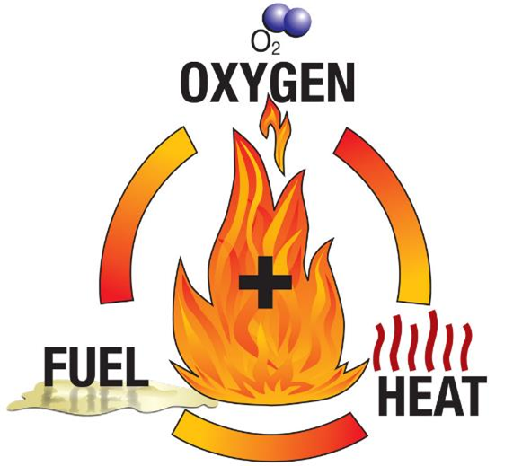
Boating Accidents
Dealing With Fire Emergencies
To prevent a fire:
Don’t mix fuel, oxygen, and heat.
Make sure ventilation systems are working.
Maintain the fuel system.
Use safe fueling procedures.

Slide 28
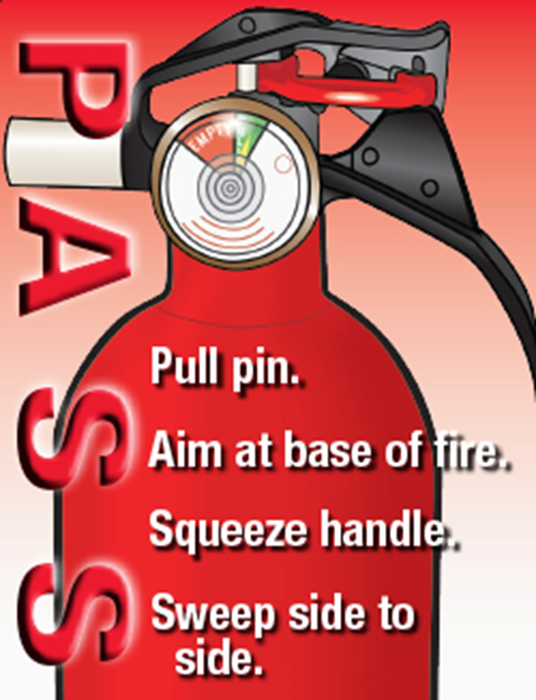
Boating Accidents
If a fire starts:
Stop the boat.
Position the fire downwind.
Shut off fuel supply, if the fire is in the engine.
Use the fire extinguisher (remember PASS).
Summon help.
How is a fire on a PWC different than other vessels?
Notes:
Ask: Ask the question and look for the following answers:
Alert crew
Put on PFDs
Turn off fuel
Disconnect electricity
Identify source of fire
Can you fight fire
If not get off boat
Call for help
Emphasize swimming away from the PWC until help arrives. Look for the following answers from the students:
Stop the engine
Take distress signals, swim away
Keep riders together until help arrives

Slide 29
Boating Accidents
Running Aground
To prevent:
Know your boating environment.
Find out the location of shallow water and submerged objects.
Learn to read nautical charts.
Notes:
Ask: How can you tell the depth of water? Responses could include:
Depth finder
Chart
Lead line

Slide 30
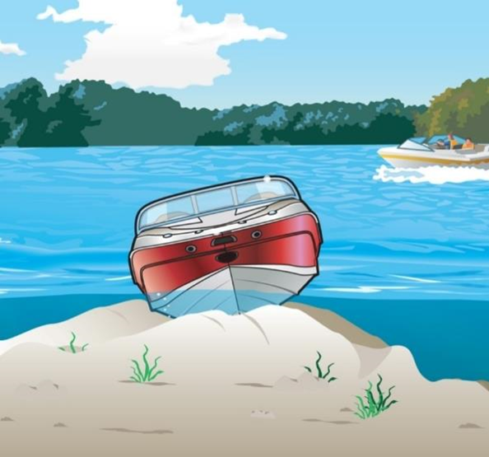
Boating Accidents
Running Aground
If you run aground:
Make sure no one is injured.
Check for leaks.
Try to get loose.
Signal for help if needed.
Notes:
The instructor should emphasize:
Check hull for damage
Check tide
Shift weight to reduce draft
PFDs and safety lines
If stuck, use visual distress signals

Slide 31
Personal Injuries
Cold Water Immersion and Hypothermia
Kill in several ways.
Can cause a reaction in water as warm as 77°F.
Understand how your body reacts to cold water to respond appropriately and increase your chance of survival.
Notes:
Ask the question. Look for these answers:
Shivering
Bluish lips and fingers
Loss of feeling in hands and feet
Cold bluish skin
Decreased mental skills
Slurred speech and blurred vision
Rigidity in hands and feet
Unconsciousness
Coma

Slide 32
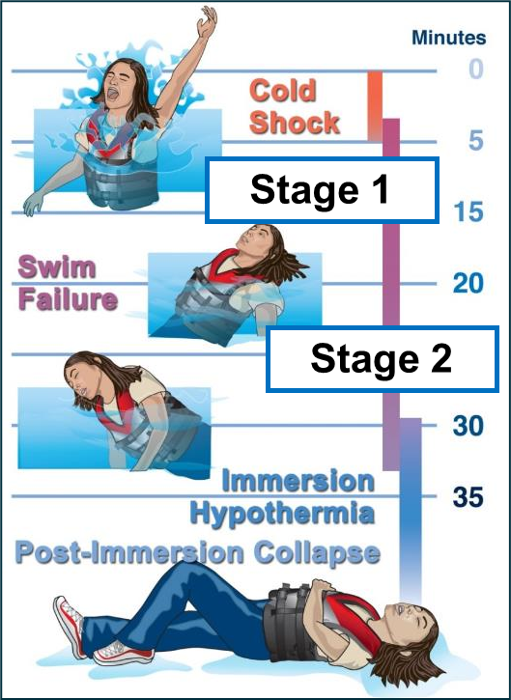
Cold Water Immersion
Stages of Cold Water Immersion
Stage 1
Initial “cold shock”
Occurs first 3–5 minutes
Stage 2
Short-term “swim failure”
Occurs 3–30 minutes following immersion

Slide 33
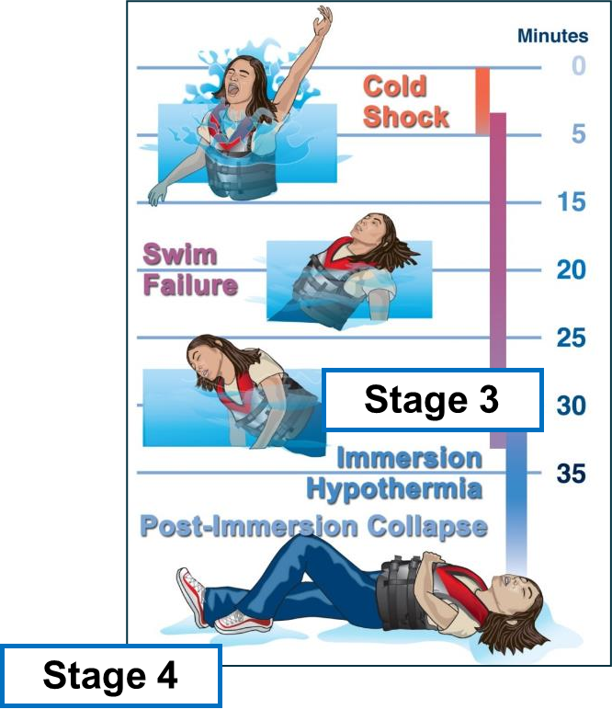
Cold Water Immersion
Stages of Cold Water Immersion
Stage 3
Long-term immersion hypothermia
Sets in after 30 minutes
Stage 4
Post-immersion collapse
Occurs during or after rescue
Notes:
Keep the victim warm. Cover with a blanket, but do not life the victims legs up above the heart. It could cause a cold surge to the heart and kill them.

Slide 34
Personal Injuries
Cold Water Immersion and Hypothermia
Survival depends on:
Keeping your head above water
Controlling your breathing
Having timely rescue by yourself or others
Retaining body heat

Slide 35
Personal Injuries
When boating in cold water conditions:
Always wear a secured PFD.
Wear layered clothing.
Equip your boat with a means for re-entry
Notes:
All boaters, regardless of type of vessel, should always have their PDF on at all times.

Slide 36
Personal Injuries
Try to avoid capsizing or falling overboard.
If you do fall into cold water:
Don’t panic.
Put on a PFD.
Do not take off your clothes.
Try to reboard your boat.
Stay as still as possible.
Adopt a position to prevent heat loss.
Send out emergency distress signals.

Slide 37
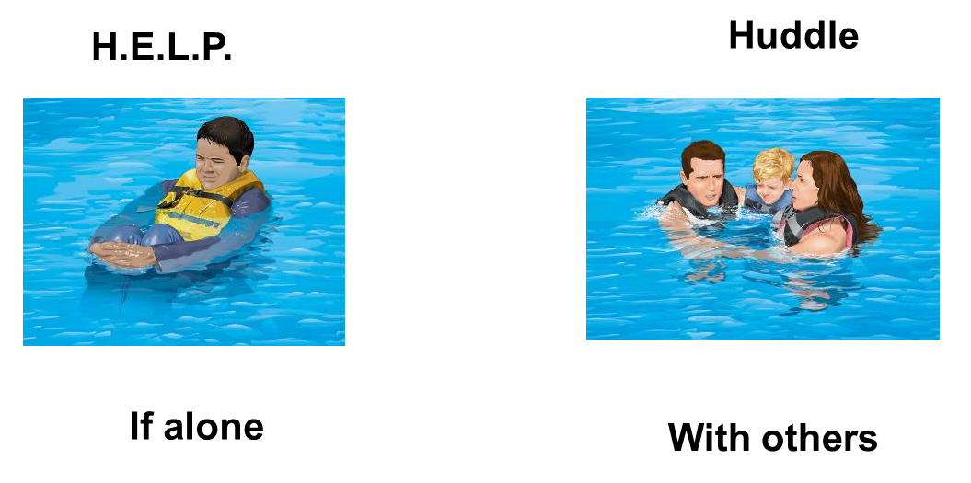
Personal Injuries
Reducing Heat Loss in Cold Water
Notes:
Discuss the HELP (Heat Escape Lessening Position) and why this will help.
Discuss the added advantages of the HUDDLE with other: conservation of heat, larger target for rescuers, and group motivation.
Note that a Type 3 PFD will likely turn you into a face down position if in the HELP position. Other types of PFDs better for this position.

Slide 38
Personal Injuries
When treating victims of cold-water immersion:
Get the victim out of the water quickly and gently.
Prevent further heat loss.
Be prepared to provide basic life support.
Seek medical help immediately.
Notes:
It is always a good idea to take at lease a basic Red Cross first aid class.

Slide 39
Personal Injuries
Carbon Monoxide Poisoning
Carbon monoxide (CO) is an invisible, odorless, tasteless gas.
Symptoms of CO poisoning:
Irritated eyes
Headache
Nausea
Weakness
Dizziness
Notes:
Discuss each of the symptoms of CO poisoning. Very dangerous situation. It can happen when tied to a dock with the engine running, when boats are rafted up and engines or generators are running. Care needs to taken to keep fresh air flowing over the boat.

Slide 40
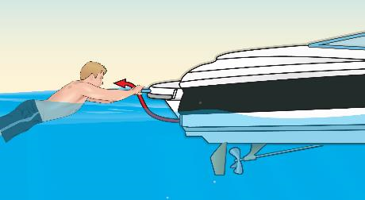
Personal Injuries
To prevent carbon monoxide poisoning:
Allow fresh air to circulate.
Keep away from engine and generator exhaust outlets.
Never sit on the back deck, “teak surf,” or hang on the swim platform.
Ventilate immediately if you detect fumes.
Install marine-rated CO detectors.
Notes:
Installation of CO detectors important, particularly in areas where people sleep, galleys, enclosed areas, etc.

Slide 41
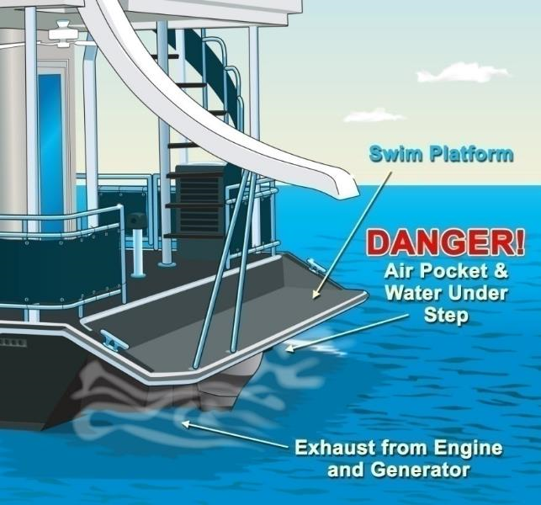
Personal Injuries
Never enter areas under swim platforms as air in these areas could be fatal if breathed in.
Notes:
Most swim platforms have slots to keep air flowing, but solid platforms keep the exhaust contained in that area and is dangerous. It can kill in seconds.

Slide 42
Personal Injuries
Before each boating trip:
Know the location of exhaust outlets.
Educate passengers about CO poisoning.
Check operation of exhaust outlets.
Listen for any change in exhaust sound.
Test each CO detector.

Slide 43
Personal Injuries
Monthly:
Make sure exhaust clamps are secure.
Look for leaks in the exhaust system.
Inspect rubber hoses for damage.
Annually:
Have a qualified technician check the engine and exhaust system.

Slide 44
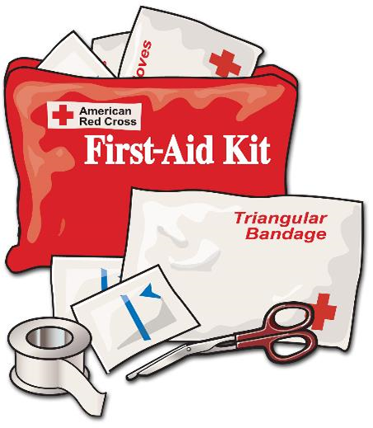
Personal Injuries
Responding to Other Serious Injuries
Shock
Bleeding
Burns
Broken Bones
Head, Neck, or Spinal Injury
Notes:
Have the students discuss what actions they would take.
Stress taking a first aid or CPR course.

Slide 45
Weather Emergencies
How to Avoid Severe Weather
Tune radio to a station with weather updates.
Be alert to weather conditions.
Track changes in barometer readings.
Watch for wind shifts, lightning, and rough water.
Assure boat and boater capability in severe weather.
Notes:
The weather condition that day is one of the items included in your “Go-No-Go” decision before departing the dock:
Be alert to weather changes
Watch for wind shift
Watch for rough water
Observe weather from all directions.
Boater skill level, including the ability and on-water experience of the operator and passengers, should be considered by the operator when evaluating overall risk.
Boat capability pertinent to those conditions; and The operator should evaluate the boat's capability and equipment when considering risk. Boat capability includes maneuverability, propulsion type, hull shape, draft, freeboard, structures above the waterline, and understanding the operational parameters and design limitations of the vessel per the owner's manual or manufacturer's specifications. • environmental conditions including low/high tide, submerged objects, sand bars, currents, etc. Boat Operators must have a continuous, systematic process of identifying and managing risk. This process includes detecting hazards associated with weather and environmental conditions, assessing risks, and implementing controls. The wind, sea state, tides, and currents affect steering; low and high tides can reveal (low tide) or hide (high tide) sandbars and other submerged objects; reduced visibility limits visual navigation, and the state of the atmosphere (such as lightning) can affect electronic navigation and communication.

Slide 46
Weather Emergencies
Be aware of weather to the west.
Watch for fog.
Head toward nearest safe shore.
Notes:
Stress:
Be alert to weather changes
Watch for wind shift
Watch for rough water
Observe weather from all directions.

Slide 47
Weather Emergencies
What to Do if Out in Severe Weather
Prepare the boat.
Slow down.
Close hatches, windows, and doors.
Stow unnecessary gear.
Turn on all navigation lights.
Keep bilges free of water.
Disconnect electrical equipment if there is lightning

Slide 48
Weather Emergencies
Prepare your passengers for severe weather.
Make sure everyone is wearing a PFD.
Have passengers sit on deck close to centerline.
Decide whether to go to shore or ride out the storm.
Head for nearest safe shoreline.
Steer bow of boat into waves.
Keep sharp lookout for other vessels or hazards.
If engine stops, drop an anchor.
Notes:
Stress:
Put on PFD- if not already on
Reduce speed
Consider seeking shelter
Close hatches and portholes
Keep weight low

Slide 49
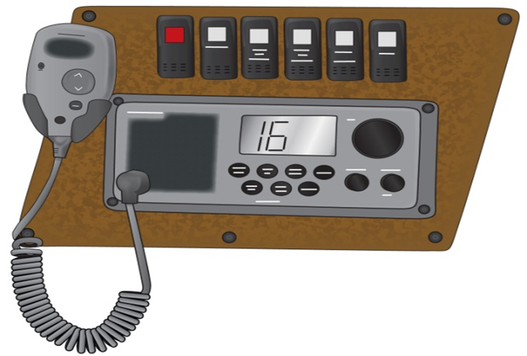
Summoning Help
Useful items:
Visual distress signals
VHF marine radio Ch. 16
Mobile phone
Emergency Position-Indicating Radio Beacon (EPIRB)
Personal Locator Beacon (PLB)
Notes:
Describe the process of calling for help, and the categories of help.
Distress: Immediate help needed, life threatening situation, e.g., taking on water, danger of sinking, fire, medical emergency requiring evacuation.
MAYDAY, MAYDAY, MAYDAY
Urgency: Help needed, but not an immediate emergency, e.g., out of fuel, taking on water but pumps are working fine and staying afloat.
PANPAN, PANPAN, PANPAN
Safety: There is a danger on the water for other boaters that should be broadcast to avoid.
SECURITE, SECURITE, SECURITE
If you have a marine VHF radio, you are required to monitor channel 16 when not using the radio on other channels. When radioing for help be sure you include important information about the boat and passengers:
Name and/or description of boat.
Number of persons on board,
Your location,
Nature of your distress.
Any medical situations on board.

Slide 50
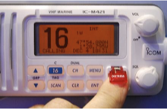
Distress, Urgency, & Safety Messages
Digital Selective Calling (DSC)
Automated distress call
Identifies your boat and location
Must be registered with Marine Mobile Service Identity (MMSI) number
Notes:
This service, called digital selective calling (DSC), allows mariners to instantly send an automatically formatted distress alert to the Coast Guard or other rescue authority anywhere in the world.
Digital selective calling also allows mariners to initiate or receive distress, urgency, safety and routine radiotelephone calls.
Register your device with an MMSI number (Maritime Mobile Service Identity). This is a unique 9-digit number that identified your vessel and location. The number is registered with Boat US.
This is tied in to Rescue 21, a series of satellites that can pinpoint your location and send information to Coast Guard units for rescue.

Slide 51
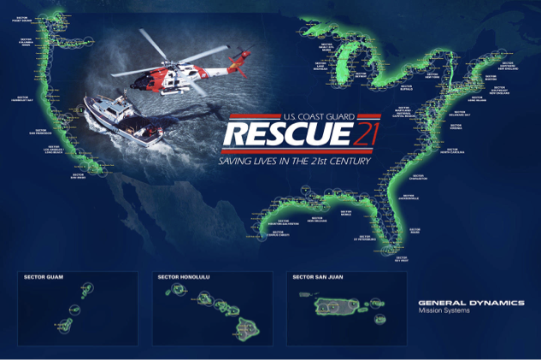
DSC/Rescue 21 Map
Notes:
Add text here

Slide 52
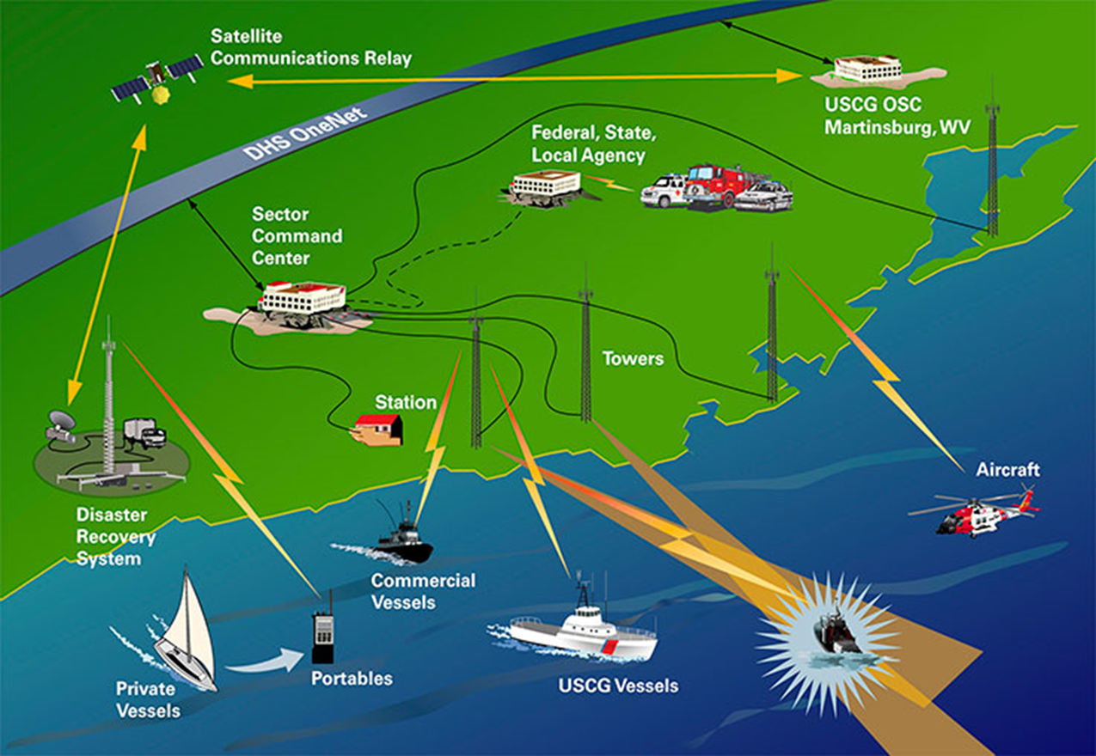
Rescue 21
Notes:
Add text here

Slide 53
Helping Others
What are some things to consider when towing another boat?
Only tow another boat is it does not endanger your vessel or crew.
Attach the line to the towing vessel’s cleat or make a bridle.
Establish a destination before towing.
Agree on form of communication between boats.
Notes:
Stress:
You may come across a boat that needs to be towed. Usually, this happens when a boat runs out of fuel. While you are required to come to the boater’s aid, this does not necessarily include towing. Using your phone or radio to call the local boat towing agency may be all that is required. You should not tow another vessel unless you feel comfortable doing it, and it does not endanger your boat or crew. If you decide to tow another boat, you should consider:
Are you able to make a secure line between the two boats? Are there secure fixtures to hold, or can you make a bridle?
Are all partied agreed on the destination for the tow? Is it too far to the original dock or is there a closer location to make towing easier?
Is there an easy mean of communication beween the two boats?

Slide 54
Helping Others
What are some things to consider when towing another boat?
Always keep watch on the line.
Reduce line chafing.
Consider weather, water, and traffic conditions.
Notes:
Stress:
Be sure that someone is watching the tow line. It should be about three wave lengths to allow for easy movement of both boats up and down the waves.
Use some form of chafing gear to prevent wear on the line. Any piece of plastic, rubber, cloth, or even a piece of old rubber hose will work.
Make sure conditions are optimum for towing. Do not endanger either vessel or crews more than necessary.

Slide 55
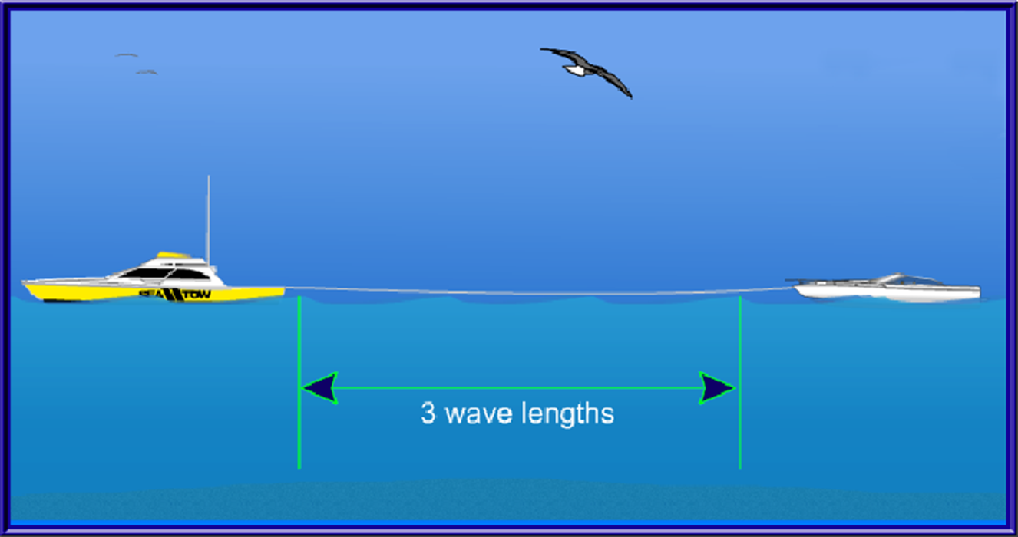
Helping Others
Adjust line length so towed boat rides at least 3 wave lengths behind
Notes:
Point out the ideal length of 3 wave lengths.

Slide 56
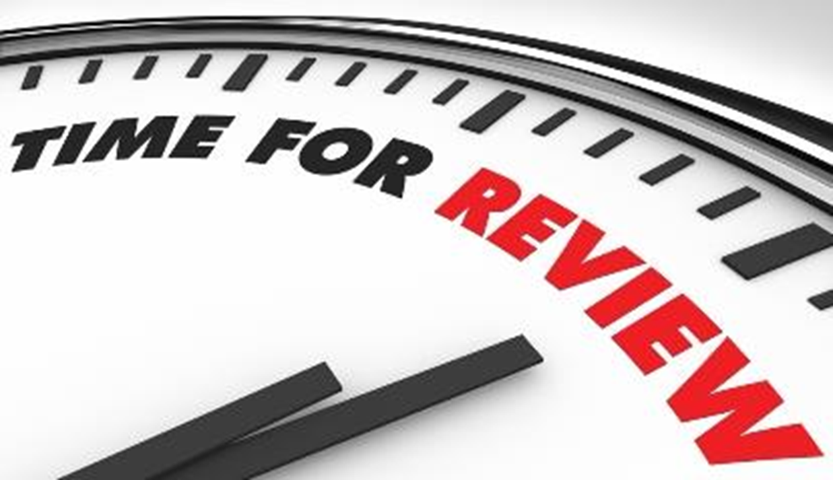
Chapter 5 Review
Notes:
Add text here

Slide 57
Review Exercises
Which of these provides warning that dangerous weather is approaching?
a. Clear, sunny skies and no wind.
b. Drop in wind speed and calmer water.
c. White clouds and gentle waves.
d. Dark clouds and shifting winds.
Notes:
Add text here

Slide 58
Review Exercises
What should you do to reduce the risk of falling overboard?
a. Stand up when changing seats.
b. Move around while underway.
c. Keep centered in the boat.
d. Keep two points points of contact if you move.
.
Notes:
Add text here

Slide 59
Review Exercises
What should a motorboat operator do when someone is
being pulled into the boat from the water?
a. Put the engine in forward gear at the slowest speed.
b. Put the engine in reverse gear at the slowest speed.
c. Keep the engine idling in neutral.
d. Turn the engine off.
Notes:
Add text here

Slide 60
Review Exercises
Why is carbon monoxide gas dangerous?
a. It is flammable and ignites easily.
b. It creates a cloud that blocks your view of other vessels.
c. It causes corrosion on electrical connections that can cause sparks.
d. It is colorless, odorless, and tasteless and can be fatal.
Notes:
Add text here

Slide 61
Review Exercises
What is the first action required of a boat operator who
witnesses a boating accident?
a. To provide assistance.
b. Keep out of the way.
c. Write an accident report.
d. Wait for rescue personnel.
Notes:
Add text here

Slide 62
Review Exercises
Under what condition is a person at the greatest risk of
developing hypothermia?
a. After being in the wind for a long time.
b. When deprived of liquid.
c. When exposed to cold air.
d. When immersed in cold water.
Notes:
Add text here

Slide 63
Review Exercises
What should you do if you fall overboard into cold water?
a. Try to re-board your boat, even if it is swamped.
b. Remove any unnecessary clothing .
c. Tread water or swim around to generate heat.
d. Try to float on your stomach with legs extended.
Notes:
Add text here

Slide 64
End Chapter 5
Notes:
Add text here

