Slide 1
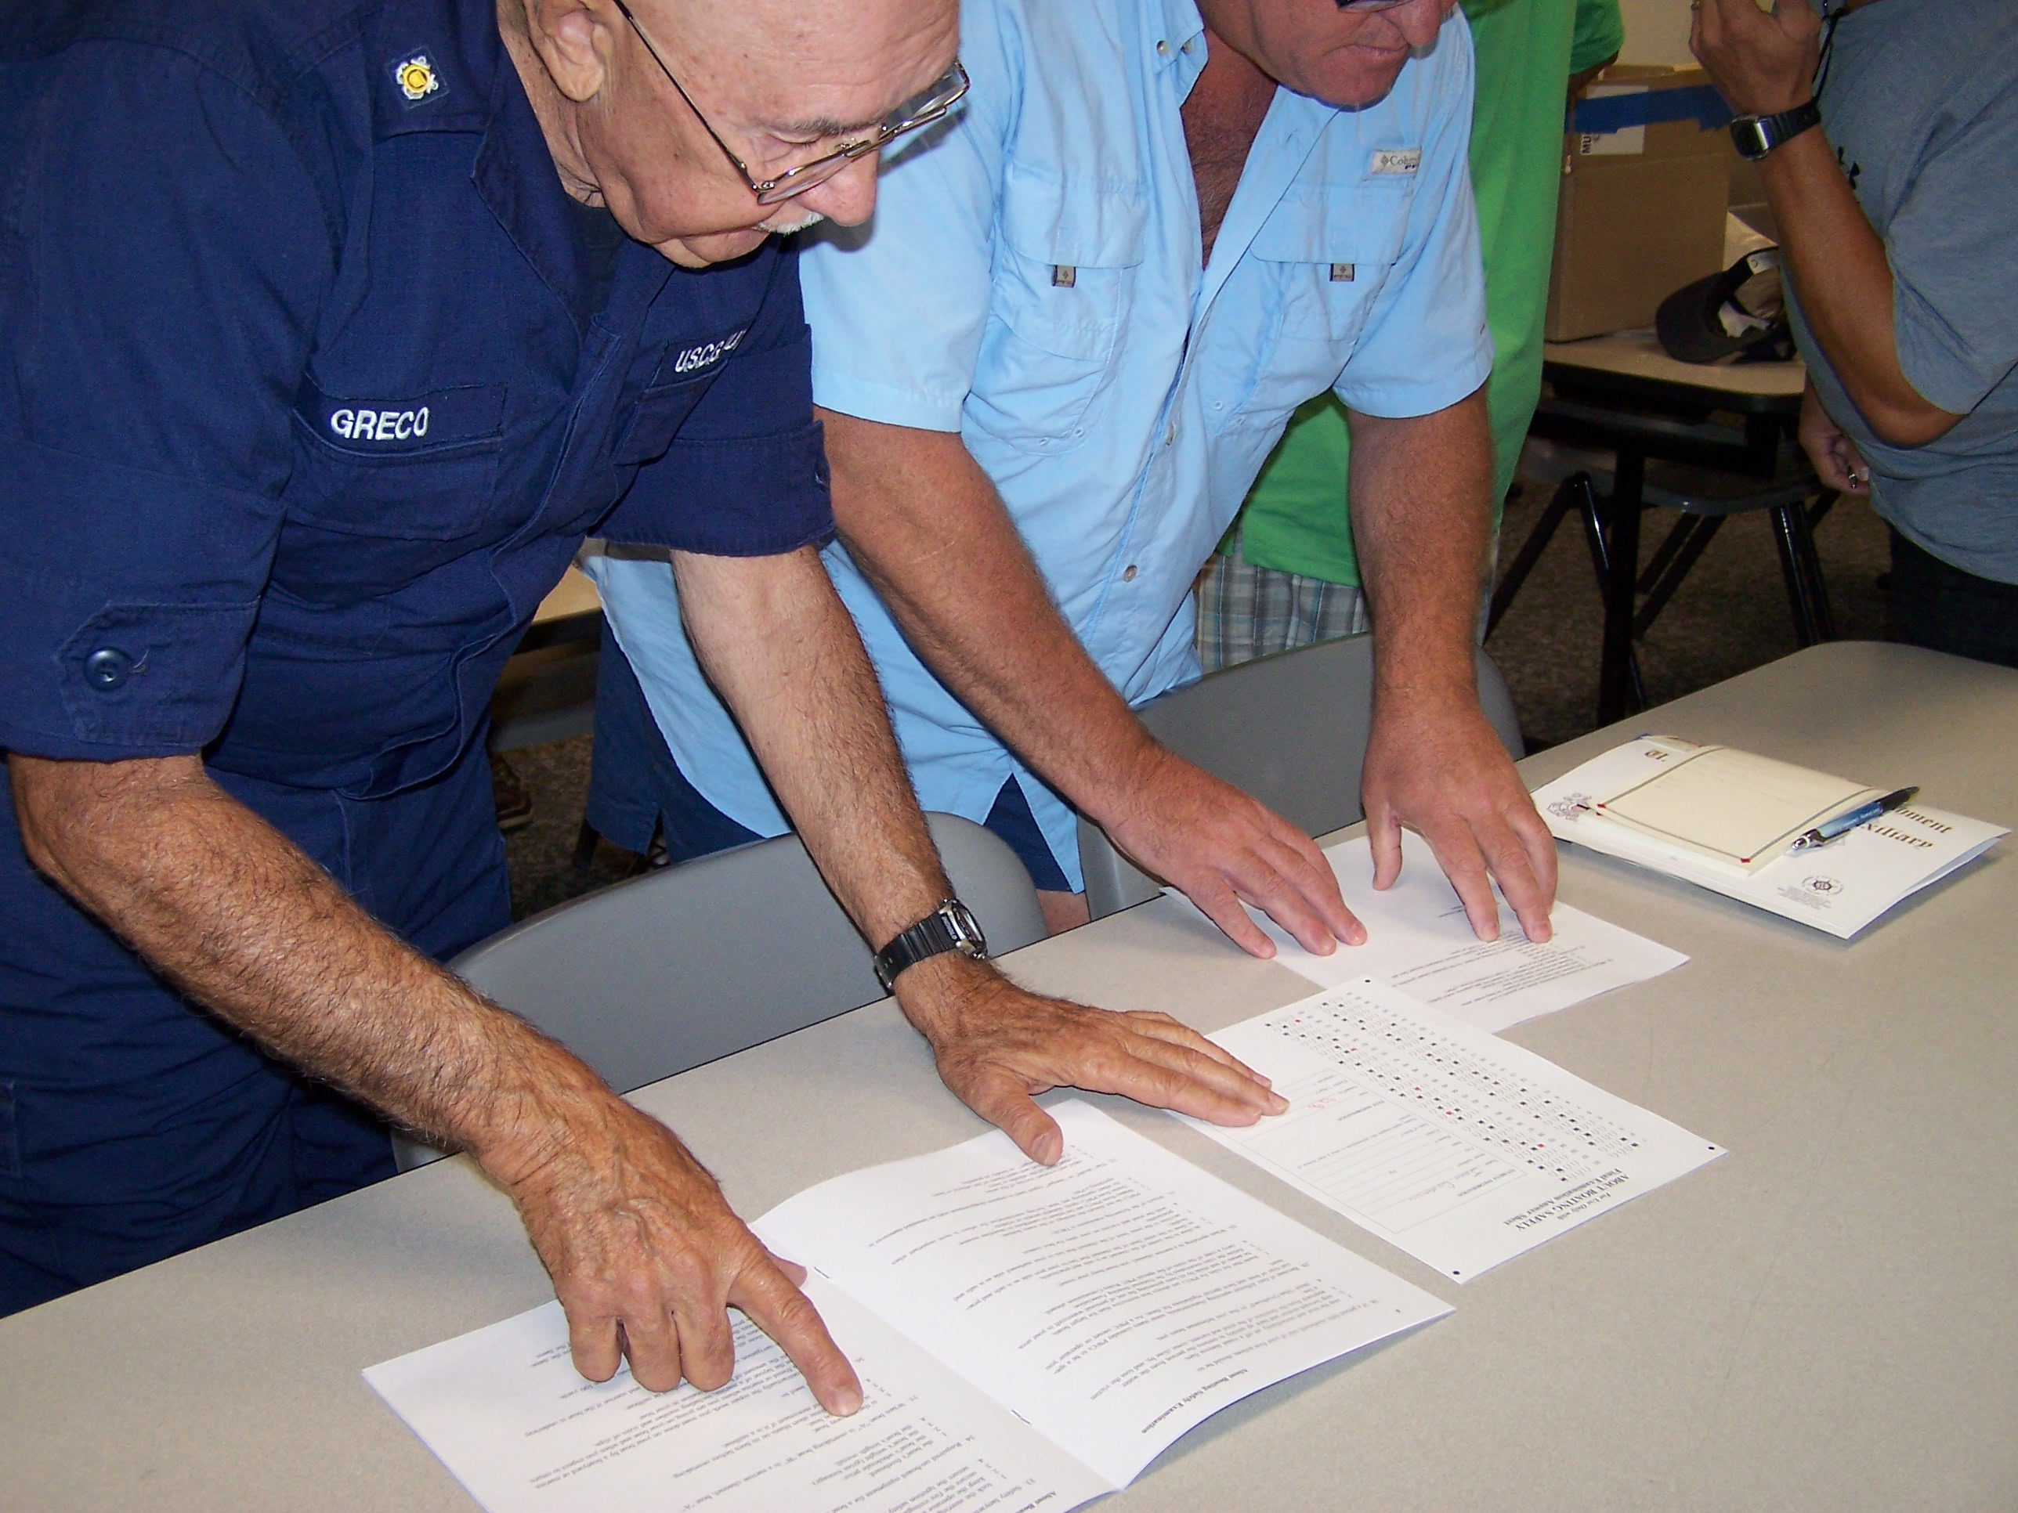
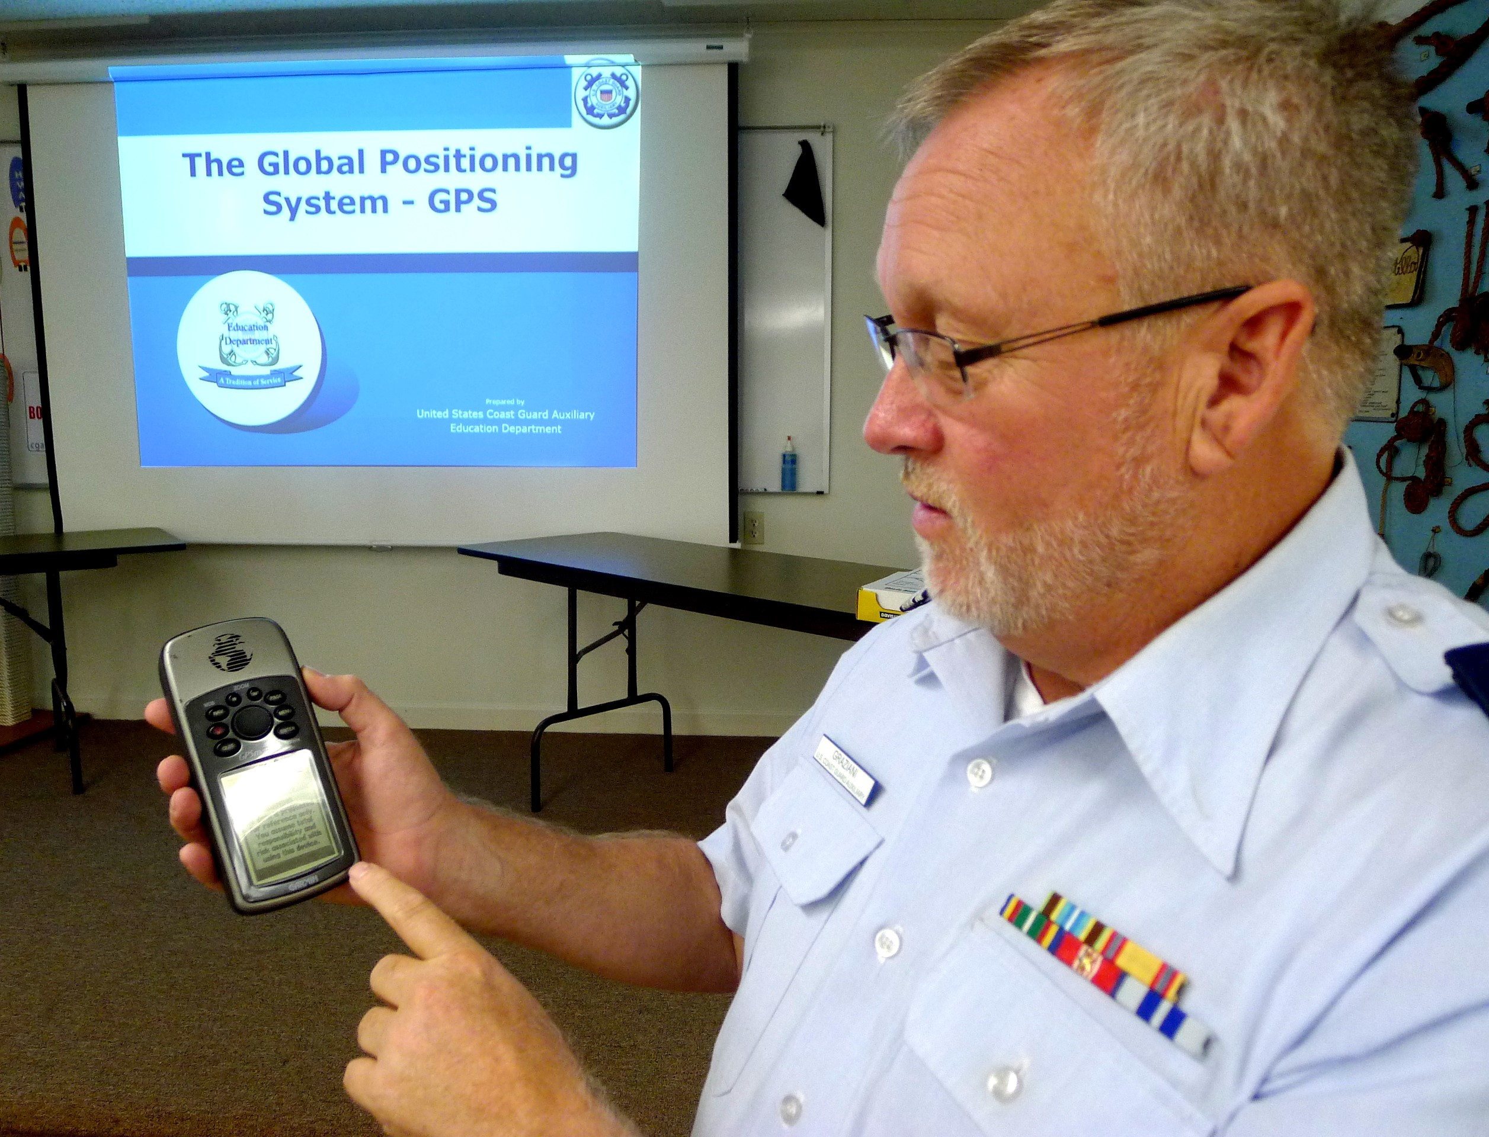
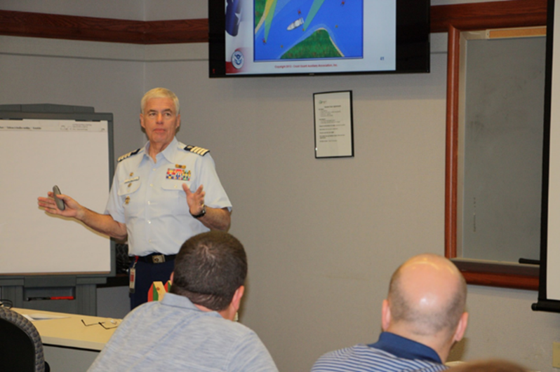
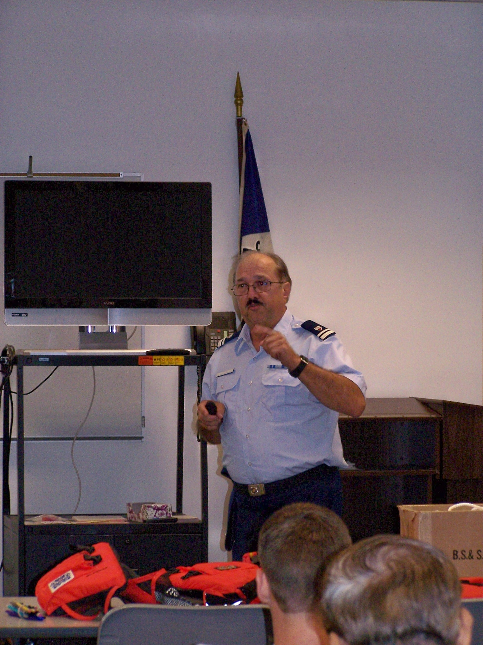
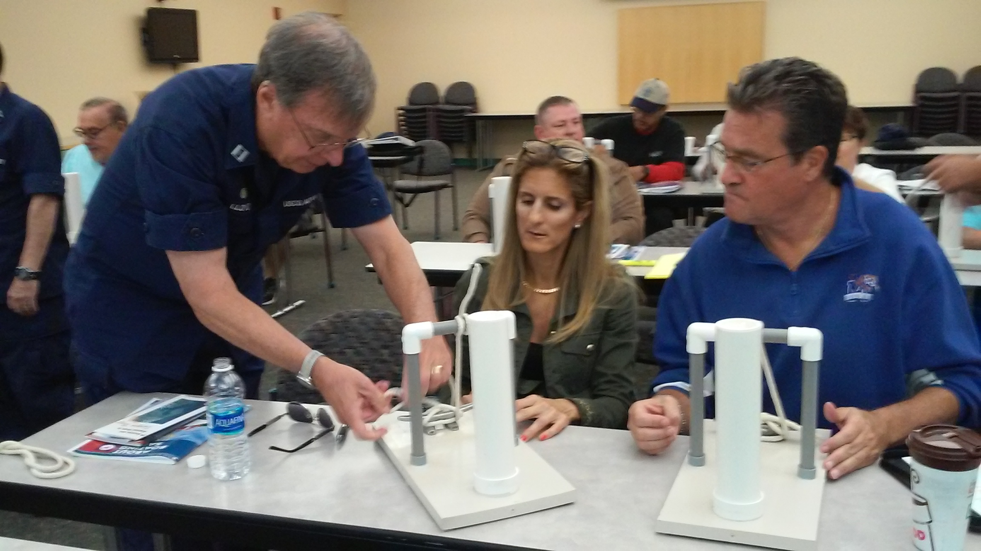
10 Steps to Instructor Certification

Slide 2
Overview
Read the ID2025 Student Guide
Read through the ID2025 PowerPoint Final Instructor Notes
Take the Instructor Exam on NTC (open book)
Review the Instructor Workshop, sign the self-attestation form, and submit to your IS officer
Review the PQS questions
Prepare the short presentation (15 to 30 minutes) with lesson plans and present under the supervision of a certified instructor
Notes:
Add text here

Slide 3
Overview
Prepare a one to two hour presentation in MT or PE with lesson plans and present under the supervision of a certified instructor
Complete Introduction to Risk Management
Answer PQS questions with an instructor mentor
Record all study and class time, except for the presentations, as 99D
Notes:
Add text here

Slide 4
Overview
Once that’s all signed off and student teaching hours and workshop are recorded in AUXDATA II, FC signs the last page of the Study Guide along with all the other activities that have been signed off by the mentor(s), and submits it to their DIRAUX according to district policy.
Notes:
Add text here

Slide 5
1. Download and Read the ID2025 Student Guide
Go to:
CGAUX.org
Select Public Education Directorate
Sign in
Select PE Resources
Click on ID2025
Download the Student Guide
Notes:
Add text here

Slide 6
2. Read through the PowerPoint Instructor Notes (optional)
Go to:
CGAUX.org
Select Public Education Directorate
Sign in
Select PE Resources
Click on ID2025
Download the ID2025 PowerPoint Instructor Notes
Notes:
Add text here

Slide 7
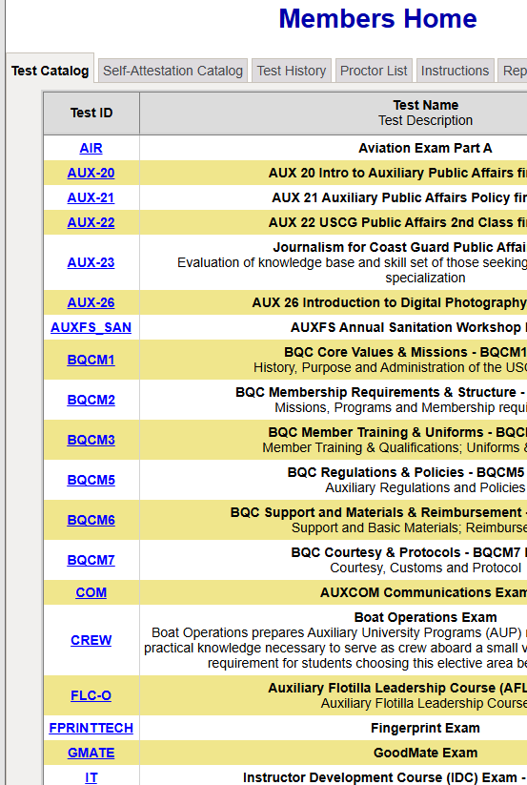
3. Take the Instructor Exam on NTC (open book)
Go to:
https://ntc2.cgaux.org/NTC/
Sign in
Go to the test catalog
Scroll down to the IT examination
Take the examination and score at least 90%
Success will be automatically uploaded to AUXDATA II within one week
Notes:
Add text here

Slide 8
4a. Review the Instructor Workshop
Go to:
CGAUX.org
Select Public Education Directorate
Sign in
Select PE Resources
Click on Instructor Workshop
Download the ID2025 Workshop and the Self-Attestation Form
Read through the workshop
Notes:
Add text here

Slide 9
4b. Sign the Self-Attestation Form Submit to your IS Officer
After reading through the workshop:
Download the ID2025 Workshop Self-Attestation Form
Complete the fill-in items
Submit to your Information Services Officer
Notes:
Add text here

Slide 10
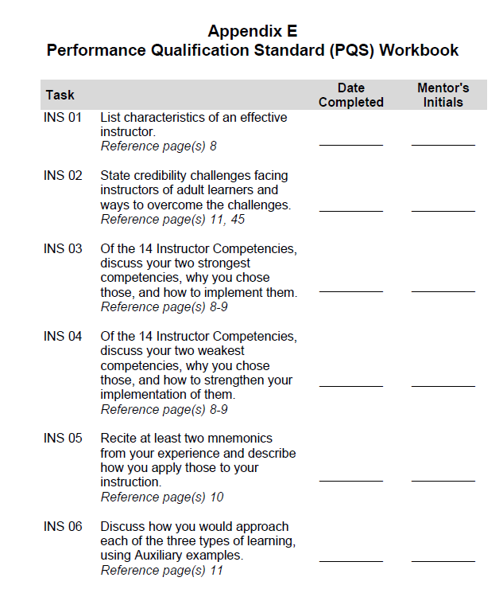
5. Review the Performance Qualification Standard Questions
Go to:
The ID2025 Student Guide – Appendix E
Go through each question and look up the answers to be assured of knowing the material
Notes:
Add text here

Slide 11
6. Prepare the short presentation (15 to 30 minutes)
Ground Rules:
This can be on any topic
Must include a complete lesson plan
AUXDATA II
Supervising instructor/mentor is listed as LEAD
Candidate is a TRAINEE.
Only one trainee per lead per session
Mission codes 06 or 14 are used
Notes:
Add text here

Slide 12
7. Prepare the long presentation (one to two hours)
Ground Rules:
This must be a public education or member training topic
Must include a complete lesson plan
AUXDATA II
Supervising instructor/mentor is listed as LEAD
Candidate is a TRAINEE.
Only one trainee per lead per session
Mission codes 06 or 14 are used
Notes:
Add text here

Slide 13
8. Complete Introduction to Risk Management
Go to:
https://classroom2.cgaux.org/moodle/
Sign in
Select R-Response
Click on Enrollment Key to get the correct key
Click on Risk Management and Operations Portal
Click on Introduction to Risk Management (ITRM)
Complete the course and quizzes
Successful completion will be automatically downloaded to AUXDATA II within a week
Notes:
Add text here

Slide 14
9. Work with a Certified Instructor and Answer PQS Questions
Ground Rules:
This is a closed-book, closed-notes session
Certified Instructor/mentor must initial and date each item on the appropriate section of the form
Notes:
Add text here

Slide 15
10. Record all study and class time, except for the presentations, as 99D
Consolidate all class time, study time, and travel time under 99D for entry into AUXDATA II
“Student Teaching,” both the short and long presentations, are entered into AUXDATA II
06A or 06B if member training
14A through 14W if public education
Certified instructor is LEAD
Candidate is TRAINEE
Only one Trainee per AUXDATA II record
Notes:
Add text here

Slide 16
Final Steps
Once everything is signed off and the student teaching hours and workshop are recorded in AUXDATA II, the candidate’s FC signs the last page of the Study Guide along with all the other activities that have been signed off by the mentor(s), and submits it to their DIRAUX according to district policy.
Note: To be certified as an instructor, the member must have a current uniform inspection. They cannot be exempt.
Notes:
Add text here

Slide 17
Thank You
If you have any questions, contact the appropriate E-Directorate Staff, following the Chain of Leadership and Management
You may email the E-Directorate at pe.feedback@cgauxnet.us
Notes:
It’s the policy of the CG Auxiliary that we solve issues at the lowest level. If the problem, question, or matter cannot be handled at this lower level, follow the Chain and press the issue higher.
All issues should be solved at the lowest possible level and elevated as needed through the chain of leadership and management to address the issue. It is NOT appropriate to go outside our organization for answers to education-related problems unless specifically instructed by the staff of the Education Directorate. Inquiries posed outside our organization confuse our partners and delay a proper response.
The entire staff of the E Directorate is standing by to answer any education questions that cannot be answered at a lower level.
The E-Directorate also maintains a feedback email address to assist members with answers they could not find anywhere else within the Auxiliary.
Members must understand they should not contact the Chief Director’s office or anyone outside the CG Auxiliary Chain of Leadership and Management. Any requests outside the Chain unnecessarily tie up resources answering these questions at BSX, NASBLA, and the BLA offices for internal Auxiliary queries. At the very least, it paints the Auxiliary as undisciplined and unable to communicate internally. At worst, it threatens our credibility at a national level with these national partners, which can have significant ramifications on future relationships.
You may email the E-Directorate at:
pe.feedback@cgauxnet.us

