Slide 1
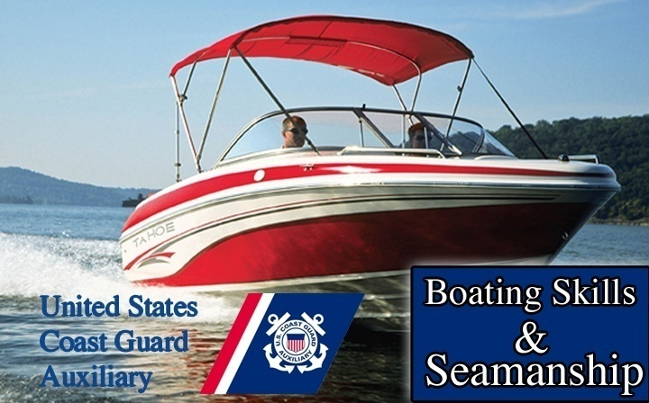
Lines & Knots For Your Boat
Chapter
11

Slide 2
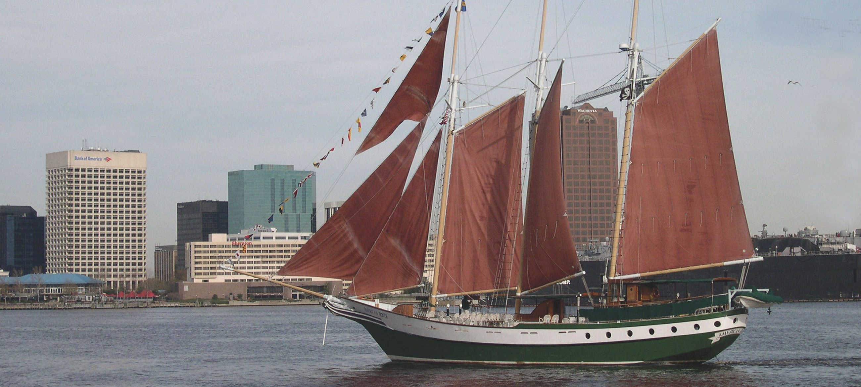
Lines & Knots For Your Boat
Chapter
11

Slide 3
Lesson Objectives
Marlinspike seamanship
Rope
Use and care
How to store
Handling hardware
Useful knots
Securing boat lines

Slide 4
Line vs. Rope
A rope is something you buy at the hardware store.
A rope becomes a line (usually) when you bring it aboard your boat

Slide 5
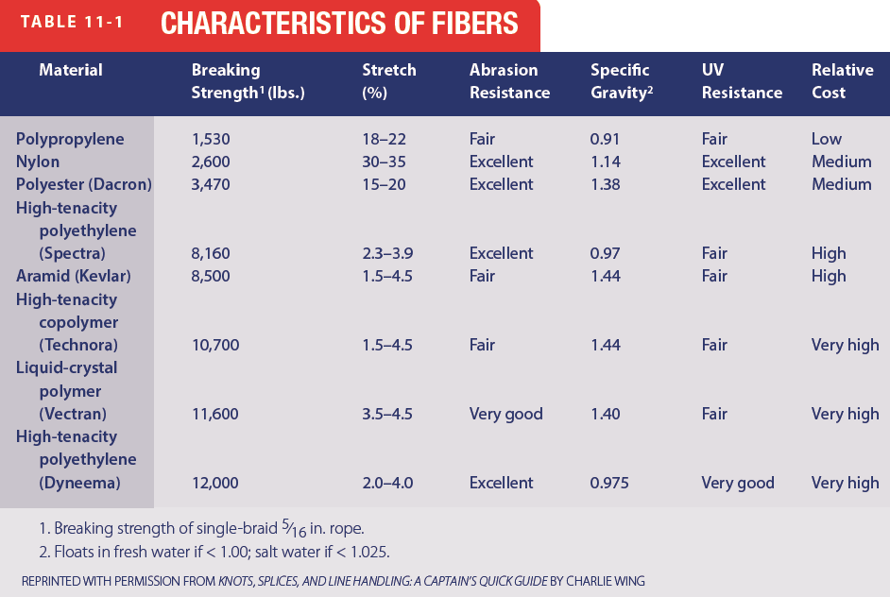
Rope Materials
Nylon
Synthetic
Mooring/Anchoring
Polyester
Dacron
Synthetic
Polypropylene
Floats
Synthetic
Special ropes
Wire

Slide 6
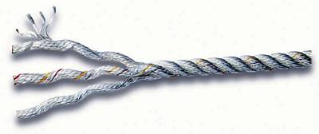
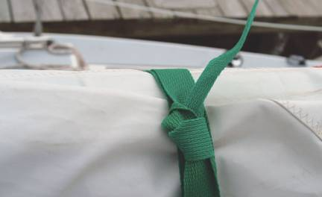
Rope Construction
Laid rope
Webbing
Reprinted with permission from Knots, Slices and Line Handling: A Captain’s Quick Guide by Charlie Wing

Slide 7
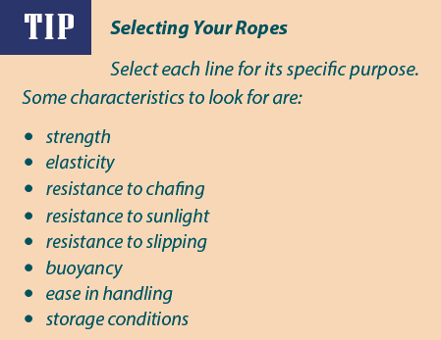
Best Type to Use
What to consider when selecting a Rope

Slide 8
Care of Rope
Coiling carefully to prevent kinks
Do not over stress – proper selection
Keep it clean and dry
Prevent chafing with chafing gear
Prevent fraying by whipping
Inspect often, especially wire rope

Slide 9
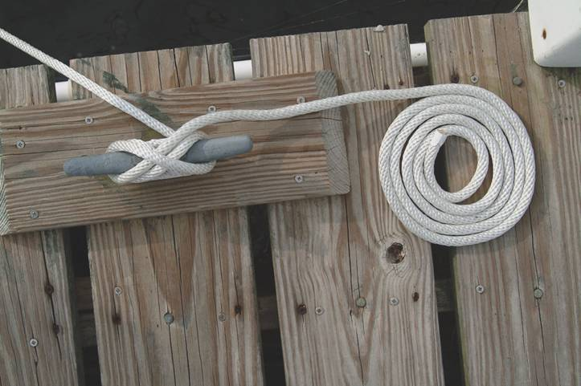
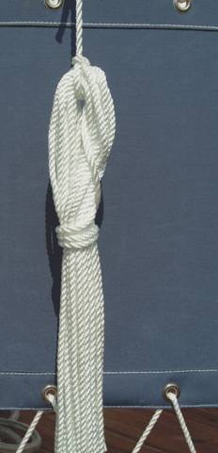
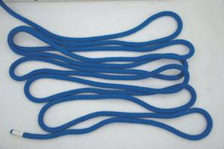
Making Up a Line
Flemish
Faking
Weather Hitch
Gasket Coil

Slide 10
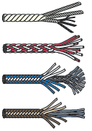
Student Activity
What are three types of Rope?
Polypropylene (Ski Rope)
Polyester (Dacron)
Nylon (Elastic)
1
2
3

Slide 11
Parts Of A Line
Working end
Bitter end
Tied to Vessel
Standing part
Main Part
Bight
Round turn
Overhand loop
Underhand loop
Turn
Bight around an object

Slide 12
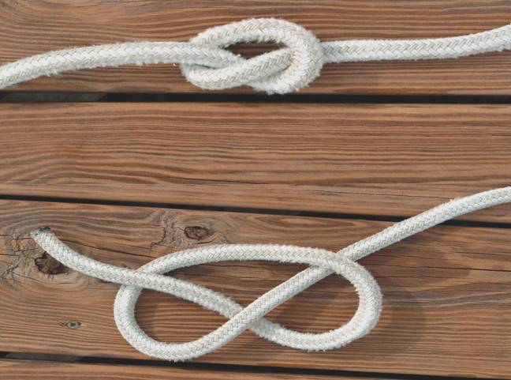
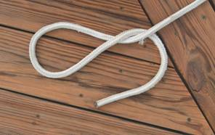
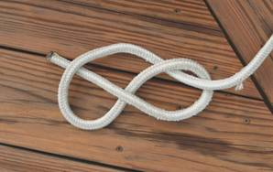
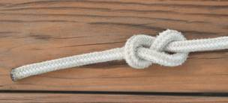
Stopper Knot
Line tied to itself is a knot
1
2
2

Slide 13
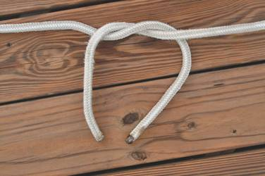
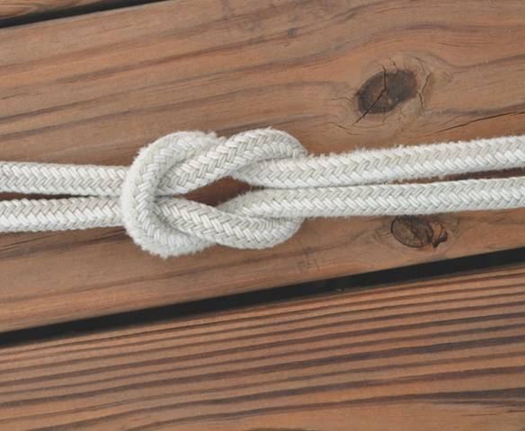
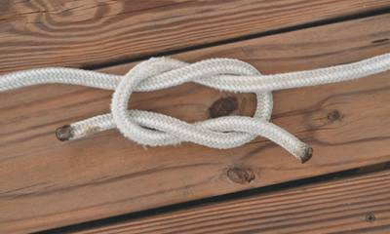
Square/Reef Knot
Do not use on heavy or critical load

Slide 14
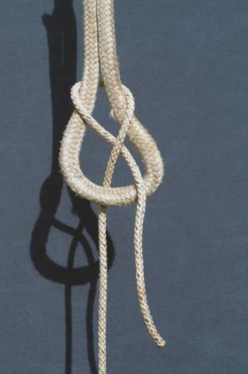
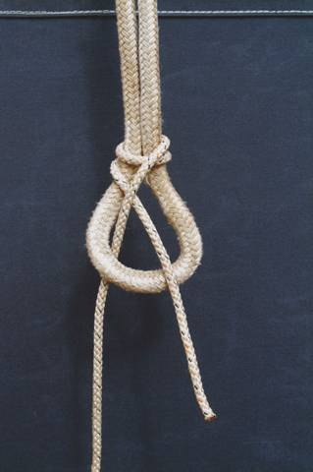
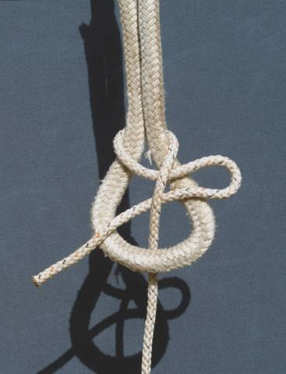
Sheet Bend/Becket Bend
Bend
Ties one line to another

Slide 15
Whipping a line
Tape line end to keep strands secure
Burn or melt loose strands at line end
Remove tape

Slide 16
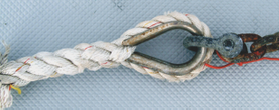
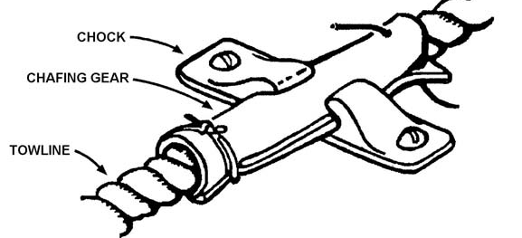
Chafing Gear
Keeps
a line from damaging a boat

Slide 17
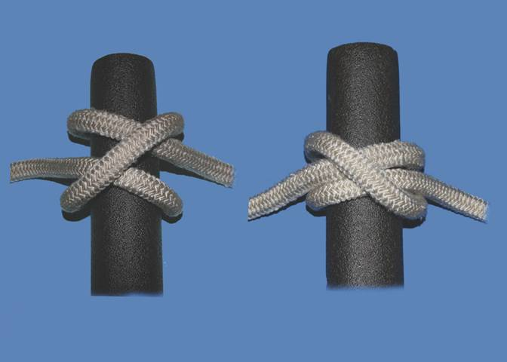
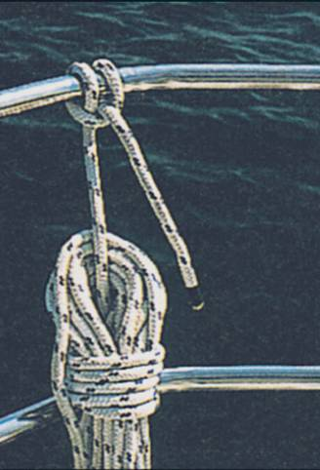
Clove Hitch
Clove Hitch
Will slip if not under tension
Finish with Half Hitch
Reprinted with permission from Nautical Knots Illustrated, Revised Edition by Paul Snyder and Arthur Snyder

Slide 18
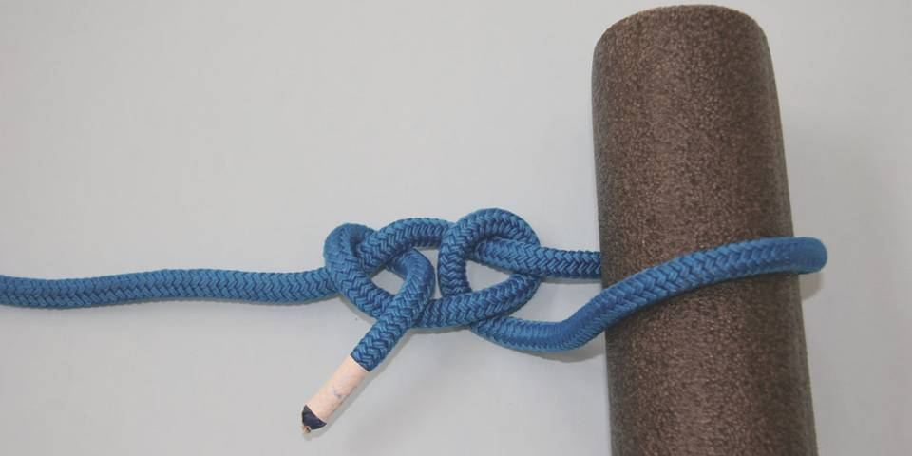
Two Half Hitches
Hitch
line attached to object

Slide 19
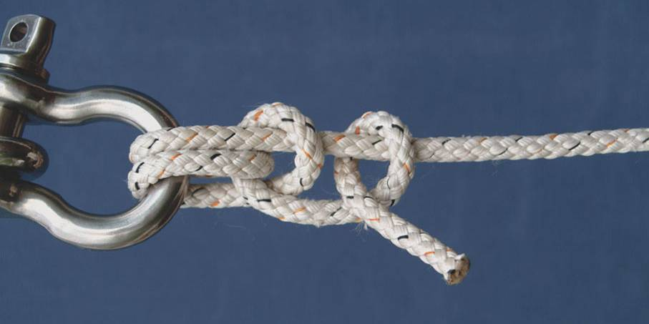
Anchor or Fisherman’s Bend
Secure way of attaching line to an object (anchor)

Slide 20
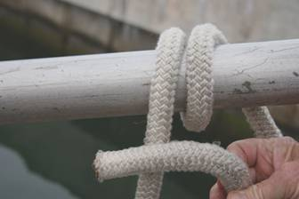
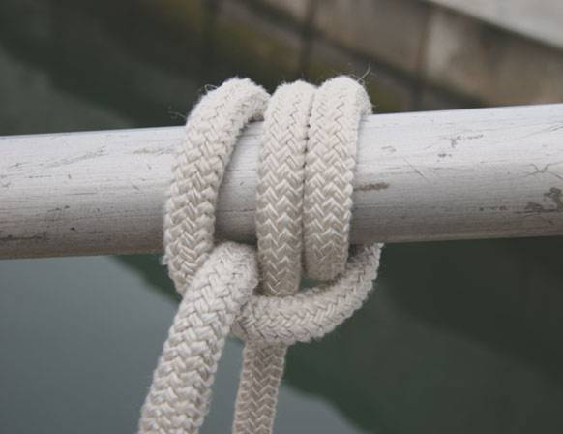
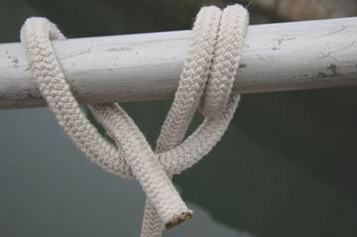
Rolling Hitch

Slide 21
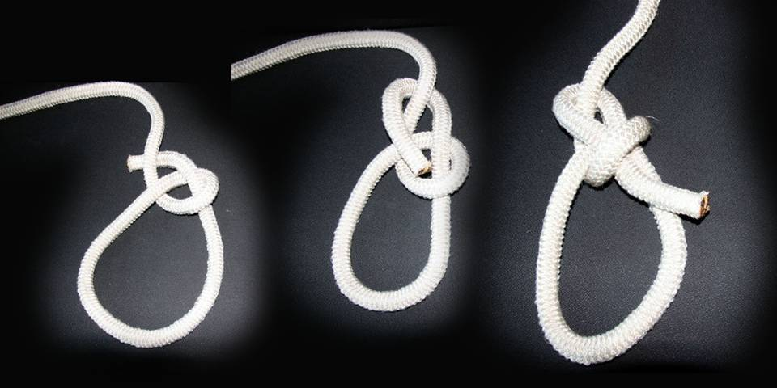
Bowline
Bowline
Forms a temporary loop

Slide 22
Student Activity
Name the most versatile Knot and why
Bowline (The KING of knots)
1

Slide 23
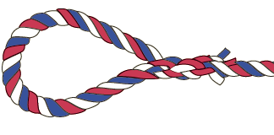
Splices
More permanent way to join two lines or form a loop (Eye)
Splice same size lines
Short Splice – Increases diameter of line
Long Splice – Does not increase diameter but does reduce strength of line
Eye Splice
Eye Splice
FID

Slide 24
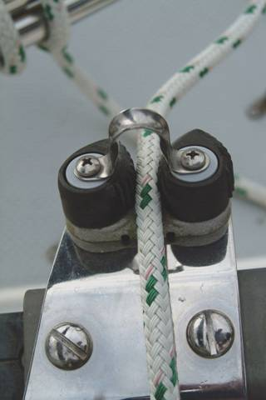
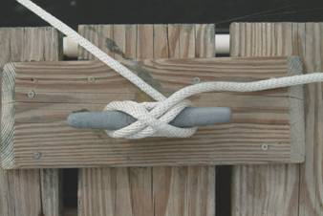
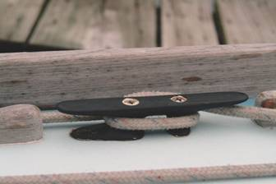
Securing Lines
Cleats
Used to secure lines for docking and anchoring
Pulleys (called Blocks)
Cam
Horned
Jam

Slide 25
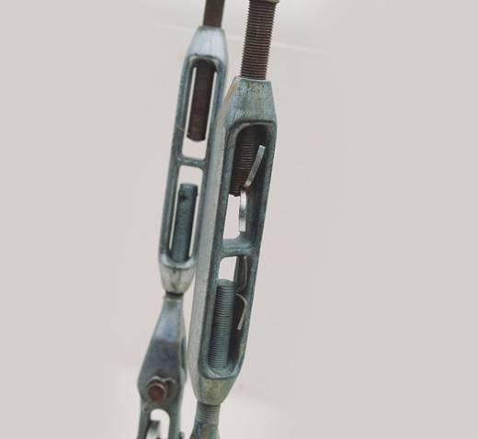
Securing Lines
Turnbuckles
A threaded fitting that is used to pull two eyes together

Slide 26
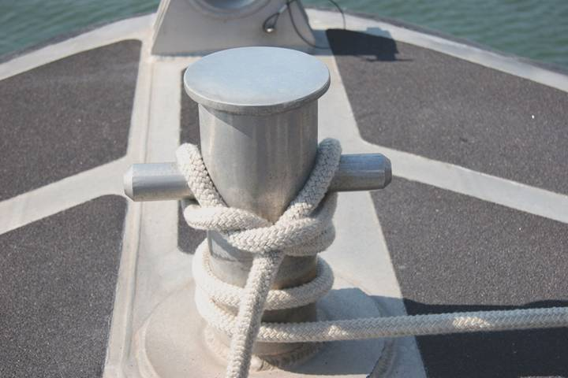
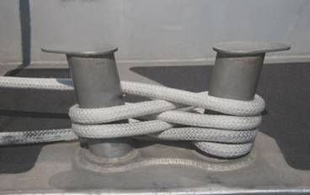
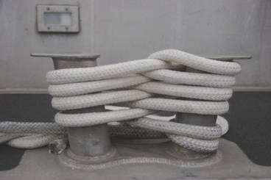
Securing Lines
Sampson Post
Bow Bitts

Slide 27
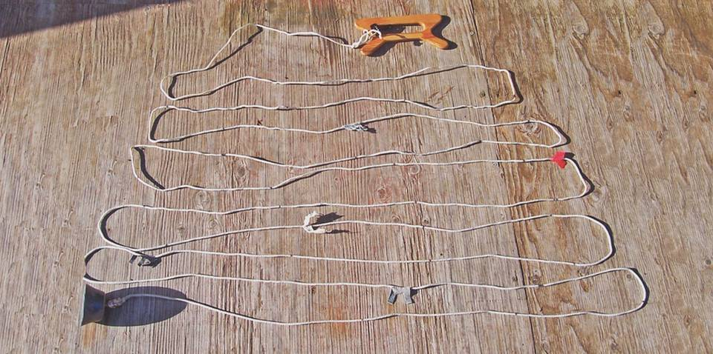
Lead Lines
Used to measure depths up to 100 feet
Depth-interval markers

Slide 28
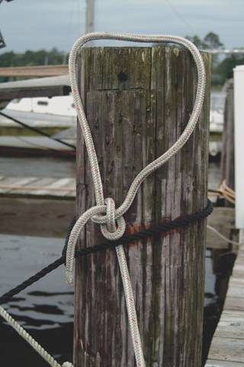
Dipping the Eye
Used to tie two dock lines to the same post

Slide 29
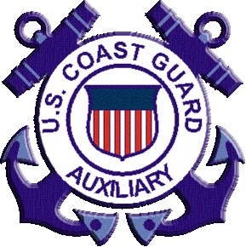
Thank you
Illustrations provided by McGraw Hill Education
The

