Slide 1
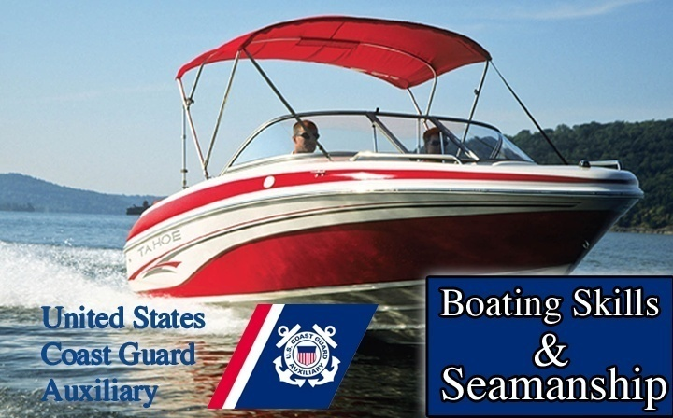
Inland Boating
Chapter
7

Slide 2
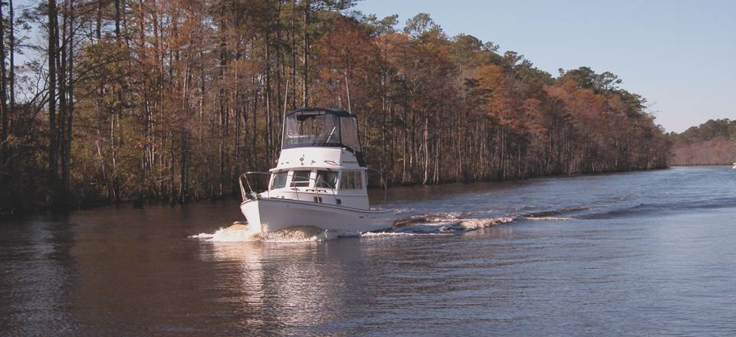
Inland Boating
Chapter
7

Slide 3

Lesson Objectives
Nature of inland waters
Navigation Rules
Aids to Navigation
Crossing and Passing Daymarks
Hazards
River charts
Navigating inland waters

Slide 4
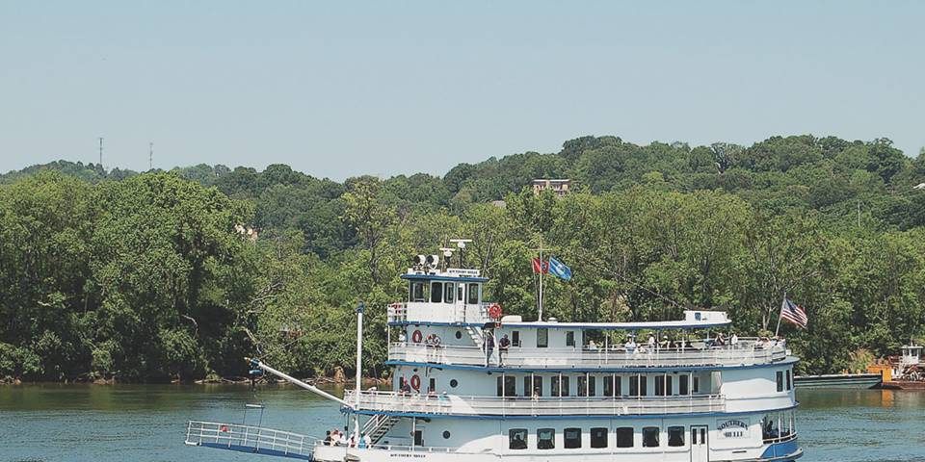
Inland Boating
Inland Waters include Rivers, Lakes and Canals
Maintained by Army Corp of Engineers

Slide 5
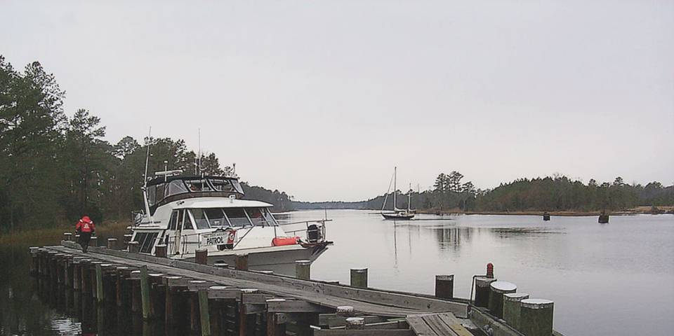
Inland Waters
Rivers – May be considered Navigable or Navigable Waterways
Include Great Lakes and ICW
Lakes – Natural, Impounded, Dammed

Slide 6
Inland Navigation
Inland Rules (chapter 6)
  In force on navigable waters inland of the demarcation lines.
  Use common sense on ALL rivers and waterways
ATONS
  US Aids to Navigation System

Slide 7
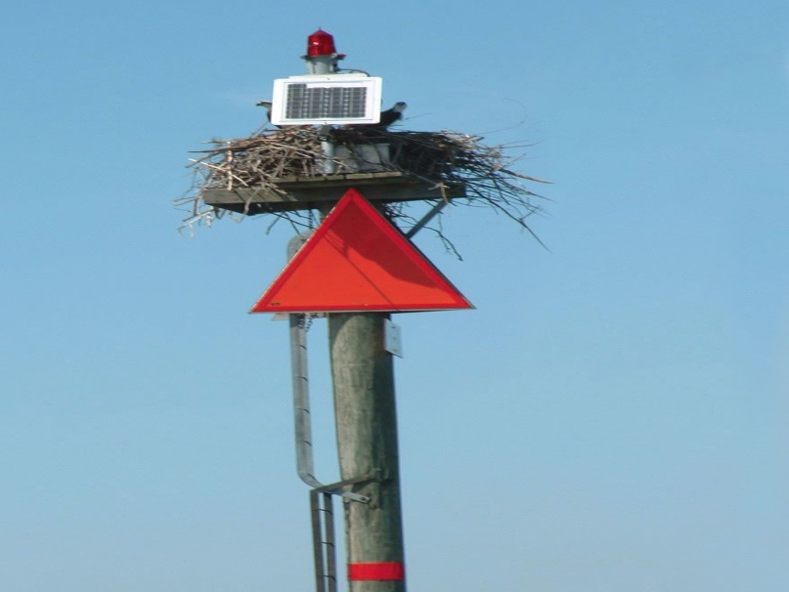
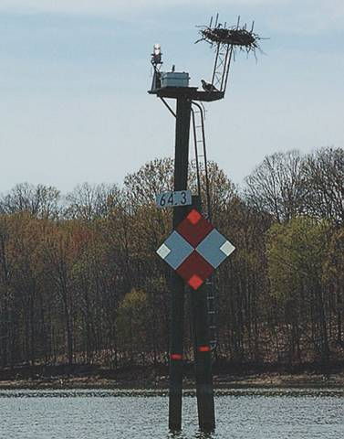

Inland Navigation
Western Rivers ATONS
  Right descending bank
  Left descending bank
  Passing Daymarks
  Crossing Daymarks
  Diamond shape
  Green and white checkerboard
  Red and white checkerboard

Slide 8
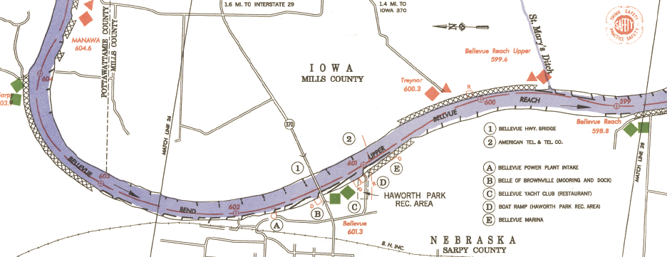
Inland Navigation
Western Rivers ATONS
  Charts do not show navigation lights

Slide 9
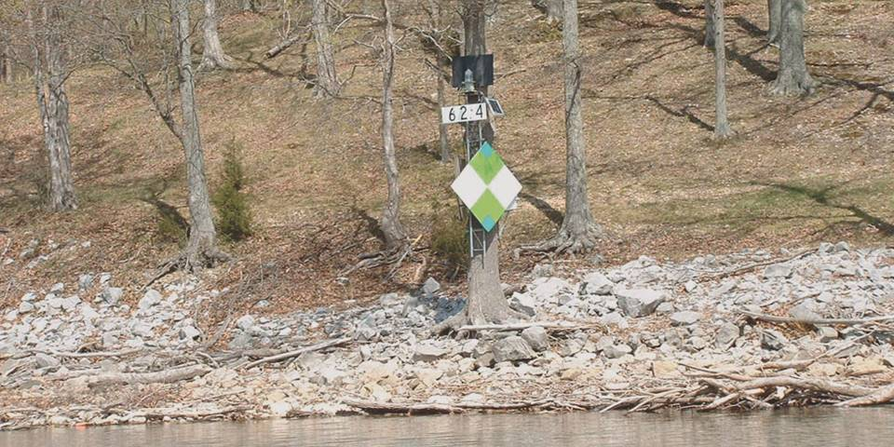
Inland Navigation
Western Rivers ATONS
Mississippi River and its tributaries
Channel on side with Daymark

Slide 10
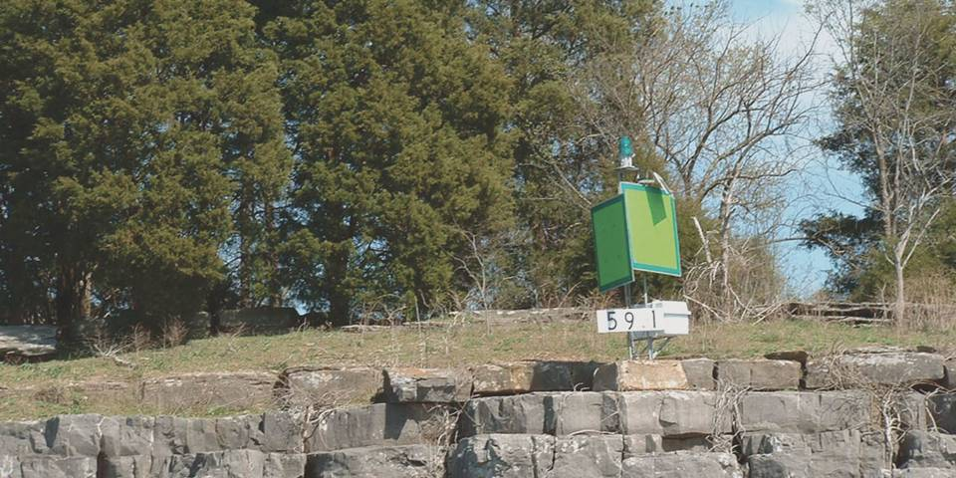
Inland Navigation
Western Rivers ATONS
  Mile Markers
  Passing Daymarks
  Buoys are not marked on chart

Slide 11
Inland Navigation
Uniform State Waterways Marking System
  Three types of markers
    Regulatory
    ATONS
    Mooring

Slide 12
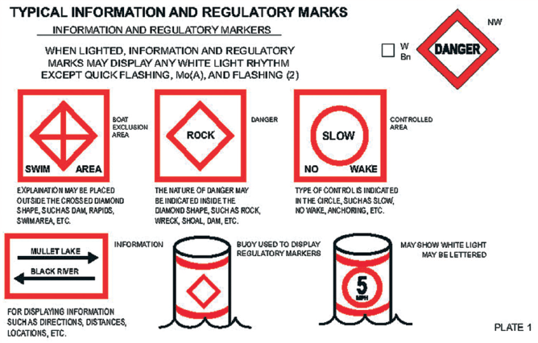
INFORMATION and REGULATORY

Slide 13
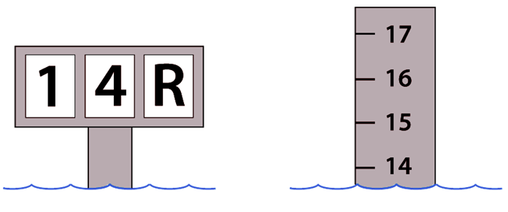
Inland Seamanship
Changing water depths and current speeds represent dangers

Slide 14
Inland Seamanship
Hazards of lakes
  Spring fed lakes present hypothermia risks
  Submerged objects
  Lake water levels
  During high water be aware of low overhead clearances
  Down stream of Dams turbulent and dangerous
  Learn Local Conditions!

Slide 15
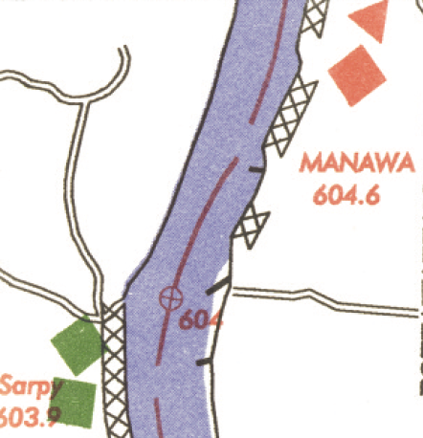
Student Activity
As you travel upstream which bank is on your Port side?
Right
Left
Left Descending Bank
Right Descending Bank
Right

Slide 16
River Currents
River Currents
  Can be quite strong
  Are concentrated in the channel
  Hinder movement up stream
  Aid movement down stream
  May run in different directions at different depths
  Right of way given to down bound vessels

Slide 17
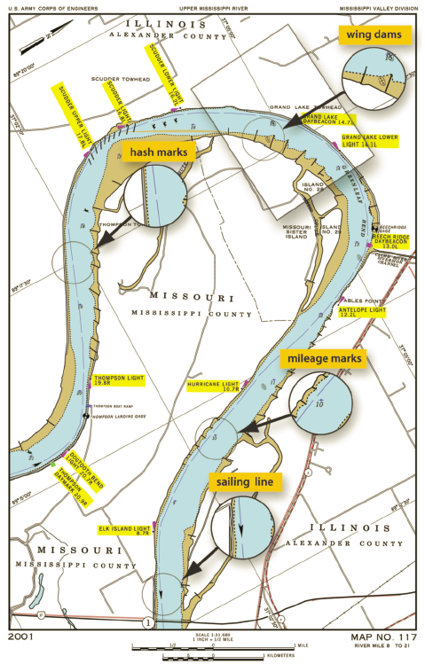
River Currents
River bends
  Outside bend (usually deeper)
  Inside bend
  Differences can cause eddies and slack water
  Reduce speed as wake can erode banks

Slide 18
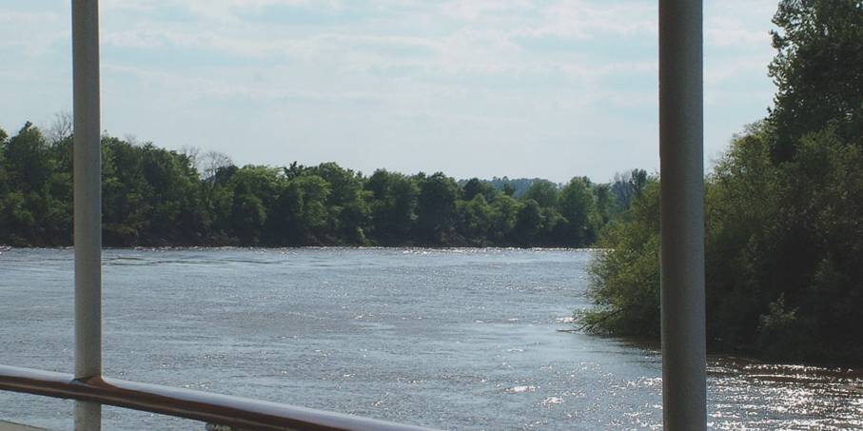
River Currents
Other river challenges
  Entering a current
  River debris

Slide 19
Maintaining Inland Waterways
Corp of Engineers
  Creates charts
Levees
Revetments
  Facing of stone or concrete
Wing Dams or Dikes
  Direct current into channel
Beware that river courses change!

Slide 20
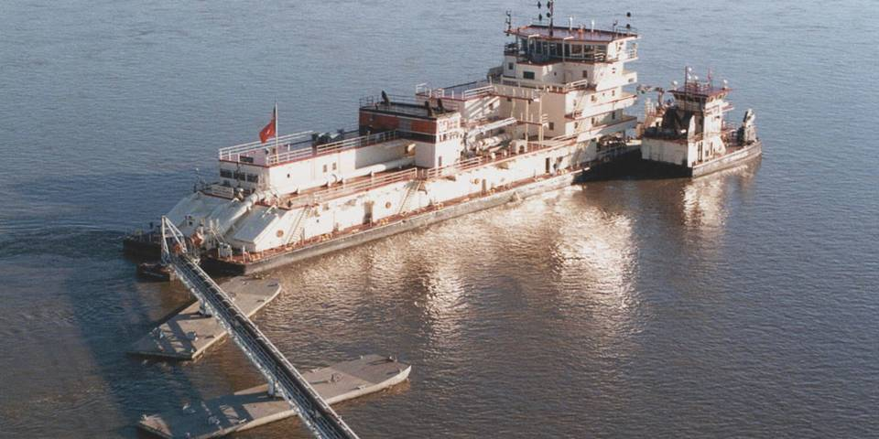
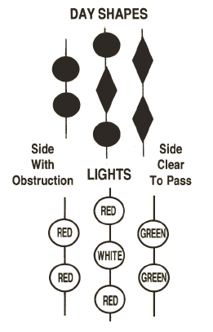
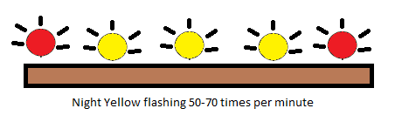
Maintaining Inland Waterways
Dredging

Slide 21
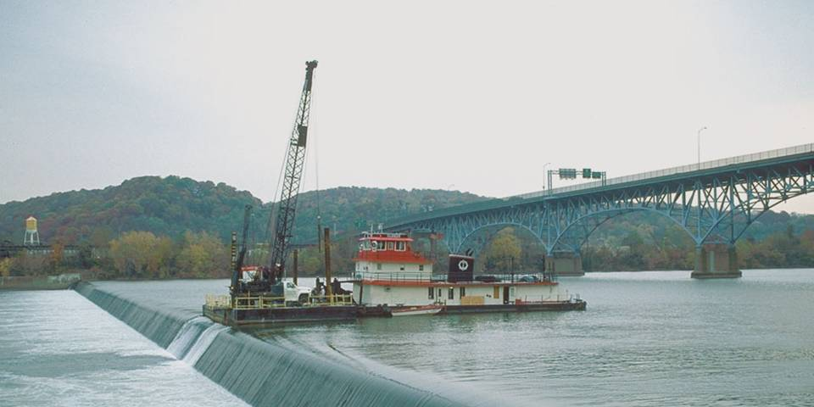
Dams
Lowhead Dams
  Present on many rivers
  Most dangerous for boaters
  Dangerous backwash
  Escape difficult if caught in the “boil”
    Swim under and down stream
  Know where they are and avoid them

Slide 22
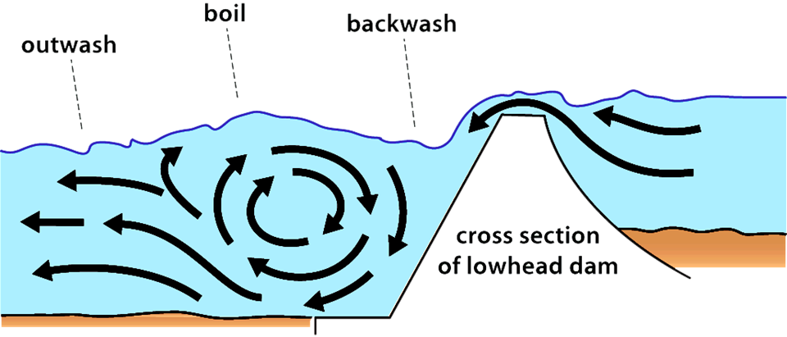
Lowhead Dam
“Efficient, Self-operating Drowning Machines”

Slide 23
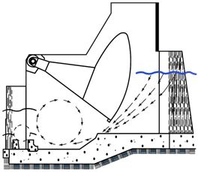
High Dams
Stay out of restricted areas
  Marked by signs, buoys, and/or flashing lights
  Upstream – strong undertows
  Downstream – tailrace boils & backwash
Dam gates
  Wicket gates
  Tainter gates

Slide 24
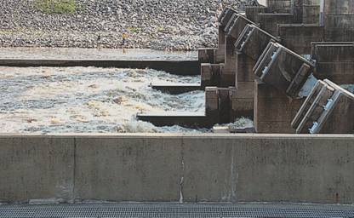
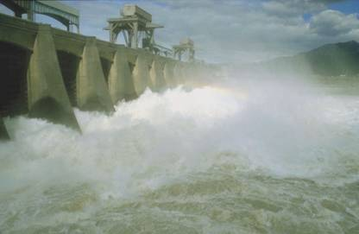
Fishing Below Dams
Dangerous
  Tailrace
  Hydroelectric turbines
Tailrace
  White water below Dam

Slide 25
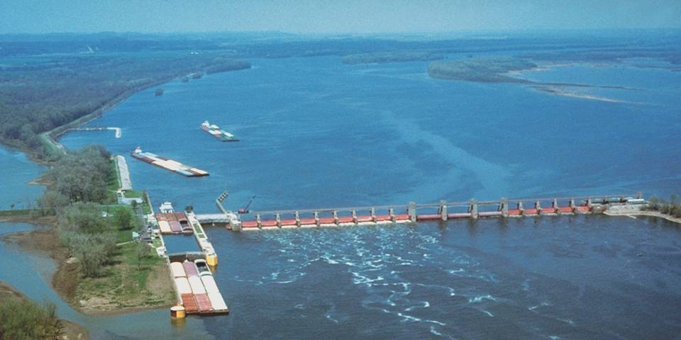
Locks
Used to raise and lower vessels passing from one body of water to another

Slide 26
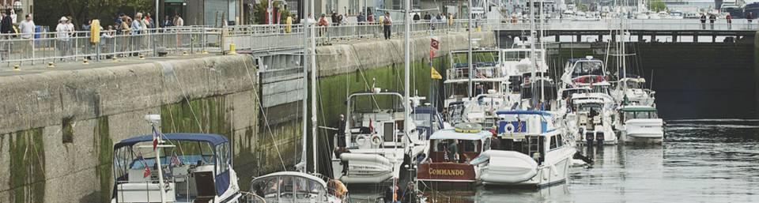
Locks
Priority for use
  Military use and mail packets
  Commercial vessels
  Recreational vessels

Slide 27
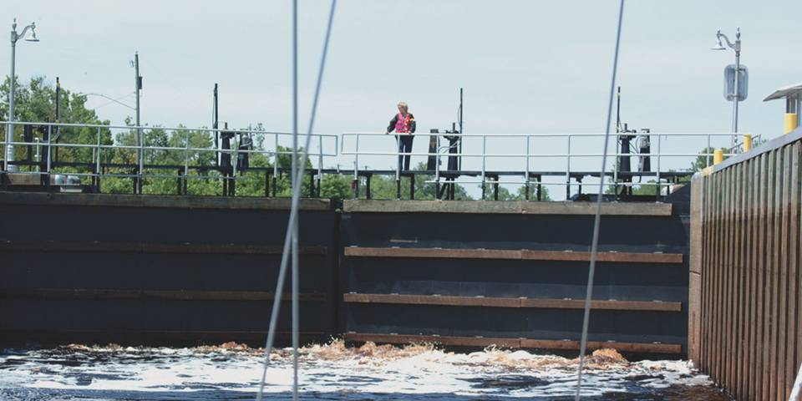
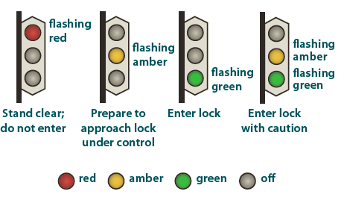
Lock Master
Lock Master can be reached on Ch. 16 then switch to working Ch. 13

Slide 28
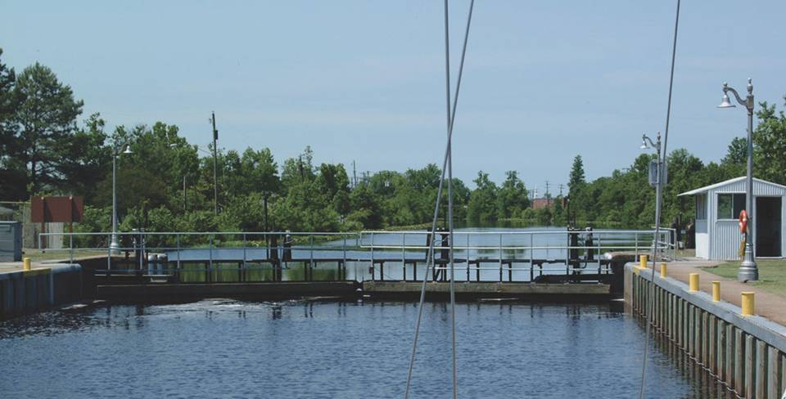
Locking Through
Wear PFD
Approach slowly
No smoking
Tie up-use own lines and fenders
Move out slowly when permitted

Slide 29
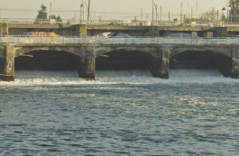
Student Activity
What is the gravest danger in a dam?
Tailrace

Slide 30
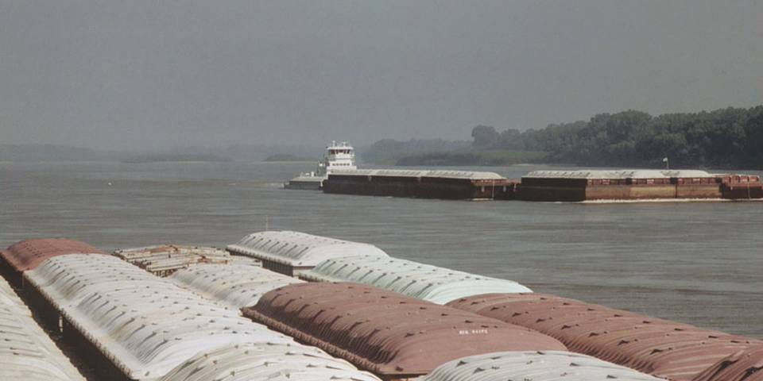
Commercial Traffic
Beware – Ocean Going Tows can be found on many rivers
Watch out for the tow
  Keep clear
  Beware of prop wash
  Blind spots
  Danger zones
VHF communication Bridge-to-Bridge Ch. 13
Reprinted with permission from Seaworthy: Essential Lessons from BoatU.S.;s 20 year Case File of Things Gone Wrong by Robert A. Adriance”

Slide 31
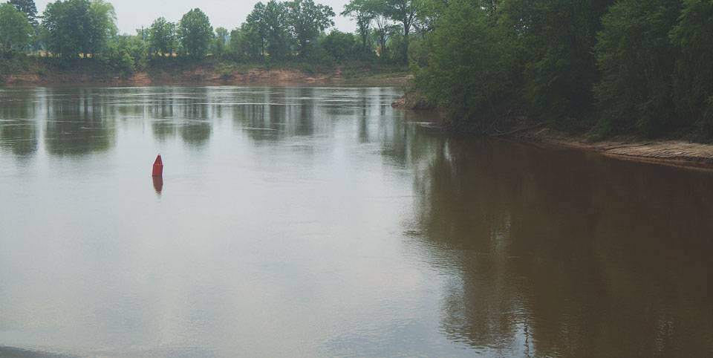
Before You Go
Study river’s chart
If moving from one fresh water body to another, observe precautions regarding non-native aquatic nuisance species (ANS)
Review drawbridge signals and regulations
Review Locks signals and regulations
All Local and State regulations

Slide 32
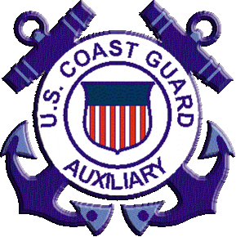
Thank you
Illustrations provided by McGraw Hill Education
The

