Slide 1
E Directorate Update Workshop
NACON 2018

Slide 2
Agenda
Introduce Concepts of Auxiliary Instructor Development Course II 2018
Review of State Conformity Project
Location of State Files/ ABS and BS&S
How to Request Changes
Marketing – Value of Auxiliary Brand

Slide 3
US Coast Guard Auxiliary Instructor Development
Course II 2018

Slide 4
E- Directorate Team
We gratefully acknowledge the contributions of the following Auxiliary members to the development of this project:
COMO Robert Laurer, DIR-E
Dr. Clark Godshall, DIR-ED
Robert Brandenstein, DVC-ED
Andrew Kelly, BC-EDD
David Fuller, DVC-ET
David Wall, DVC-ES
Karen Miller, ADSO-MT
We also thank the United States Power Squadrons for their cooperative use of resources in updating this training course.

Slide 5
WHY?
More than ten years have passed since course was updated.
2018 update better aligns Auxiliary Instructor Training program with best practices of adult instructional teaching and learning.
Notes:
Improvements in instructional techniques and methods have occurred over the past decade. We need to update our ID course to take advantage of these changes.
In 2018, the E-Directorate, undertook an update to improve the content and utility of the Auxiliary Instructor Training program towards alignment with instructional best practices of teaching and learning.

Slide 6
What’s New?
Instructor Development 2018 (IDC II) emphasizes practical guidance towards learning and instructional techniques.
Increased emphasis on lesson planning and program delivery.
Notes:
This version of the Instructor Development Course II (IDC II) Student Course emphasizes practical guidance towards learning and instructional techniques with increased emphasis on lesson planning and program delivery.

Slide 7
For Whom?
The material is intended for ALL Auxiliarists who teach:
Member Training instructors.
especially for Public Education instructors.
Notes:
The material is intended for all Auxiliarists, but especially for Public Education Instructors.

Slide 8
IDC II Course
Geared toward non-technical students.
Provides the student with minimal technical theory and practical knowledge.
Educational theory and classroom skills have been updated.
Notes:
The course is geared to accommodate non-technical students, and concentrates on providing every student with minimal technical theory and practical knowledge. The discussion of theory and classroom skills have been updated to cover the various challenges an instructor will encounter along with planning for presenting to an audience.

Slide 9
Future Updates
Report Errors and omissions to the E-Directorate
Course author contact info as at auxofficer.cgaux.org/auxoff/index.php.
Route comments and concerns via your chain-of-leadership
Notes:
Students and instructors who find errors and omissions in this Student Course Book, are strongly encouraged to report them to the E-Directorate so that future editions of this course can be improved. You can contact the authors using the contact information available on the National website at auxofficer.cgaux.org/auxoff/index.php. Additionally, students or instructors may also route comments and concerns via their respective chain-of-leadership.

Slide 10
IDC II-Required
Completion of the open book National On-line test with a minimum score of 90% or better.
Completion of all IDCII Performance Qualification System (PQS) tasks, signed by a currently Certified Instructor.
Notes:
The Instructor Trainee will complete the open book National On-line test with a minimum score of 90% or better.
The Instructor Trainee will complete all Instructor Development Course II Performance Qualification System (PQS) tasks, which will be signed by a currently Certified Instructor.

Slide 11
Required
Upon successful completion of all PQSs, mandated training and the National On-line test, the trainee—(given students and an instructional setting), will:
Conduct a fifteen to thirty minute training event in accordance with the IDC II course material. A certified instructor will evaluate this presentation.
Following successful evaluation by the Instructors(s), conduct a one to two hour training event using chapter(s) from any of the Coast Guard Auxiliary approved Public Education courses or, if permitted, Member Training Courses.
Notes:
Upon successful completion of all PQSs, mandated training and the National On-line test, the trainee—(given students and an instructional setting), will:
Conduct a fifteen to thirty minute training event in accordance with the IDC II course material. A certified instructor will evaluate this presentation.
Following successful evaluation by the Instructors(s), conduct a one to two hour training event using chapter(s) from any of the Coast Guard Auxiliary approved Public Education courses or, if permitted, Member Training Courses.

Slide 12
Required
Following the successful evaluation, the certified instructor will recommend the trainee to the Flotilla Commander as having successfully completed the Instructor Development Course II for the US Coast Guard Auxiliary.
The Flotilla Commander will then notify DIRAUX according to Auxiliary District policy, and the candidate will receive the Instructor Certification and Instructor ribbon.
Notes:
Following the successful evaluation, the certified instructor will recommend the trainee to the Flotilla Commander as having successfully completed the Instructor Development Course II for the US Coast Guard Auxiliary.
The Flotilla Commander will then notify DIRAUX according to Auxiliary District policy, and the candidate will receive the Instructor Certification and Instructor ribbon.

Slide 13
Overview
-To provide the best possible training experience, participants are expected to accomplish the following:
-Actively participate in class discussions and group exercises.
-Accurately complete lesson plans for review
-Conduct an initial 15-30 minute training event.
-Make adjustments to training based on self, peer, and instructor feedback.
-Conduct the final 1-2 hour training event.
Notes:
-To provide the best possible training experience, participants are expected to accomplish the following:
-Actively participate in class discussions and group exercises.
-Accurately complete lesson plans for review
-Conduct an initial 15-30 minute training event.
-Make adjustments to training based on self, peer, and instructor feedback.
-Conduct the final 1-2 hour training event.

Slide 14
Highlights of IDC II Course
Intro
Requirements
Course Overview Lesson Planning Accommodating All Students Using Electronic Technologies Instructional Equipment Recordkeeping

Slide 15
Table of Contents
UNIT 1 Welcome and Introduction Page 4
Course Objectives+ Overview Page 5
UNIT 2 14 Instructional Competency Page 7
Influencing Learning Page 7
Types of Learning Page 8
Verbal and Non-Verbal Communications Page 9
Bridges to Effective Communications Page 10
Professional Demeanor Page 11
UNIT 3 Lesson Planning Pages 15-18
9-Event Lesson Plan Page 15
UNIT 4 Using Media Effectively Page18
UNIT 5 Effective Communications Skills Strategies
Verbal Page 19
Non-Verbal Page 20
Question and Answering Techniques Page 21
Effective Questioning Techniques Page 22
Five types of Open-ended Questions Page 22
UNIT 6 Difficult Situations Pages 24-26
UNIT 7 Accommodating All Students Page 27
Removing Barriers Page 28
Other Challenges Page 28
UNIT 8 Instructing with Electronic Technologies Pages 30 -33
Appendix A Presentation Tips
Appendix B Recordkeeping—AuxPlus PE
Appendix C (Student Study Guide)
Lesson Plan Worksheets Pages 2-3
9 Events Lesson Planning Worksheets Pages 4-6
Appendix D (PQS Workbook)
Intent Page 2
Tasks Page 3-5
Final Certification Sheet Page 6
Appendix E (Mentor Guide)
Intent Page 2
Instructor Qualification Checklist Pages 3-6
Mentor Trainer Evaluation Form Page 7

Slide 16
Table of Contents
UNIT 6 Difficult Situations Pages 24-26
UNIT 7 Accommodating All Students Page 27
Removing Barriers Page 28
Other Challenges Page 28
UNIT 8 Instructing with Electronic Technologies
Pages 30 -33
Appendix A Presentation Tips
Appendix B Recordkeeping—AuxPlus PE
Appendix C (Student Study Guide)
Lesson Plan Worksheets Pages 2-3
9 Events Lesson Planning Worksheets Pages 4-6
Appendix D (PQS Workbook)
Intent Page 2
Tasks Page 3-5
Final Certification Sheet Page 6
Appendix E (Mentor Guide)
Intent Page 2
Instructor Qualification Checklist Pages 3-6
Mentor Trainer Evaluation Form Page 7

Slide 17
EXCERPT-- IDC II-Introduction
As a Coast Guard Auxiliary instructor, you will influence many people. You will affect a student’s:
Attitude
Perseverance
Confidence
Self Efficacy
Notes:
As an instructor in the Coast Guard Auxiliary, you will have an influence on many other people. You will also have a significant influence upon your students. You will affect attitude, perseverance, confidence and self-efficacy. You will cause people with mediocre skills to excel. The importance of how we behave toward others cannot be overestimated.
A facilitator or Instructor-trainer applies training techniques such as principals of learning, motivation, communication, and instructional methods. Grasping and practicing with these techniques will help the beginning instructor when taking on such new responsibilities.

Slide 18
Excerpt--Lesson Planning
Lesson plans help the instructor organize topics in a logical manner. They describe how one will facilitate learning activities in the classroom. They also help determine the resources, refer­ences, and teaching aids that need to be prepared to face the students. Instructors who use lesson plans can present the same information to subsequent groups of students and know they are presenting the same information each time.
Notes:
Excerpt from Unit 3 on Lesson Planning

Slide 19
Excerpt— Accommodating ALL Students
Many people face physical challenges that leave them with permanent special needs. When our courses are open to the general public, people with special learning needs may require reasonable accommodations. There may be students in the courses that face various types of physical challenges.

Slide 20
Excerpt--Instructing with Electronic Technologies
E-learning refers to various uses of educational technology both in and outside the classroom. Both Web-based and computer-based learning independent of the Internet are included. Instructional content and materials can consist of text, images, animations, and streaming video/audio with the information being delivered in different ways, including the Internet, CD-ROM, cable or satellite television, smartphones, iPads, and audio/videotape.

Slide 21
Excerpt— Instructional Equipment
Instructors use different types of equipment in conducting their lessons. This appendix provides suggestions for using the most commonly used equipment.
Chalkboards
Dry Erase Boards
Handouts
Multimedia Projectors

Slide 22
Recordkeeping - AUXplusPE
AUXplusPE answers this question for you.
AUXplusPE is a “one-stop shop” for all your recordkeeping needs.
Online instructions and tutorials are provided.
Includes personal help as needed.
http://auxplus.cgaux.org for all materials.
Notes:
AUXplusPE answers this question for you.
The Auxiliary offers a special program to take care of all of these recordkeeping requirements and more.
AUXplusPE6 provides a “one-stop-shop” for all your recordkeeping needs.
Online instructions and tutorials are provided, as well as personal help as needed.
http://auxplus.cgaux.org for downloading, instructions, and tutorials

Slide 23
Recordkeeping - AUXplusPE6 (cont)
Information only entered once.
AUXplusPE6 automatically generates welcome letters, certificates, wallet cards, and 7030s.
Backs up of all of your flotilla’s PE records.
Notes:
AUXPplusPE requires each piece of information to be entered only once: instructor information, attendee information, class information, etc.
AUXplusPE automatically generates welcome letters, certificates, wallet cards, and 7030s.
Each time AUXplusPE6is closed, the program emails the national staff with a backup of all of your flotilla’s records.

Slide 24
Recordkeeping - AUXplusPE6 (cont)
Easy access to retrieve lost completion cards.
Provides national staff more detailed PE data than what is captured on the 7030s.
Delivers files to your local licensing agencies, as well as summary reports to your SO-PE.
Notes:
AUxplusPE6 provides easy access to retrieve lost boating class completion cards.
Use of AUXplusPE6 gives national staff more detailed PE data than what is captured on the 7030s.
If needed in your state, AUXplusPE6 can deliver files to your local licensing agencies, as well as summary reports to your SO-PE.

Slide 25
Recordkeeping - AUXplusPE6 (cont)
For your peace of mind...if your computer crashes or you get a new recordkeeper, the AUXplusPE6 staff can email your most recent backup.
Provides a continuation of flotilla records through the succession and transition of FSO-PEs.

Slide 26
Next Steps:
-Approvals via the chain of leadership
-Roll out to field
-Obtain feedback for improving

Slide 27
IN SUMMARY
Update of PQS and National Test Questions
Improved planning and less rote memory required
Goal is to develop skills over multiple practice times
Modernization of new areas including full student access and accommodations
AUXplusPE provides a “one-stop shop” for all your recordkeeping needs.

Slide 28
State
Conformity Project
2017- 2018

Slide 29
State Conformity Project
E-DIR conducted a review of AUX boating classes in all states and territories for NASBLA conformity.
Created state-specific modules and tests for each state and territory.
Sought review and approval of the state-specific modules by the various state boating administrators and NASBLA
Created files in the AUX E-LIB for easy download and use by local Flotillas.
Notes:
Review the process we used as a team to respond to NASBLA concerns about the consistency of AUX boating certification classes, how we then built the PowerPoint presentation and tests, sent those for review and approval by state boating administrators across the country, and in territories where appropriate. We then revised tests and presentation as recommended by the state BLAs. A state-by-state library was then created within the E-Directorate’s ELIB Resource Center to provide easy downloadable files for each flotilla to access.

Slide 30
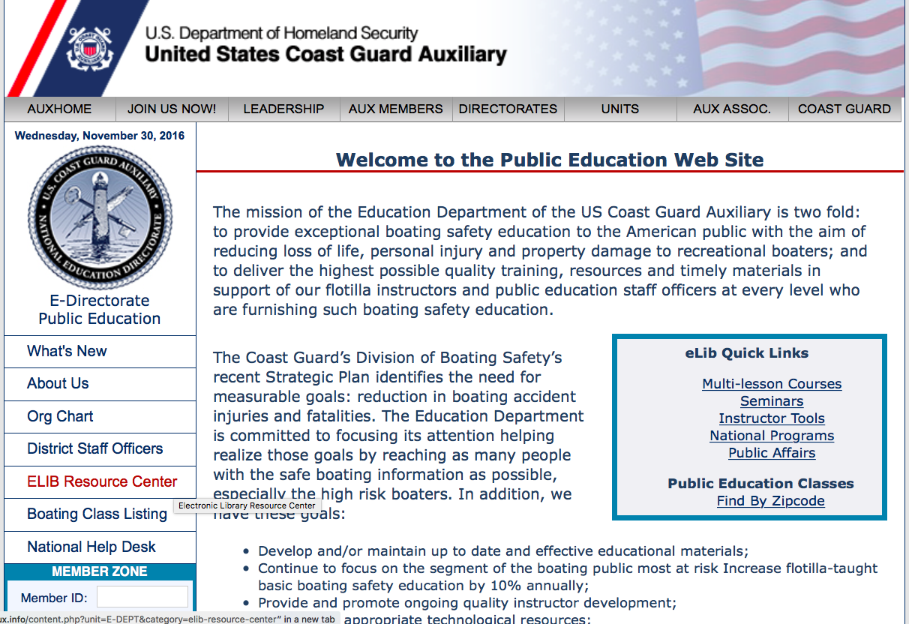
Location of State Files: ELIB Resource Center
Notes:
All of the materials are designed for use by DSO-PEs, SO-PEs, FSO-PEs, and can be found in the password-protected ELIB Resource Center from the E Directorate’s webpage. Contained within the ELIB Resource Center is the section containing the state materials for both ABS and BS&S classes.

Slide 31
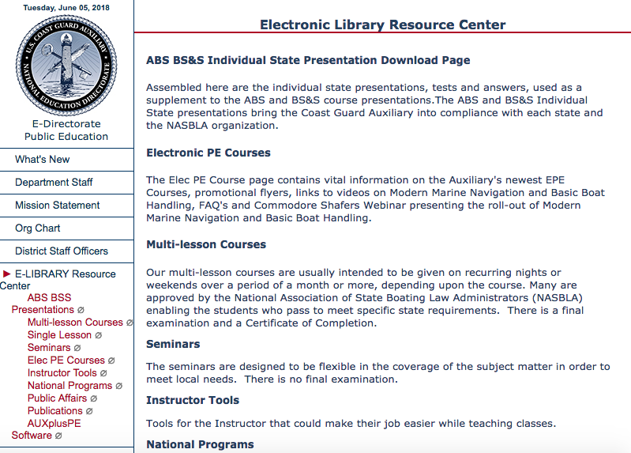
ELIB State Presentations
Notes:
The first item on the ELIB menu list is page is the link to the approved ABS and BS&S state presentations and test materials.

Slide 32
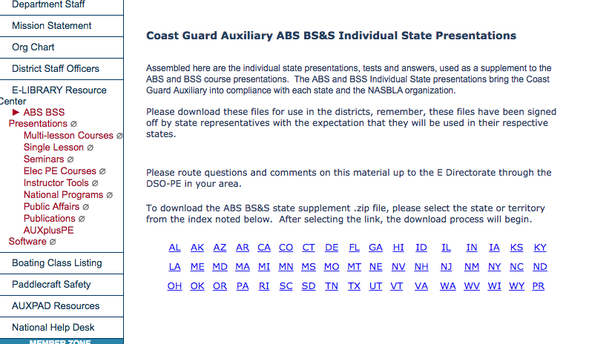
State and Territory Files
Notes:
Simply click on your state or territory and a zip file will be downloaded with all of your materials including the PowerPoint presentation and test materials.

Slide 33
How to Request Edits
Go through the Chain of Leadership:
Instructor FSO-PE SO-PE
DSO-PE Director of E-Directorate.
If approved, changes will be made as requested.
The updated version of the presentation or test will be uploaded to the ELIB state file.
Be as specific as possible with the requested change.
Notes:
It is possible that you may find an error, a typo, or have some additional information you’d like made to your particular state presentation. If so, the process is to go through your Chain of Leadership. The flotilla’s FSO-PE should make the request through the SO-PE, who will take it to the DSO-PE. The DSO-PE will contact the Director of the E-Directorate. While the E-Directorate is happy to help various local flotillas make their presentations relevant to local AORs, it is also important to note that these presentation are NASBLA approved as they are. While you may add local knowledge to it, you may not remove or edit any of the approved materials.

Slide 34
Marketing
RBS Team
Working Together

Slide 35
Marketing Value of the Auxiliary Brand
Admiral Zukunft reflected on his guiding principal, “Commitment to Excellence.”
“When a #USCG uniform walks into a room, it does not matter if it is a Seaman Apprentice or the Commandant, there is immediate respect and admiration for our service - I call it brand recognition. Our people are phenomenal ambassadors of goodwill - and it shows as we have become the world leader in maritime governance.”
Notes:
In May, 2018, outgoing Commandant, Admiral Zukunft reflected on his guiding principal, “Commitment to Excellence.”
“When a #USCG uniform walks into a room, it does not matter if it is a Seaman Apprentice or the Commandant, there is immediate respect and admiration for our service - I call it brand recognition. Our people are phenomenal ambassadors of goodwill - and it shows as we have become the world leader in maritime governance.”

Slide 36
How to Price Your Class?
What is the value of the Auxiliary Brand?
What is the value of your association with the Coast Guard?
Does any of the “competition” offer the expertise and knowledge your Instructors deliver to the students?
Do you perform any hands on demos with teaching aids or conduct VSCs in the parking lot? This cannot be duplicated on-line.
Notes:
Do you know your reputation in your community and are you considered “experts” in boating safety? Is your local reputation and that of the Coast Guard one of respect and are you viewed positively? Does the public associate you positively and in the same or similar light to the Coast Guard? If so, you can certainly use this good will to your advantage in marketing. NO ONE ELSE in the Public Education business has the opportunity you have to leverage this important distinction to set you apart from all other choices in boating education. This is perhaps the most underutilized tool in the marketing toolbox in Flotilla across the nation.
Teaching aids and hands on demos cannot be duplicated on-line and have a dual purpose. They reinforce learning and they provide a more complete experience for the students making them more likely to recommend your classes to their friends. Word of mouth referrals are among the more powerful and effective ways to fill your classrooms.

Slide 37
How to Price Your Class?
What value does your class provide students?
Expert instruction?
Helpful handouts?
Local knowledge?
Camaraderie?
What is this value worth to your students?
Are there other options for your students to receive the value you provide? What will it cost from other providers?
Notes:
When pricing your class there are several factors you should consider. What free options do your potential students have? Do your local government agencies also provide free safe boating classes in competition to your classes? What is the general economic climate in your AOR? Is it a wealthy boating community with large marinas in a coastal area? Is your AOR made up primarily of small boaters who locally fish on small lakes and rivers? Do you provide handouts that cost you to order or produce? Do you serve coffee, donuts, lunch, or other refreshments to your students? There is definitely an intellectual value to your class. How does that fit into your pricing model?

Slide 38
How to Price Your Class?
Are you priced too low and is there a perception that because it is cheap, it is inferior?
What is the going rate in your AOR for education?
Understand that you can never compete against free if you are using price to fill the seats. Try other methods and promote them
Brainstorm ideas using techniques in the PIG
Notes:
Sometimes, being too cheap sends a message that you are delivering less value, not more. You must know what is the accepted going rate in your local AOR for education. If that price is zero, the ONLY way to match is make your course free and that is not good for your Flotilla. If you take the position that you will compete only on price, you will lose. Someone else can always do it cheaper all the way to free. Your team must brainstorm to find ideas of ways to promote your education offerings locally. What may sound like an outrageous idea to some may actually be the idea that results in success. There is an entire section on Brainstorming in the Coast Guard “PIG” (Performance Improvement Guide) which is a book used extensively in advanced Auxiliary Leadership courses. Find someone who has taken an advanced leadership course and get a copy of the PIG or do a search on-line and download your own copy.
A possible idea for promotion is to give them something extra they did not pay for. The French and Spanish Creoles call it lagniappe (LAN-yap). Sort of a “baker’s dozen” that is unexpected and appreciated. You can think of dozens more in a good brainstorming session – have fun doing it!

Slide 39
Go Where the Students Are
Along with classrooms, consider teaching at:
Yacht clubs
Marinas
Sport shops
Hunting clubs
Local dealers
Boat shows
Safety trade shows
Any place boaters may gather
Team with your FSO-PV and FSO-VE for various outreach opportunities
Notes:
Traditional classrooms are not the only places to hold classes. Check with your PV and VE staff officers to open their outreach partners for teaching locations. Go where boaters (potential students) gather: sport shops, hunting/fishing clubs, dealerships, boat shows, sporting goods stores, kayak and paddle craft stores, etc. Many locations will allow you to use a room for teaching a class. It also brings people into their location creating possible new customers. Let’s also remember to go where the online students are….boating chat rooms, blogs, hang-outs, etc.

Slide 40
Auxiliary Marketing Ideas
An Auxiliary Marketing Ideas Document outlining ideas that Flotillas can use is in the E-Library.
It is designed to stimulate thinking about how you can adapt these ideas to your local needs.
We need your feedback so we can share your successes using these ideas.

Slide 41
Leadership Talent wins games, but teamwork wins championships….Michael Jordan
RBS Team Working Together.
Teamwork: All prevention depts. working together. Responsibility Brings Success.
Preventative SAR: Produce knowledgeable boaters able to help other boaters.
Notes:
Teamwork is important to the success of all organizations. Just as we often say that Public Affairs is the responsibility of all Auxiliarists, the entire RBS team is needed to educate the boating public, whether through classes, vessel safety checks, publication distribution, or social media. As the Operations Team participates in active search and rescue (SAR) efforts, the RBS team provides “Preventative SAR” efforts. By producing boaters who are knowledgeable of safety practices and laws, RBS efforts produce boaters who avoid unsafe practices, or who are able to help other boaters they encounter who are in trouble, thereby reducing SAR calls to Coast Guard and other first responders.

Slide 42
RBS Teamwork Samples
PA, PE, PV, VE, PB all working together.
PE teaches Paddler’s Guide to Safety course while VE available to conduct courtesy VSC’s of paddle craft at local paddle craft clubs, sport shops, etc.
VE locations include a PA table: “PAVE Event”.
PA events include PE class registration forms, and take fees (consider use of Paypal or Square account).
PA creates advertising for classes.
PB posts class information on website and Facebook page.
Notes:
The “PAVE event” note refers to a practice of including a PA table with boating safety and education information at VE stations. This provides the opportunity for interaction in multiple ways with the boating public and families. It allows the RBS Team to work together.
The use of Paypal or four-square payment technology allows for boating class fee payment while at boating events such as boat shows. Advance payment commits student attendance. Such students might need to change the date of their chosen class, but are less likely to cancel entirely.

Slide 43
RBS Team Working Together
Important to keep webpages and Facebook pages current
Provides positive image for your flotilla
Opportunity for the RBS Team to work together (FC, VFC, PA, PB, PE, VE, PV)
Responsibility Brings Success

Slide 44
Recruiting for the Auxiliary
“Preach the Gospel at all times - use words if necessary” - attributed to St. Francis of Assisi
Every PE class is a recruitment opportunity.
Every PE class is a PA event.
Include recruiting materials.
Instructors reflect diversity of the community.
Invite students to a flotilla meeting.
Notes:
Every PE class is a recruitment event, even if you don’t do any explicit recruiting. Instructor interaction with students is important. Show your students pictures of the Auxiliary in action (these can be inside and outside of your substantive lessons)
Always ask:
Are your classes the kinds of events that students would want to help produce?
Are your instructors the kinds of people with whom your students want to spend more time?
Do your instructors reflect the diversity of your community?
An organization that does not value inclusion and diversity will fail to keep pace in today’s world.

Slide 45
THAT’S ALL FOLKS!
QUESTIONS????
We hope you found this presentation informative and useful for your PE program.
Please share your PE stories with us at pe.feedback@cgauxnet.us
Notes:
We are interested in hearing about your PE experiences with all of these products. Please feel free to share both your success stories and your challenges. All of us in the RBS and leadership community will learn from your experiences.

